Slide 2
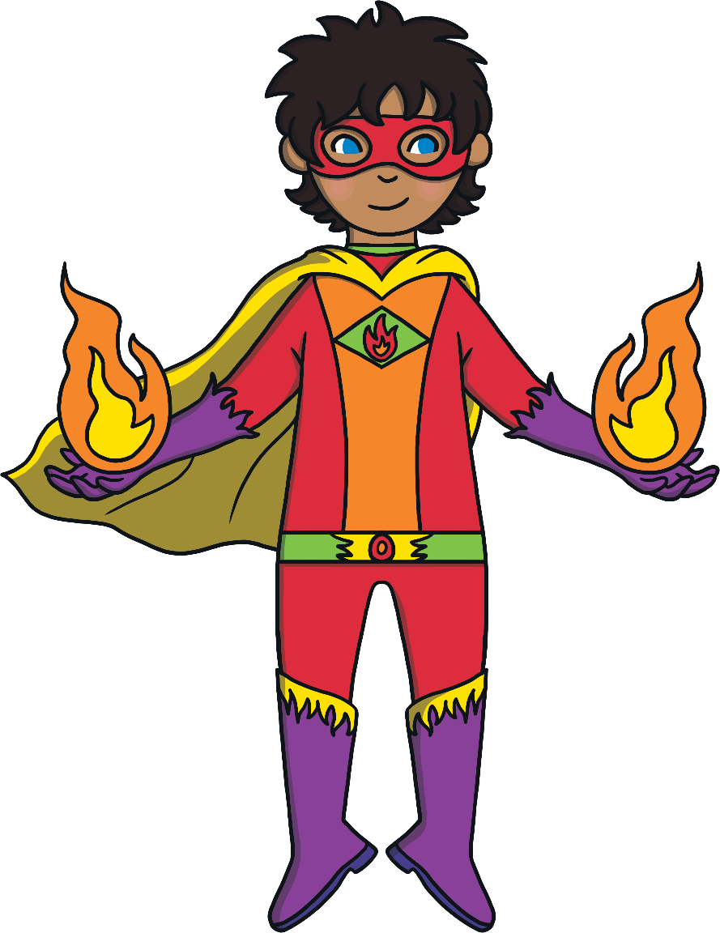
Take a look at the dots and see how many there are. Can you say how many dots there are before a superhero flies across the screen? You’ll need to be quick!
Ask your adult to go through the powerpoint quickly. How fast can you count the dots?
Lets go!

Slide 3
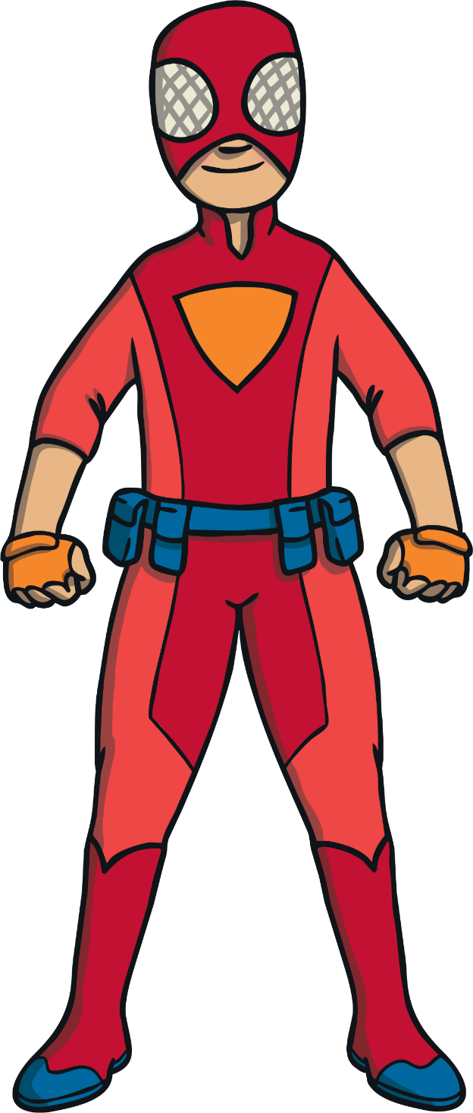

Slide 4
How many dots did you spot?
2
Next

Slide 5
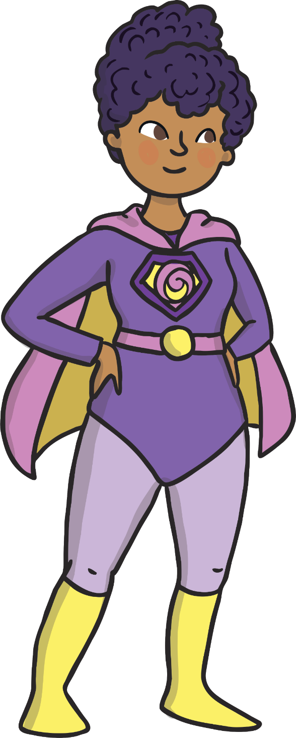

Slide 6
How many dots did you spot?
3
Next

Slide 7
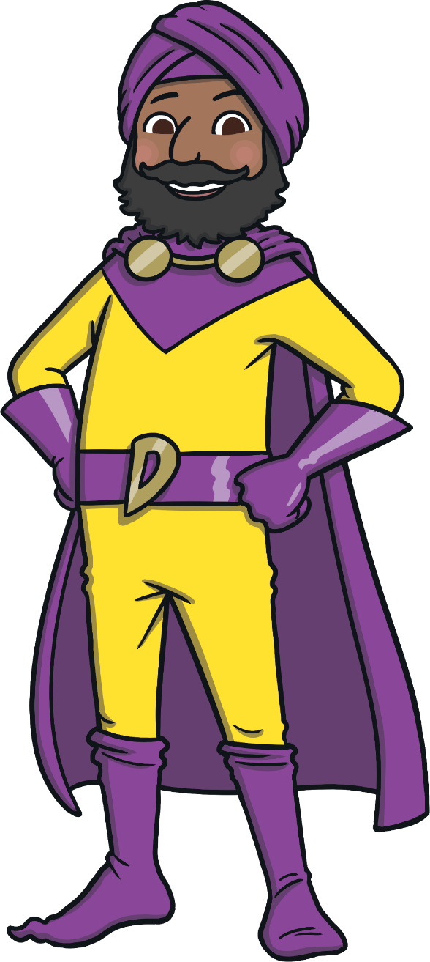

Slide 8
How many dots did you spot?
1
Next

Slide 9
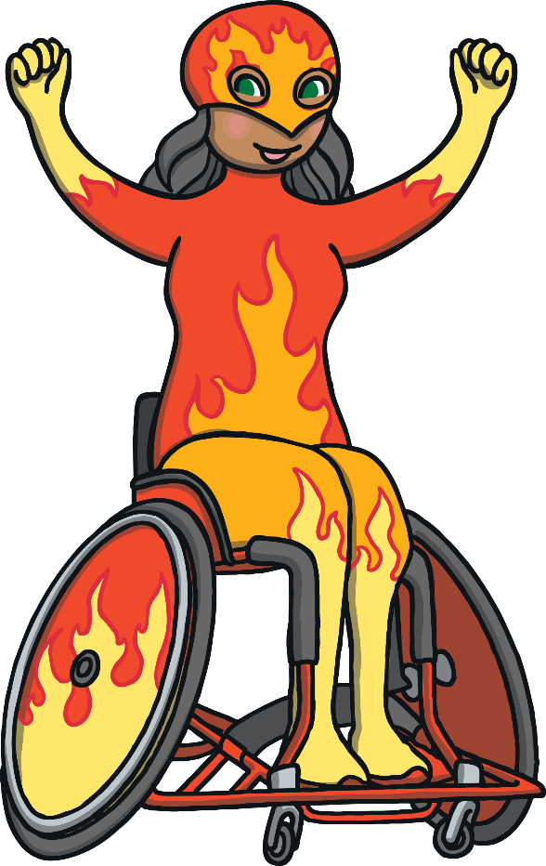

Slide 10
How many dots did you spot?
5
Next

Slide 11
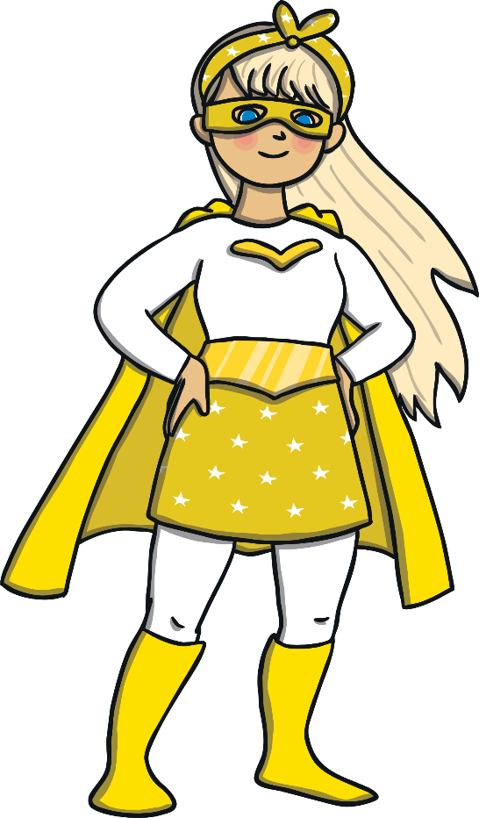

Slide 12
How many dots did you spot?
4
Next

Slide 13
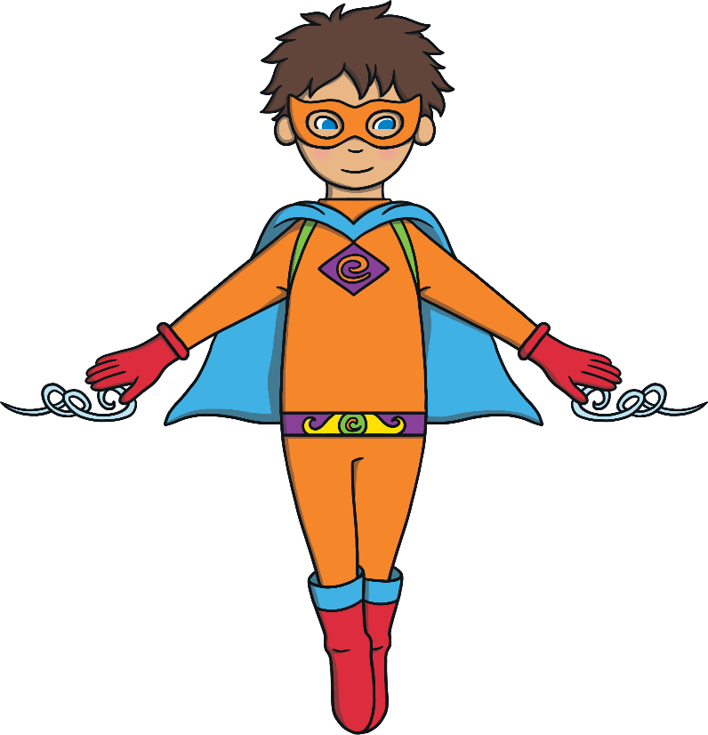

Slide 14
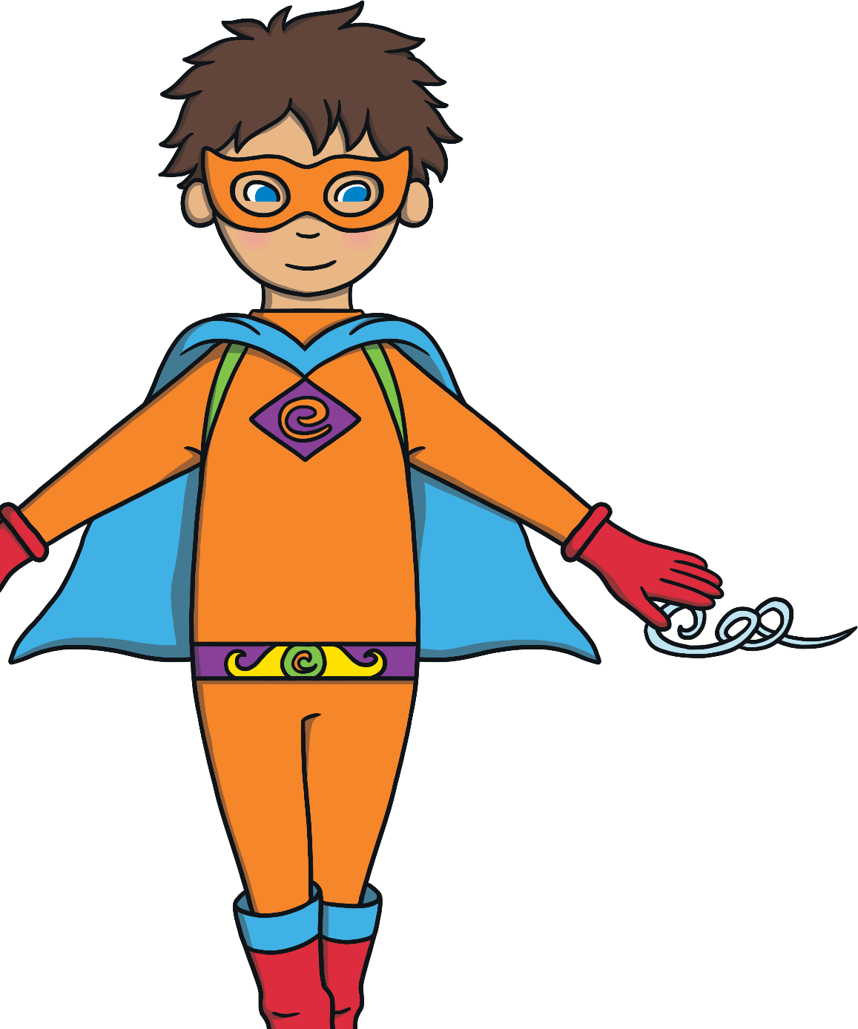
How many dots did you spot?
3
Next

Slide 15
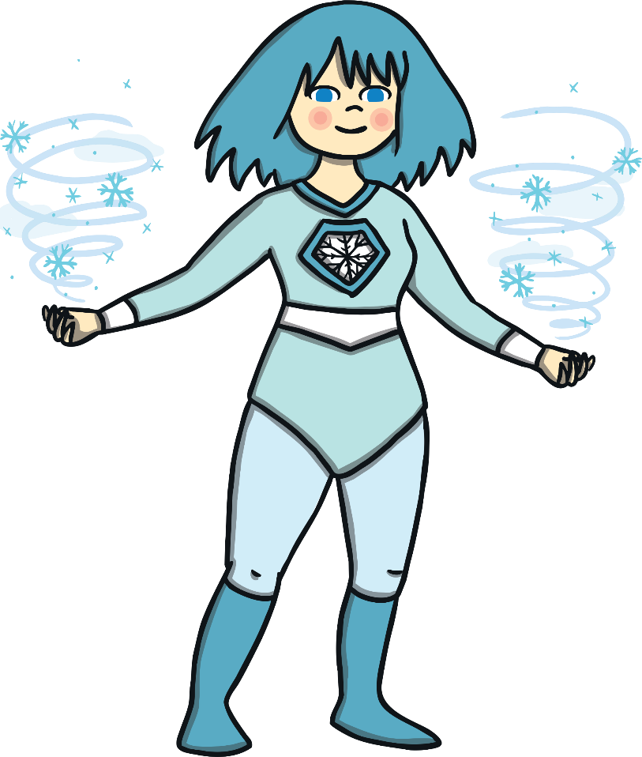

Slide 16
How many dots did you spot?
2
Next

Slide 17
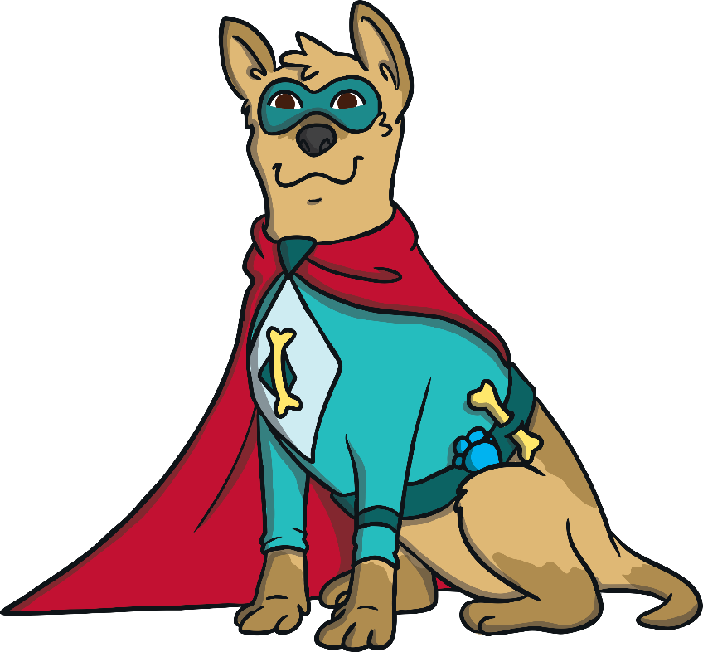

Slide 18
How many dots did you spot?
5
Next

Slide 19
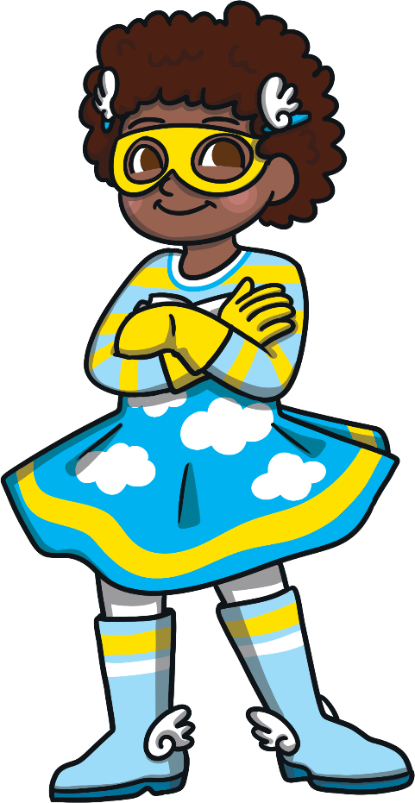

Slide 20
How many dots did you spot?
4
Next

Slide 21
Well done!
Finish

