Slide 1


Renu Poddar 26th November, 2018
Grow in Love, Live in Peace

Slide 2

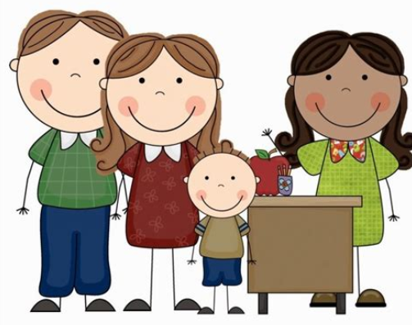
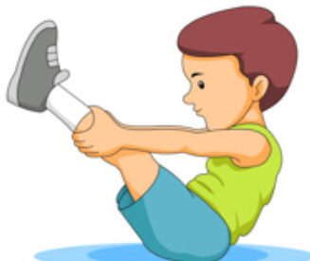
Grow in Love, Live in Peace
Notes:
https://www.youtube.com/watch?v=rzLBp2lnywM
Don’t downplay it. Maths is like sit ups and crunches. In a football match, u don’t have to do situps but u apply the strength you have gained with exercise

Slide 3
How and why did the mathematics mastery approach develop?
Too many children are falling behind.
Not enough children are excelling.
Teaching has been focused on procedures over understanding.
Negative attitudes towards maths ability and enjoyment.
Grow in Love, Live in Peace

Slide 4
What do we mean by Mastery?
Deep and sustainable learning – for all
  Depth is the key to avoiding the need to repeat teaching.
  It doesn’t feel like we’re starting again each term.
The ability to build on something that has already been sufficiently mastered
  …for this stage of learning - Mastery is a continuum
Grow in Love, Live in Peace
Notes:
What does it mean to ‘teach for mastery’?
Mastery for all – not just the most able as originally put forward by the DfE.

Slide 5
Maths Mastery approaches
Mastery approaches often make the whole class move at the same pace. Students who learn faster stay on the same content while others catch up, being stretched with rich, complex problems that challenge them to consolidate their understanding.
In a mastery framework, teachers differentiate the time and support they provide for students, not content. In fact, mastery can only be achieved with strong, effective interventions for individuals within the class.
Students need ‘intelligent’ practice, with variation in the way they apply their learning to new situations, helping them to see the mathematical structures used.
Grow in Love, Live in Peace

Slide 6
What does a mastery maths lesson look like?
There are 3 elements to a mastery lesson:
Fluency
Reasoning (you will observe this element today).
Problem solving
Grow in Love, Live in Peace

Slide 7
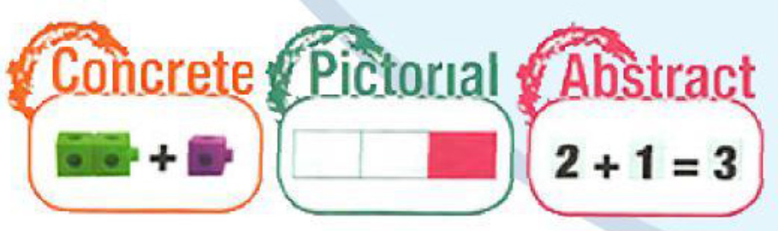
Grow in Love, Live in Peace

Slide 8
Seeing pattern and structure is important in a mastery curriculum
Grow in Love, Live in Peace

Slide 9
Make 7
6 + 1= 7
5 + 2 = 7
4 + 3 = 7
3 + 4 = 7
2 + 5 = 7
1 + 6 = 7
0 + 7 = 7
Grow in Love, Live in Peace

Slide 10
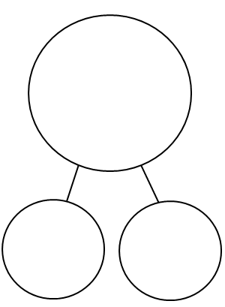
Partitioning numbers
The Part Part Whole Model
Grow in Love, Live in Peace

Slide 11

Grow in Love, Live in Peace
Notes:
I was in the park and watching some ducks walking towards two ponds. Mother duck was in the park with her five ducklings following her. The fog came and she couldn’t see which pond her ducklings had gone to. What could she have seen when the fog lifted?

Slide 12
Grow in Love, Live in Peace
Notes:
I was in the park and watching some ducks walking towards two ponds. Mother duck was in the park with her five ducklings following her. The fog came and she couldn’t which pond her ducklings had gone to. What could she have seen when the fog lifted?
Model using the part (pond) –part (pond) –whole (park) circle model on the board.

Slide 13
?
5
?
?
Grow in Love, Live in Peace

Slide 14
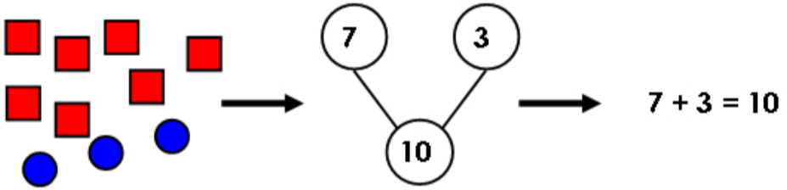
Grow in Love, Live in Peace

Slide 15
?
128
?
?
Grow in Love, Live in Peace

Slide 16
7 + 5
Grow in Love, Live in Peace
Notes:
Explain process of making 10

Slide 17
7 + 5
3
2
Grow in Love, Live in Peace
Notes:
Importance of relating concrete to pictorial to abstract

Slide 18
7 + 5
2
5
Grow in Love, Live in Peace
Notes:
A different way of doing it.
What’s the same? What’s different?
Example of procedural variation: same problem, different solution

Slide 19
Grow in Love, Live in Peace

Slide 20
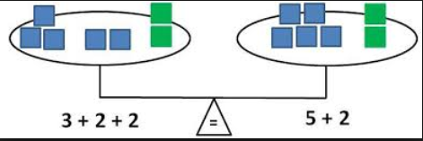
Grow in Love, Live in Peace

Slide 21


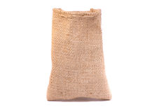


Subtraction within a context
What does the 6 represent?
What does the 2 represent?
What does the 4 represent?
?
Before
Next
Now
6 - 2 = 4
Grow in Love, Live in Peace
Notes:
Start to add and subtract – Always in a context.
Lots of language – explaining the maths that’s happening.
Use of rehearse and repeat.

Slide 22
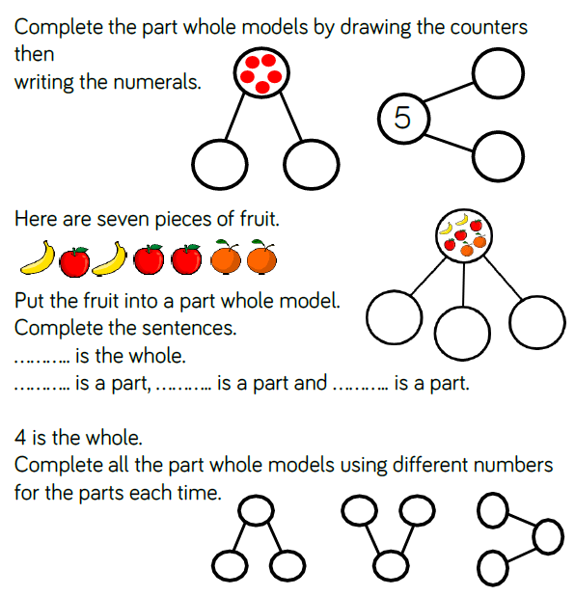
Grow in Love, Live in Peace

Slide 23
7 + 5
Grow in Love, Live in Peace
Notes:
Ask teachers to think about how to represent this calculation using ten frames. First, put the counters on the frames to represent 7 and 5. Good discussion point to ask how they know (because there are 3 missing; I recognise the numicon shape; I can see a 4 and a 3 and that makes 7).

Slide 24
7 + 5
Grow in Love, Live in Peace
Notes:
Explain process of making 10

Slide 25
7 + 5
3
2
Grow in Love, Live in Peace
Notes:
Importance of relating concrete to pictorial to abstract

Slide 26
7 + 5
2
5
Grow in Love, Live in Peace
Notes:
A different way of doing it.
What’s the same? What’s different?
Example of procedural variation: same problem, different solution

Slide 27
Grow in Love, Live in Peace

Slide 28
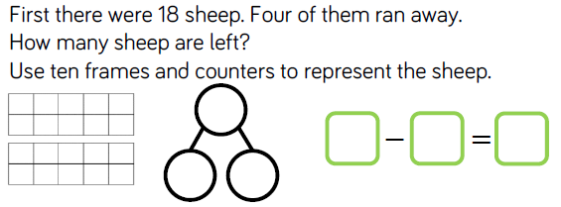
Grow in Love, Live in Peace

Slide 29
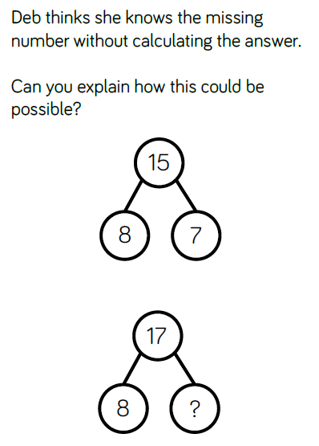
Grow in Love, Live in Peace

Slide 30
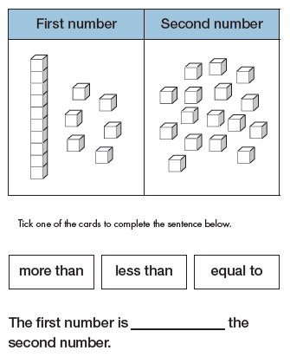
Grow in Love, Live in Peace

Slide 31
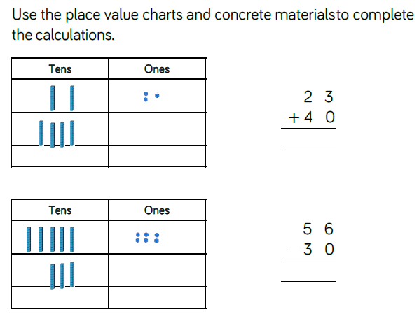
Grow in Love, Live in Peace

Slide 32
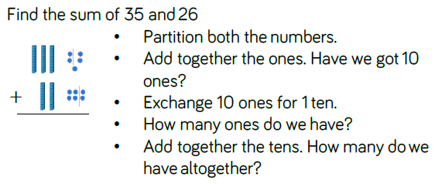
Grow in Love, Live in Peace

Slide 33
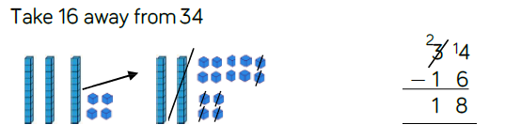
Grow in Love, Live in Peace

Slide 34
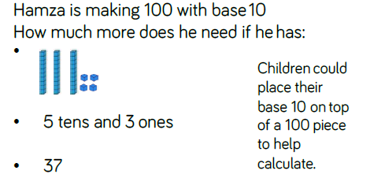
Grow in Love, Live in Peace

Slide 35
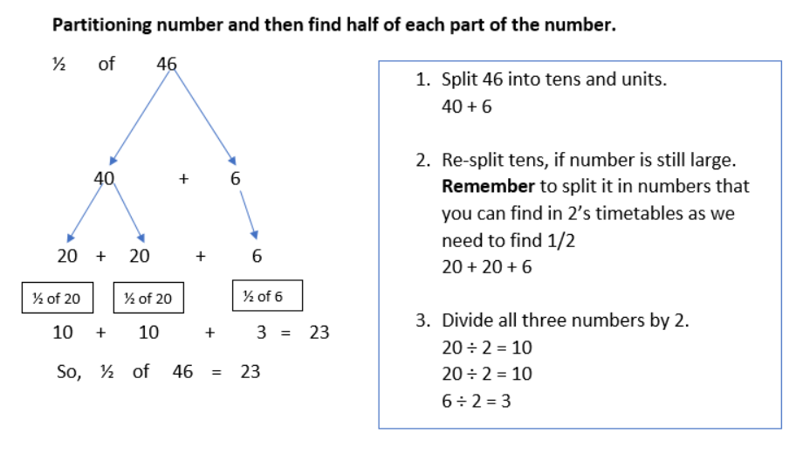
Double and Half ??
Grow in Love, Live in Peace

Slide 36
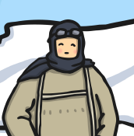

Teaching Multiplication
Grow in Love, Live in Peace
Notes:
What came first? Importance of regular counting in 2s, 3s, 5s, 10s. Support for children who couldn’t do that so that all are ready to learn multiplication.
Introduced through context (linked to work on Antarctic exploration and knitting).
Link to prior knowledge: how many socks would 3 explorers need?
What if there were 9 explorers?
What if there were 0 explorers? – importance of 0

Slide 37
2 + 2 + 2 = 6
Grow in Love, Live in Peace
Notes:
What came first? Importance of regular counting in 2s, 3s, 5s, 10s. Support for children who couldn’t do that so that all are ready to learn multiplication.
Introduced through context (linked to work on Antarctic exploration and knitting).
Link to prior knowledge: how many socks would 3 explorers need?
What if there were 9 explorers?
What if there were 0 explorers? – importance of 0

Slide 38

What if there were 9 explorers?
2 + 2 + 2 + 2 + 2 + 2 + 2 + 2 + 2 = 18
Grow in Love, Live in Peace
Notes:
What came first? Importance of regular counting in 2s, 3s, 5s, 10s. Support for children who couldn’t do that so that all are ready to learn multiplication.
Introduced through context (linked to work on Antarctic exploration and knitting).
Link to prior knowledge: how many socks would 3 explorers need?
What if there were 9 explorers?
What if there were 0 explorers? – importance of 0

Slide 39
What if there were 9 explorers?
2 × 9 = 18
Grow in Love, Live in Peace
Notes:
What came first? Importance of regular counting in 2s, 3s, 5s, 10s. Support for children who couldn’t do that so that all are ready to learn multiplication.
Introduced through context (linked to work on Antarctic exploration and knitting).
Link to prior knowledge: how many socks would 3 explorers need?
What if there were 9 explorers?
What if there were 0 explorers? – importance of 0

Slide 40
What if there were 8 explorers?
2 × 8 = 16
Grow in Love, Live in Peace
Notes:
What came first? Importance of regular counting in 2s, 3s, 5s, 10s. Support for children who couldn’t do that so that all are ready to learn multiplication.
Introduced through context (linked to work on Antarctic exploration and knitting).
Link to prior knowledge: how many socks would 3 explorers need?
What if there were 9 explorers?
What if there were 0 explorers? – importance of 0

Slide 41
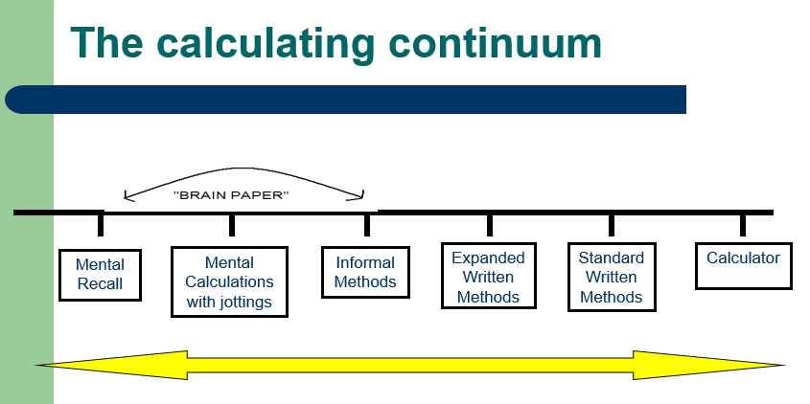
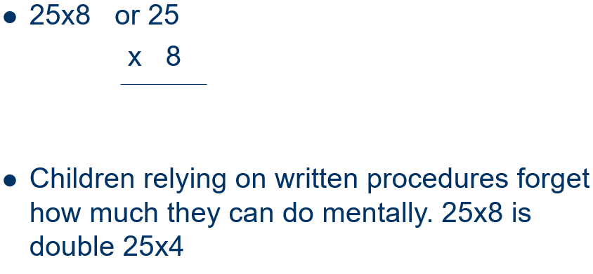
Mental ability vs. Written methods
Grow in Love, Live in Peace
Notes:
An emphasis on development of mental calculation

Slide 42
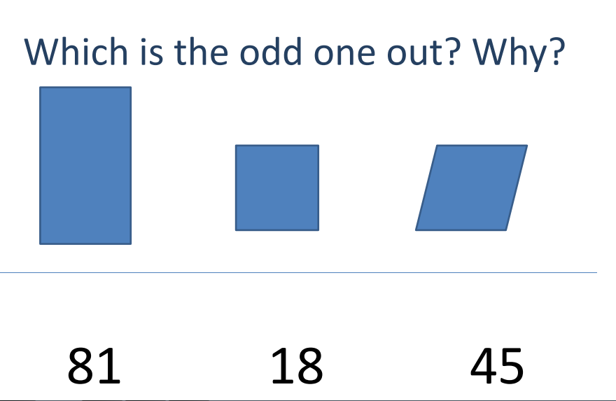
How do we develop reasoning in lessons?
Grow in Love, Live in Peace

Slide 43
On 14 September 2017 the Department for Education announced that the Times Tables Check will now be administered for children in Year 4, starting in the 2019-20 academic year.
We will conduct a national voluntary pilot between 10 June and 28 June 2019, to allow schools to familiarise themselves with the check before it becomes statutory in June 2020.
The national curriculum specifies that pupils should be taught to recall the multiplication tables up to and including 12x12 by the end of year 4.
Children will be tested using an on-screen check, where they will have to answer multiplication questions against the clock. The test will last no longer than 5 minutes and is similar to other tests already used by primary schools. Their answers will be marked instantly.
Grow in Love, Live in Peace

Slide 44
The Importance of Bar Models
https://learnzillion.com/lesson_plans/5400-solve-word-problems-by-drawing-bar-models/
Grow in Love, Live in Peace

Slide 45
6
Use of stem sentences.
3 is a part.
3 is a part.
6 is the whole
3
3
6
Grow in Love, Live in Peace
Notes:
Children use double-sided counters to show this.
“3 is a part. 3 is a part. 6 is the whole.”

Slide 46
6
Use of stem sentences.
6 is the whole
1 is a part.
5 is a part.
?
?
6
Grow in Love, Live in Peace
Notes:
Children complete part whole diagram.

Slide 47
Move from pictorial/ symbolic to abstract.
6
6
1 |  |  | 5
Grow in Love, Live in Peace
Notes:
Children complete part whole diagram.

Slide 48
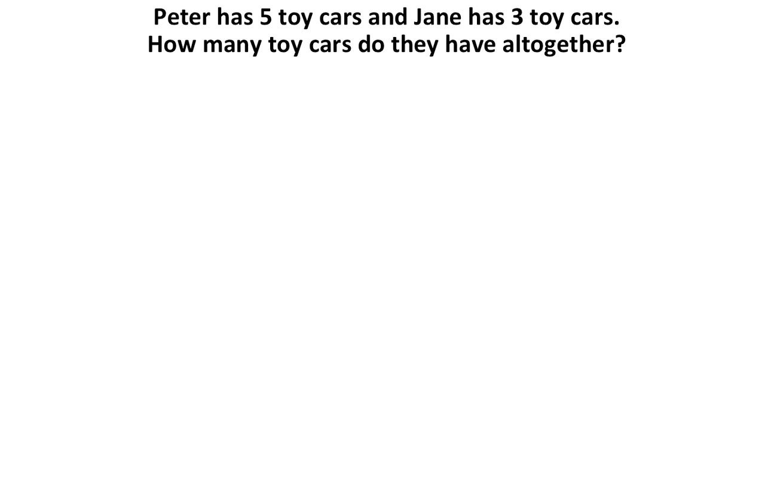
KS1 bar modelling
Grow in Love, Live in Peace

Slide 49


KS1 Bar Modelling
Tim has 4 sweets and Ben has 2 sweets.
How many sweets do they have altogether?
6
6
6
6
6
4
4
2
Tim
Ben
Tim
Ben
Tim
Ben
Tim
Ben
Tim
Ben

Slide 50
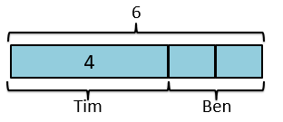
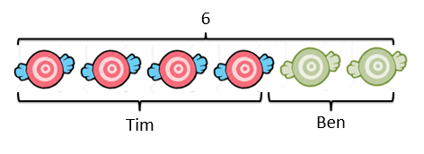
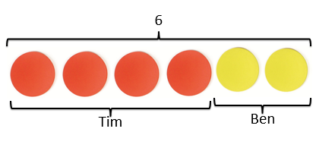
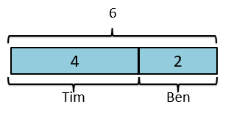
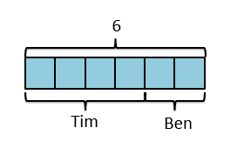
Small steps
4 + 2 = 6

Slide 51
What Are Bar Models?
16
9
7
9
16
7
7
8
Grow in Love, Live in Peace

Slide 52
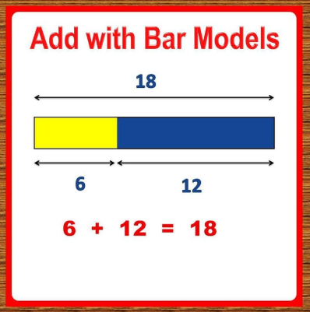
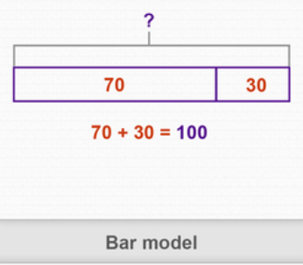
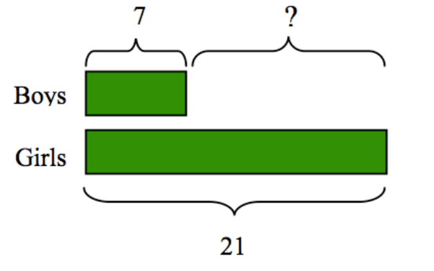
Grow in Love, Live in Peace

Slide 53
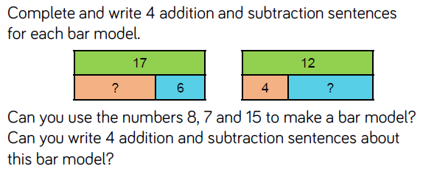
Grow in Love, Live in Peace

Slide 54

A Consistent Picture
2 of 20 = ?
5
4 + 11 = ?
5 x 4 = ?
11
0
4
?
Grow in Love, Live in Peace

Slide 55
A Consistent Picture
4 + 11 = ?
15 - 4 = ?
?
15
4
11
4
?
5 x 4 = ?
20 ÷ 5 = ?
?
20
4
4
4
4
4
?
?
?
?
?
2 of 20 = ?
5
20
?
Grow in Love, Live in Peace

Slide 56
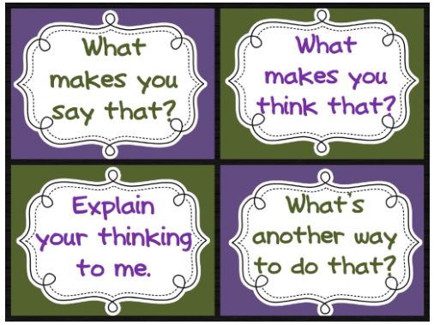
We are promoting Mathematical Talk
Grow in Love, Live in Peace

Slide 57

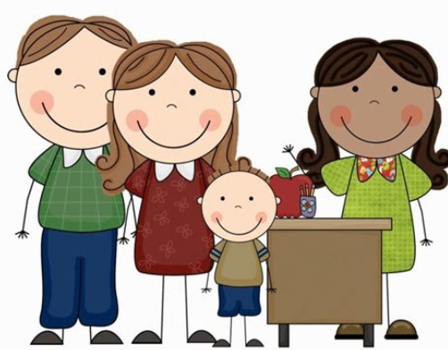
Promote a positive attitude to maths
Look at tables differently
Ask your child to teach you maths
Encourage your child to be independent in maths
Use maths with your child in daily life
Display maths work at home
Communicate with your child’s teacher
Play games that encourage mathematical thinking
Let us Remember:
Children need to wonder and struggle
You are not the answer key
Encourage their original ideas
Grow in Love, Live in Peace

Slide 58


Grow in Love, Live in Peace

