Slide 1


Workshop for parents on
Renu Poddar 26th November, 2018
Grow in Love, Live in Peace

Slide 2

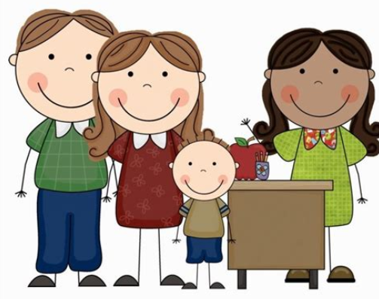
Grow in Love, Live in Peace
Notes:
https://www.youtube.com/watch?v=rzLBp2lnywM

Slide 3
A true mastery approach is about giving every child a deep, secure understanding of every part of the curriculum. That means that students won’t go beyond Division until they are confident, and teachers won’t have to try and teach Fractions to students who aren’t ready.
Grow in Love, Live in Peace

Slide 4
What do we mean by Mastery?
Deep and sustainable learning – for all
  Depth is the key to avoiding the need to repeat teaching.
  It doesn’t feel like we’re starting again each term.
The ability to build on something that has already been sufficiently mastered
  …for this stage of learning - Mastery is a continuum
Grow in Love, Live in Peace
Notes:
What does it mean to ‘teach for mastery’?
Mastery for all – not just the most able as originally put forward by the DfE.

Slide 5
Teaching for Mastery
Representation
& Structure
Access
Mathematical Thinking
Chains of Reasoning
Fluency
Number Facts
Variation
Procedural
Conceptual
Table Facts
Pattern
Making Connections
Making Connections
Making Connections
Making Connections
Coherence
Small connected steps are easier to take
Grow in Love, Live in Peace
Notes:
We’ve shared some examples of how we are implementing the mastery approach in our classrooms.
Return to 5 big ideas.
Collect examples from audience of when they spotted the big ideas in our session.

Slide 6
Maths Mastery approaches
Mastery approaches often make the whole class move at the same pace. Students who learn faster stay on the same content while others catch up, being stretched with rich, complex problems that challenge them to consolidate their understanding.
In a mastery framework, teachers differentiate the time and support they provide for students, not content. In fact, mastery can only be achieved with strong, effective interventions for individuals within the class.
Students need ‘intelligent’ practice, with variation in the way they apply their learning to new situations, helping them to see the mathematical structures used.
Grow in Love, Live in Peace

Slide 7
How and why did the mathematics mastery approach develop?
Too many children are falling behind.
Not enough children are excelling.
Teaching has been focused on procedures over understanding.
Negative attitudes towards maths ability and enjoyment.
Grow in Love, Live in Peace

Slide 8
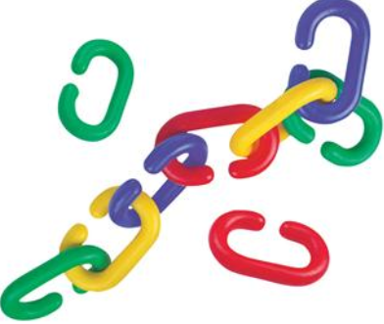
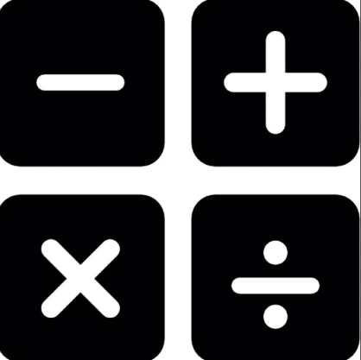
Chain Game.
Use series of operations and use the answers from the previous operation
Starting number?
Reasoning???
Grow in Love, Live in Peace

Slide 9
What does a mastery maths lesson look like?
There are 3 elements to a mastery lesson:
Fluency
Reasoning
Problem solving (you will observe this element today).

Slide 10
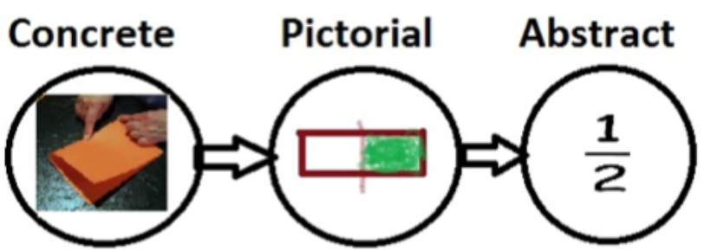
Grow in Love, Live in Peace

Slide 11
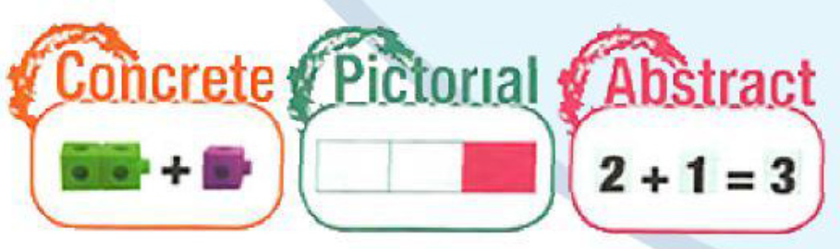
Grow in Love, Live in Peace

Slide 12
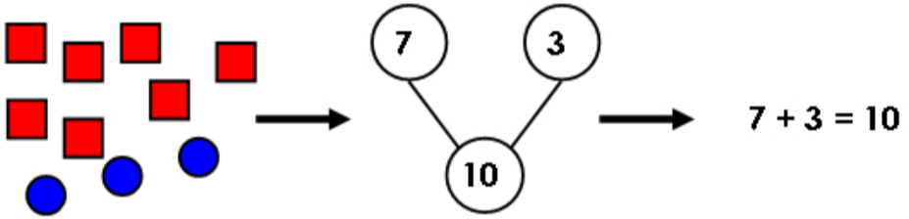
Grow in Love, Live in Peace

Slide 13
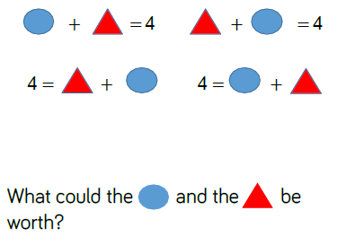
Grow in Love, Live in Peace

Slide 14
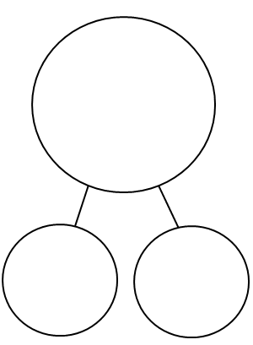
Partitioning numbers
The Part Part Whole Model
Grow in Love, Live in Peace

Slide 15
?
128
?
?
Grow in Love, Live in Peace

Slide 16
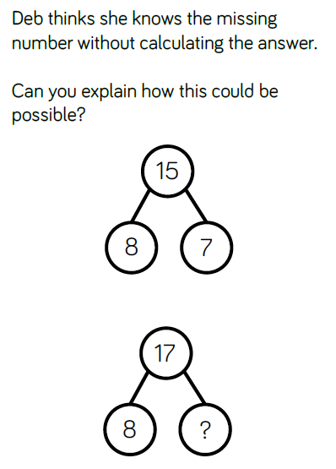
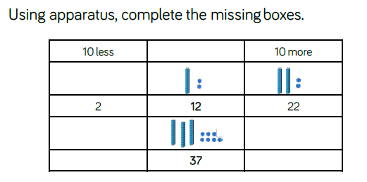
Grow in Love, Live in Peace

Slide 17
7 + 5
Grow in Love, Live in Peace
Notes:
Explain process of making 10

Slide 18
7 + 5
3
2
Grow in Love, Live in Peace
Notes:
Importance of relating concrete to pictorial to abstract

Slide 19
7 + 5
2
5
Grow in Love, Live in Peace
Notes:
A different way of doing it.
What’s the same? What’s different?
Example of procedural variation: same problem, different solution

Slide 20
Grow in Love, Live in Peace

Slide 21
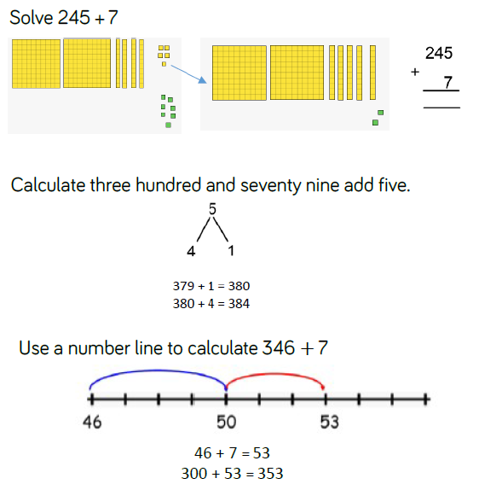
Grow in Love, Live in Peace

Slide 22
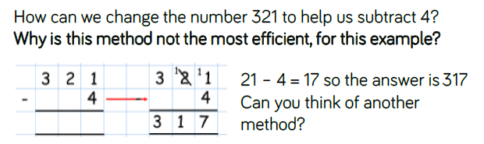
TASK
Grow in Love, Live in Peace

Slide 23
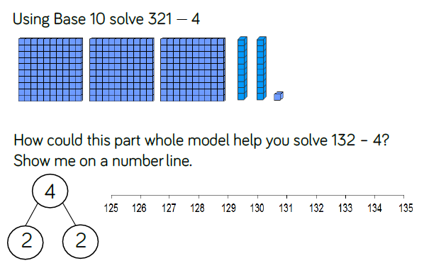
Grow in Love, Live in Peace

Slide 24
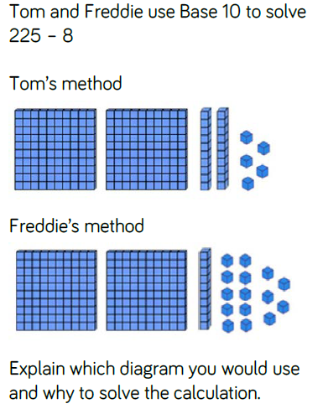
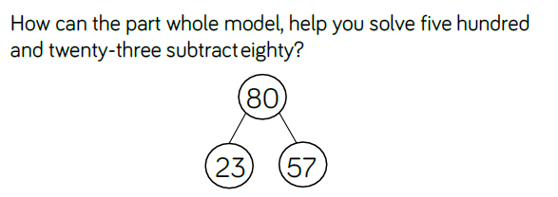
TASK
Grow in Love, Live in Peace

Slide 25
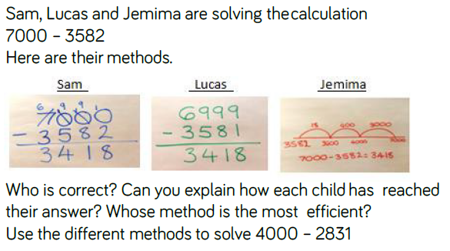
Grow in Love, Live in Peace

Slide 26
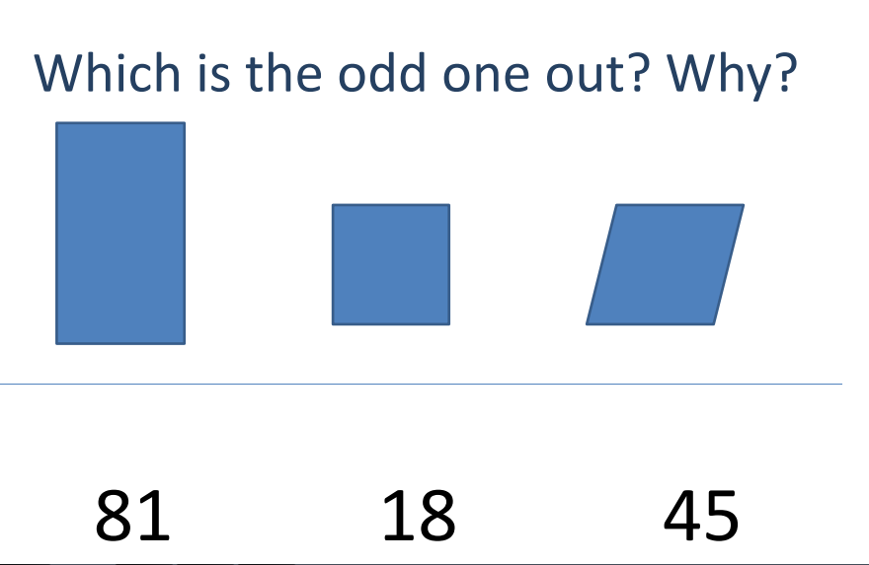
How do we develop reasoning in lessons?
Grow in Love, Live in Peace

Slide 27
On 14 September 2017 the Department for Education announced that the Times Tables Check will now be administered for children in Year 4, starting in the 2019-20 academic year.
We will conduct a national voluntary pilot between 10 June and 28 June 2019, to allow schools to familiarise themselves with the check before it becomes statutory in June 2020.
The national curriculum specifies that pupils should be taught to recall the multiplication tables up to and including 12x12 by the end of year 4.
Children will be tested using an on-screen check, where they will have to answer multiplication questions against the clock. The test will last no longer than 5 minutes and is similar to other tests already used by primary schools. Their answers will be marked instantly.
Grow in Love, Live in Peace

Slide 28
TASK
43 X 3
Which number is the multiplicand?
Which number is the multiplier?
STEM SENTENCES:
The multiplicand is …
The multiplier is …
43 X 3 = 129
Grow in Love, Live in Peace

Slide 29
What’s the same and what’s different about these two calculations?
43 X 3 = 129
44 X 3
Can you use your answer from 43 x 3 to work out 44 x 3?
Grow in Love, Live in Peace

Slide 30
43
43
43
43 X 3 = 129
+ 1
+ 1
+ 1
44
44
44
44 X 3 = ?
44 X 3 = 43 x 3 + ?
Grow in Love, Live in Peace

Slide 31
The Importance of Bar Models
Grow in Love, Live in Peace

Slide 32
Session Contents
What are ‘bar models’?
How can bar models be used?
How can bar models be introduced?
What do bar models look like across key stages?
Grow in Love, Live in Peace

Slide 33
Discussion
What do bar models look like?
Why are bar models used?
Grow in Love, Live in Peace

Slide 34
What Are Bar Models?
16
9
7
9
16
7
7
8
Grow in Love, Live in Peace

Slide 35
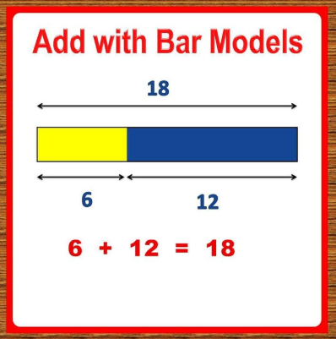
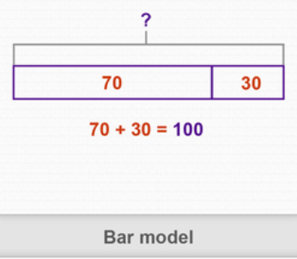
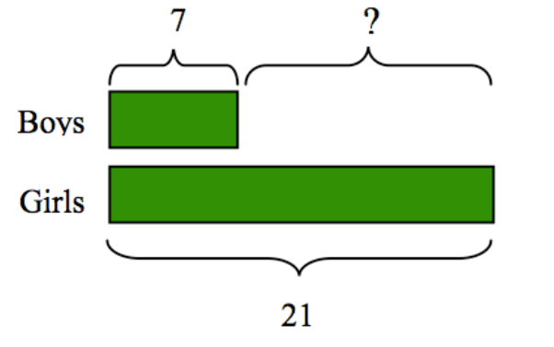
Grow in Love, Live in Peace

Slide 36


A Consistent Picture
2 of 20 = ?
Share 20 in the ratio 2:3
5
4 + 11 = ?
5 x 4 = ?
11
20
0
4
?
:
4
4
4
4
4
Grow in Love, Live in Peace

Slide 37
A Consistent Picture
4 + 11 = ?
15 - 4 = ?
?
15
4
11
4
?
5 x 4 = ?
20 ÷ 5 = ?
?
20
4
4
4
4
4
?
?
?
?
?
2 of 20 = ?
5
20
?
Grow in Love, Live in Peace

Slide 38

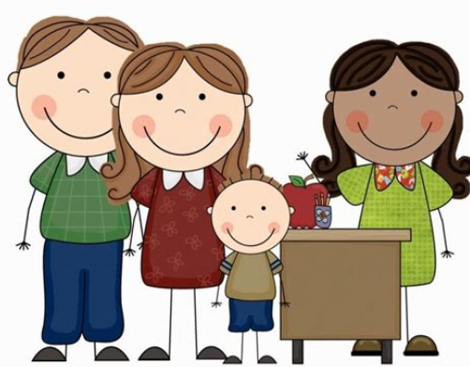
Promote a positive attitude to maths
Look at tables differently
Ask your child to teach you maths
Encourage your child to be independent in maths
Use maths with your child in daily life
Display maths work at home
Communicate with your child’s teacher
Play games that encourage mathematical thinking
Let us Remember:
Children need to wonder and struggle
You are not the answer key
Encourage their original ideas
Grow in Love, Live in Peace

Slide 39

Grow in Love, Live in Peace

