Slide 1


Renu Poddar 10th December, 2018
Grow in Love, Live in Peace

Slide 2

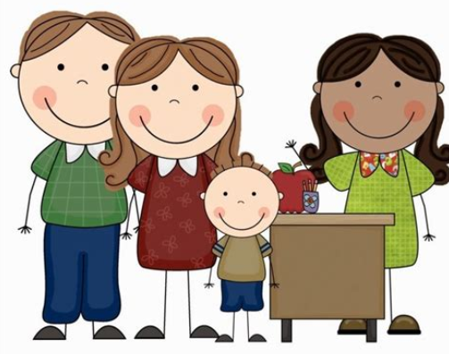
Grow in Love, Live in Peace
Notes:
https://www.youtube.com/watch?v=rzLBp2lnywM
Don’t downplay it. Maths is like sit ups and crunches. In a football match, u don’t have to do situps but u apply the strength you have gained with exercise

Slide 3
How and why did the mathematics mastery approach develop?
Too many children are falling behind.
Not enough children are excelling.
Teaching has been focused on procedures over understanding.
Negative attitudes towards maths ability and enjoyment.
Grow in Love, Live in Peace

Slide 4
What do we mean by Mastery?
Deep and sustainable learning – for all
  Depth is the key to avoiding the need to repeat teaching.
  It doesn’t feel like we’re starting again each term.
The ability to build on something that has already been sufficiently mastered
  …for this stage of learning - Mastery is a continuum
Grow in Love, Live in Peace
Notes:
What does it mean to ‘teach for mastery’?
Mastery for all – not just the most able as originally put forward by the DfE.

Slide 5
Representation
& Structure
Access
Mathematical Thinking
Chains of Reasoning
Fluency
Number Facts
Variation
Procedural
Conceptual
Table Facts
Pattern
Making Connections
Making Connections
Making Connections
Making Connections
Coherence
Small connected steps are easier to take
Grow in Love, Live in Peace
Notes:
We’ve shared some examples of how we are implementing the mastery approach in our classrooms.
Return to 5 big ideas.
Collect examples from audience of when they spotted the big ideas in our session.

Slide 6
Maths Mastery approaches
Mastery approaches often make the whole class move at the same pace. Students who learn faster stay on the same content while others catch up, being stretched with rich, complex problems that challenge them to consolidate their understanding.
In a mastery framework, teachers differentiate the time and support they provide for students, not content. In fact, mastery can only be achieved with strong, effective interventions for individuals within the class.
Students need ‘intelligent’ practice, with variation in the way they apply their learning to new situations, helping them to see the mathematical structures used.
Grow in Love, Live in Peace

Slide 7
What does a mastery maths lesson look like?
There are 3 elements to a mastery lesson:
Fluency
Reasoning (you will observe this element today).
Problem solving
Grow in Love, Live in Peace

Slide 8
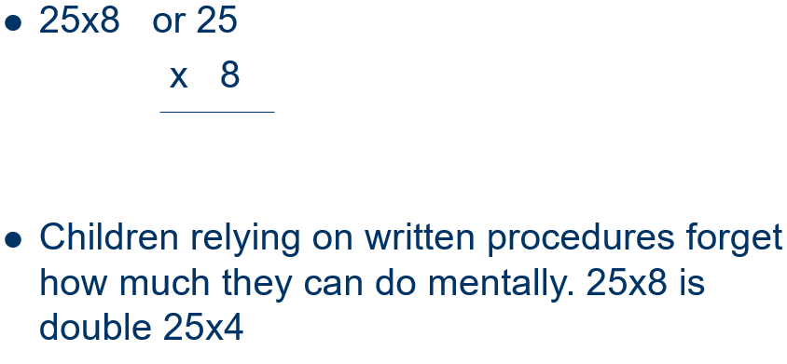
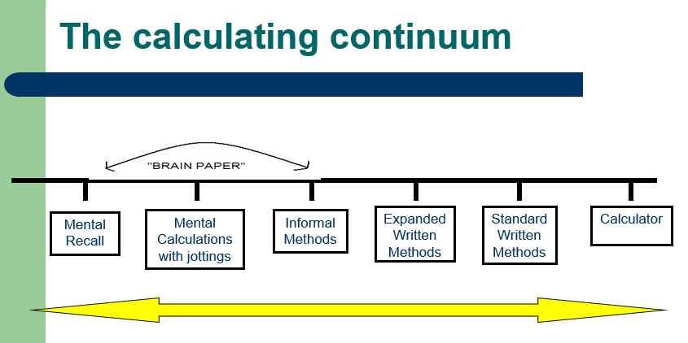
Mental ability vs. Written methods
Grow in Love, Live in Peace
Notes:
An emphasis on development of mental calculation

Slide 9
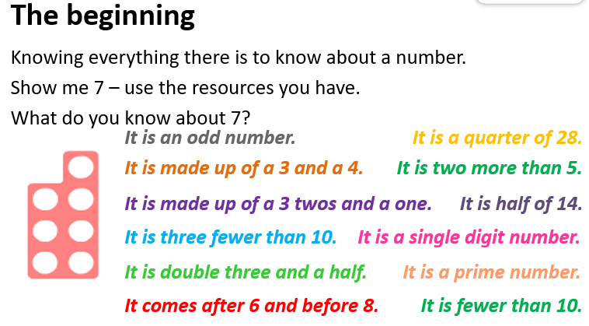
Grow in Love, Live in Peace

Slide 10
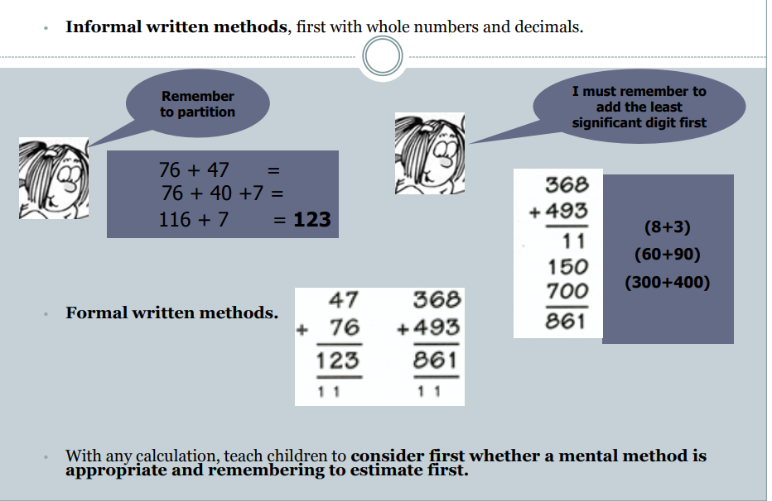
Grow in Love, Live in Peace

Slide 11
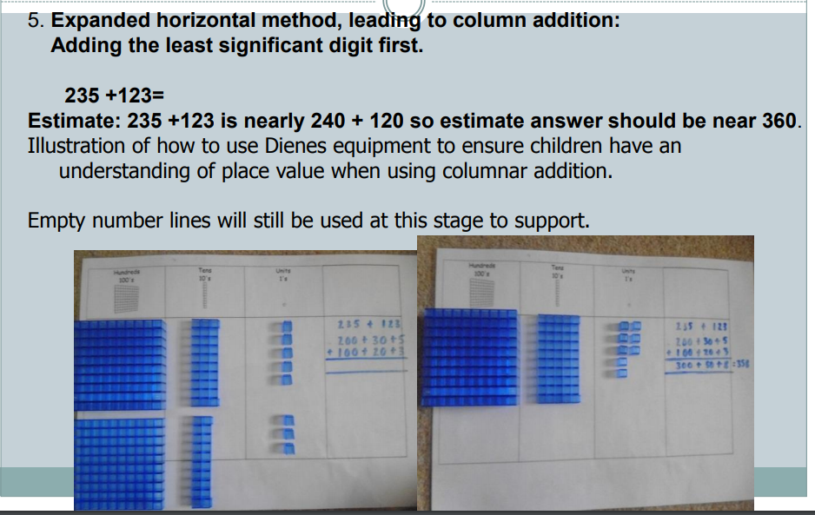
Grow in Love, Live in Peace

Slide 12
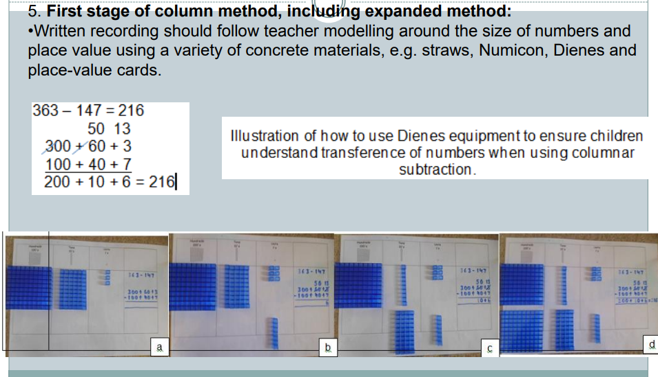
Grow in Love, Live in Peace

Slide 13
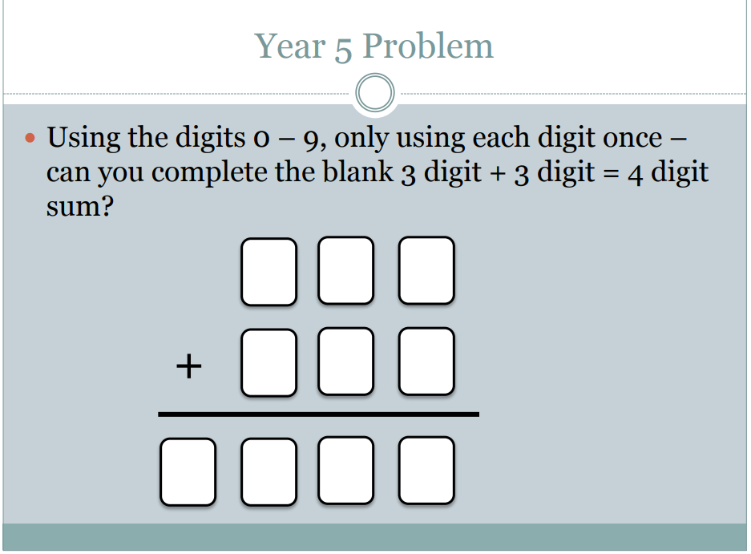
Grow in Love, Live in Peace

Slide 14
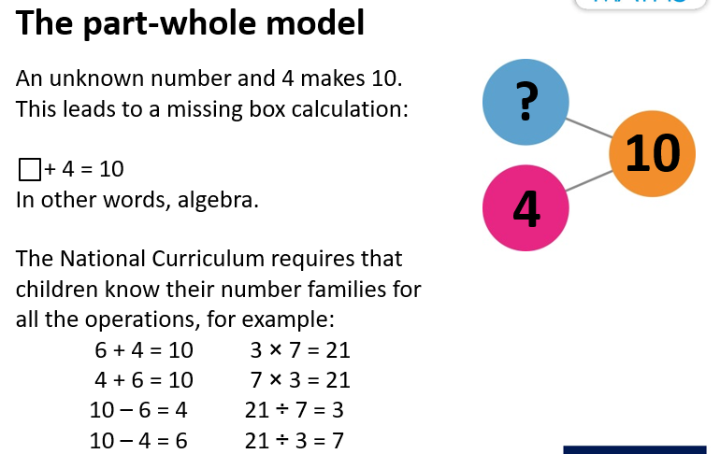
Grow in Love, Live in Peace

Slide 15
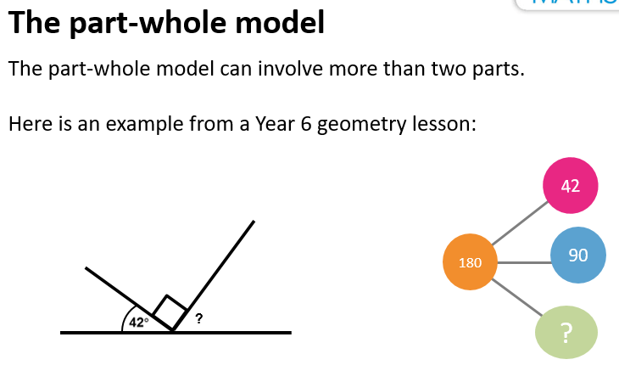
Grow in Love, Live in Peace

Slide 16
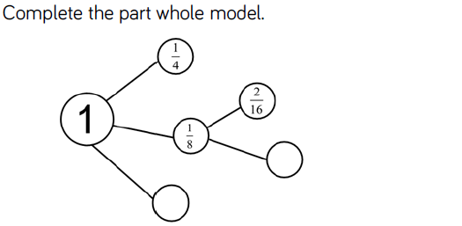
Grow in Love, Live in Peace

Slide 17
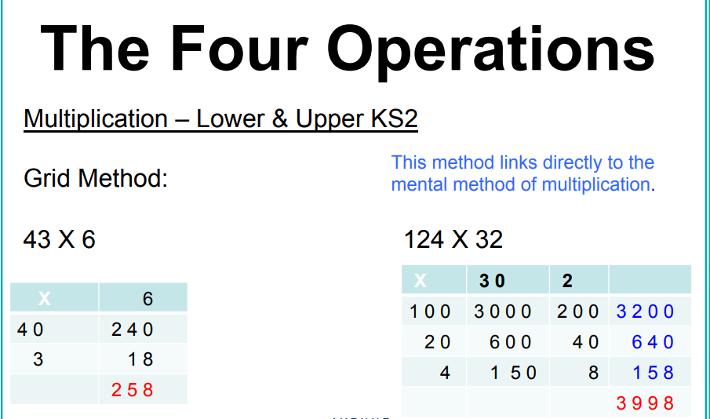
Grow in Love, Live in Peace

Slide 18
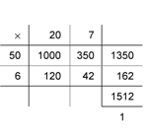
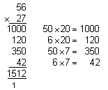
Long Multiplication –The Process
Grow in Love, Live in Peace

Slide 19
Example
124 x 26 =
1
2
124
First
6 x 4 = 24
x
26
Then
6 x 20 = 120
7
4
4
NEED TO ADD ANOTHER 20
+
120 + 20 = 140
2480
Then
6 x 100 = 600
3224
NEED TO ADD ANOTHER 100
600 + 100 = 700
1
1
Finally
20 x 124 = 2480
Grow in Love, Live in Peace

Slide 20

Long Multiplication
Children must remember to enter a place holder
Grow in Love, Live in Peace

Slide 21
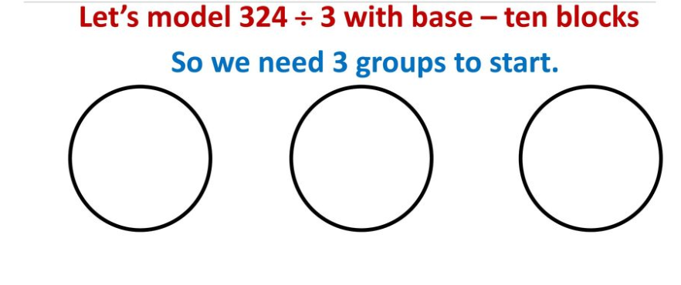
Grow in Love, Live in Peace

Slide 22
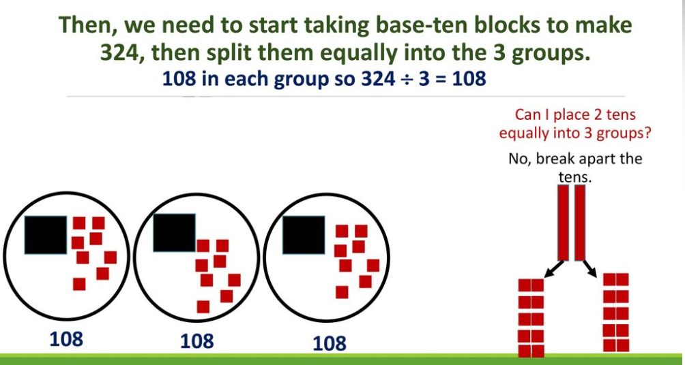
Grow in Love, Live in Peace

Slide 23
Example
147÷3
147
3
Step 1- Draw the Bus Stop
Step 2- Put the number you are dividing by on the outside.
Step 3- Put the number you want to divide inside.
Now were ready…
Grow in Love, Live in Peace

Slide 24
0
4
9
2
3
1
4
7
Step 1- How many 3s go into 1?
Step 2- How many 3s go into 14?
Step 3- How many 3s go into 27?
Grow in Love, Live in Peace

Slide 25
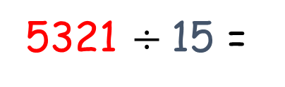
Bob has 5321 apples. She wants to put equal amounts into 15 different baskets. How many apples can he put in each basket?
4
0
3
5
r 11
5321 $÷$15 =
15
5 3 2 1
-
0
4 5 0 0
How many 15s in 5?
15 x 300
3
How many 15s in 53?
0 8 2 1
5
-
0 7 5 0
How many 15s in 82 ?
15 x 50
4
How many 15s in 71 ?
71
-
60
15 x 4
11
Remainder

Slide 26
Bob has 5321 apples. She wants to put equal amounts into 15 different baskets. How many apples can he put in each basket?
4
0
3
5
r 11
5321 $÷$15 =
15
5 3 2 1
-
0
4 5
How many 15s in 5?
15 x 3
3
How many 15s in 53?
0 8 2
5
-
0 7 5
How many 15s in 82 ?
15 x 5
4
How many 15s in 71 ?
71
-
60
15 x 4
11
Remainder

Slide 27
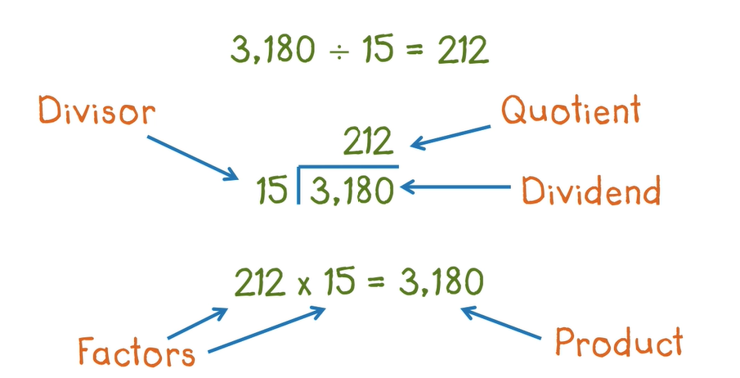
Grow in Love, Live in Peace

Slide 28
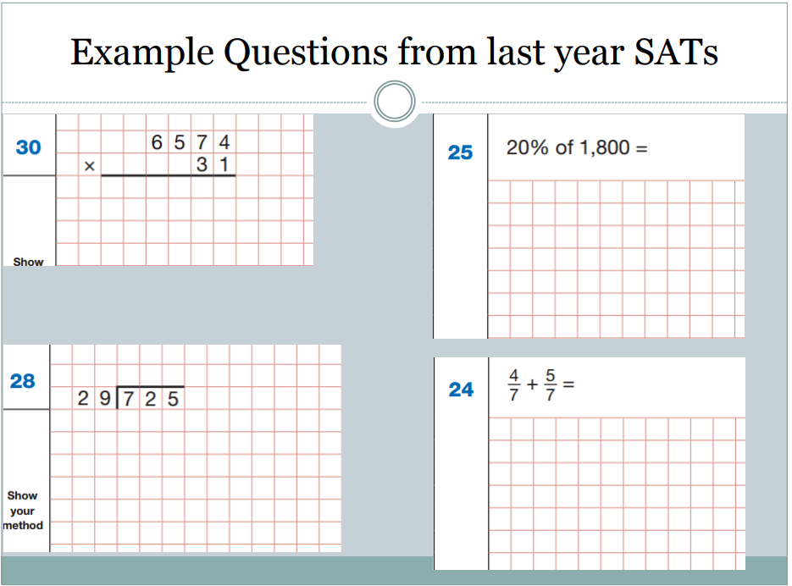
Grow in Love, Live in Peace

Slide 29
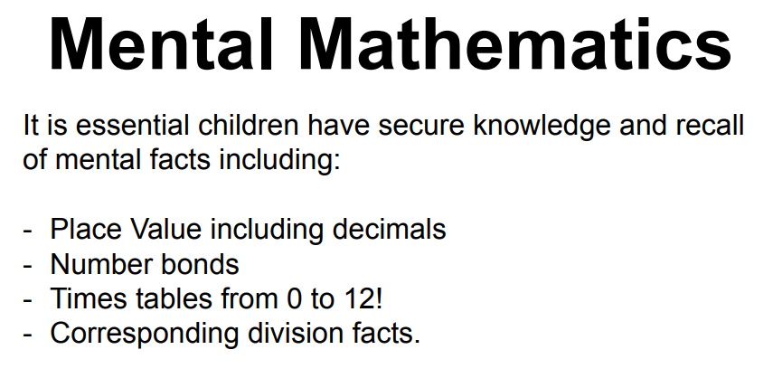
Grow in Love, Live in Peace

Slide 30
Why is mental calculation important?
2000
-102
How would approach this problem?
Grow in Love, Live in Peace

Slide 31
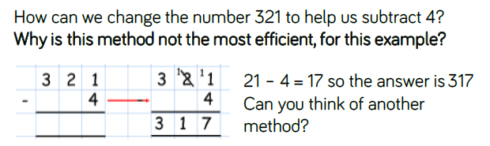
TASK
Grow in Love, Live in Peace

Slide 32
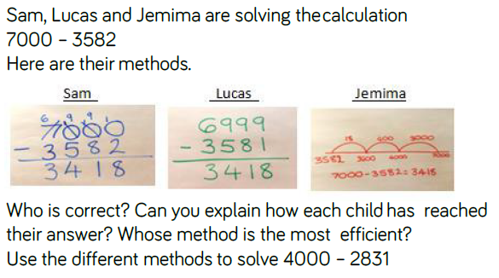
Grow in Love, Live in Peace

Slide 33
Introducing the bar model
Alex buys large eggs and small eggs.
Altogether he buys 20 eggs
There are 7 small eggs.
How many large eggs are there?
7
?
20
Answer : There are 13 large eggs.
Grow in Love, Live in Peace
Notes:
.

Slide 34
Extending the bar model to multiplication
Peter puts 5 bread rolls into each packet.
He has 4 packets.
How many bread rolls does he put into the 4 packets altogether?
5
5
5
5
?
There are 20 bread rolls altogether.
Grow in Love, Live in Peace

Slide 35
Extending the bar model to ratios
12
12
12
12
12
Tim and Sally share marbles in the ratio of 2:3
If Sally has 36 marbles, how many are there altogether?
Grow in Love, Live in Peace

Slide 36
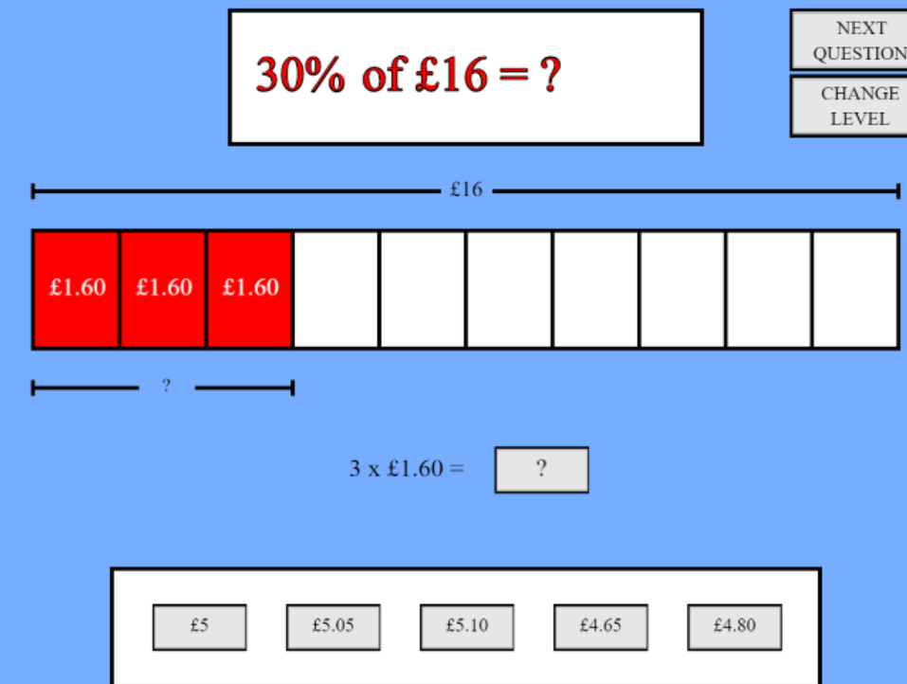
Grow in Love, Live in Peace

Slide 37
To find 10% divide the original number by ten.
To find 20% find 10% and double it.
To find 50% half it.
To find 25% half it, and half it again.
To find 5% find 10% and half it.
To find 1% divide by 100.
Grow in Love, Live in Peace

Slide 38
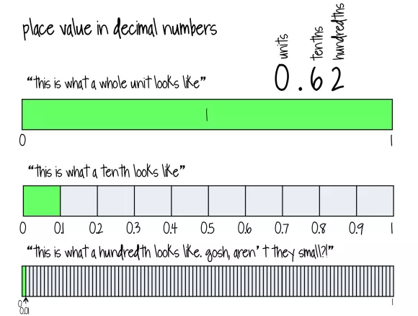
Grow in Love, Live in Peace

Slide 39

https://www.mathplayground.com/ThinkingBlocks/thinking_blocks_fractions_1.html

Slide 40
Let’s work together
To solve
the problem using Bar Model
https://www.mathplayground.com/tb_fractions/index.html
Grow in Love, Live in Peace

Slide 41
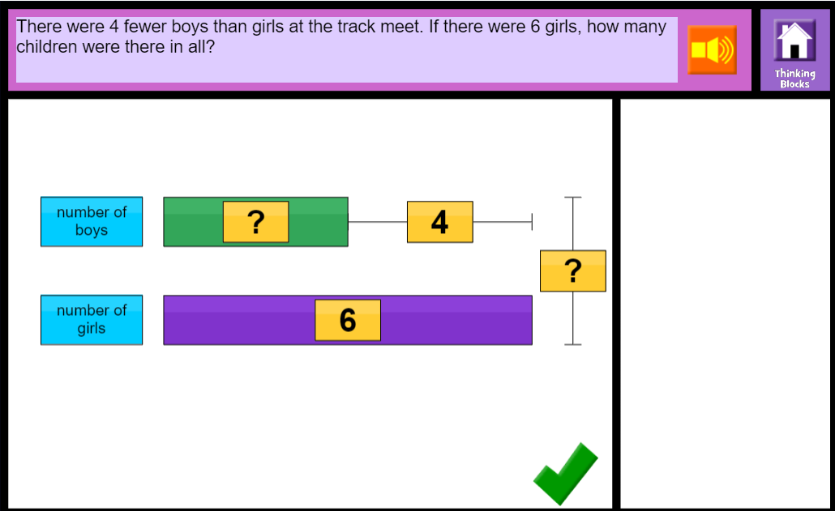
Grow in Love, Live in Peace

Slide 42
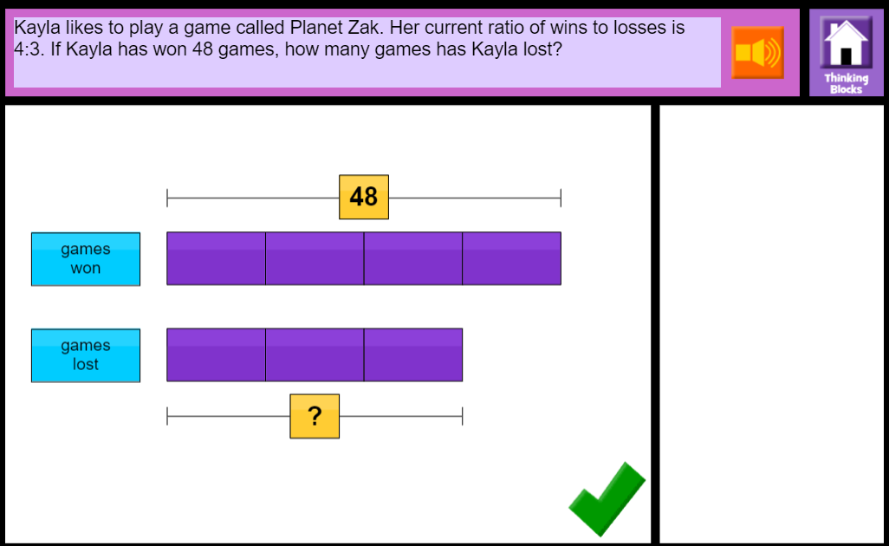
Grow in Love, Live in Peace

Slide 43
How many equal sections is each square cut into?
2
4
8
16
How many of the sections are blue?
1
2
4
8
What fraction of each square is blue?
x2
x2
x2
Are these fractions equal?
How do you get from one fraction to the next?
Grow in Love, Live in Peace

Slide 44
How many equal sections is each square cut into?
3
9
36
How many of the sections are blue?
1
3
12
What fraction of each square is blue?
x3
x4
Are these fractions equal?
How do you get from one fraction to the next?
Grow in Love, Live in Peace

Slide 45
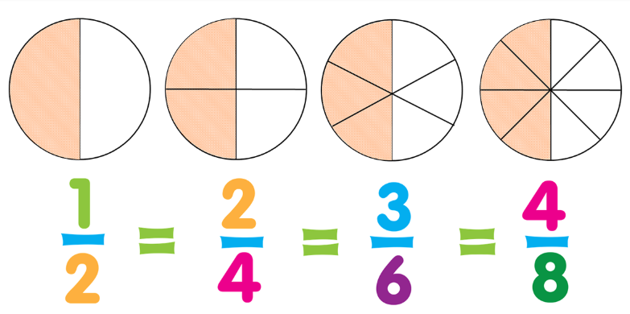
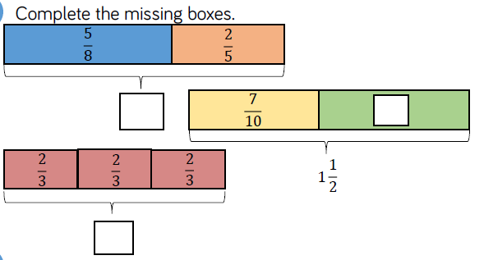
Grow in Love, Live in Peace

Slide 46
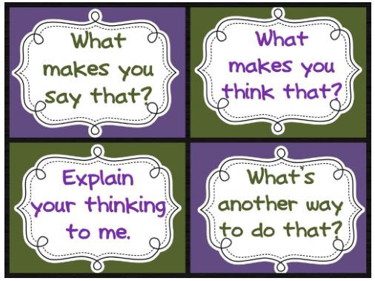
We are promoting Mathematical Talk
Grow in Love, Live in Peace

Slide 47

Promote a positive attitude to maths
Look at tables differently
Ask your child to teach you maths
Encourage your child to be independent in maths
Use maths with your child in daily life
Display maths work at home
Communicate with your child’s teacher
Play games that encourage mathematical thinking
Let us Remember:
Children need to wonder and struggle
2. You are not the answer key
3. Encourage their original ideas
Grow in Love, Live in Peace

Slide 48

Your Feedback Please
Grow in Love, Live in Peace

