Slide 1

KS2 SATS Meeting

Slide 2

What are the SATs?
SATs is a term people use to refer to End of Key Stage 2 Assessments;
It lasts for four days beginning on Monday 11th May 2020 and ending on Thursday 14th May 2020;
Children will sit the following Test papers:
- Grammar, Punctuation and Spelling (Paper 1) – Monday 11th May 2020;
- Grammar, Punctuation and Spelling (Paper 2) – Monday 11th May 2020;
- Reading – Tuesday 12th May 2020;
- Maths Paper 1 (Arithmetic) – Wednesday 13th May 2020;
- Maths Paper 2 (Reasoning) – Wednesday 13th May 2020;
- Maths Paper 3 (Reasoning) – Thursday 14th May 2020.
Writing is assessed using evidence collected by your child’s teacher throughout Year 6, so there is no Year 6 SATs writing test.
There will be no Science sampling for Year 6 this year.
Therefore, no Year 6 Science SATs Paper in 2020.
*The key stage 2 tests will be taken on set dates unless your child is absent, in which case they may be able to take them up to 5 school days afterwards.

Slide 3
When and how are the SATs carried out?
The tests will take place during normal school hours, under exam conditions;
Children are not allowed to talk to each other from the moment the assessments are handed out until they are collected after the test has ended;
Afterwards, the completed papers are sent away to be marked externally;
The children’s results are sent back to school at some point in July;
The standard timings of tests differ but last no more than 60 minutes:
- Grammar, Punctuation and Spelling (Paper 1) – 45 minutes;
- Grammar, Punctuation and Spelling (Paper 2) – 15 minutes;
- Reading – 60 minutes;
- Maths Paper 1 (Arithmetic) – 30 minutes;
- Maths Paper 2 (Reasoning) – 40 minutes;
- Maths Paper 3 (Reasoning) – 40 minutes.

Slide 4
Specific arrangements for SATs:
Children with additional needs, who have similar provision in their day-to-day learning at school, may be allotted specific arrangements, including:
Additional (extra) time;
Tests being opened early to be modified;
An adult to read for them;
An adult to scribe (write) for them;
Written or spoken translations of the mathematics reasoning papers;
The use of prompts or rest breaks;
Arrangements for children who are ill or injured at the time of the tests.
*Pupils with an EHC plan are automatically allowed up to 25% additional time (except for the spelling paper, which is not strictly timed). Pupils who use the modified large print or braille versions of the tests are automatically allowed up to 100% additional time

Slide 5
What sort of results are reported?
Once marked, the tests will be given the following scores:
A raw score (the total number of marks achieved for each paper);
A scaled score (which is explained below);
A judgement of whether the National Standard has been met.
After marking each test, the external markers will convert each raw score into a scaled score to show whether each child is working below, at or above the national standard.
When the scaled score is given, it is given in a range from 80 to 120.
A scaled score of 100 or more is meeting the national standard.
There are no separate tests for higher achieving pupils; however, a scaled score close to 120 would show that a child is working above the national standard.

Slide 6
Grammar, Punctuation and Spelling
Grammar, Punctuation and Spelling is made up of two papers which will take place on Monday 11th May 2020:
Paper 1 is the longer paper lasting 45 minutes, children will be tested on grammar, punctuation and spelling generally;
Paper 2 is a shorter paper lasting 15 minutes, where children will be tested on spelling only – they are asked to fill in a blank within a sentence, attempting to spell out the spelling word in context correctly.

Slide 7
Grammar, Punctuation and Spelling (Paper 1)
Grammar, Punctuation and Spelling (Paper 1) is the longer paper lasting 45 minutes, which takes place on Monday 11th May 2020.
The children will be prepared by their class teacher so they are equipped with a good knowledge of the technical vocabulary needed to identify and describe various aspects of grammar and punctuation marks.
Grammar, Punctuation and Spelling (Paper 1) focuses on the following areas:
- Grammatical terms/word classes;
- Functions of sentences;
- Combining words, phrases and clauses;
- Verb forms, tenses and consistency;
- Punctuation;
- Vocabulary;
- Standard English and formality.
Grammar, Punctuation and Spelling (Paper 1) requires a range of answer types such as circling missing capital letters, multiple choice questions, one-word answers, but does not require longer formal answers.

Slide 8
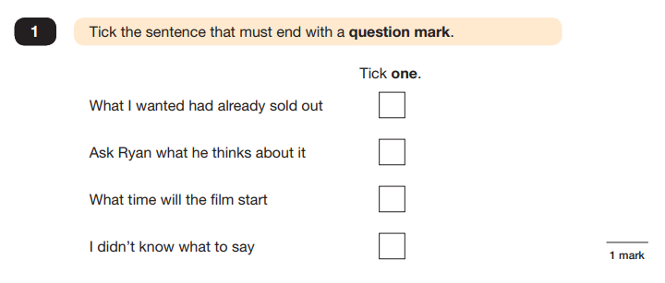
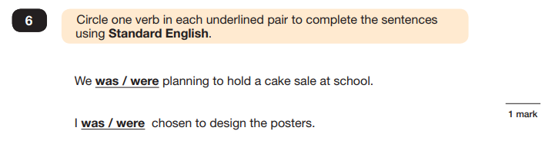
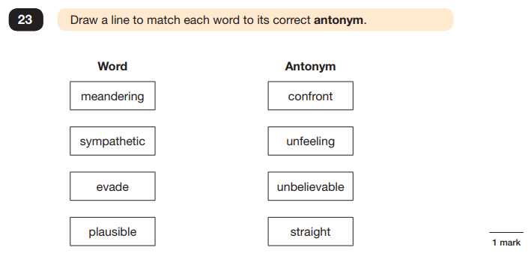
Grammar, Punctuation and Spelling (Paper 1)
Example questions:

Slide 9
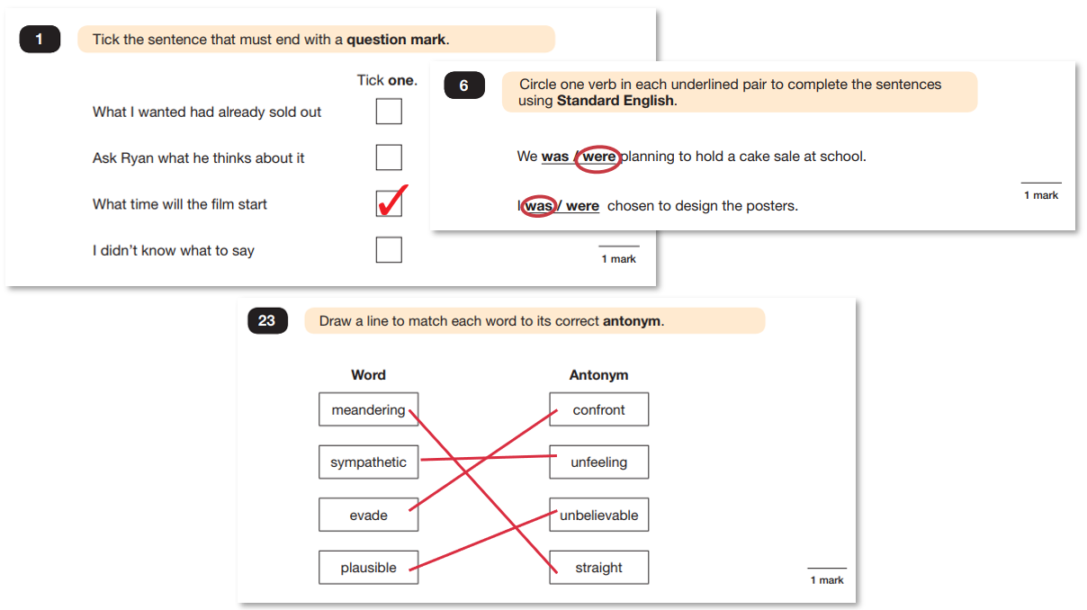
Example questions:

Slide 10
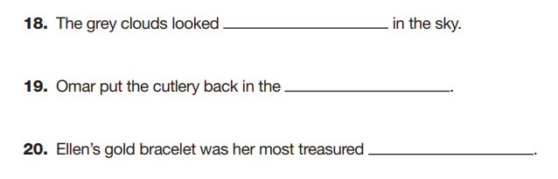
Grammar, Punctuation and Spelling (Paper 2)
Grammar, Punctuation and Spelling (Paper 2) is the shorter paper lasting 20 minutes, which takes place on Monday 11th May 2020.
Example questions:

Slide 11
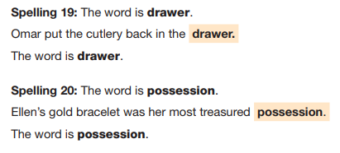
Grammar, Punctuation and Spelling (Paper 2)
Grammar, Punctuation and Spelling (Paper 2) is the shorter paper lasting 20 minutes, which takes place on Monday 11th May 2020.
Example questions:

Slide 12
Reading
The Year 6 Reading SATs paper will be sat on Tuesday 12th May 2020.
The assessment has been designed to measure whether children’s comprehension of age-appropriate reading material meets the national standard.
It a standard timing of 60 minutes, including reading the texts and answering questions. There are three different set texts for the children to read, which could be any combination of non-fiction, fiction and/or poetry.
The Reading paper focuses on the following areas known as Content Domains:
2a) give/explain the meaning of words in context;
2b) retrieve and record information/identify key details from fiction and non-fiction;
2c) summarise main ideas from more than one paragraph;
2d) make inferences from the text/explain and justify inferences with evidence from the text;
2e) predict what might happen from details stated and implied;
2f) identify/explain how information/content is related and contributes to meaning as a whole;
2g) identify/explain how meaning is enhanced through choice of words and phrases;
2h) make comparisons within the text.
The Year 6 Reading SATs paper requires a range of answering styles, including responding to multiple choice questions, one-word answers, and multiple mark questions which require more formal paragraph-length answers.

Slide 13
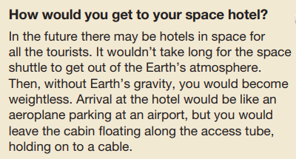
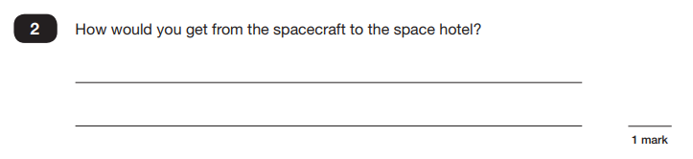
Reading
Example question, based on Text 1 – Space Tourism:
2b) retrieve and record information/identify key details from fiction and non-fiction

Slide 14
Reading
Example question, based on Text 1 – Space Tourism:
2b) retrieve and record information/identify key details from fiction and non-fiction

Slide 15
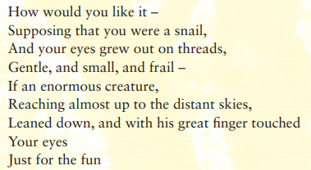
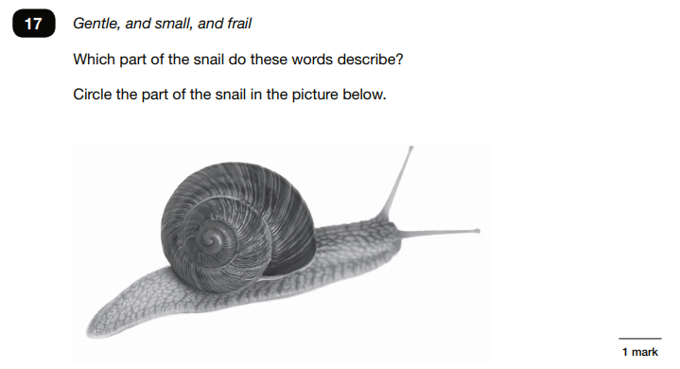
Reading
Example question, based on
Text 2 – Giants:
2b) retrieve and record information/identify key details from fiction and non-fiction

Slide 16
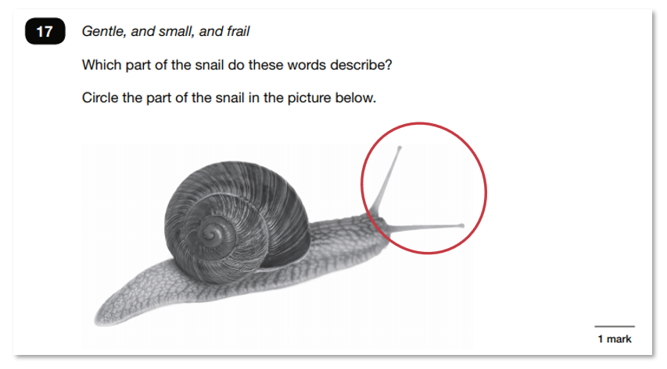
Reading
Example question, based on
Text 2 – Giants:
2b) retrieve and record information/identify key details from fiction and non-fiction

Slide 17
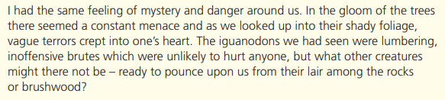
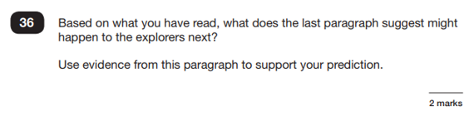
Reading
2e) predict what might happen from details stated and implied

Slide 18
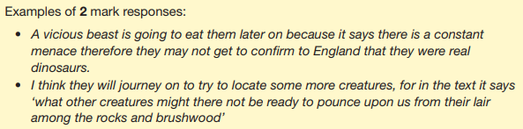
Reading
Example question, based on Text 3 – The Lost World:
2e) predict what might happen from details stated and implied

Slide 19
Reading
Since the current testing format for the Year 6 SATs began in 2016, there has been a tendency for the number of marks to go in favour towards three particular types of content domain / questions.
For example, in 2017:
20% of marks could be gained by answering questions where children had to give/explain the meaning of words in context (Content Domain 2a);
Over a quarter of marks could be gained by answering questions where children had to retrieve/record information or details from the texts (2b);
Almost half of the marks were allotted to questions requiring children to make inferences from a text, justifying inferences with text evidence (2d).
So, when reading with your child at home, try asking questions like:
Find a word in this paragraph that is closest in meaning to ‘provide word –
e.g. annoyed’ (2a);
In what year did ‘provide fact – e.g. the French authorities make it illegal for people to swim from France to England’? (2b);
In the last paragraph, X does not want to Y.
Give two reasons why X does not want Y. (2d)

Slide 20
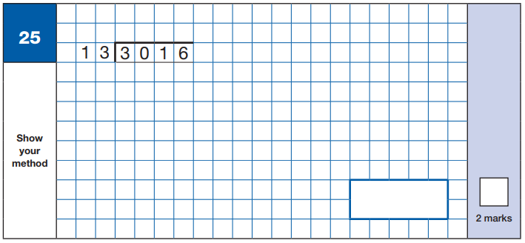
Maths Paper 1 (Arithmetic)
Maths Paper 1 (Arithmetic) will take place on Wednesday 13th May 2020.
It has a standard timing of 30 minutes and is worth a total of 40 marks.
It covers the four operations (division, multiplication, addition, subtraction and mixed operation calculations requiring BIDMAS), as well as number properties, calculating percentages of amounts, calculations using decimals, and calculations using fractions.
Example question:

Slide 21
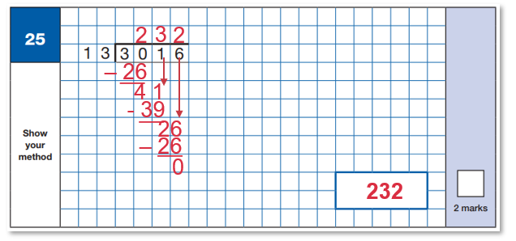
Maths Paper 1 (Arithmetic)
Maths Paper 1 (Arithmetic) will take place on Wednesday 13th May 2020.
It has a standard timing of 30 minutes and is worth a total of 40 marks.
It covers the four operations (division, multiplication, addition, subtraction and mixed operation calculations requiring BIDMAS), as well as number properties, calculating percentages of amounts, calculations using decimals, and calculations using fractions.
Example question:
1 – 13
2 – 26
3 – 39
4 – 52
5 – 65
6 – 78
7 – 91
8 – 104
9 - 117
10 - 130

Slide 22

Maths Paper 1 (Arithmetic)
Maths Paper 1 (Arithmetic) will take place on Wednesday 13th May 2020.
It has a standard timing of 30 minutes and is worth a total of 40 marks.
It covers the four operations (division, multiplication, addition, subtraction and mixed operation calculations requiring BIDMAS), as well as number properties, calculating percentages of amounts, calculations using decimals, and calculations using fractions.
Example question:

Slide 23
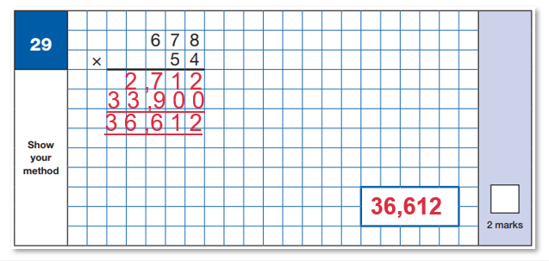
Maths Paper 1 (Arithmetic)
Maths Paper 1 (Arithmetic) will take place on Wednesday 13th May 2020.
It has a standard timing of 30 minutes and is worth a total of 40 marks.
It covers the four operations (division, multiplication, addition, subtraction and mixed operation calculations requiring BIDMAS), as well as number properties, calculating percentages of amounts, calculations using decimals, and calculations using fractions.
Example question:

Slide 24
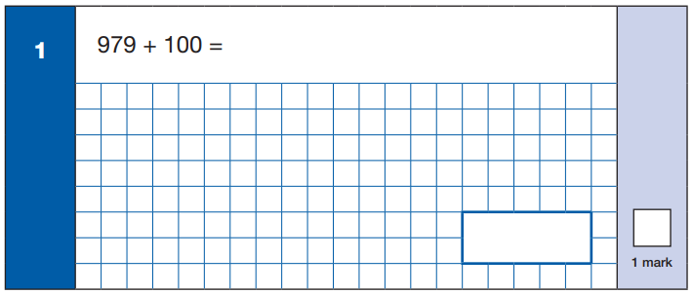
Maths Paper 1 (Arithmetic)
Maths Paper 1 (Arithmetic) will take place on Wednesday 13th May 2020.
It has a standard timing of 30 minutes and is worth a total of 40 marks.
It covers the four operations (division, multiplication, addition, subtraction and mixed operation calculations requiring BIDMAS), as well as number properties, calculating percentages of amounts, calculations using decimals, and calculations using fractions.
Example question:

Slide 25
Maths Paper 1 (Arithmetic)
Maths Paper 1 (Arithmetic) will take place on Wednesday 13th May 2020.
It has a standard timing of 30 minutes and is worth a total of 40 marks.
It covers the four operations (division, multiplication, addition, subtraction and mixed operation calculations requiring BIDMAS), as well as number properties, calculating percentages of amounts, calculations using decimals, and calculations using fractions.
Example question:
1,079

Slide 26
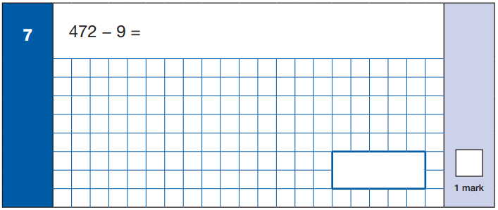
Maths Paper 1 (Arithmetic)
Maths Paper 1 (Arithmetic) will take place on Wednesday 13th May 2020.
It has a standard timing of 30 minutes and is worth a total of 40 marks.
It covers the four operations (division, multiplication, addition, subtraction and mixed operation calculations requiring BIDMAS), as well as number properties, calculating percentages of amounts, calculations using decimals, and calculations using fractions.
Example question:

Slide 27
Maths Paper 1 (Arithmetic)
Maths Paper 1 (Arithmetic) will take place on Wednesday 13th May 2020.
It has a standard timing of 30 minutes and is worth a total of 40 marks.
It covers the four operations (division, multiplication, addition, subtraction and mixed operation calculations requiring BIDMAS), as well as number properties, calculating percentages of amounts, calculations using decimals, and calculations using fractions.
Example question:
463

Slide 28
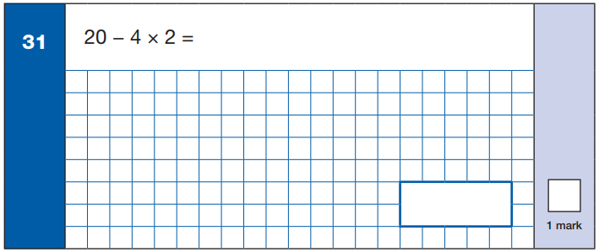
Maths Paper 1 (Arithmetic)
Maths Paper 1 (Arithmetic) will take place on Wednesday 13th May 2020.
It has a standard timing of 30 minutes and is worth a total of 40 marks.
It covers the four operations (division, multiplication, addition, subtraction and mixed operation calculations requiring BIDMAS), as well as number properties, calculating percentages of amounts, calculations using decimals, and calculations using fractions.
Example question:

Slide 29
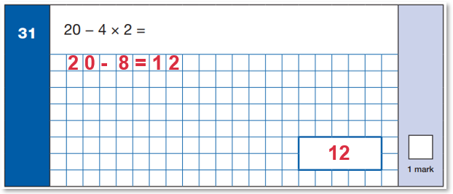
Maths Paper 1 (Arithmetic)
Maths Paper 1 (Arithmetic) will take place on Wednesday 13th May 2020.
It has a standard timing of 30 minutes and is worth a total of 40 marks.
It covers the four operations (division, multiplication, addition, subtraction and mixed operation calculations requiring BIDMAS), as well as number properties, calculating percentages of amounts, calculations using decimals, and calculations using fractions.
Example question:

Slide 30
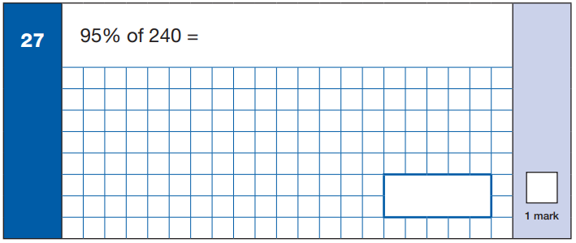
Maths Paper 1 (Arithmetic)
Maths Paper 1 (Arithmetic) will take place on Wednesday 13th May 2020.
It has a standard timing of 30 minutes and is worth a total of 40 marks.
It covers the four operations (division, multiplication, addition, subtraction and mixed operation calculations requiring BIDMAS), as well as number properties, calculating percentages of amounts, calculations using decimals, and calculations using fractions.
Example question:

Slide 31
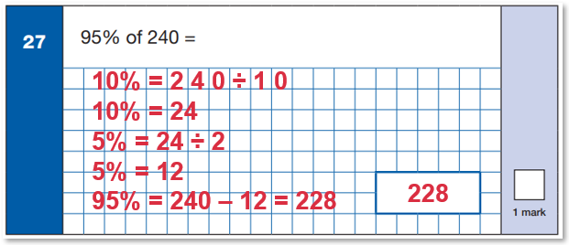
Maths Paper 1 (Arithmetic)
Maths Paper 1 (Arithmetic) will take place on Wednesday 13th May 2020.
It has a standard timing of 30 minutes and is worth a total of 40 marks.
It covers the four operations (division, multiplication, addition, subtraction and mixed operation calculations requiring BIDMAS), as well as number properties, calculating percentages of amounts, calculations using decimals, and calculations using fractions.
Example question:

Slide 32
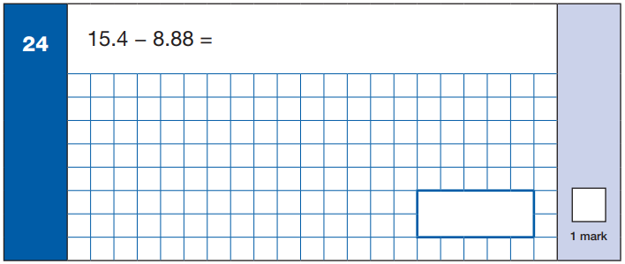
Maths Paper 1 (Arithmetic)
Maths Paper 1 (Arithmetic) will take place on Wednesday 13th May 2020.
It has a standard timing of 30 minutes and is worth a total of 40 marks.
It covers the four operations (division, multiplication, addition, subtraction and mixed operation calculations requiring BIDMAS), as well as number properties, calculating percentages of amounts, calculations using decimals, and calculations using fractions.
Example question:

Slide 33
Maths Paper 1 (Arithmetic)
Maths Paper 1 (Arithmetic) will take place on Wednesday 13th May 2020.
It has a standard timing of 30 minutes and is worth a total of 40 marks.
It covers the four operations (division, multiplication, addition, subtraction and mixed operation calculations requiring BIDMAS), as well as number properties, calculating percentages of amounts, calculations using decimals, and calculations using fractions.
Example question:
6.52

Slide 34
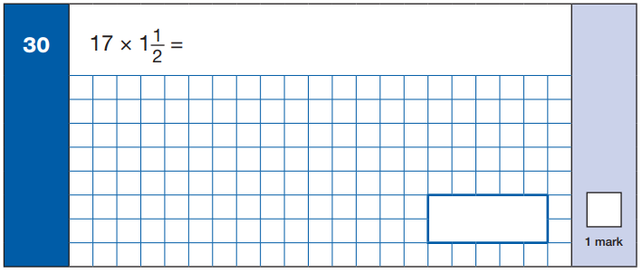
Maths Paper 1 (Arithmetic)
Maths Paper 1 (Arithmetic) will take place on Wednesday 13th May 2020.
It has a standard timing of 30 minutes and is worth a total of 40 marks.
It covers the four operations (division, multiplication, addition, subtraction and mixed operation calculations requiring BIDMAS), as well as number properties, calculating percentages of amounts, calculations using decimals, and calculations using fractions.
Example question:
6.52

Slide 35
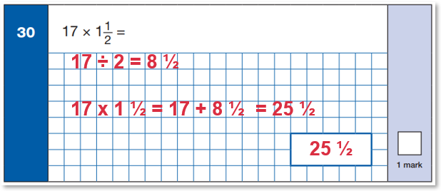
Maths Paper 1 (Arithmetic)
Maths Paper 1 (Arithmetic) will take place on Wednesday 13th May 2020.
It has a standard timing of 30 minutes and is worth a total of 40 marks.
It covers the four operations (division, multiplication, addition, subtraction and mixed operation calculations requiring BIDMAS), as well as number properties, calculating percentages of amounts, calculations using decimals, and calculations using fractions.
Example question:

Slide 36
Maths Papers 2 & 3 (Reasoning)
Maths Paper 2 (Reasoning) will take place on Wednesday 13th May 2020.
Maths Paper 3 (Reasoning) is scheduled for Thursday 14th May 2020.
Both have standard timings of 40 minutes and are worth 35 marks each.
Paper 2 requires children to demonstrate their mathematical knowledge and skills, as well as their ability to solve problems and their mathematical reasoning.
Questions focus on the following Mathematical topic areas:
- Number and place value– including Roman Numerals;
- Addition, subtraction, multiplication and division (calculations);
- Geometry – properties of shapes;
- Geometry – position and direction;
- Statistics;
- Measurement – including length, perimeter, mass (weight), volume, time and money;
- Algebra;
- Ratio and proportion;
- Fractions, decimals and percentages.
The questions get harder throughout the paper.
It is not unusual for a child to be unable to complete the entire paper in time.

Slide 37
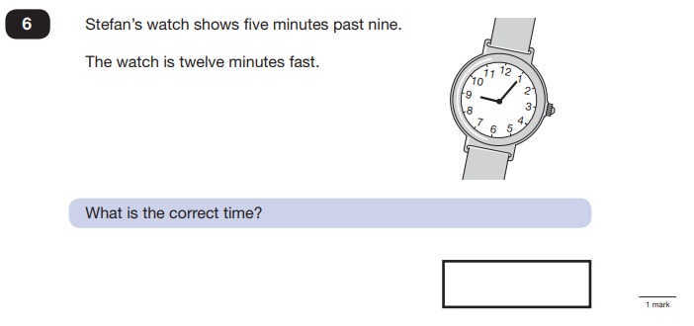
Maths Papers 2 (Reasoning)
Maths Paper 2 (Reasoning) will take place on Wednesday 13th May 2020.
Maths Paper 3 (Reasoning) is scheduled for Thursday 14th May 2020.
Both have standard timings of 40 minutes and are worth 35 marks each.
Example questions:

Slide 38
Maths Papers 2 (Reasoning)
Maths Paper 2 (Reasoning) will take place on Wednesday 13th May 2020.
Maths Paper 3 (Reasoning) is scheduled for Thursday 14th May 2020.
Both have standard timings of 40 minutes and are worth 35 marks each.
Example questions:
7 minutes to 9 or
8:53

Slide 39
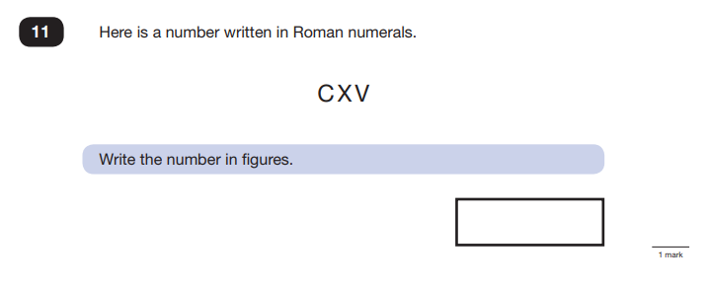
Maths Papers 2 (Reasoning)
Maths Paper 2 (Reasoning) will take place on Wednesday 13th May 2020.
Maths Paper 3 (Reasoning) is scheduled for Thursday 14th May 2020.
Both have standard timings of 40 minutes and are worth 35 marks each.
Example questions:

Slide 40
Maths Papers 2 (Reasoning)
Maths Paper 2 (Reasoning) will take place on Wednesday 13th May 2020.
Maths Paper 3 (Reasoning) is scheduled for Thursday 14th May 2020.
Both have standard timings of 40 minutes and are worth 35 marks each.
Example questions:
115

Slide 41
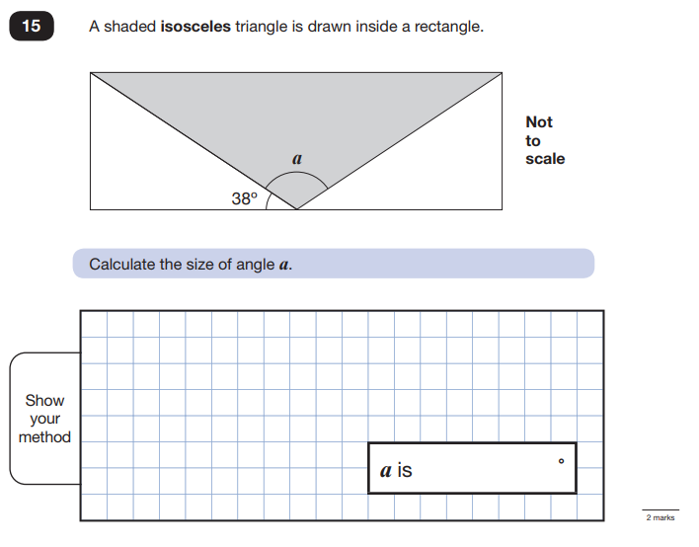
Maths Papers 2 (Reasoning)
Maths Paper 2 (Reasoning) will take place on Wednesday 13th May 2020.
Maths Paper 3 (Reasoning) is scheduled for Thursday 14th May 2020.
Both have standard timings of 40 minutes and are worth 35 marks each.
Example questions:

Slide 42
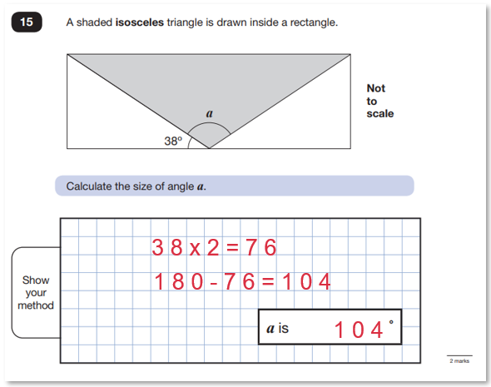
Maths Papers 2 (Reasoning)
Maths Paper 2 (Reasoning) will take place on Wednesday 13th May 2020.
Maths Paper 3 (Reasoning) is scheduled for Thursday 14th May 2020.
Both have standard timings of 40 minutes and are worth 35 marks each.
Example questions:

Slide 43
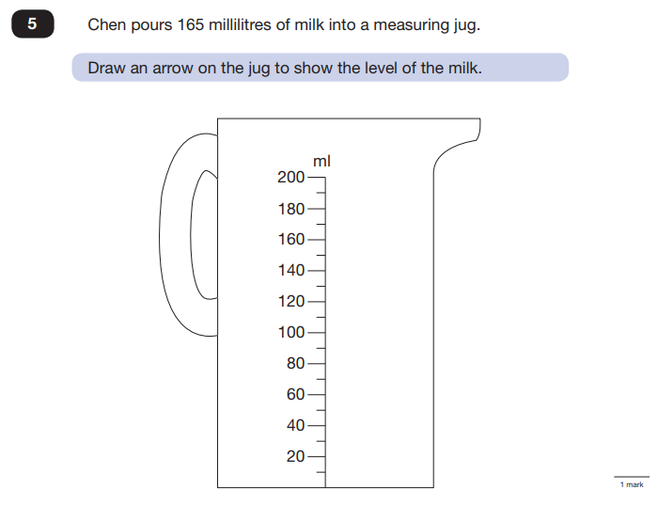
Maths Papers 3 (Reasoning)
Maths Paper 2 (Reasoning) will take place on Wednesday 13th May 2020.
Maths Paper 3 (Reasoning) is scheduled for Thursday 14th May 2020.
Both have standard timings of 40 minutes and are worth 35 marks each.
Example questions:

Slide 44
Maths Papers 3 (Reasoning)
Maths Paper 2 (Reasoning) will take place on Wednesday 13th May 2020.
Maths Paper 3 (Reasoning) is scheduled for Thursday 14th May 2020.
Both have standard timings of 40 minutes and are worth 35 marks each.
Example questions:

Slide 45
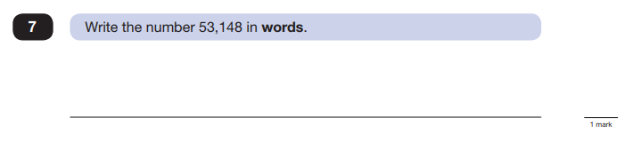
Maths Papers 3 (Reasoning)
Maths Paper 2 (Reasoning) will take place on Wednesday 13th May 2020.
Maths Paper 3 (Reasoning) is scheduled for Thursday 14th May 2020.
Both have standard timings of 40 minutes and are worth 35 marks each.
Example questions:

Slide 46
Maths Papers 3 (Reasoning)
Maths Paper 2 (Reasoning) will take place on Wednesday 13th May 2020.
Maths Paper 3 (Reasoning) is scheduled for Thursday 14th May 2020.
Both have standard timings of 40 minutes and are worth 35 marks each.
Example questions:
Fifty-three thousand, one hundred and forty-eight

Slide 47
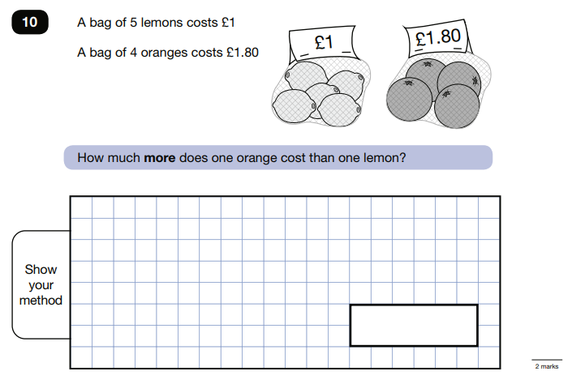
Maths Papers 3 (Reasoning)
Maths Paper 2 (Reasoning) will take place on Wednesday 13th May 2020.
Maths Paper 3 (Reasoning) is scheduled for Thursday 14th May 2020.
Both have standard timings of 40 minutes and are worth 35 marks each.
Example questions:

Slide 48
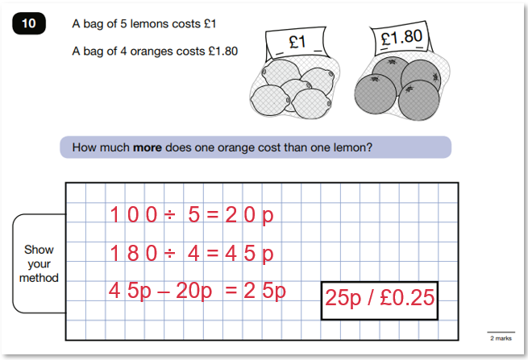
Maths Papers 3 (Reasoning)
Maths Paper 2 (Reasoning) will take place on Wednesday 13th May 2020.
Maths Paper 3 (Reasoning) is scheduled for Thursday 14th May 2020.
Both have standard timings of 40 minutes and are worth 35 marks each.
Example questions:

Slide 49
How can I support my child in preparing for their SATs?
Firstly, a positive attitude goes a long way – so as much encouragement and support as possible (but we don’t need to tell you that)!
• Direct any questions or concerns you have about SATs to your child’s teacher, rather than worry your child with them;
• Give your child opportunities to go outside and avoid overuse of screens - this can apply to leisure pursuits as well as how they study;
• Try to provide a quiet corner of the house for homework and study, that’s as free from distractions as possible;
• Encourage your child to talk to their teacher or another adult they trust if they express persisting anxieties about SATs. Remember that a small amount of anxiety is normal and not harmful;
• If your child is unwilling to talk to their teacher, talk to them yourself;
• Plan something nice and fun for the weekends before and after SATs – this will help your child start the week well and also give them something to look forward to;
• Ensure your child is eating and drinking well, and getting a suitable amount of sleep.
DO NOT USE PAST PAPERS – if your child has a tutor,
insist they do not use them too!

Slide 50
Remember this about SATs?
SATs focus on what they know about Maths and English
They won’t reflect how talented they are at Science, Geography, Art or PE, and they certainly won’t highlight positive personal characteristics such as kindness and integrity.
SATs results don’t always tell the whole story
The results will say they DID or DIDN’T meet a certain standard, but not necessarily by what margin. Additionally, the thresholds tend to change each year according to overall national performance, so what was classed as ‘did meet the expected standard’ in 2016 may have been considered a ‘did not’ in 2015.
So don’t let your child see SATs as a simple case of ‘pass’ or ‘fail’.
SATs last for one week
In reality it’s just one or two papers lasting 30-60 minutes each day. We can’t emphasise enough the importance of keeping that in perspective.

Slide 51
What should I do if I’m worried about my child?
It would be unnatural for SATs not to induce a certain degree of worry or anxiety but there is, of course, a tipping point.
SATs should not:
affect a child’s appetite;
affect a child’s ability to sleep;
alter a child’s personality;
induce panic, tears or disengagement from lessons;
be a reason not to attend school.
If any of the above are evident, then SATs may be causing an excessive degree of anxiety, and your child may benefit from additional support. This isn’t about removing the reality of SATs, but rather equipping your 10 or 11 year old child
to cope with the situation and be stronger for it.

Slide 52
What should I do if I’m worried about my child?
Steps to take:
Talk to the class teacher
Is your child showing the same symptoms at school as they are at home? Is there anything else going on at home which may be contributing to your child’s overall level of stress? Work with the school so everyone concerned can be offering the support that’s needed.
Spend time with your child
Try to understand what aspect of SATs concerns them most. Is it the worry of ‘failing’? Is it the worry of getting stuck on a paper? If your child can pinpoint what’s bothering them most, you can take specific steps to help reassure them.
Try not to project your own anxieties or views on the SATs
If you don’t believe in SATs, or do not think your child should be doing them, then neither will they.
Confront any media coverage
Show clippings if there’s been anything negative and ask them to talk about what they’re seen and how they feel. Reinforce the reality.
Encourage your child to talk to their teacher
SATs are obviously linked to school, so don’t be surprised if they favour the reassurance of teachers above family members.

Slide 53
SATs Breakfast
During the week of SATs we will have daily SATs breakfast for the children
This will ensure that the children are relaxed and ready for the test ahead.
SATs breakfast is for Year 6 pupils only (NO SIBLINGS ALLOWED)
Gate will open at 8:00 and the children will be provided with breakfast.

Slide 54
Advice for Year 6 children!
Listen to what your teacher says;
Your teacher is cheering you on and wants you to do your best;
Make sure you get plenty of sleep and stay well fed – sleep and food help keep the brain moving;
Read the questions carefully. This can help to avoid any silly mistakes!
Don’t worry if there’s something you can’t answer. Take a deep breath! You can always move on and go back later but it’s better to write something rather than nothing;
Keep in mind year 6 SATs are just one week of your entire life!

