Slide 1

PowerPoint 2 – cross curricular

Slide 2
Guide for parents/carers,
Read the ‘notes’ section at the bottom of the slides for specific instructions before beginning the lesson.
Read the slide and set the tasks or challenges for the child/ren. There is no rush and you do not have to do everything, but be aware that the lessons follow and build on from one another, so try not to skip lessons but rather work in order and stop when you feel is best for your child. When next PowerPoints appear, don’t feel pressured to skip ahead if you have not finished everything yet, it’s better to work through each slide and complete a PowerPoint before moving on to the next one in order to better enrich the child’s learning ☺
Some slides will have one task, others more. You can break these down however you like e.g. All the tasks on one slide can be spread across a few days or done in one day, but please do not do more than one whole slide a day! The slides are numbered to help you differentiate between the different types of tasks.
Ms Foster

Slide 3
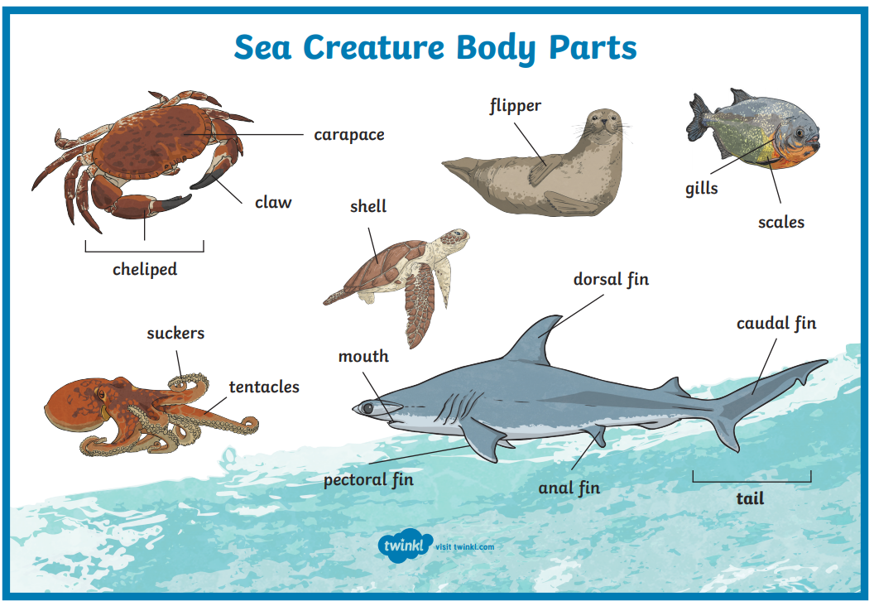
1
Notes:
Task 1: Look at the sea creature body parts, are there body parts you knew already? Are some new to you? Which ones? Use the pictures, internet and/or dictionary to find out more about it. Write down the parts and their functions e.g. tail –at the back end of an animal used to control balance

Slide 4
2
Notes:
Task 2: Look at the sea creature body parts. Use them (and pictures of other sea creatures you like) to draw AND label a new sea creature! Don’t forget to name it!

Slide 5
Steps to Success:
Title/heading (name of animal included e.g. ‘All about the ….’)
Subheadings and paragraphs (appearance, diet, habitat, interesting facts etc.) at least 3 paragraphs
ABC . , ! ?
Full sentences
Scientific language
Adjectives
Comparison and contrast to other sea creatures.
3
Write a sea creature description based on your creation from the previous activity.
Notes:
Task 3: Write a sea creature description based on your creation. Remember: capital letters, punctuation (. , ! ? at least), adjectives, scientific language e.g. shell/fins etc. Tip: children may need to conduct further research about other animals to support their work.

Slide 6
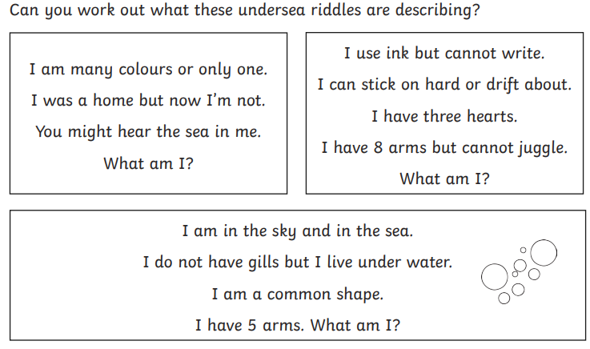
Under the Sea Riddles!
4
Notes:
Task 4: Solve the riddles!
Task 5: Make up 3 of your own riddles!

Slide 7
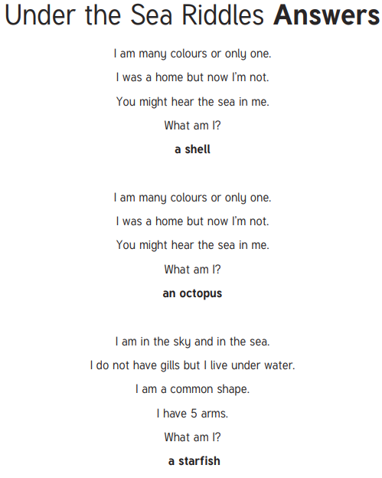
4

Slide 8
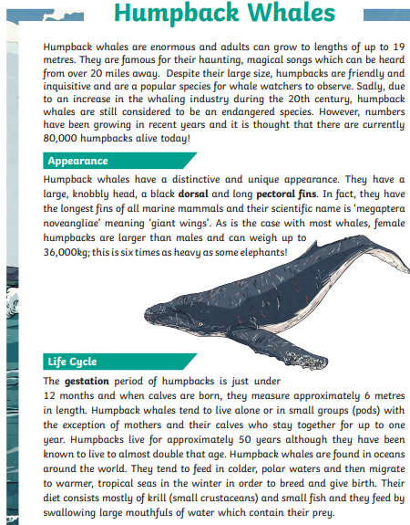
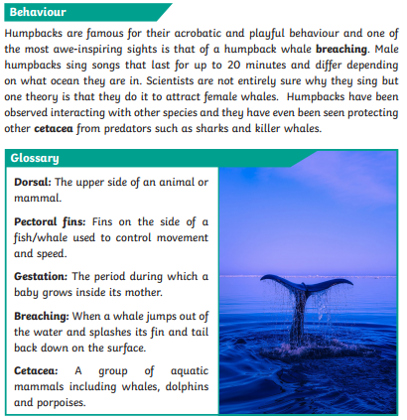
5
Notes:
Task 5: Zoom in to read the information on humpback whales before answering the comprehension questions on the next slide. Children are encouraged to refer back to the locate and extract key information.

Slide 9
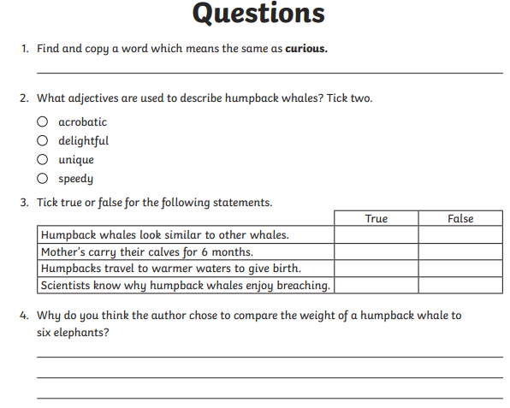
5
Notes:
Answer the questions.

Slide 10
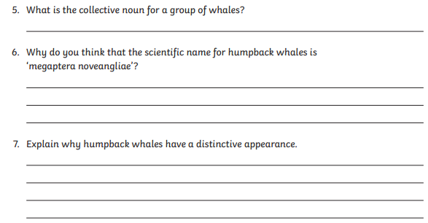

5
Notes:
Answer the questions.

Slide 11
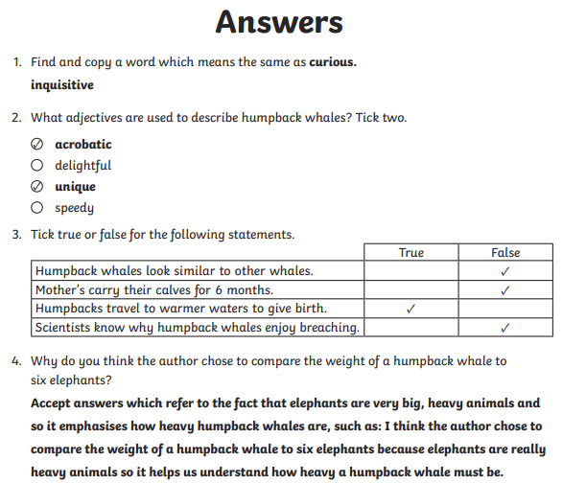
5
Notes:
Check the answers.

Slide 12
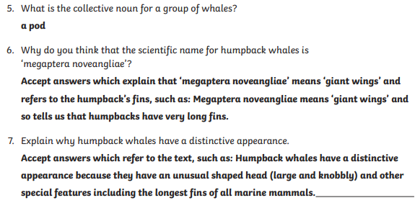

5
Notes:
Check the answers.

