Slide 1
Practical Science Re-cap 1
Summer 1
Week 1 - 2

Slide 2
About this power-point:
This power-point contains a practical exercise that children can do at home with an adult. This exercise is related to a topic that children in Year 6 need to know about, before they move on, into Year 7. Key vocabulary is stated at the beginning of each session.
The exercise will help Year 6 children to re-cap their existing knowledge and further their understanding of scientific principles, that they are expected to know.
After completing each session, there are further challenges (that children can choose from, just as they would do in school), however they can do more than one challenge if they wish!

Slide 3
Contents for entire Summer 1:
Practical 1: Sedimentary Rocks – Chocolate Rocks
Practical 2: Materials – Egg White and Yoke
Practical 3: Materials 2 – Magic Potions 1
Practical 4: Solids and Liquids – Picking Up An Ice Cube
Practical 5: Animals including humans 1 - Heart
Practical 6: Animals including humans 2 - Blood

Slide 4
Practical 1
Sedimentary Rocks
Looking at the creation of sedimentary rocks over time.
Vocabulary:
sedimentary
pressure

Slide 5
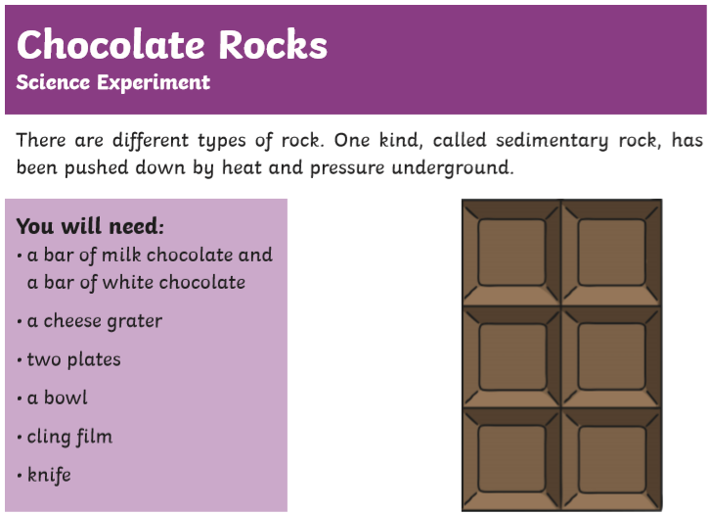

Slide 6

Note: Please bear the following in mind as you are executing the practical.

Slide 7
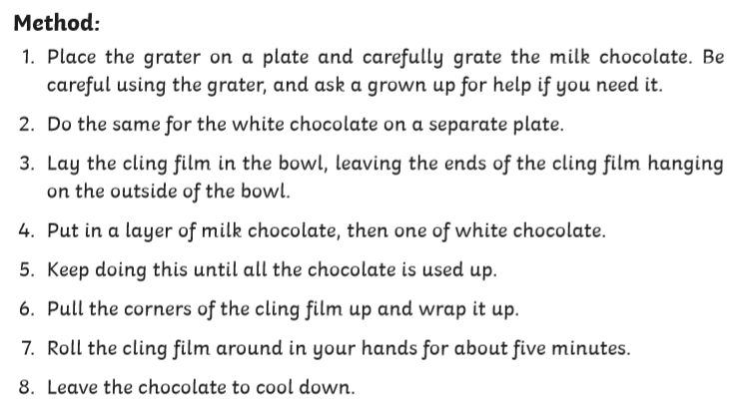

Slide 8
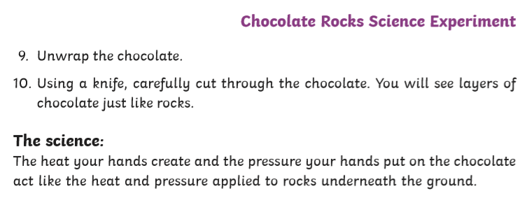

Slide 9
Choose your challenge:
Mild
Record your results.
(This can be done by using a series of labelled drawings and captions, explaining what is happening in each of the drawings).
Spicy
Create a comic strip to show how sedimentary rocks are actually formed.
What ‘processes’ are involved?
What other rock types could you write about?
Hot
Research the formation of Metamorphic Rocks.
Write a short report on how Metamorphic Rocks are formed.
How could you make this interesting for the reader?
e.g. adding pictures with labels, ‘Did you know’ fact box

Slide 10
Practical 2
Materials
Looking at materials. This practical experiment demonstrates how to separate two liquids that have a different viscosity to each other, using a force.
Vocabulary:
capacity liquids
viscous pressure
viscosity force

Slide 11
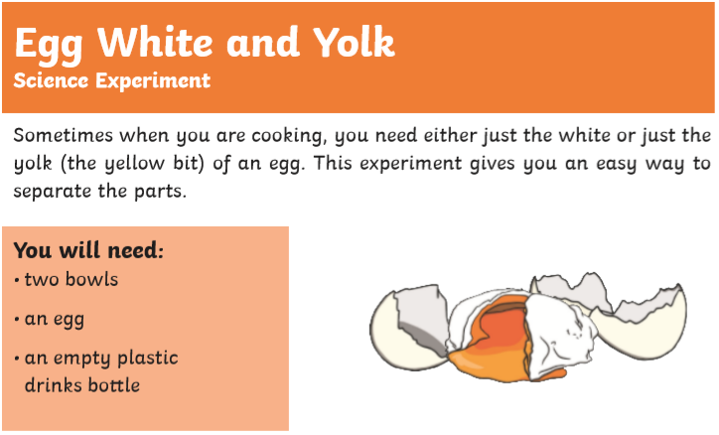

Slide 12

Note: Please bear the following in mind as you are executing the practical.

Slide 13
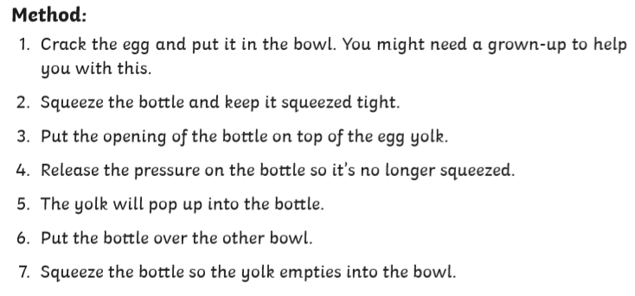

Slide 14
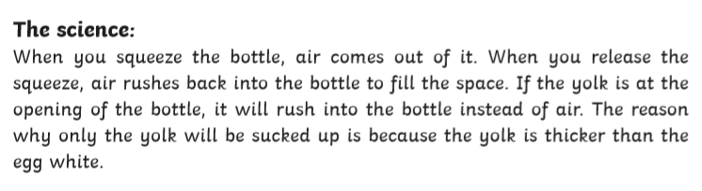

Slide 15
Choose your challenge:
Mild
How could you record your result?
What conclusion could you write? (You can us the last slide to help you).
Spicy
Have a go at separating two other liquids; e.g. oil and water.
How could you do this?
Write a clear method for this experiment.
What could you write your conclusion?
Hot
Have a go at separating two other liquids; e.g. oil and water.
How could you do this?
Write a clear method for this experiment.
What could you write your conclusion?
How could you ensure you created a fair test?

