Slide 1
Practical Science Re-cap 1
Summer 1
Week 3

Slide 2
About this power-point:
This power-point contains a practical exercise that children can do at home with an adult. This exercise is related to a topic that children in Year 6 need to know about, before they move on, into Year 7. Key vocabulary is stated at the beginning of each session.
The exercise will help Year 6 children to re-cap their existing knowledge and further their understanding of scientific principles, that they are expected to know.
After completing each session, there are further challenges (that children can choose from, just as they would do in school), however they can do more than one challenge if they wish!

Slide 3
Contents for entire Summer 1:
Practical 1: Sedimentary Rocks – Chocolate Rocks
Practical 2: Materials – Egg White and Yoke
Practical 3: Materials 2 – Magic Potions 1
Practical 4: Solids and Liquids – Picking Up An Ice Cube
Practical 5: Animals including humans 1 - Heart
Practical 6: Animals including humans 2 - Blood

Slide 4
Practical 3
Materials 2
Looking at how the quantity of a material can affect a liquid.
Vocabulary: acid
base
gas
carbon dioxide
effervescence (fizz)

Slide 5
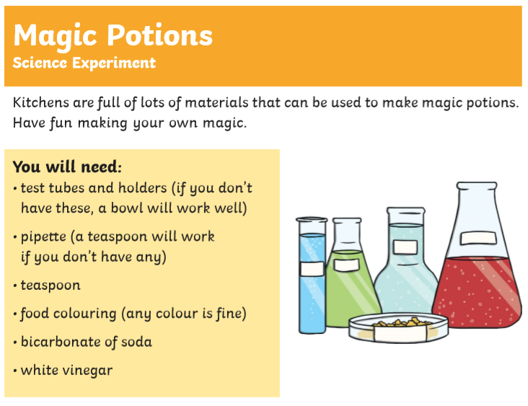

Slide 6
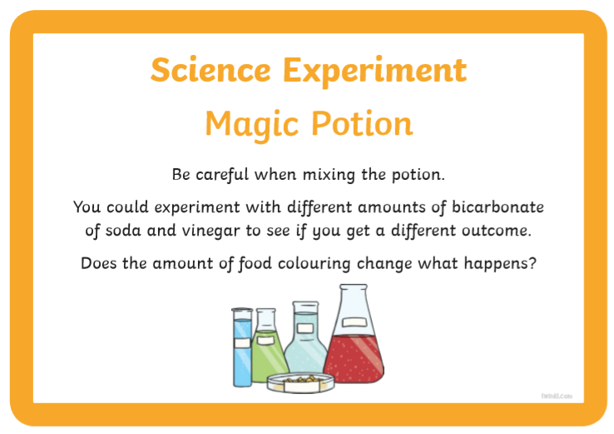
Note: Please bear the following in mind as you are executing the practical.

Slide 7
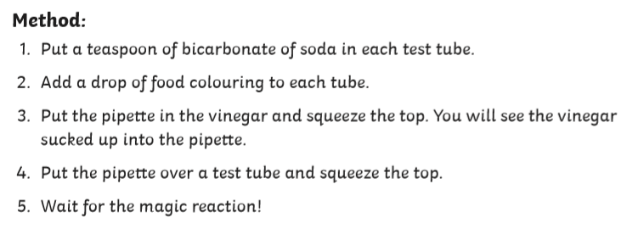

Slide 8
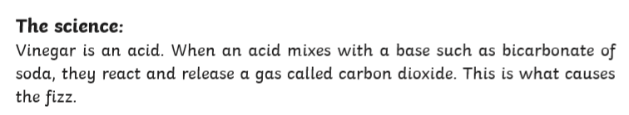

Slide 9
Choose your challenge:
Mild
Time each of the reactions.
How could you record your results using a line graph?
What conclusion could you write?
Spicy
Time each of the reactions.
How could you record your results using a line graph? What other data method could you use to record your results? Why?
What conclusion could you write?
How could you vary your experiment? What would you change? (e.g. the amount of drops of vinegar used) Explain.
Write a prediction for what could happen in each of your new variable experiments.
Hot
Time each of the reactions.
How could you record your results using a line graph? What other data method could you use to record your results? Why?
What conclusion could you write?
Vinegar is an acid. What could you use instead of vinegar and have the same reaction? Explain.
Write a prediction for what could happen in each of your new variable experiments (where you have replaced the use of vinegar).

