Slide 1

Home Learning: RE
Summer I: Week 2
Monday 27th April – Friday 1st May 2020

Slide 2

LO: To be able to show how yours and others decisions about friendship are informed by beliefs and values

Slide 3
Unity
LO: To be able to show how yours and others decisions about friendship are informed by beliefs and values.
Big question – What nourishes and what spoils friendship?
Lord Jesus Christ,
In you we know the love of God.
When we gather together in your name
We experience the marvels of your loving presence which challenge us to live for one another.
Help us to follow your example,
So that we may never become complacent.
Help us listen to your constant all to us, to continue the work you begun, you who lived and died for us.
Grant this through your Spirit of Love.
Amen

Slide 4

Lord Jesus Christ
In you we know the love of God.
When we gather together in your name
we experience the marvels of your loving presence
which challenge us to live for one another.
Help us to follow your example
so that we may never become complacent.
Help us listen to your constant call to us
to continue the work you began,
YOU who lived and died for us.
Grant this through your Spirit of Love.
Amen

Slide 5

What Makes/Breaks A Friendship
Lo: To be able to show how yours and others decisions about friendship are informed by beliefs and values
Copy and complete the two mind-maps into
Write down what you think makes a friendship and what breaks a friendship.
What makes a friendship
What breaks a friendship

Slide 6
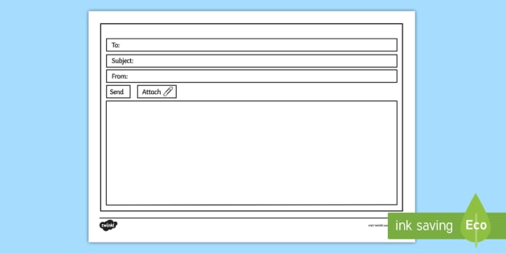
Jesus’ Prayer for Unity
Writing as a disciple, send an email to a friend, explaining what Jesus had taught about being one in heart and mind
And
The difference it has made in your life.

Slide 7
Peter
Unity for all
James
Dear Peter,
I heard Jesus talk again today, he was talking about the need to be one. Not only one with him, but with all people. I was truly amazed at his words and they made such sense, of course we are all better off when we are one, when we have one common purpose, to spread the word of God. He said that all his people should unite and be one, just as the body is made up of many parts, but it is one altogether. Jesus offered prayers that we may be one, so that the world will truly believe that God sent him down to be among us. He spoke about the glory of the Kingdom, when all are united. I have come away from the encounter renewed in my faith and my mission, I know that I am to spread God’s love among the people and make them all one in his name. Peter if you get the chance you must yourself, hear the wonderful news.
In God’s name
James

