Slide 1

PowerPoint 3 – cross curricular

Slide 2
Guide for parents/carers,
Read the ‘notes’ section at the bottom of the slides for specific instructions before beginning the lesson.
Read the slide and set the tasks or challenges for the child/ren. There is no rush and you do not have to do everything, but be aware that the lessons follow and build on from one another, so try not to skip lessons but rather work in order and stop when you feel is best for your child. When next PowerPoints appear, don’t feel pressured to skip ahead if you have not finished everything yet, it’s better to work through each slide and complete a PowerPoint before moving on to the next one in order to better enrich the child’s learning ☺
Some slides will have one task, others more. You can break these down however you like e.g. All the tasks on one slide can be spread across a few days or done in one day, but please do not do more than one whole slide a day! The slides are numbered to help you differentiate between the different types of tasks.
Ms Foster

Slide 3
1

Slide 4
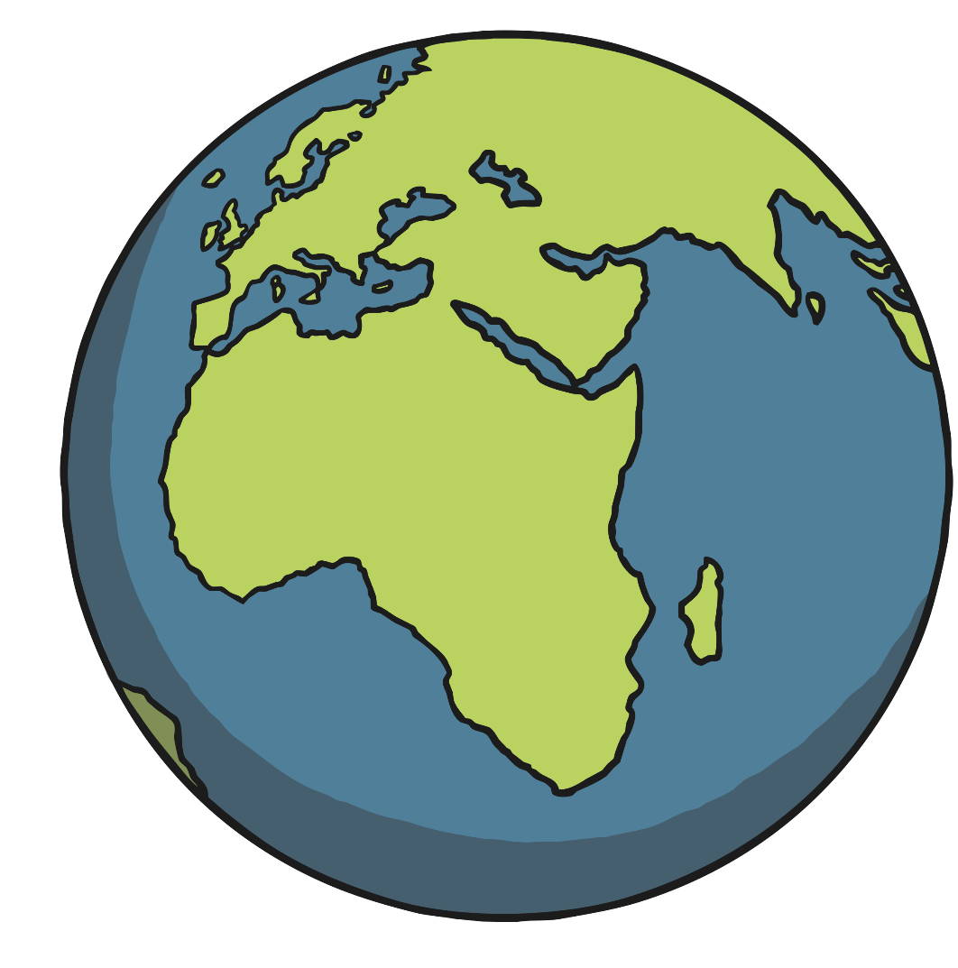
What Is an Ocean?
1
An ocean is a very large area of salt water. Most of the Earth is covered
in ocean.
There are five oceans in the world:
Pacific Ocean
Atlantic Ocean
Indian Ocean
Southern Ocean
Arctic Ocean
Notes:
Read and discuss.

Slide 5
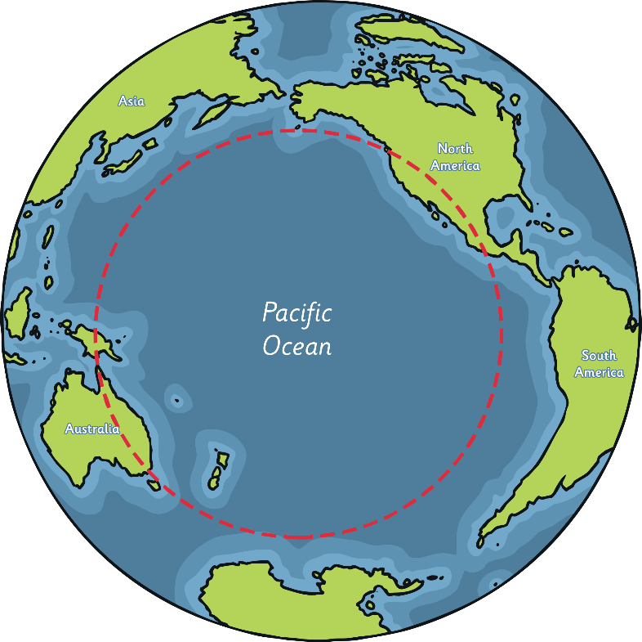
Pacific Ocean
1
The Pacific Ocean is the biggest ocean in
the world.
It reaches from North and South
America to Asia and Australia.
The Pacific Ocean is surrounded by a
line of volcanoes known as the Ring of Fire.
It is also home to the Great Barrier Reef,
which is the largest coral reef in the world.
Challenger Deep, the deepest point on Earth, is in the Pacific Ocean.
Did You Know…?
The word ‘Pacific’ means peaceful.
Notes:
Read and discuss.

Slide 6
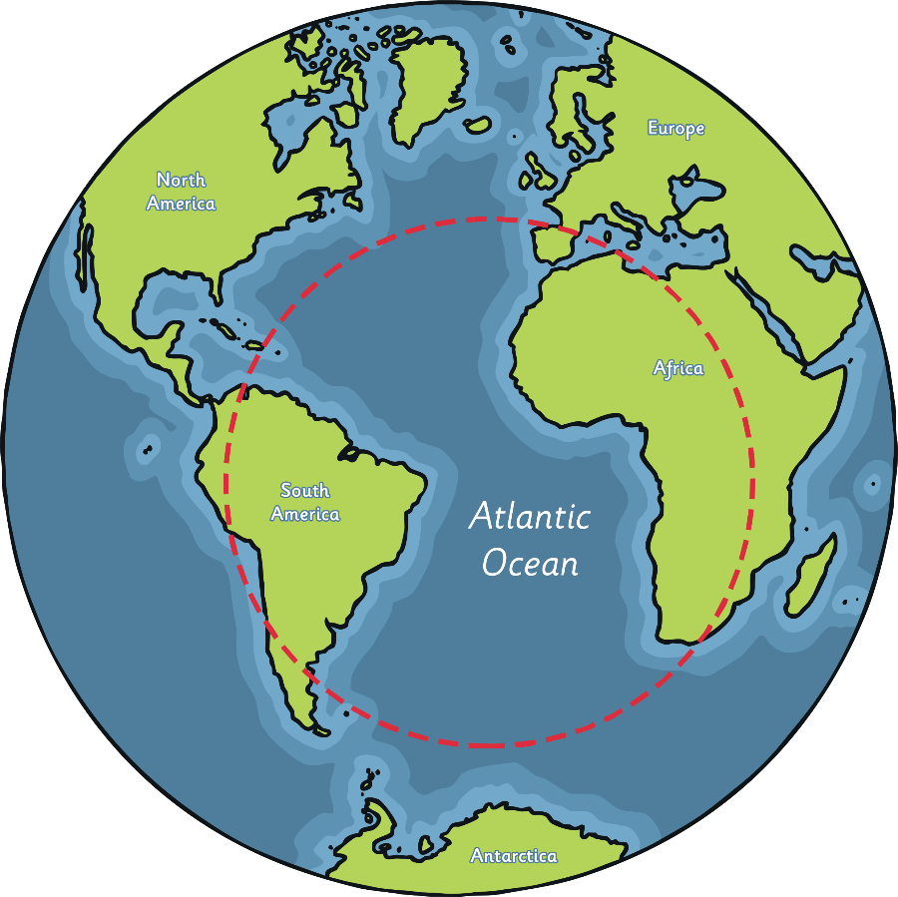
Atlantic Ocean
1
The Atlantic Ocean is the second biggest
ocean in the world.
It reaches from North and South
America to Europe and Africa.
The Atlantic Ocean is huge, but only
half the size of the Pacific Ocean.
The Mid-Atlantic Ridge, the longest
mountain range in the world, is
underwater in the Atlantic Ocean.
Did You Know…?
The first person to sail across the Atlantic Ocean from Europe to America was Leif Eriksson, a Viking, in the year 1000.
Notes:
Read and discuss.

Slide 7
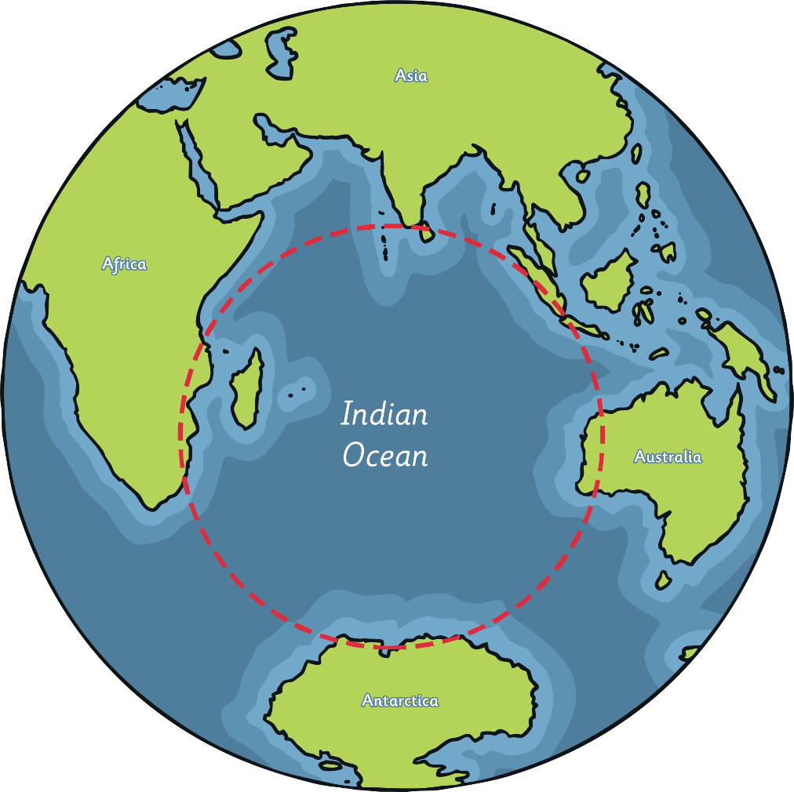
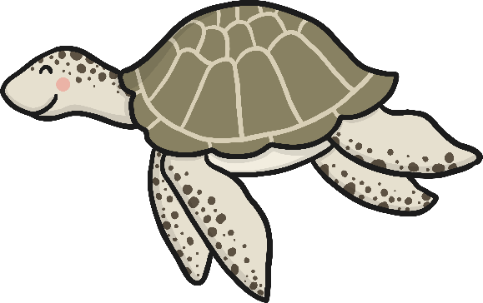

Indian Ocean
1
The Indian Ocean is the third biggest ocean in the world.
It is named after the country of India.
The Indian Ocean is home to many
endangered sea creatures, including
turtles, seals and dugongs (also
known as sea cows).
Notes:
Read and discuss.

Slide 8
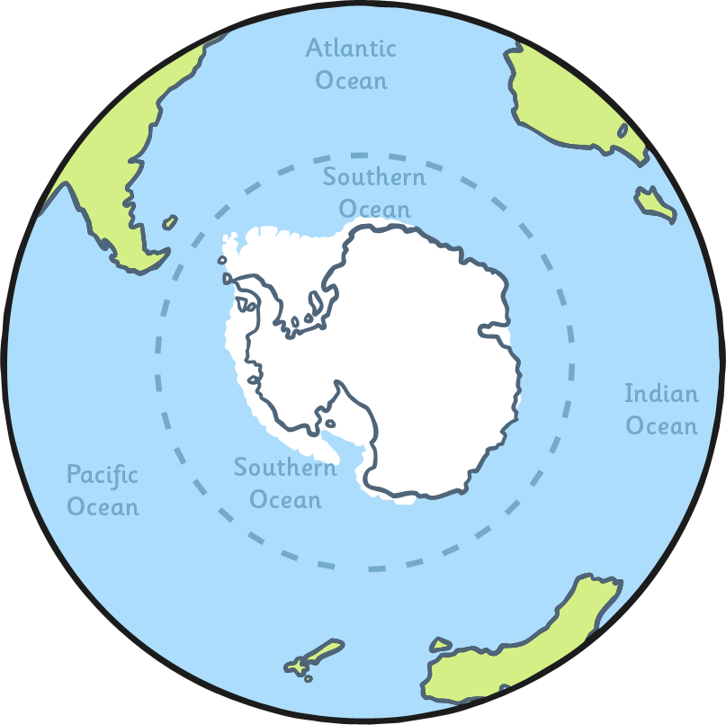
Southern Ocean
1
The Southern Ocean is the second smallest ocean in the world.
It is also known as the Antarctic
Ocean as it surrounds Antarctica.
It is the coldest and wildest
ocean in the world.
The Southern Ocean is home to
emperor penguins, blue whales,
elephant seals, giant squid and
the wandering albatross.
Notes:
Read and discuss.

Slide 9
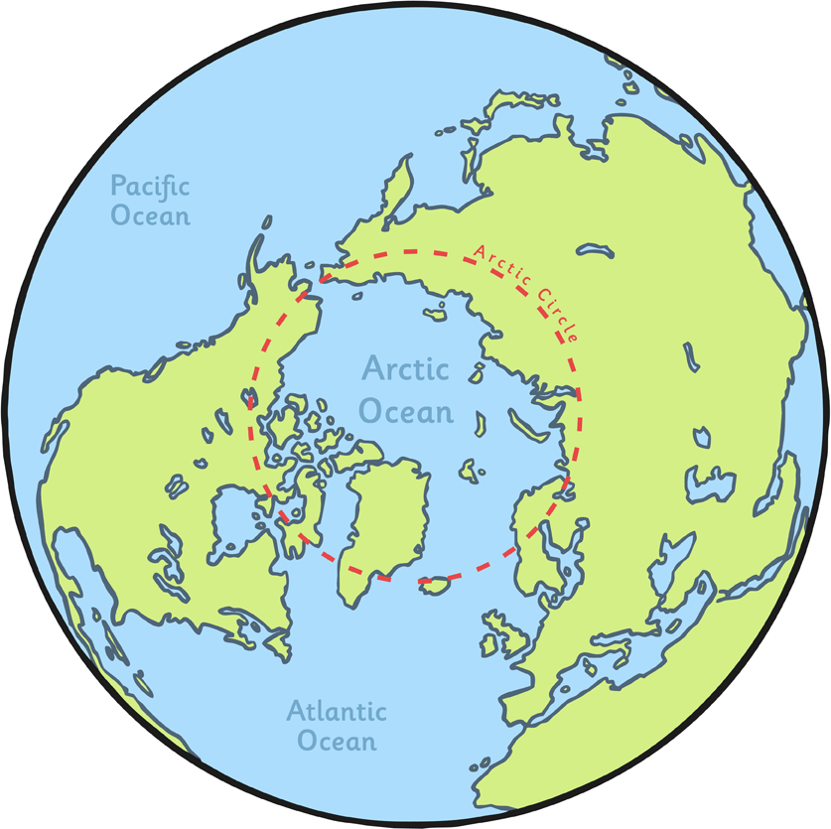
Arctic Ocean
1
The Arctic Ocean is the smallest ocean in
the world.
It surrounds the Arctic.
Often, the Arctic Ocean is completely
covered in ice.
Polar bears live on the ice that covers
the ocean and can swim in the water.
Did You Know…?
Because of climate change, the amount of ice covering the Arctic is getting smaller every year.
Notes:
Read and discuss.

Slide 10
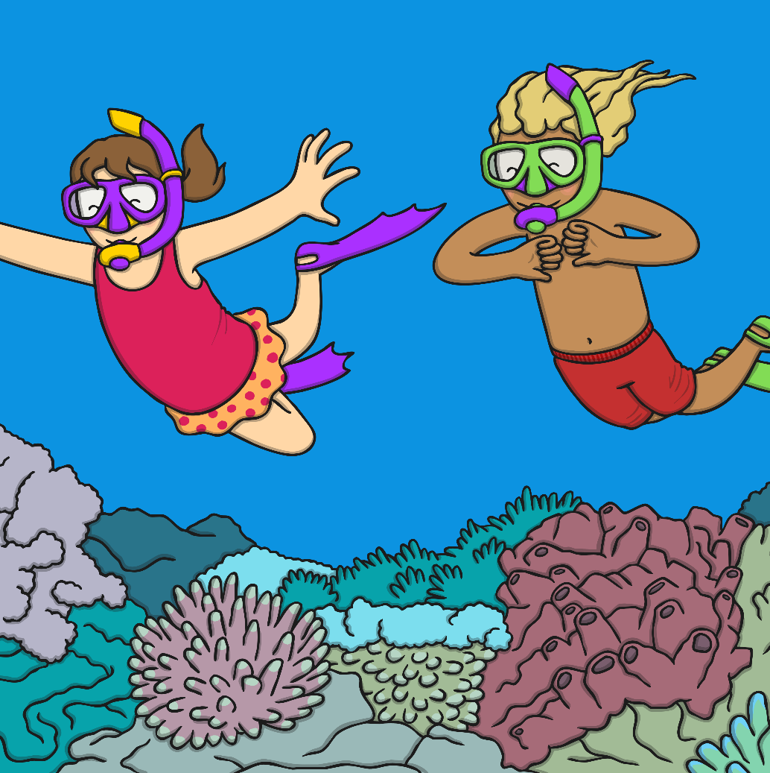
Why Are Oceans so Important?
1
Oceans make up over 70% of the Earth’s surface.
There are over 700,000 different species
of animal that live in the ocean. It is
important to protect the oceans to
make sure their habitats are safe.
The ocean is also full of tiny
plants which help to produce
oxygen, which we need
to breathe.
On top of this, oceans also provide
food for many creatures, including
humans!
Notes:
Read and discuss.

Slide 11
What did you learn?
1
Write down 5 facts you have learnt today.
Remember: full sentences, capital letters, full stops, commas, accurate spelling (you can check back on the pages you need).

Slide 12
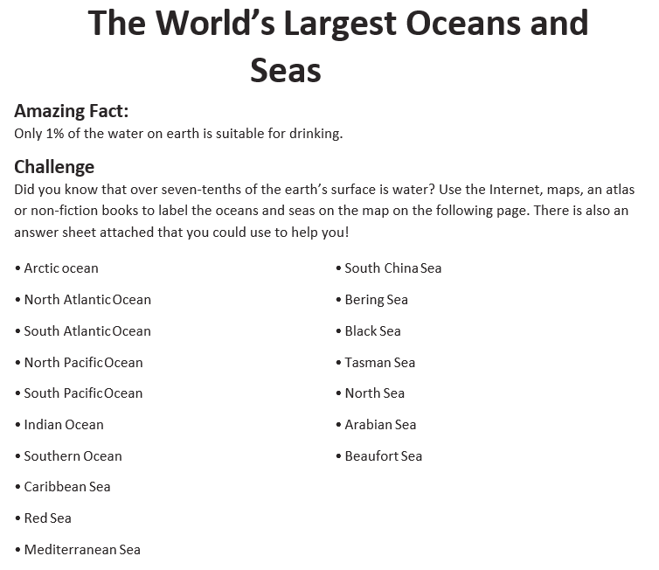
2
Notes:
You can download this as a file and print it: The World’s Largest Oceans and Seas Activity (Task 2)

Slide 13
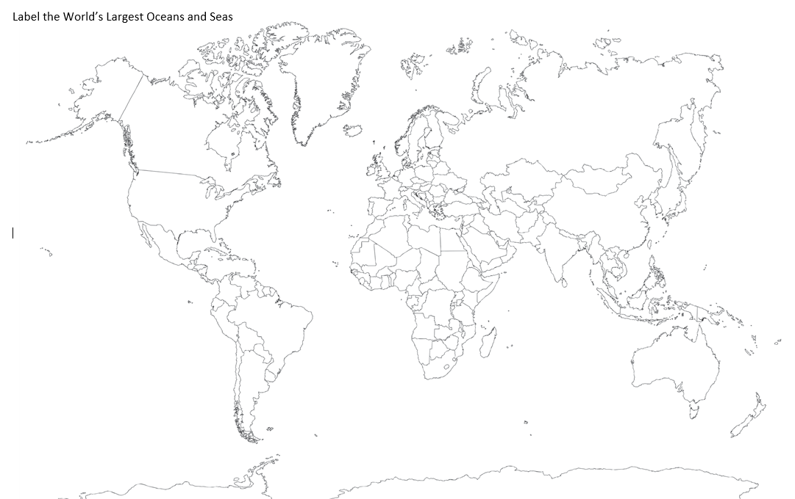
2
Notes:
You can download this as a file and print it: The World’s Largest Oceans and Seas Activity (Task 2)

Slide 14
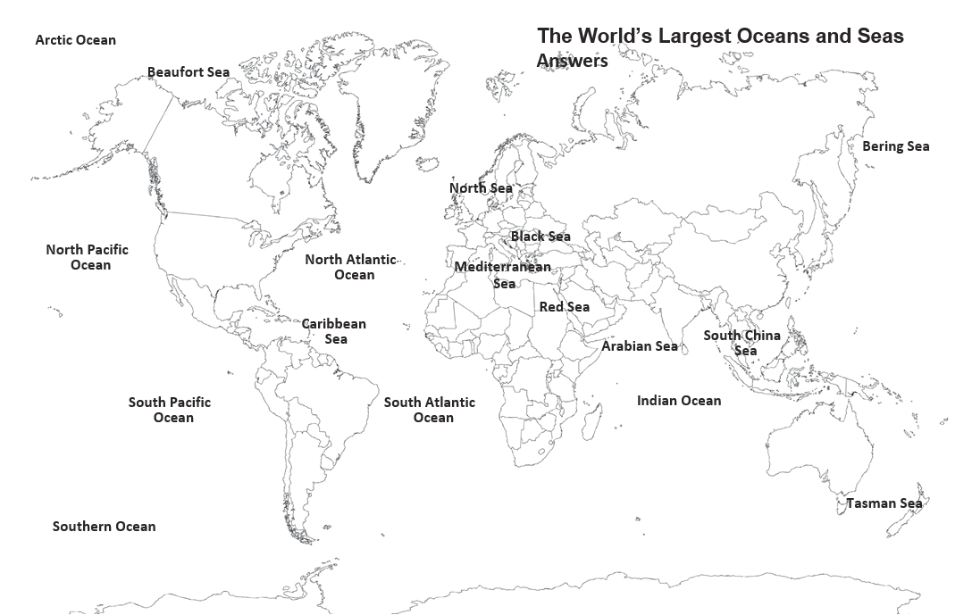
2
Notes:
You can download this as a file and print it: The World’s Largest Oceans and Seas Activity (Task 2)

Slide 15
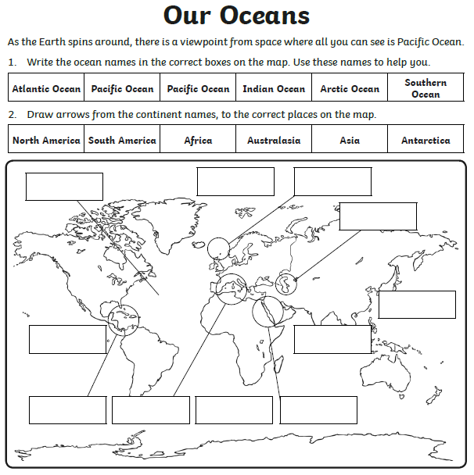
3
Notes:
You can download this as a file and print it: Our Oceans Activity (Task 3)

Slide 16
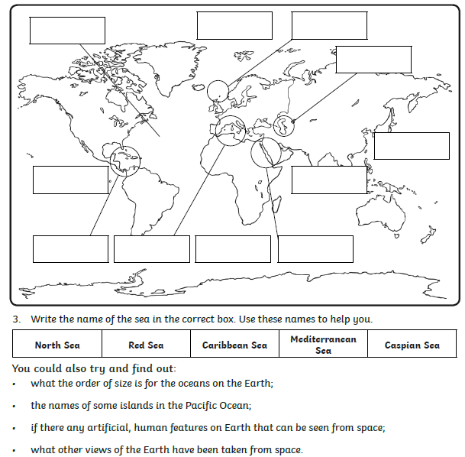
3
Notes:
You can download this as a file and print it: Our Oceans Activity (Task 3)

Slide 17
Classifying sea life
4
To ‘classify’ is to group things based on their shared features. Animals that classify as mammals must: breathe air, give birth to live young and be warm blooded. Animals classified as birds must: have wings, hollow bones, a beak, claws. Plants classified as flowers must: have petals, a stem, leaves.
You will learn about four examples of sea life then use the internet (with an adult) to research what they are classed as e.g. shark = fish, sea lion = mammal, clam – mollusc.
You could then challenge yourself to think of and find out other animals that are the same class:
E.g.
Fish are classified as sea creatures which have: fins, gills, can breathe underwater, can swim. Fish = shark, clownfish, salmon.
Sea mammals are classified as sea creatures which have: fins, a tail, need to breathe air, give birth to live young. Sea mammals: sea lion, dolphin, whales.

Slide 18
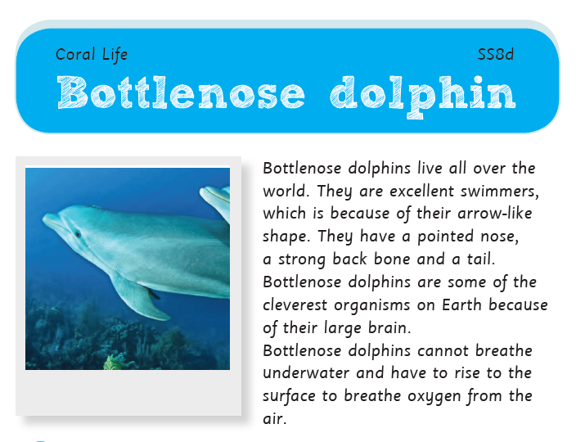
4

Slide 19
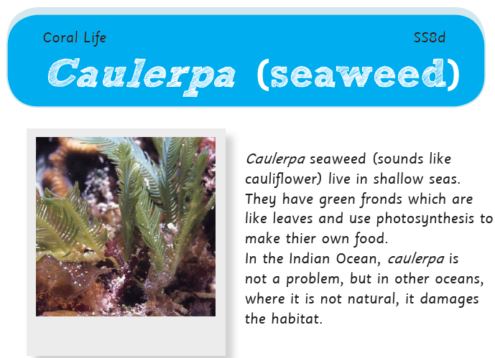
4

Slide 20
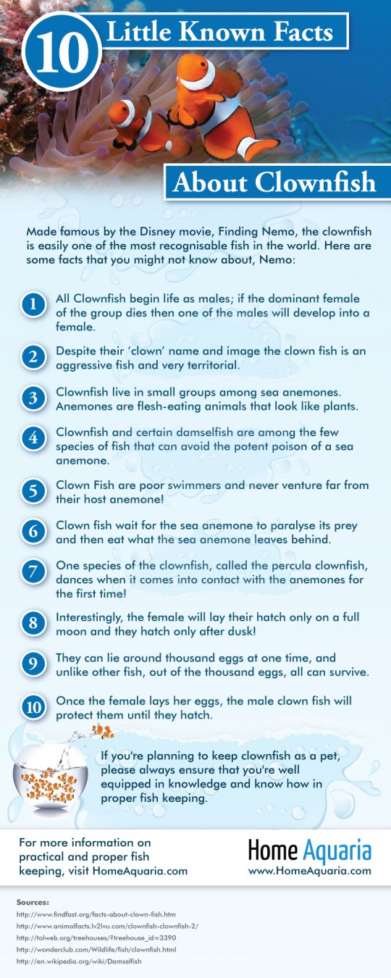
4

Slide 21
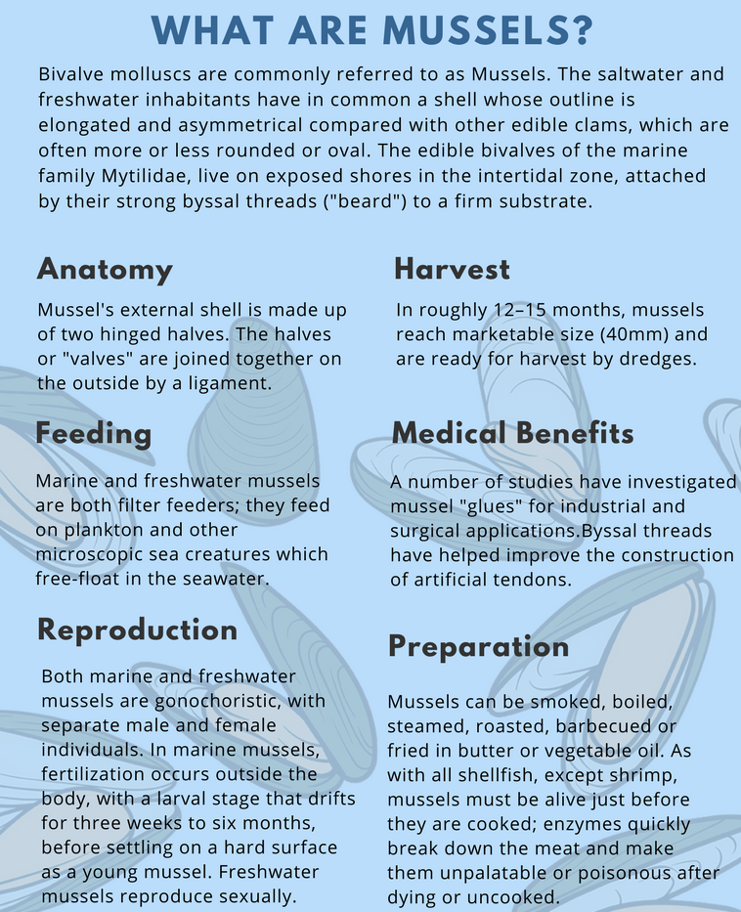
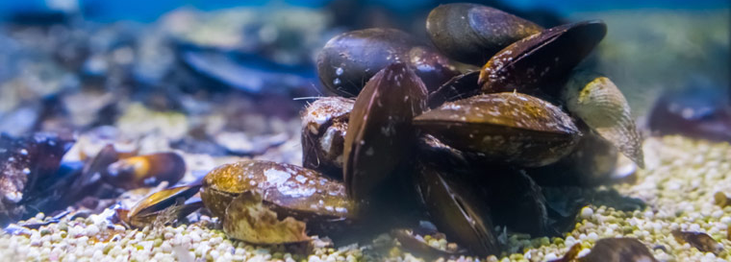
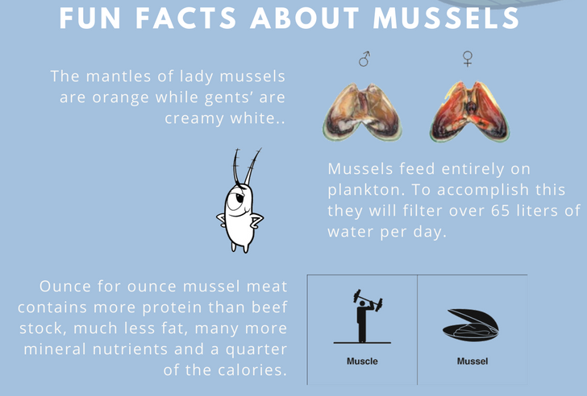

4

Slide 22
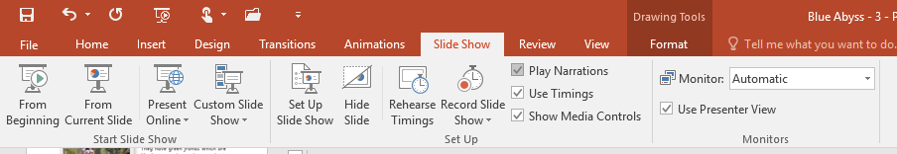

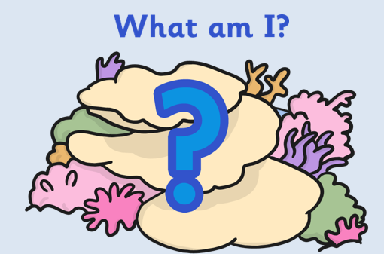

What am I? Interactive Game Instructions
5
You will need to play the PowerPoint as a slideshow.
Click the seaweed at the left hand side to reveal the clues.
Click the shell to reveal the answer.
Click the arrow to go to the next question.

Slide 23




5

Slide 24





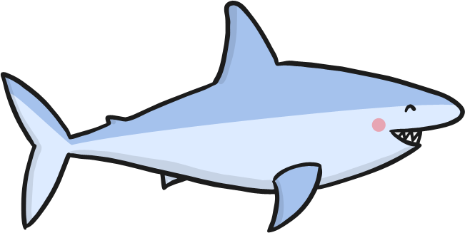

5
I have very sharp teeth.
I have an amazing sense of smell.
I am a predator of the sea.

Slide 25
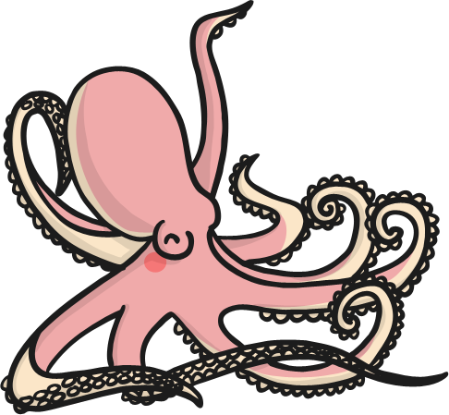

5
I am mildly poisonous.
I have a great, big head.
I have rows of suckers on my many legs.

Slide 26
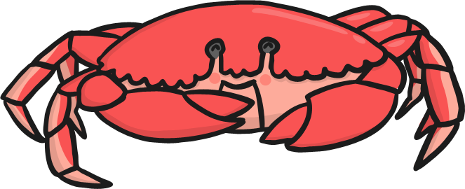

5
I have 10 legs.
I am a crustacean.
I have sharp pincers.

Slide 27
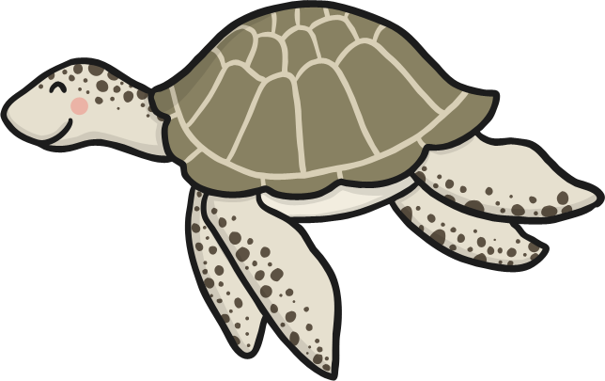

5
I have 4 flippers.
I have cousins that live on land.
I have a shell that protects me.

Slide 28
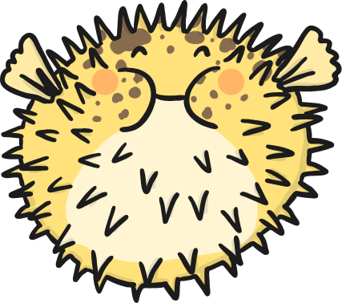

5
I look harmless but I am very poisonous .
In Japan, people like to eat me.
I can blow myself up to be twice as big when I am in danger.

Slide 29


5
I am a mammal.
I have a blowhole.
I can grow to be very big .

Slide 30

5
Unusually, the males of my species become pregnant.
I am an endangered animal.
Despite my name, I am actually a fish.

Slide 31
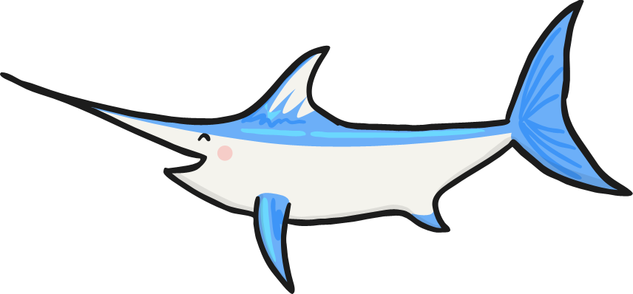

5
I have a very long and sharp nose.
I am one of the fastest swimmers in the ocean.
I am most active at night.

Slide 32


5
I can be smaller than a pinhead or bigger than a human.
I have no brain.
I can sometimes change colours.

Slide 33
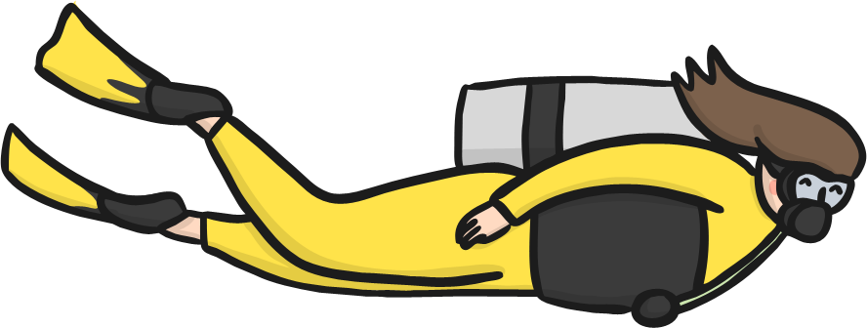

5
I am a mammal.
I use special equipment to breathe under water.
I spend most of my time on land.

Slide 34


5

