Slide 1
Year 4
PENTECOST – SERVING
Please see notes sections below for guidance.

Slide 2
EXPLORE
Each of us, by the way we live our lives, the way we treat others, and by our words and actions, show if we have an attitude of service.
Often, we are especially influenced by those whose actions speak powerfully of a life of service.
Think of someone who impresses you deeply because of the way she/he lives.
What is it that impresses you?
What do you think inspires them?
Notes:
Discuss.

Slide 3
REVEAL
Christians believe that the Spirit of God is active in each person and, in a special way, in the community of believers, which is the Church. It is the work of the Spirit to enable people to hear God’s message and to live Jesus’ way of service.
Notes:
Discuss: What do you think this means?

Slide 4
Word of God
“The Spirit of the Lord is upon me, because he has anointed me to bring Good News to the poor. He has sent me to proclaim release to the captives and recovery of sight to the blind, to let the oppressed go free, to proclaim the year of the Lord’s favour.”
Luke 4: 18-19
Notes:
Discuss: What do you think this means?

Slide 5
Prayer and Reflection
Father, pour out your Spirit
upon your people,
and grant us
a new vision of your glory,
a new faithfulness to your Word
and a new consecration to your service,
that your love may grow among us,
and your kingdom come:
through Christ our Lord.
Amen.
(Prayer of preparation for Vatican II)
Notes:
Pray together – allow child to lead the prayer by starting and ending with the sign of the cross.

Slide 6
KEY WORDS
Pentecost, Holy Spirit, Resurrection, fellowship
Notes:
Do you know what these words mean? Let’s look them up. Write the definition.

Slide 7
Pentecost is a Greek word meaning fiftieth. The Jewish ‘Feast of Weeks’ was a thanksgiving feast 50 days after Passover.
Notes:
Read and understand.

Slide 8
At this feast the Jewish people celebrate Shavuot, the Festival of Weeks. It celebrates the giving of the Torah, that is the first five books of the Bible, at Mount Sinai. In Jesus’ day it would have been a time when there were a lot of people in Jerusalem. This was the time of year when the Holy Spirit came upon the apostles and Mary. This is described in Chapter 2 of the Acts of the Apostles.
Notes:
Read and understand.

Slide 9
The Coming of the Holy Spirit
When the day of Pentecost came, all the believers were gathered together in one place. Suddenly there was a noise from the sky which sounded like a strong wind blowing, and it filled the whole house where they were sitting. Then they saw what looked like tongues of fire which spread out and touched each person there. They were all filled with the Holy Spirit and began to talk in other languages, as the Spirit enabled them to speak.
There were Jews living in Jerusalem, religious people who had come from every country in the world. When they heard this noise, a large crowd gathered. They were all excited, because all of them heard the believers talking in their own languages. In amazement and wonder they exclaimed, “These people who are talking like this are Galileans! How is it, then, that all of us hear them speaking in our own native languages? We are from Parthia, Media, and Elam; from Mesopotamia, Judea, and Cappadocia; from Pontus and Asia; from Phrygia and Pamphylia, from Egypt and the regions of Libya near Cyrene. Some of us are from Rome, both Jews and Gentiles converted to Judaism, and some of us are from Crete and Arabia—yet all of us hear them speaking in our own languages about the great things that God has done!”
Notes:
Read and understand.
You can also watch this animation: https://www.youtube.com/watch?v=IqG_lvZhU-A

Slide 10
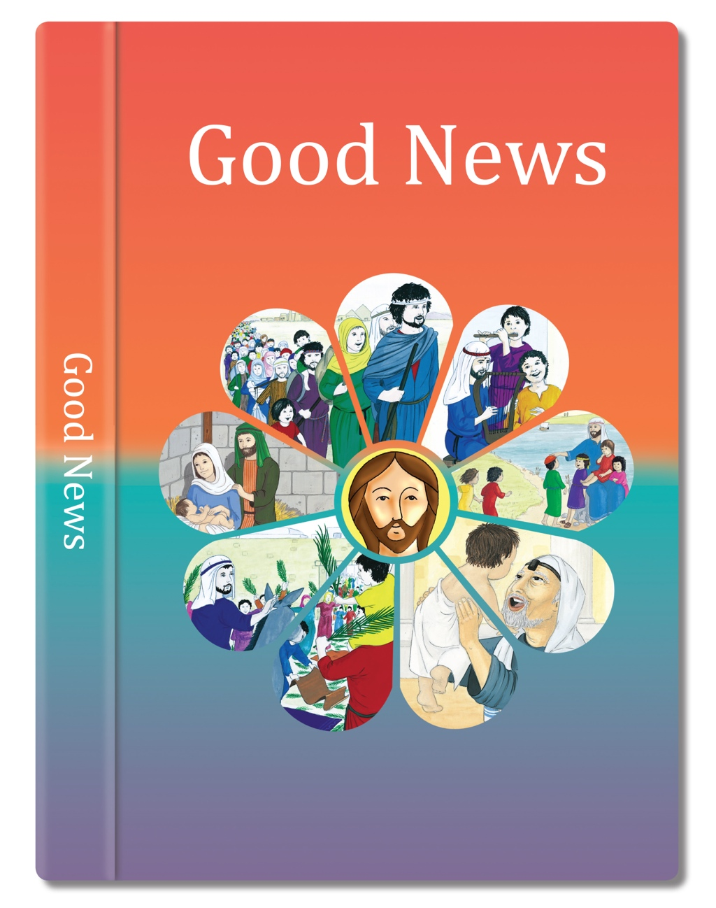

Slide 11

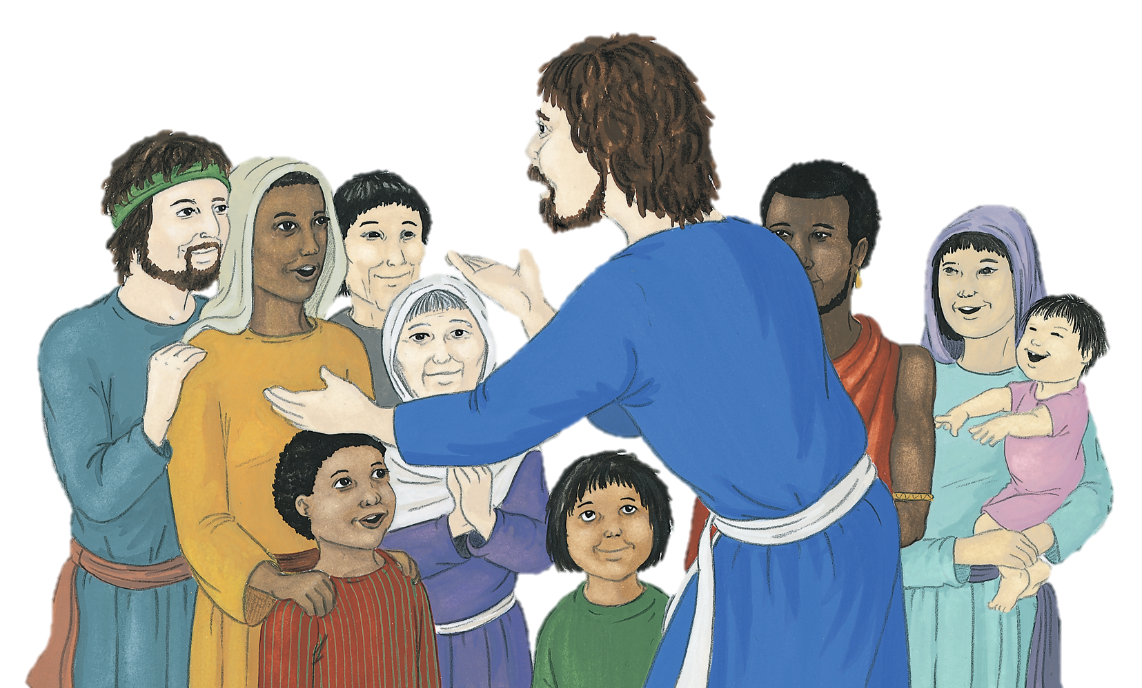
Then Peter stood up with the other apostles and in a loud voice began to speak to the crowd:
Jesus of Nazareth was a man whose divine authority was clearly proven to you by all the miracles and wonders which God performed through him.
‘Fellow Jews and all of you who live in Jerusalem, listen to me and let me tell you what this means. this is what the prophet Joel spoke about:
You yourselves know this, for it happened here among you.
In accordance with his own plan, God had already decided that Jesus would be handed over to be crucified.
‘Yes, even on my servants, both men and women, I will pour out my spirit in those days, and they will proclaim my message.’
But God has raised this very Jesus from death, and we are all witnesses to this fact.
Listen to these words, fellow Israelites!
Notes:
Read and understand.

Slide 12
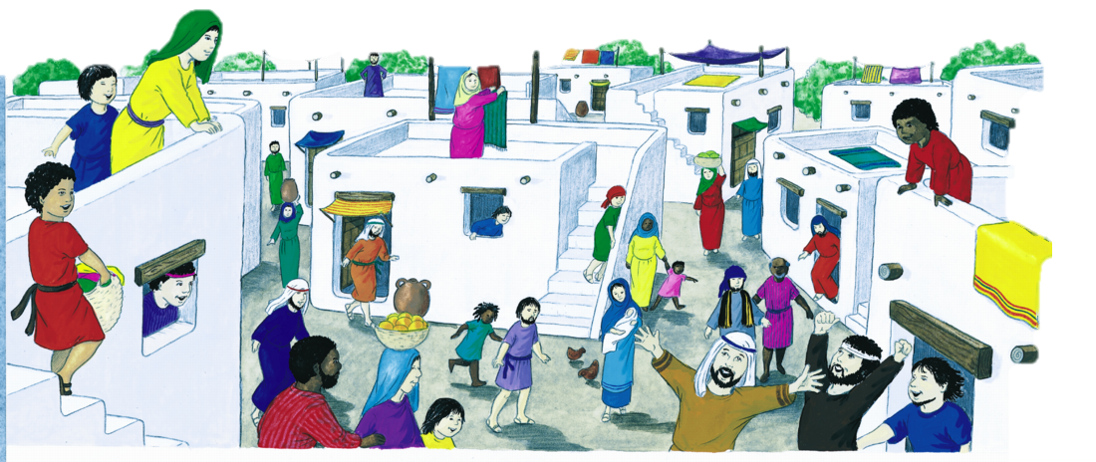
All the people of Israel, then, are to know for sure that this Jesus, whom you crucified, is the one that God has made lord and messiah!
For God’s promise was made to you and your children, and to all who are far away - all whom the Lord our God calls to himself’.
When the people heard this, they were deeply troubled and said to Peter and the other apostles, ‘What shall we do, brothers?’
Many of them believed his message and were baptised, and about three thousand people were added to the group that day.
Peter said to them, ‘Each one of you must turn away from your sins and be baptised in the name of Jesus Christ, so that your sins will be forgiven; and you will receive God’s gift, the holy spirit.
They spent their time in learning from the apostles, taking part in the fellowship, and sharing in the fellowship meals and the prayers.
Based on Acts 2
(Come and See)
Notes:
Read and understand.

Slide 13


Slide 14
The power of the Holy Spirit is for all Christians and all are called to share the Gospel message. The Good News of Jesus is for the whole world. The event is celebrated in Christian churches on the Feast of Pentecost.
Notes:
Read and understand.

Slide 15
SOME KEY QUESTIONS
What happened to the friends of Jesus?
How would this help people to spread the Good News?
What reaction did the people have who heard Peter speak?
What effect did it have on their lives?
How would you have felt on hearing Peter’s message?
How does the power of the Holy Spirit change people’s lives?
How could you be bearers of Good News in school or at home?
Notes:
Discuss and answer (written responses)

Slide 16
SOME SUGGESTED ACTIVITIES
Illustrate or record in your own way what this scripture passage tells us about the power of the Holy Spirit in the lives of the apostles at Pentecost. Describe the difference it made to their lives.
Use a religious painting that depicts Pentecost and describe what is happening in the painting. Focus on the people, symbols and colour etc. How does this link to the scripture studied in the topic so far?
Write an article entitled ‘Power of the Spirit’ describing the difference that the power of the Holy Spirit at Pentecost made to the apostles.
Notes:
You can pick the activity you like the idea of best.

