Slide 1
Practical Science Re-cap 1
Summer 1
Week 4

Slide 2
About this power-point:
This power-point contains a practical exercise that children can do at home with an adult. This exercise is related to a topic that children in Year 6 need to know about, before they move on, into Year 7. Key vocabulary is stated at the beginning of each session.
The exercise will help Year 6 children to re-cap their existing knowledge and further their understanding of scientific principles, that they are expected to know.
After completing each session, there are further challenges (that children can choose from, just as they would do in school), however they can do more than one challenge if they wish!

Slide 3
Contents for entire Summer 1:
Practical 1: Sedimentary Rocks – Chocolate Rocks
Practical 2: Materials – Egg White and Yoke
Practical 3: Materials 2 – Magic Potions 1
Practical 4: Solids and Liquids – Picking Up An Ice Cube
Practical 5: Animals including humans 1 - Heart
Practical 6: Animals including humans 2 - Blood

Slide 4
Practical 4
Solids and Liquids
Looking at changing states.
Vocabulary:
temperature
melting point
molecules

Slide 5
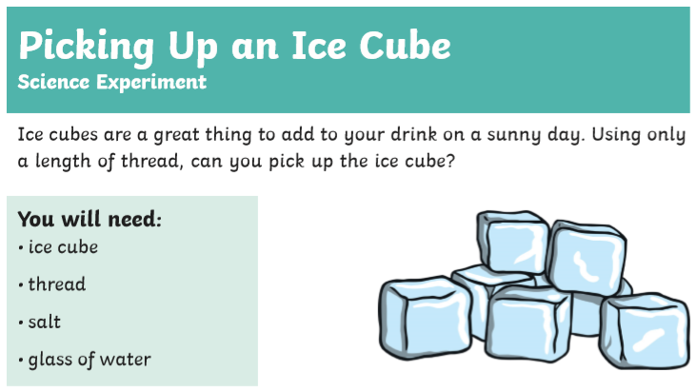

Slide 6
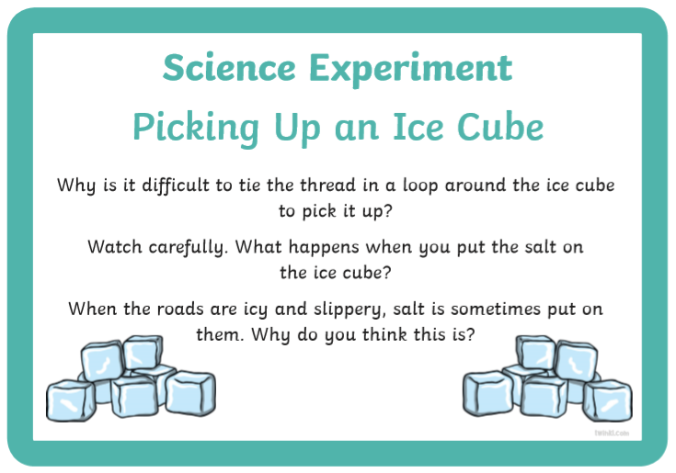

Slide 7
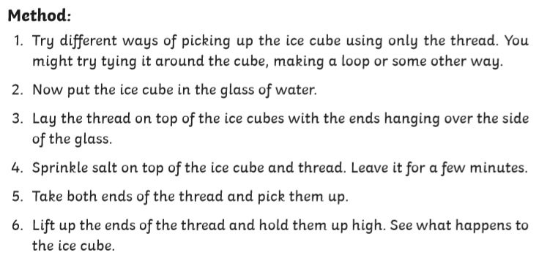

Slide 8
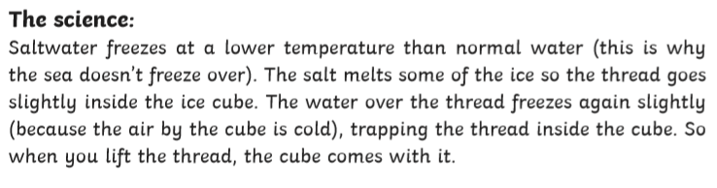

Slide 9
What Are The Effects of Salt on Ice Cubes?
•••
Putting salt on ice cubes makes them colder. This may seem strange, but ice-cream makers have known this for as long as they have ‘plied their trade’. If you have never had ice cream made the old-fashioned way, with salt, you're missing out on a treat. When you make ice cubes colder by putting salt on them, you have to be careful not to hold them in your hands because they can give your skin burns.
Fact: salt does not actually lower the temperature of the ice cubes, it just lowers their freezing point, which is the same as saying it lowers their melting point. When salt is around, ice cubes have to be colder to be solid, and they will melt at a temperature lower than the freezing point of pure water. That's why people use salt to melt ice on streets and sidewalks the world over.

Slide 10
The Salt and Ice Reaction
You can not actually call the interaction of salt and ice a reaction because no chemical change takes place, but something definitely happens. The ice starts to melt, but it feels colder. This paradox occurs because two different things happen inside and on the ice.
Salt Makes Ice Melt at a Lower Temperature
Salt is an ionic compound composed of positive sodium (Na) and negative chlorine (Cl) ions, and water molecules are polar, each having a weak positive charge on one side and a negative one on the other.
When salt and water come in contact, each side of the water molecule attracts one of the salt ions, the salt molecule breaks apart, and the water molecules surround the ions. This process of dissolving fills the water with a solute, and because it's there, the water molecules have more freedom of movement. The water stays in a liquid state at a lower temperature.
Only when the ambient temperature drops below the new freezing point will the ice start to melt, and that depends on the salt concentration. That's why rock salt melts road ice in a jiffy when the temperature outside is near freezing, or just below it. It doesn't work well when the temperature drops below 15 F (-9 C), and it won't work at all if the temperature reaches 0 F (-18 C)
Salt Makes Ice Feel Colder
On the surface of a pure-water ice cube at the melting point, some water molecules are still frozen to each other while some are enjoying the relative freedom of being in the liquid state, and there is a balance between them.
When you add salt, it changes the balance, and more of the molecules go into the liquid state and drip away, while the ones in the solid state have to be at a lower temperature to stay solid. What's left of the ice cube, after the water melts off, is colder than a regular ice cube.

Slide 11
Choose your challenge:
Mild
Explain why salt makes ice feel colder?
Explain why salt is used to melt ice on the roads in winter.
Spicy
List all the variables you could investigate in this type of experiment.
How could you record the different results?
Hot
Why can you not actually call the interaction of salt and ice, a reaction?
Explain the paradox when ice melts due to salt having been put on it.
Use your knowledge of changing materials and write a detailed report (with labelled drawings) about how ice on mountain tops changes to water and then turns back to ice. What process / cycle is this?

