Slide 1

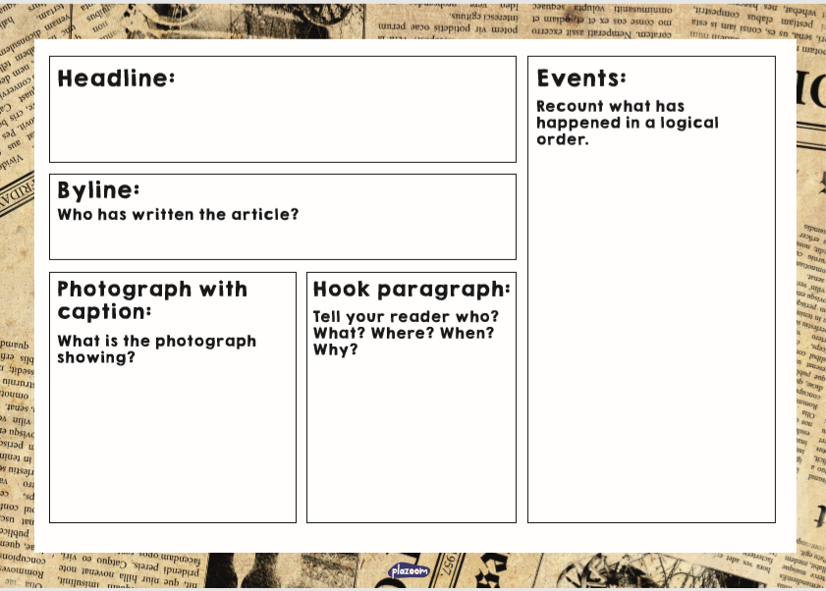

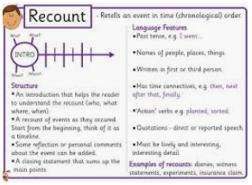


Year 6
Summer 1
Lessons 1 - 5
Writing – Week 4 – Monday 11th May
There is a writing task for each day.
Choose your challenge for the day. Remember to use all the writing conventions you know. Keep the writing interesting by choosing your vocabulary carefully.

Slide 2
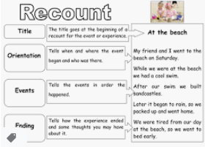
Week 4 - Day 1 – choose your challenge.
Write a diary entry. Write a diary entry as if you are Mrs. Ebbel. What could she be thinking / feeling about Bradley and the other students in the class? Remember to write in first person. | Write a recount. Write a recount chapter 28 – 29 from Mrs Ebbel’s perspective. Remember to write in first person. | Write a recount. Write a recount chapter 28 – 29 from Mrs Ebbel’s perspective. Remember to write in first person.

Slide 3
Week 3 - Day 2 - 3 – choose your challenge – review science.
Write a non-chronological report. Your challenge is to write a non-chronological report about Evolution. You may need to research all the different aspects. | Write a non-chronological report. Your challenge is to write a non-chronological report about Charles Darwin. You may need to research all the different aspects. | Write a non-chronological report. Your challenge is to write a non-chronological report about Adaptation of Species. You may need to research all the different aspects.
How could you extend your challenge?

Slide 4
Week 4 - Day 4 - 5 – choose your Topic-based challenge.
Write an informal letter Write a letter as if you are Darwin. You must write to your father, from your trip in Australia, telling your father what you have seen. You must research Darwin’s journey before doing this task. Remember the features of persuasive writing. | Write an informal letter Write a letter as if you are Darwin. You must write to your father, from your trip in Australia, telling your father what you have seen. You must research Darwin’s journey before doing this task. Remember the features of persuasive writing. | Write an informal letter Write a letter as if you are Darwin. You must write to your father, from your trip in Australia, telling your father what you have seen. You must research Darwin’s journey before doing this task. Remember the features of persuasive writing.
How could you extend your challenge?

