Slide 1
Year 6 Arithmetic and Mixed Tests
Summer 1
Instructions
Work has been set for each and every Year 6 student on MyMaths. Each child must log in and complete the tasks set. These following slides are arithmetic based work, which is to be done in conjunction to the work set.
There are 6 entire tests below.
You can do 1 slide a day, thus completing 4 slides per week. After which, you should log into MyMaths on the Friday of each week and actually re-do the test online. This will give you the opportunity to check your results.
Good luck.

Slide 2
Year 6 - Arithmetic 1
MyMaths – April 2020.
Summer 1 - Week 1

Slide 3
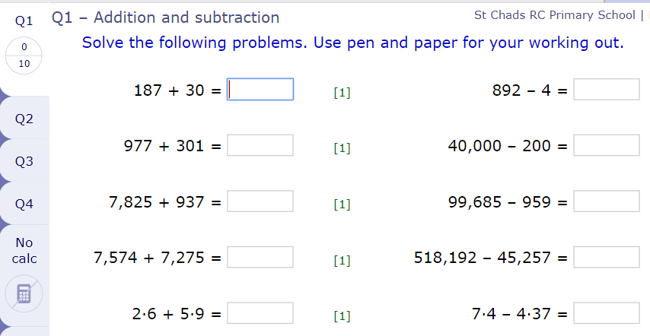

Slide 4
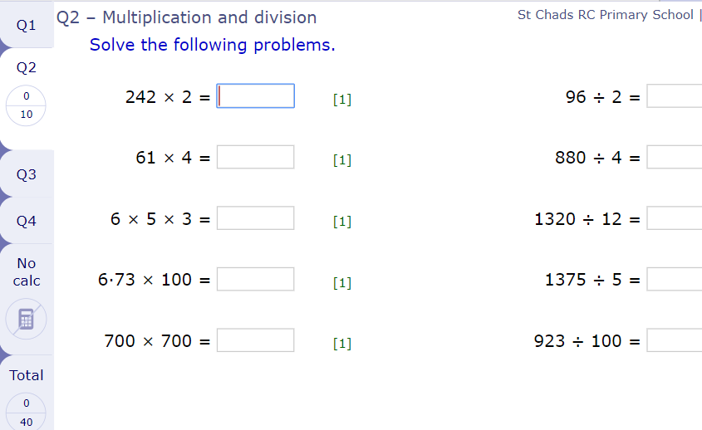

Slide 5
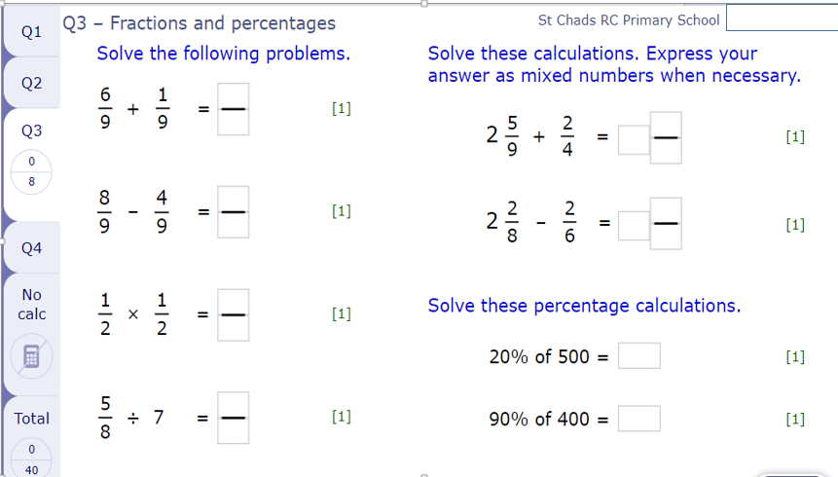

Slide 6
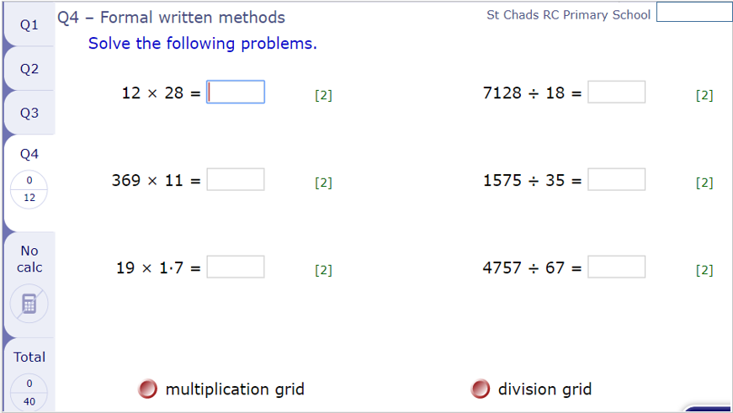

Slide 7
Year 6 - Arithmetic 2
MyMaths – April 2020.
Summer 1 - Week 2

Slide 8
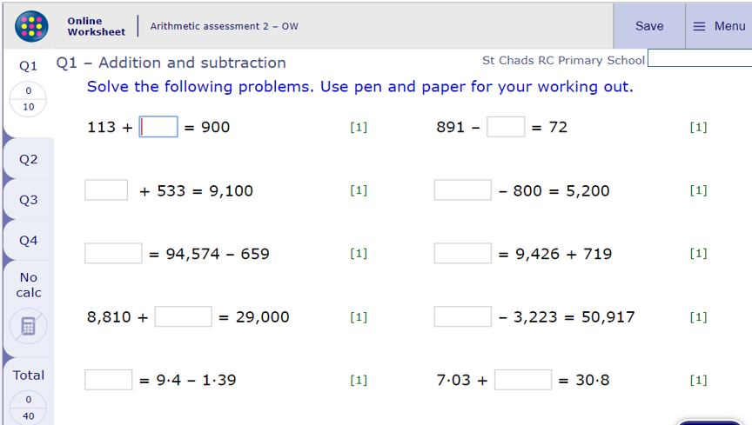

Slide 9
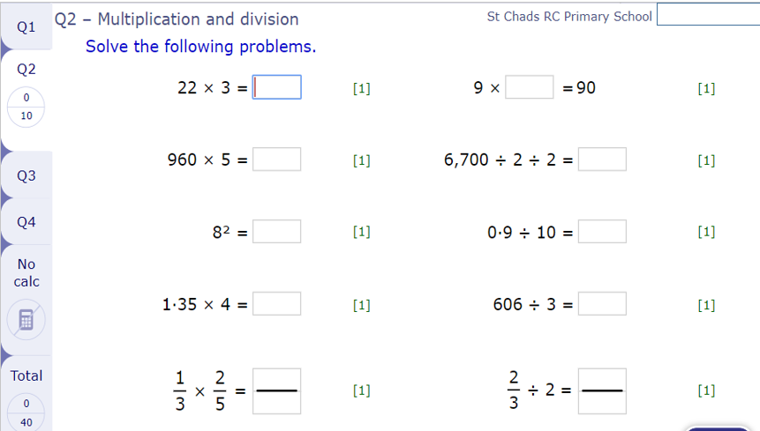

Slide 10
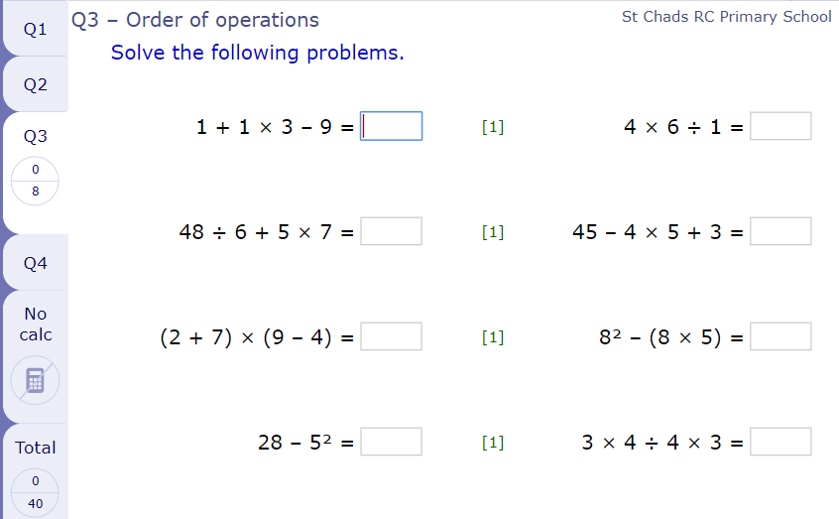

Slide 11
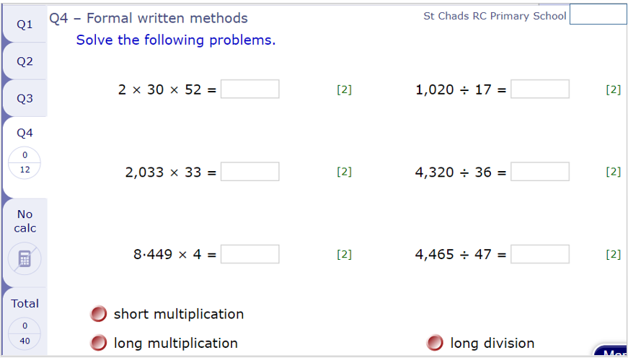

Slide 12
Year 6 - Mixed Assessment 1
MyMaths – May 2020.
Summer 1 - Week 3

Slide 13
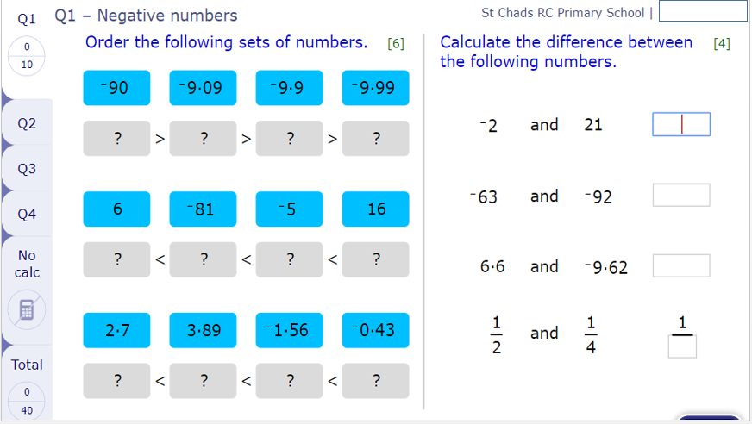

Slide 14
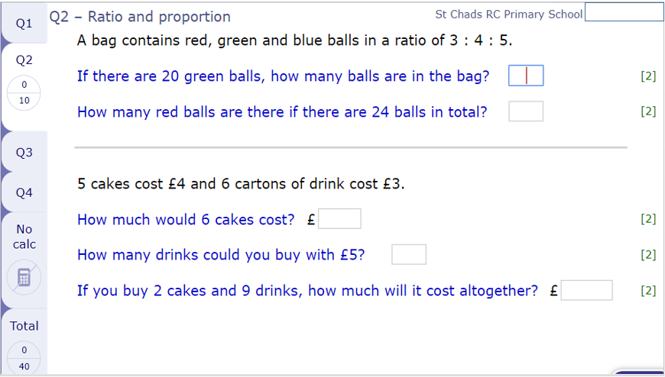

Slide 15
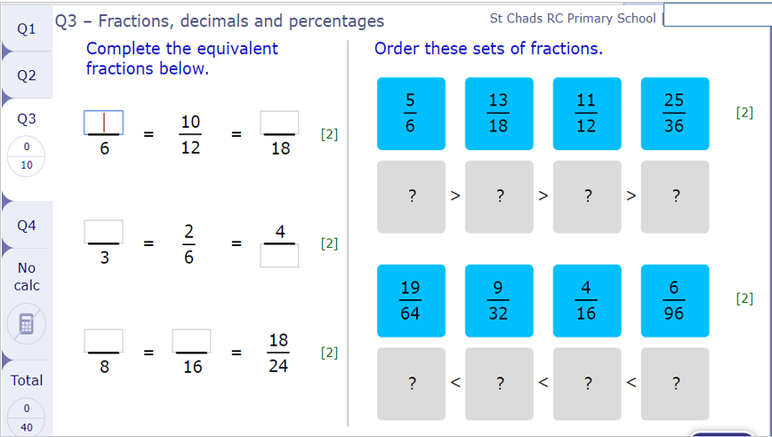

Slide 16
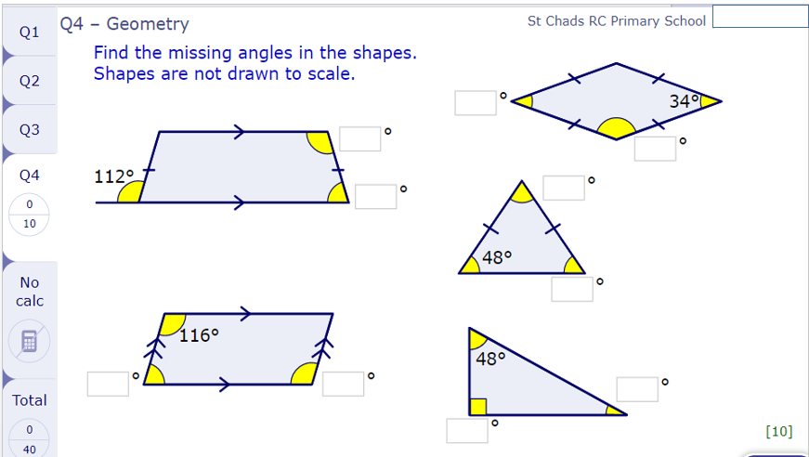

Slide 17
Year 6 - Mixed Assessment 2
MyMaths – May 2020.
Summer 1 - Week 4

Slide 18
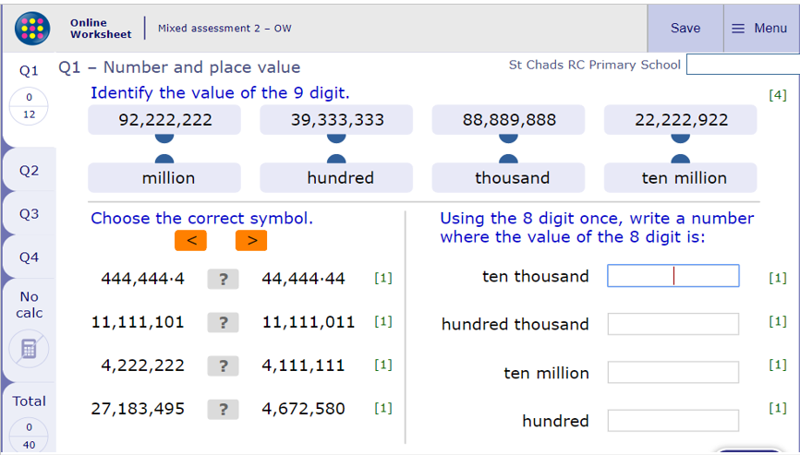

Slide 19
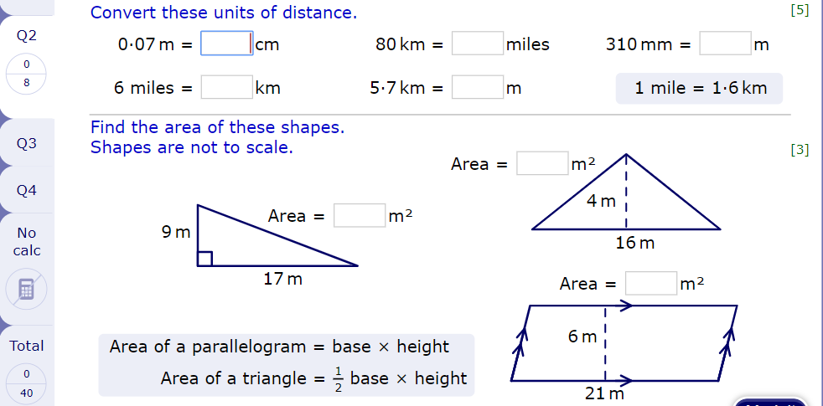

Slide 20
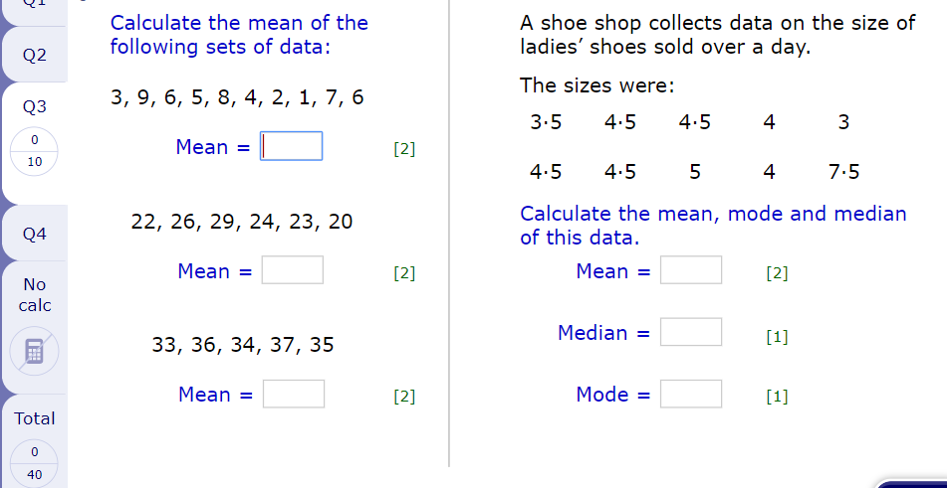

Slide 21
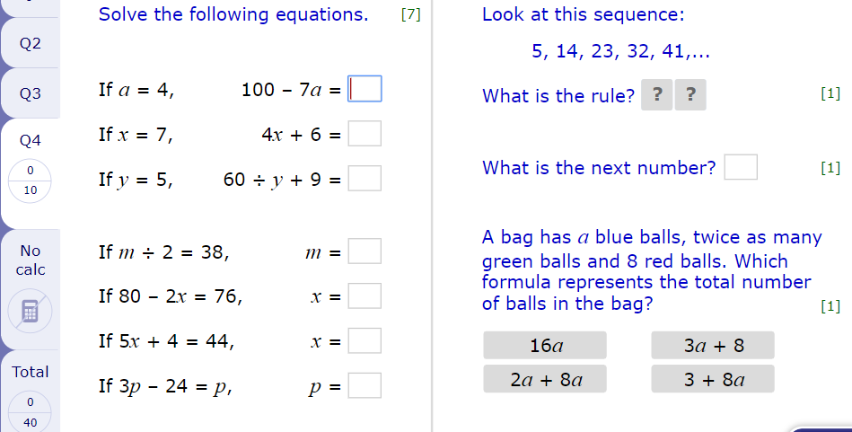

Slide 22
Year 6 - Mixed Assessment 3
MyMaths – April 2020.
Summer 1 - Week 5

Slide 23
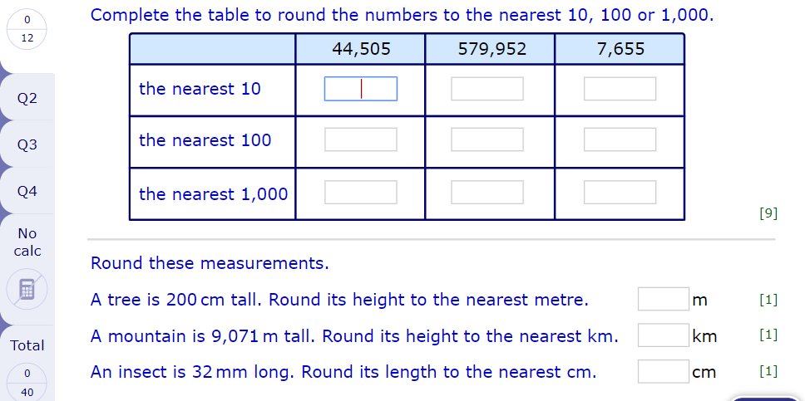

Slide 24
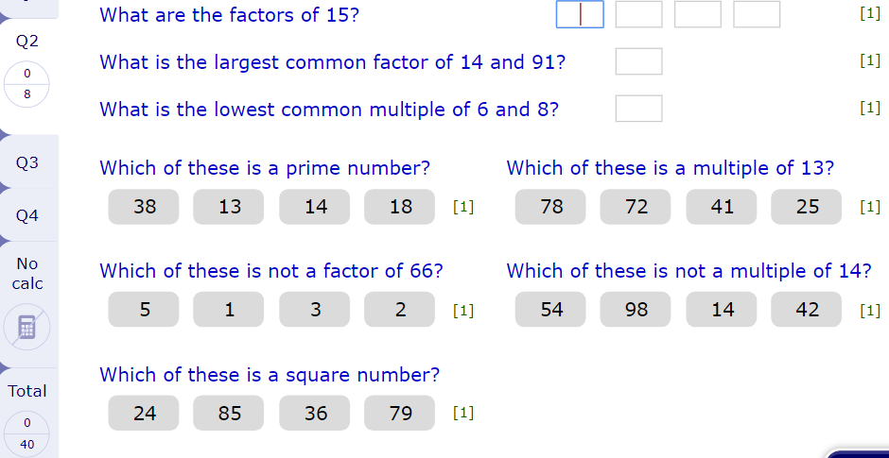

Slide 25
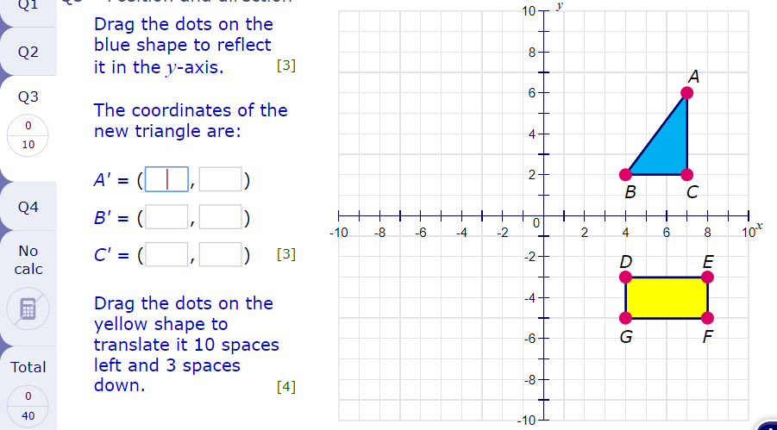

Slide 26
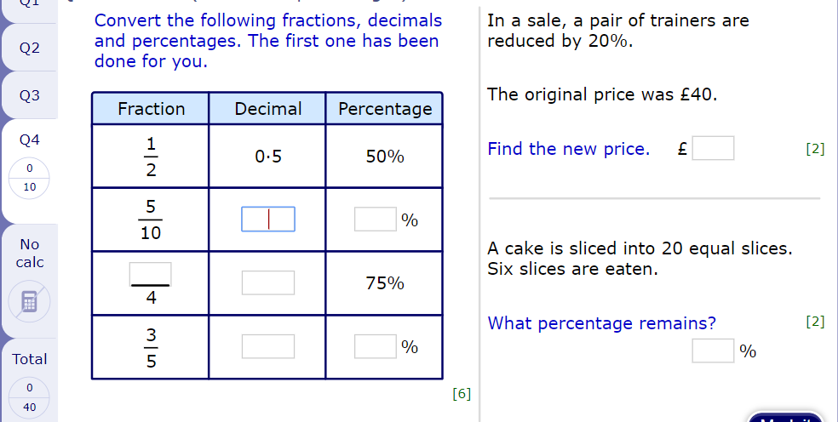

Slide 27
Year 6 - Mixed Assessment 4
MyMaths – April 2020.
Summer 1 - Week 6

Slide 28
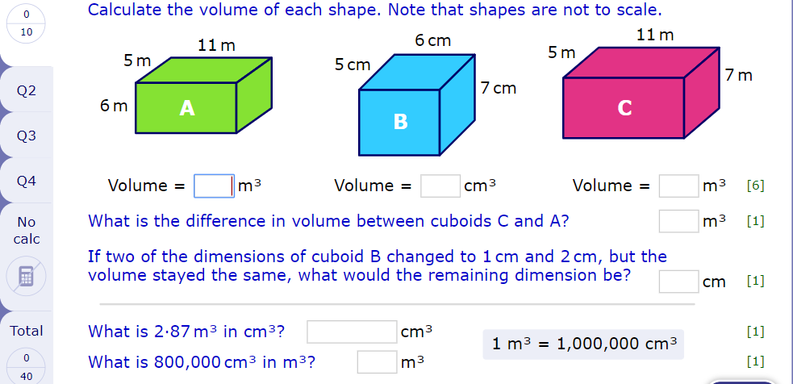

Slide 29
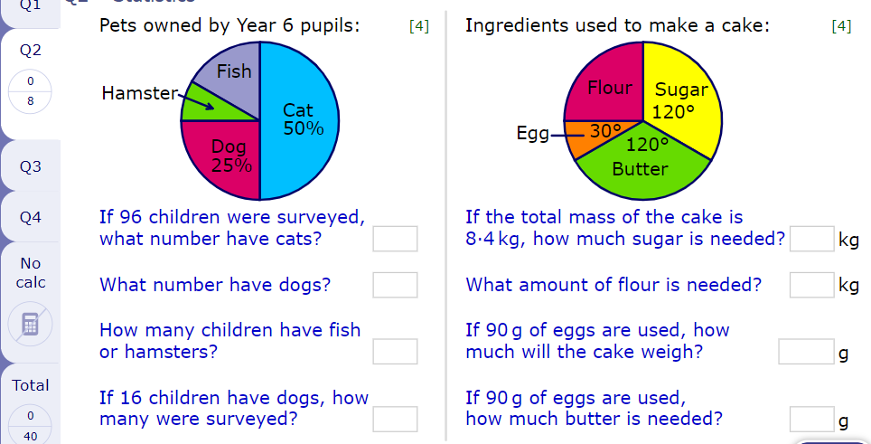

Slide 30
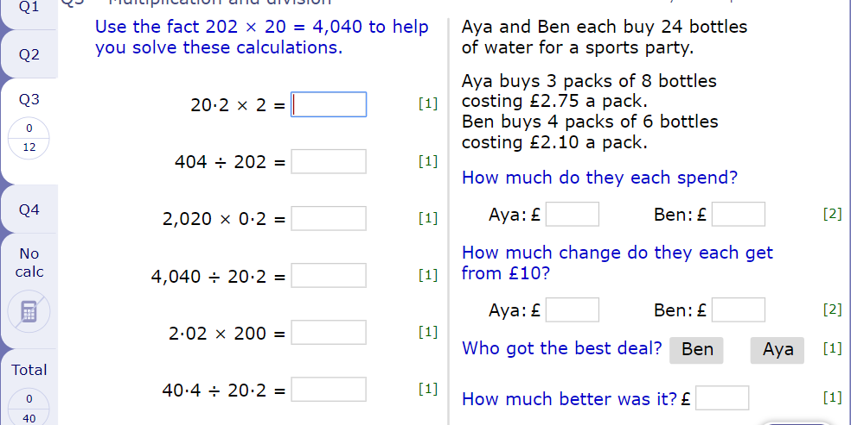

Slide 31


