Slide 1
Practical Science Re-cap 1
Summer 1
Week 5

Slide 2
About this power-point:
This power-point contains a practical exercise that children can do at home with an adult. This exercise is related to a topic that children in Year 6 need to know about, before they move on, into Year 7. Key vocabulary is stated at the beginning of each session.
The exercise will help Year 6 children to re-cap their existing knowledge and further their understanding of scientific principles, that they are expected to know.
After completing each session, there are further challenges (that children can choose from, just as they would do in school), however they can do more than one challenge if they wish!

Slide 3
Contents for entire Summer 1:
Practical 1: Sedimentary Rocks – Chocolate Rocks
Practical 2: Materials – Egg White and Yoke
Practical 3: Materials 2 – Magic Potions 1
Practical 4: Solids and Liquids – Picking Up An Ice Cube
Practical 5: Animals including humans 1 - Heart
Practical 6: Animals including humans 2 - Blood

Slide 4
Practical 5
Animals including humans 1 - Heart
During this session, you will initially re-cap your knowledge of various structures and organs of the human body. You will then looking at the circulatory system.
Vocabulary:
circulatory system
heart lungs
veins arteries

Slide 5
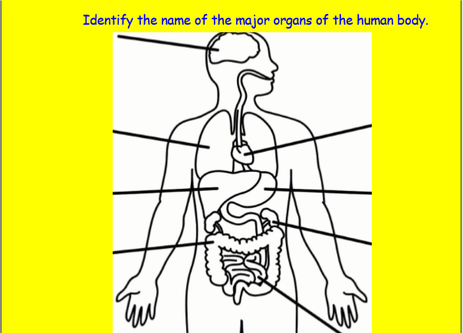

Slide 6
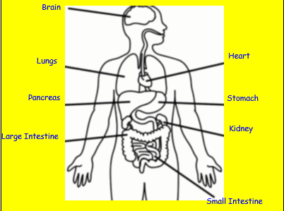
Answers

Slide 7
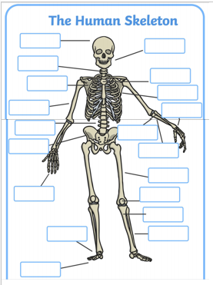
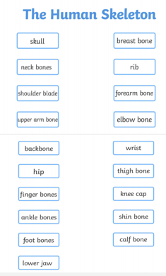

Slide 8
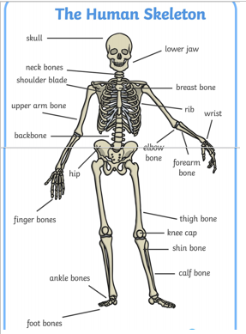
Answers

Slide 9
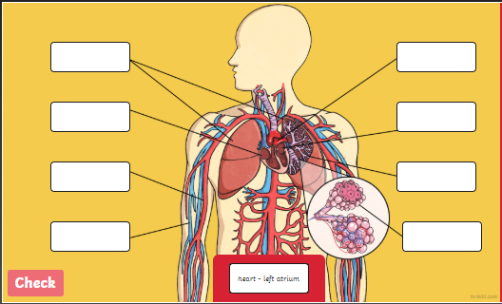
Label the different parts of the circulatory system.

Slide 10
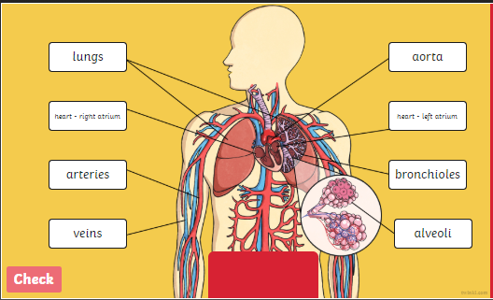
Answers

Slide 11
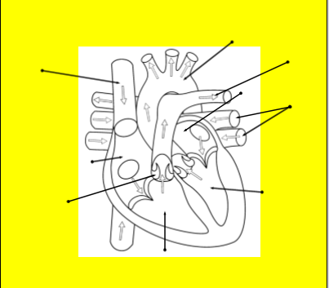
Label the different parts of the heart.

Slide 12
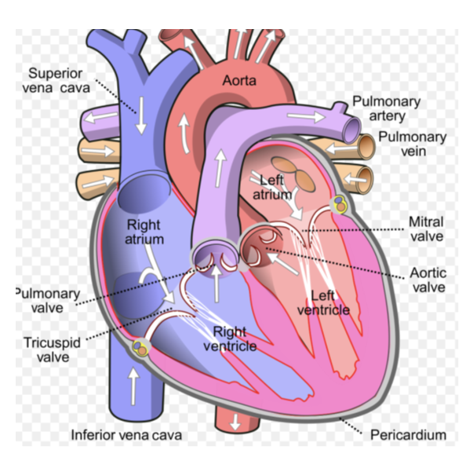
Answers

Slide 13
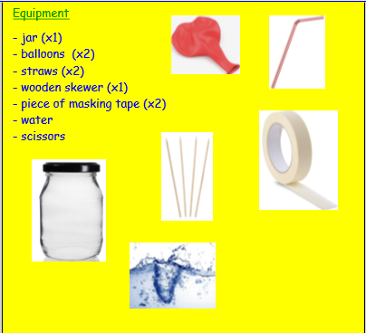
L.O: To create a model of the human heart.

Slide 14
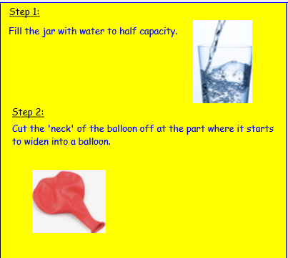

Slide 15
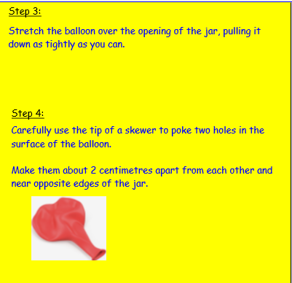

Slide 16
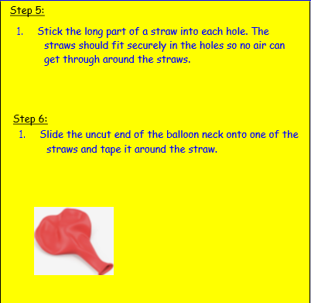

Slide 17
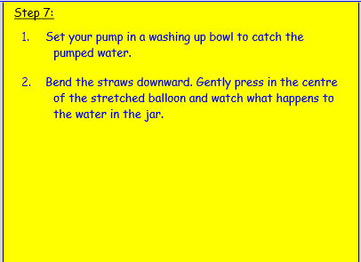

Slide 18
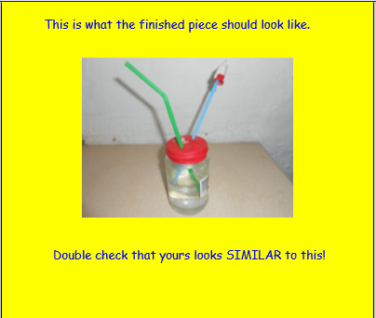

Slide 19
Choose your challenge:
Mild
Create a comic strip to demonstrate what happens at each part of the experiment.
Explain what happens when you press the centre of the balloon.
Spicy
Write a detailed account of your observations throughout the experiment, using scientific language.
Explain what happens when you press the centre of the balloon.
What do you think the central part of the heart is called? (Look at the diagram). What does it remind you of?
How could you record your results?
Hot
Write a detailed account of your observations throughout the experiment, using scientific language.
Explain what happens when you press the centre of the balloon.
What do you think the central part of the heart is called? (Look at the diagram). What does it remind you of?
How could you record your results?

