Slide 1
Practical Science Re-cap 1
Summer 1
Week 6

Slide 2
About this power-point:
This power-point contains a practical exercise that children can do at home with an adult. This exercise is related to a topic that children in Year 6 need to know about, before they move on, into Year 7. Key vocabulary is stated at the beginning of each session.
The exercise will help Year 6 children to re-cap their existing knowledge and further their understanding of scientific principles, that they are expected to know.
After completing each session, there are further challenges (that children can choose from, just as they would do in school), however they can do more than one challenge if they wish!

Slide 3
Contents for entire Summer 1:
Practical 1: Sedimentary Rocks – Chocolate Rocks
Practical 2: Materials – Egg White and Yoke
Practical 3: Materials 2 – Magic Potions 1
Practical 4: Solids and Liquids – Picking Up An Ice Cube
Practical 5: Animals including humans 1 - Heart
Practical 6: Animals including humans 2 - Blood

Slide 4
Practical 6
Animals including humans 1 - Blood
Looking at looking at the circulatory system in a little more detail.
Vocabulary:
circulatory system blood
heart lungs
veins arteries
vessels fluid
oxygen carbon dioxide

Slide 5
The following slides have some information about blood, however there are various mistakes on each slide.
Your first task, is to research the functions of blood and identify any mistakes encountered on the slides.
Then you will be given a set of challenges to choose from. Good luck!

Slide 6
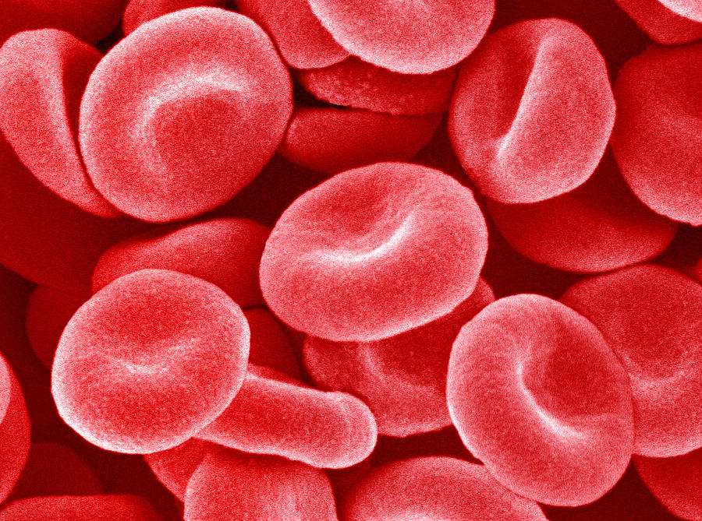
What is blood?
Blood is a body fluid in humans and other animals that delivers necessary substances such as nutrients and oxygen to the cells and transports metabolic waste products away from those same cells.
Other functions of blood
Picks up food from your liver
Collects waste and gets rid of this in your kidney
Distributes heart around your body
Did you know if you laid out all of the blood vessels in your body on a sing line it would be 60,000 miles long?

Slide 7
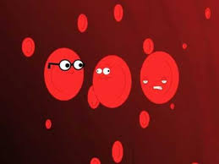
TYPES OF BLOOD CELLS
White blood cells
The blood travels through plasma with the white blood cells; the blood then goes through the veins. The white cells stay with the red blood cells so if there was any infection, the white blood cells would stop the infection. There are 7000 white blood cells in 1 drop of blood.
Red blood cells
Did you know that there are 5 million red blood cells in one drop of blood?

Slide 8


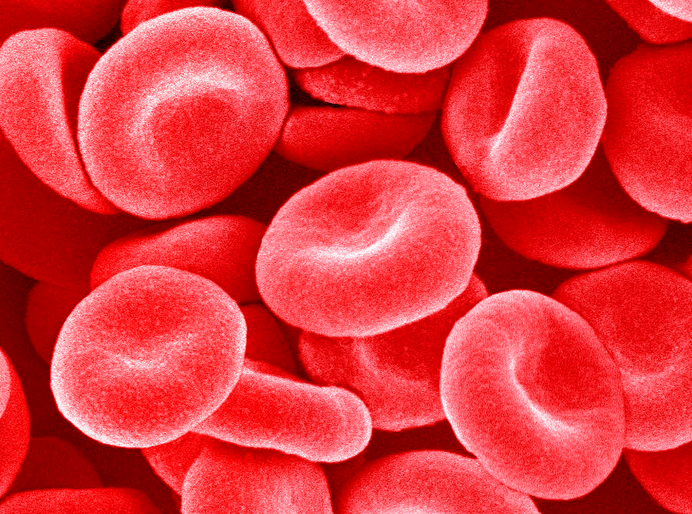
Experts view: If there is less oxygen, your body makes more cells, that’s why mountaineers have thick blood
Fact or False: You can live with no blood.
Did you know? Every second , your body makes 3 million blood cells.
Answer: False
In your bone, there is a gel made out of stensels. It is called bone marrow, and it makes new blood cells. The new blood cells then go into the blood stream.
In adult bodies, blood is only made by the spine , ribs and the pelvis.
Red Blood Cells
Did you know?
In one drop of blood, there are 5 million red blood cells.

Slide 9

How is blood used?
1 pint of blood could save 3 lives.
Fact or Opinion?
Fact
Blood does many things that we could not live without. It is so important that we would die without it.
There are 4 types of blood cells
True or false
False there are only two
Red blood cells can carry oxygen. It contains haemoglobin – a red protein- that combines with oxygen to move it around the body.
A video showing blood flowing through the body
https://www.youtube.com/watch?v=0__SF41xyIw
White blood cells fight off infections and bacteria attacking your skin. They can die while fighting infection or bacteria. Once it is dead it forms a puss. Eww!
Mini quiz
How many white blood cells are in one drop of blood? 7000
How many times does your heart beat a minute when you are relaxing? 70 times
How long does donating blood take? 15 mins
Did you know that when we are too hot blood vessels supplying blood can swell? This can cause warm blood to flow near the surface of the skin where heat can be realised to the air. This is why we go red when we are hot.
Experts view:
It is believed by scientist Bonne Van Frank, that if everyone donates blood at least once in their life, there will be 80% less deaths due to blood loss.

Slide 10

It is a specialized bodily fluid that supplies essential substances and nutrients, such as sugar, oxygen, and hormones to our cells, and carries waste away from those cells, this waste is eventually flushed out of the body in urine, feces, sweat, and lungs (carbon dioxide). Blood also contains clotting agents
Facts | Opinion
If you have no blood there you will either die or get donated blood.
Blood makes up around 7% of the weight of a human body.
True | False
How to make stage blood.
Add 8 ounces of water to the blender.
Add 16 ounces of powdered sugar to the blender (you can find a 16 ounce box of sugar at the store). Blend it up. ...
Add 1 ounce of red food coloring (you can also purchase a 1 ounce jar at the store). ...
Add 1 tablespoon of cocoa powder. ...
Use a spoon to scoop out some of the fake blood.

Slide 11
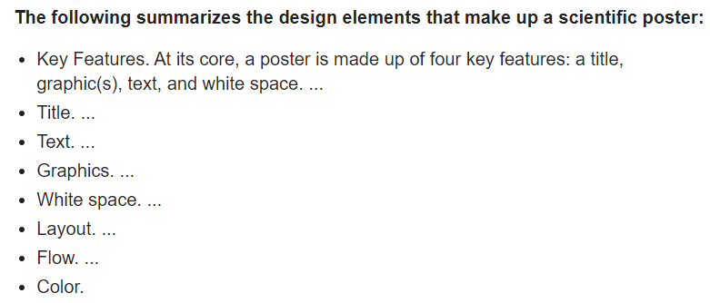
Choose your challenge: For each of the challenges, you may use information from the slides (once you have researched its authenticity), or do your own research.
Mild
Create a poster about the functions of blood.
Spicy
Create an informative leaflet about the functions of blood.
Things EVERY Leaflet Should Include
Choose a Title
The Purpose of the Leaflet
Who is the Leaflet For?
Details, Details, Details!
Speak Directly to People
The Right Spacing
Eye-Catching, Useful Imagery (diagrams with captions and labels)
The Power of Persuasion
Call to Action
Hot
Write a non-chronological report about blood.
Features of a non-chronological report
Title / heading
Introduction
Paragraphs
Sub-headings
Factual language
Present tense
Technical / scientific language
Third person
Formal tone
General language
Some use of bullet points
Diagrams with captions and labels

