Slide 1

PowerPoint 6 – Biography writing

Slide 2
Guide for parents/carers,
Always read the ‘notes’ section at the bottom of the slides for specific instructions before beginning the lesson.
Read the slide and set the tasks or challenges for the child/ren. There is no rush and you do not have to do everything, but be aware that the lessons follow and build on from one another, so try not to skip lessons but rather work in order and stop when you feel is best for your child. When next PowerPoints appear, don’t feel pressured to skip ahead if you have not finished everything yet, do what is best for you ☺
Some slides will have one task, others more. You can break these down however you like e.g. All the tasks on one slide can be spread across a few days or done in one day, but please do not do too much in a day! The slides are numbered to help you differentiate between the different tasks.

Slide 3

Biography writing
1
This week, we would like you to learn about biographies and to begin to learn how to write biographies yourselves!
But what is a biography? Do you know?

Slide 4
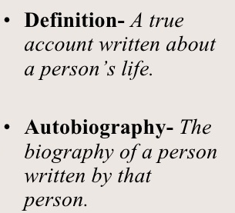
1

Slide 5
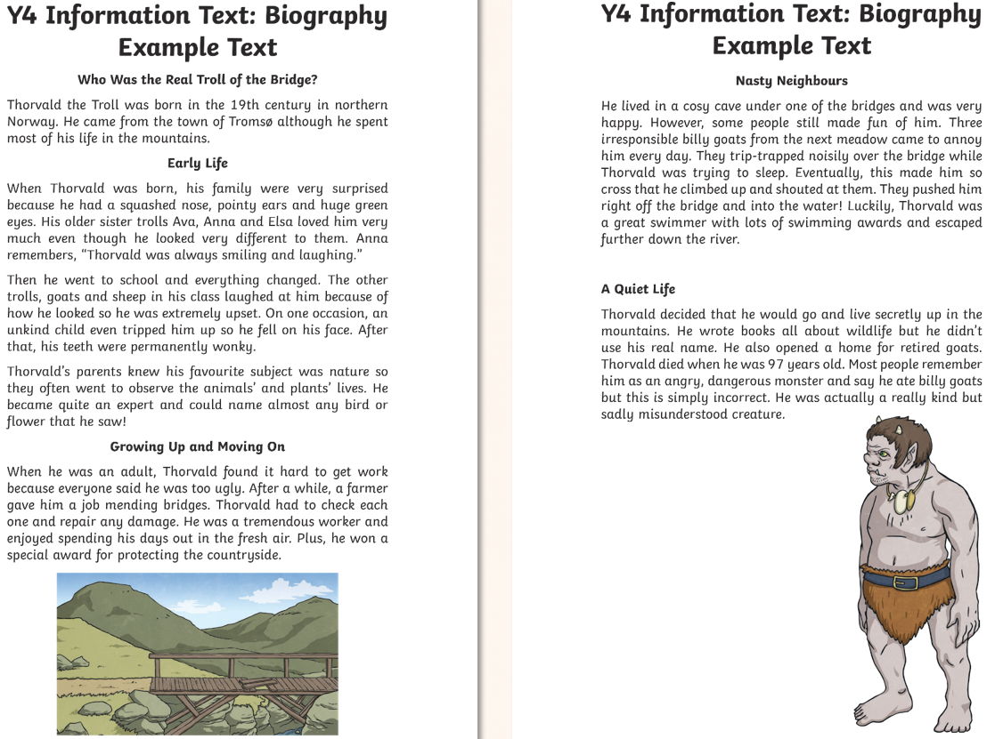
1
Notes:
Read the example text together, support your child to sound out tricky words or to use context to help them work it out. If they are unsure of the meaning of a word, they could look it up online or in a dictionary or you could explain to them what it means.
Ask: How is the text written? What do you notice? (subheadings, paragraphs, past tense, factual, detailed etc.)

Slide 6
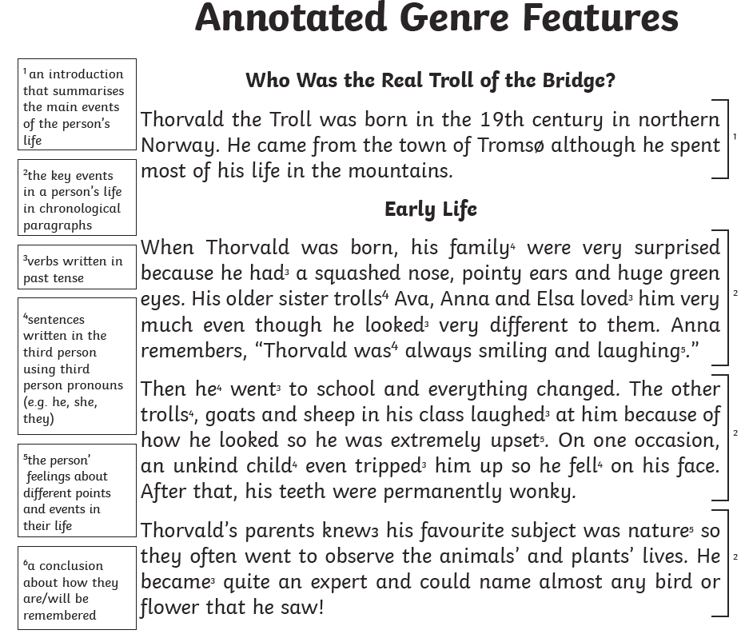
1

Slide 7
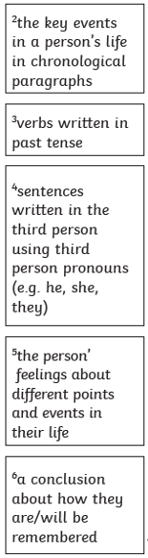
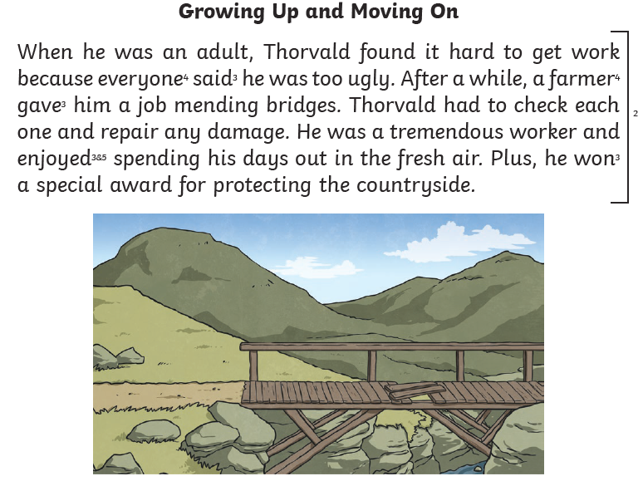
1

Slide 8
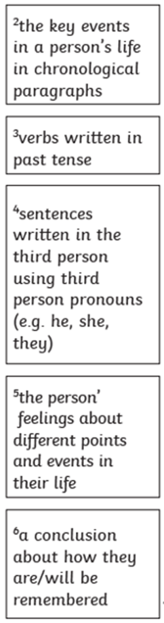
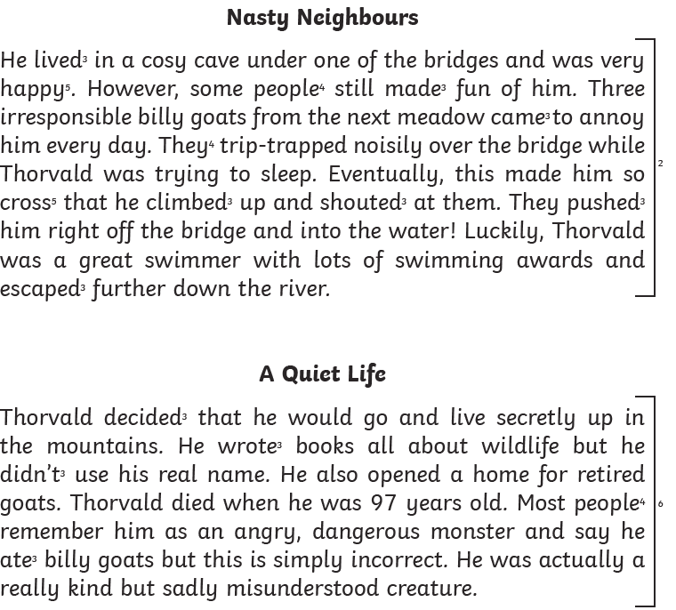
1

Slide 9
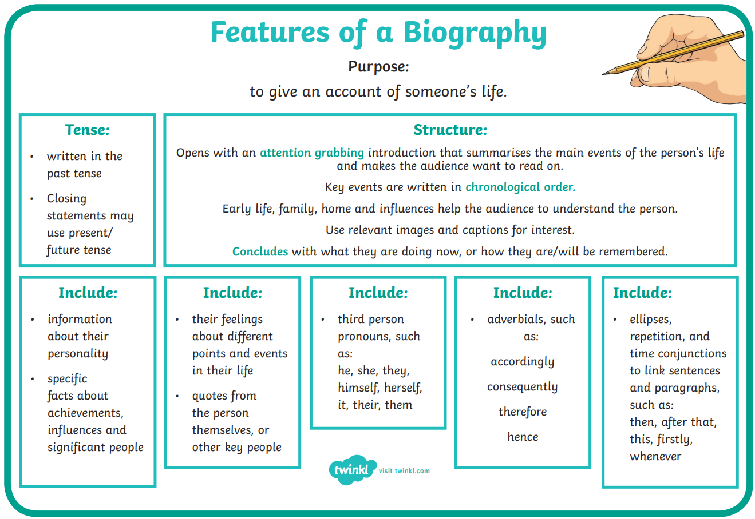
Task: Write a biography about a fairy tale character!
1
Pick a fairy tale/fictional character e.g. Goldilocks, Wolf, Red Riding Hood, Cinderella, Prince Charming etc.
Read/watch the story and take notes about all the information you think you’d need to write an effective biography about them.
Use the internet (with an adult) to research some additional information about the character you have chosen.
Use the features of a biography guide on the right to help you write a biography about the character you have chosen.

Slide 10
2

Slide 11
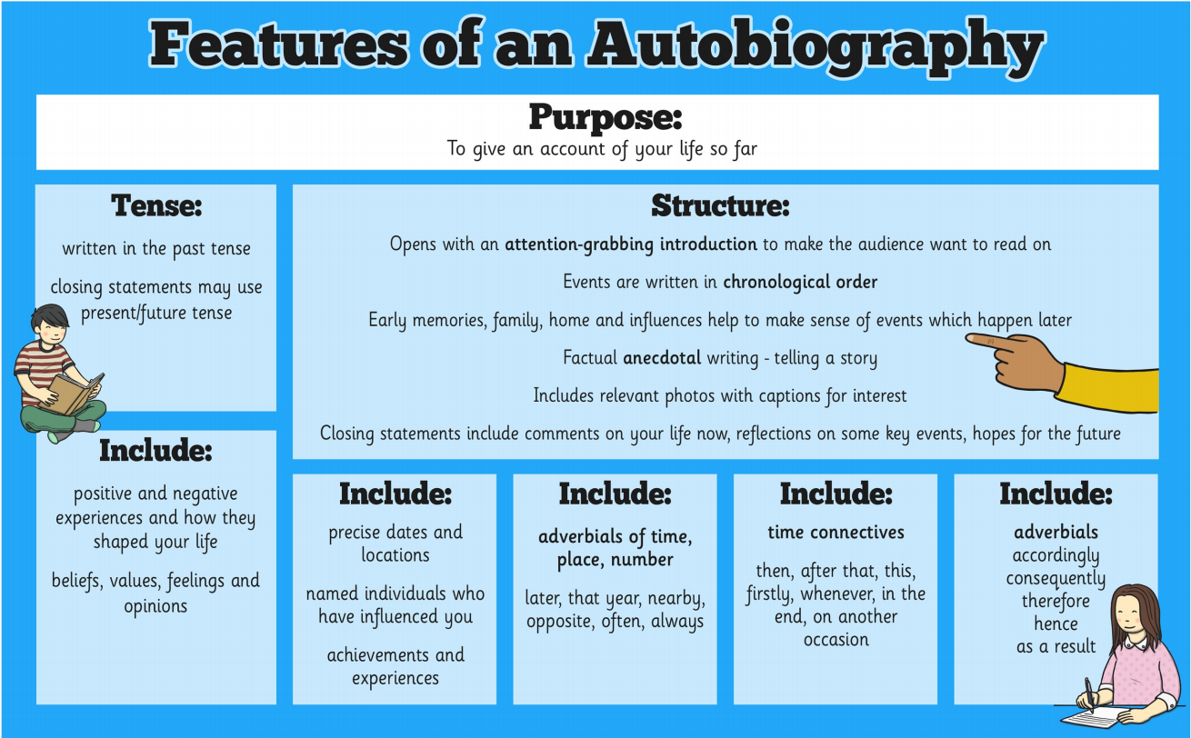
Task: Write an autobiography about yourself!
2
Notes:
Go through and discuss the features of an autobiography.

Slide 12
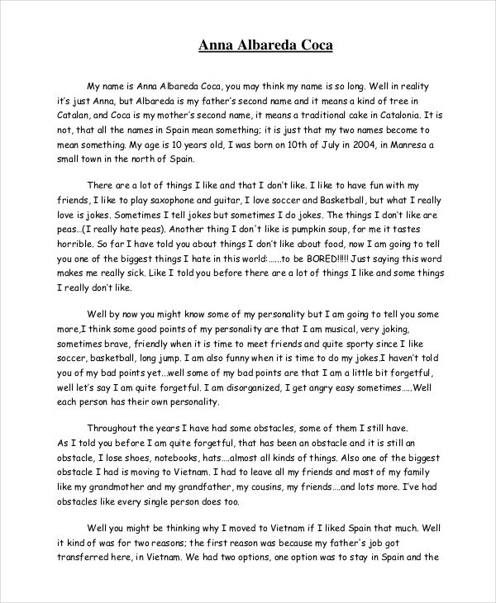
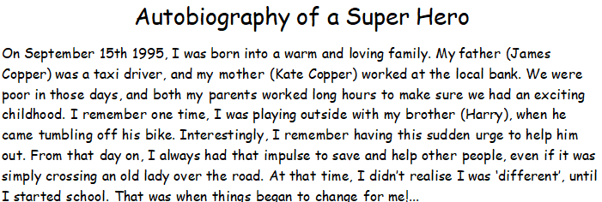
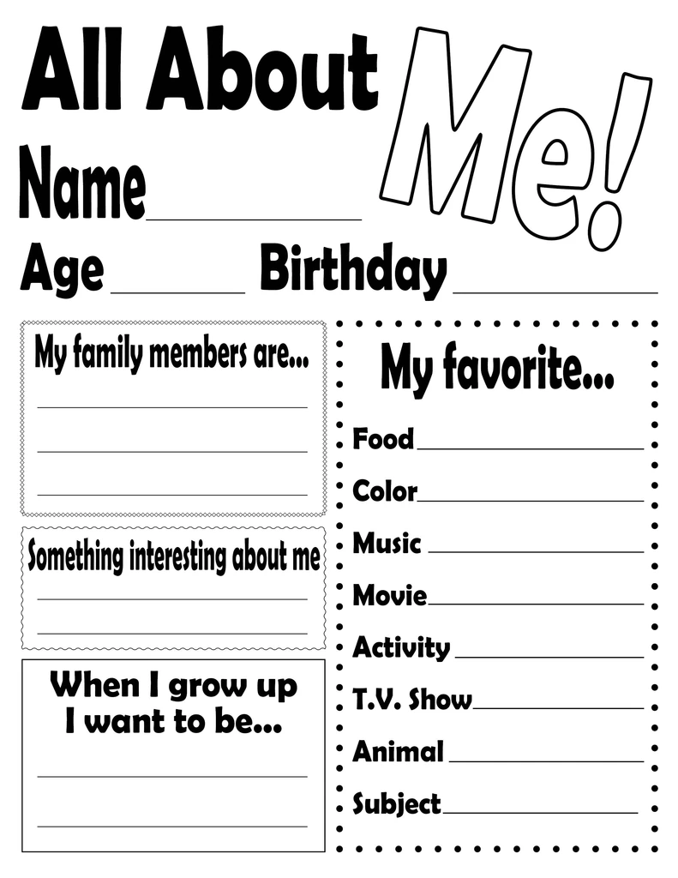
Examples:
2
Notes:
Read the examples. Can you spot any of the features of an autobiography in the examples?

Slide 13
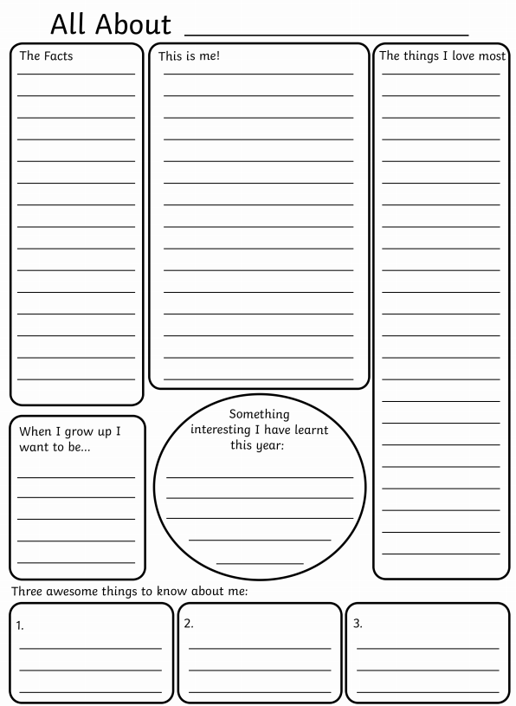

2
You could print off this template and write directly onto it, create your own similar to it, or write directly into your home learning book or onto paper. It’s up to you!

Slide 14
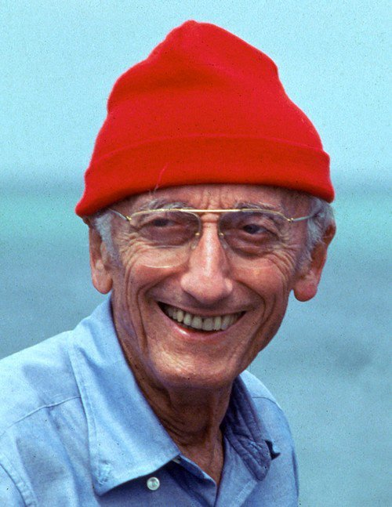
Now that you are biography writing professionals… it’s time to write a biography about a very famous oceanographer – Jacques Cousteau!
3
Watch these videos and visit this website to learn about Jacques Cousteau… and don’t forget to take notes as you go along!
https://www.youtube.com/watch?v=9z08SD5iRuk
https://www.youtube.com/watch?v=Vrok04MISGY
https://kids.kiddle.co/Jacques_Cousteau

Slide 15
Task: Write a biography about Jacques Cousteau.
3
Notes:
This could also be done as an information poster, leaflet, booklet, PowerPoint or Word document.

