Slide 1

PowerPoint 7 – Biography writing

Slide 2
Guide for parents/carers,
Always read the ‘notes’ section at the bottom of the slides for specific instructions before beginning the lesson.
Read the slide and set the tasks or challenges for the child/ren. There is no rush and you do not have to do everything, but be aware that the lessons follow and build on from one another, so try not to skip lessons but rather work in order and stop when you feel is best for your child. When next PowerPoints appear, don’t feel pressured to skip ahead if you have not finished everything yet, do what is best for you ☺
Some slides will have one task, others more. You can break these down however you like e.g. All the tasks on one slide can be spread across a few days or done in one day, but please do not do too much in a day! The slides are numbered to help you differentiate between the different tasks.

Slide 3
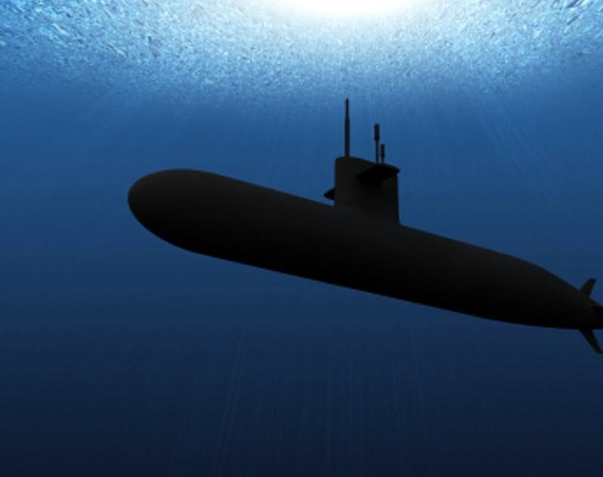
Submarines
1

Slide 4
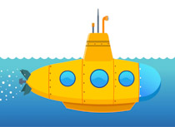
Watch this informative video about submarines:
1
https://www.youtube.com/watch?v=c3W937dORLI

Slide 5
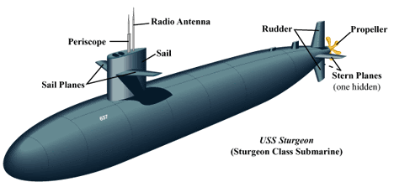
Can you draw and label your own submarine? Research the parts that you are unsure of.
1

Slide 6
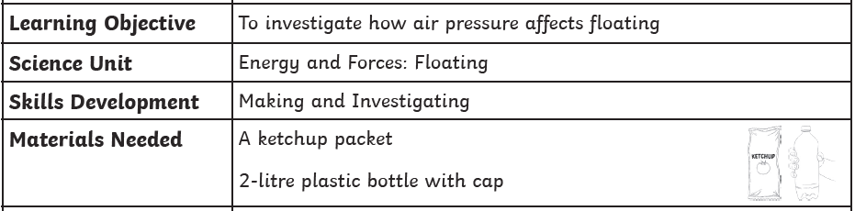
Submarine experiment!
2
Notes:
Full page experiment sheet available to download called: Submarine experiment

Slide 7
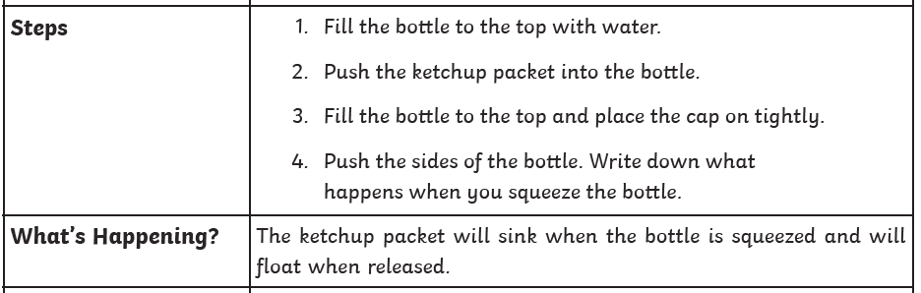
2
Notes:
Full page experiment sheet available to download called: Submarine experiment

Slide 8
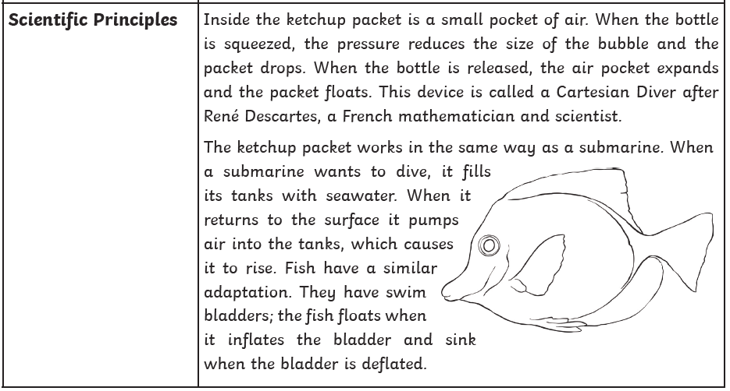
2
Notes:
Full page experiment sheet available to download called: Submarine experiment

Slide 9
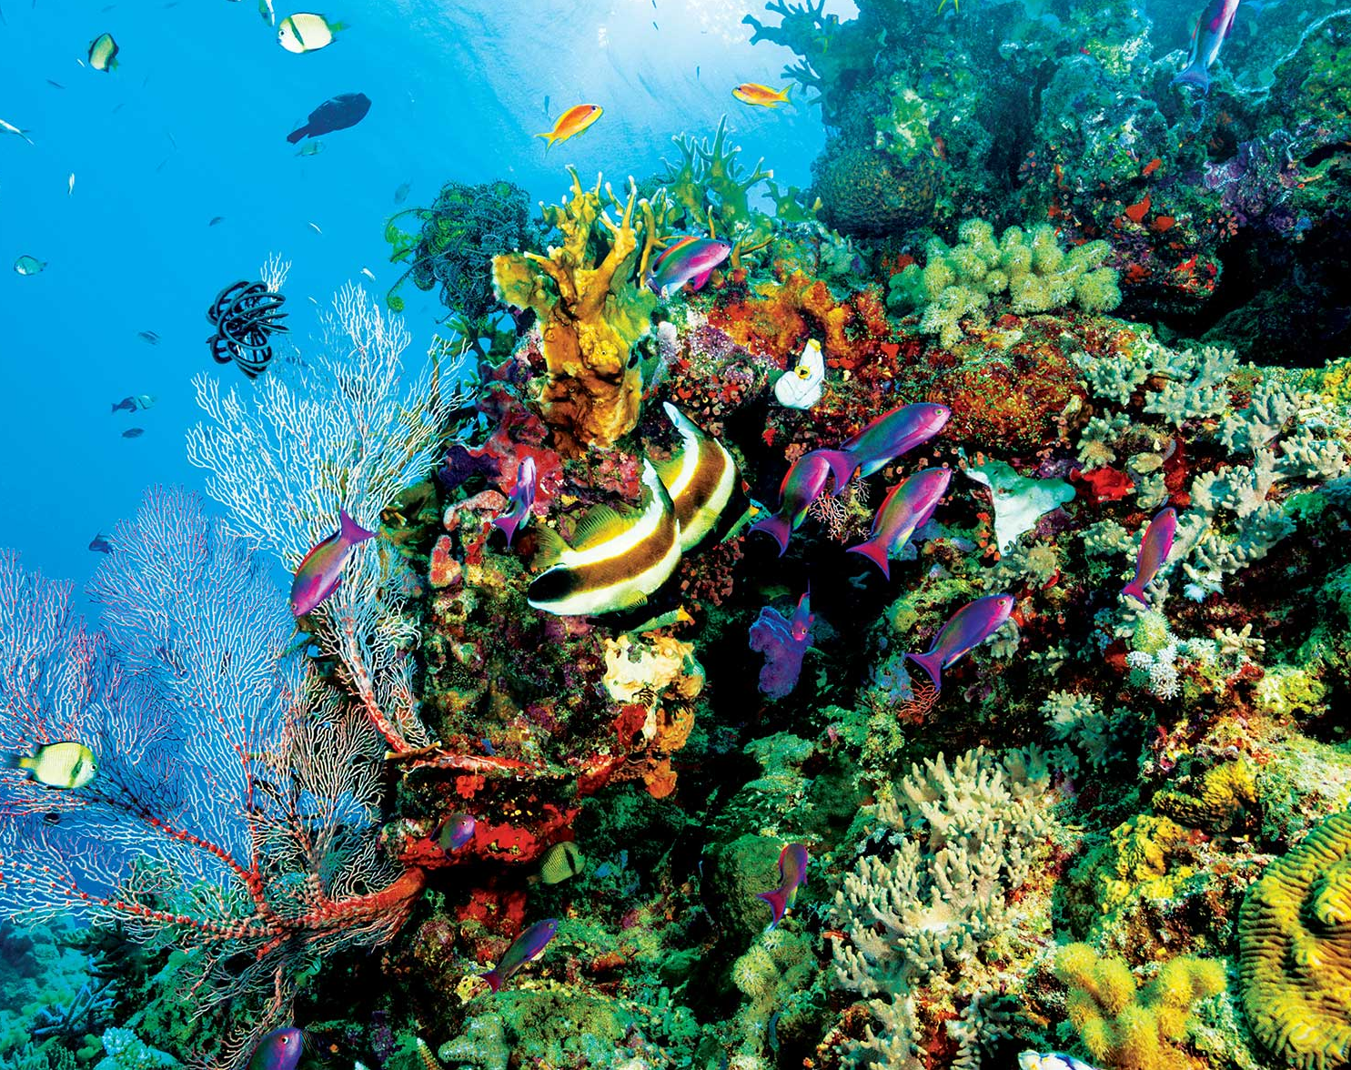
The Great Barrier Reef!
3

Slide 10
Watch these videos about the Great Barrier Reef:
3
https://www.youtube.com/watch?v=61RzwbaSoeU
https://www.youtube.com/watch?v=J2BKd5e15Jc
https://www.youtube.com/watch?v=8w7qflkeKdE
Make notes about what you learn as you go along! Remember to use bullet point, punctuation, full sentences.

Slide 11
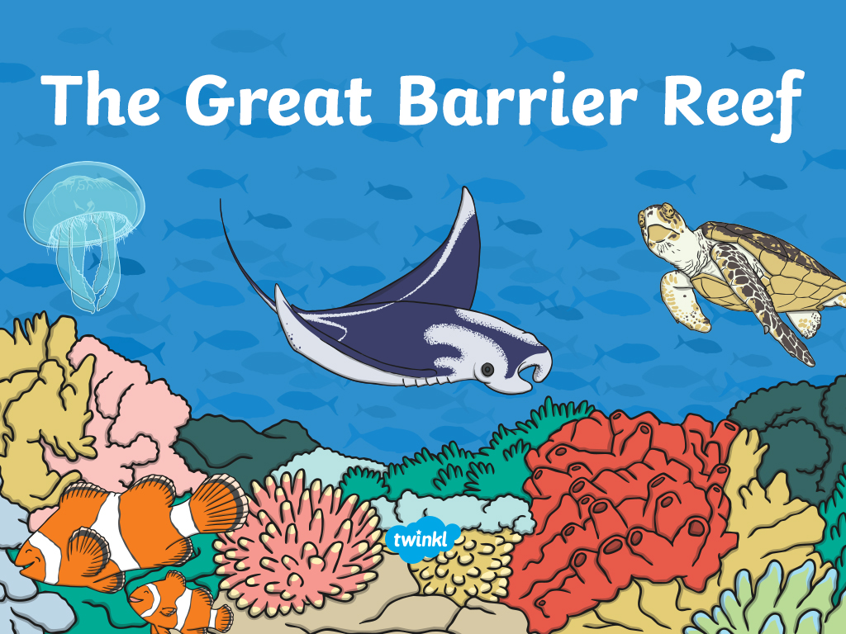
4

Slide 12
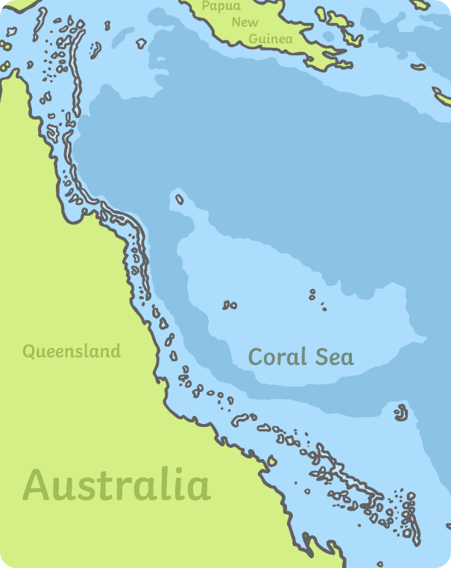
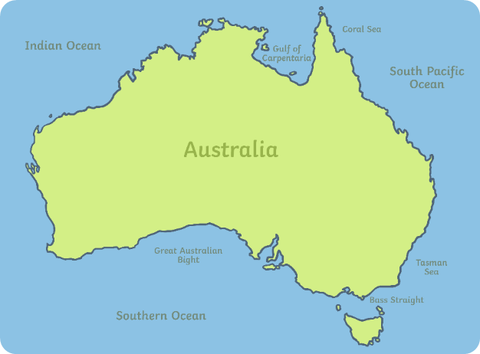
Where is the Great Barrier Reef?
4
The park stretches over 3000km (1800 miles) along the Queensland coast, from near the southern town of Bundaberg, up past Cape York.

Slide 13
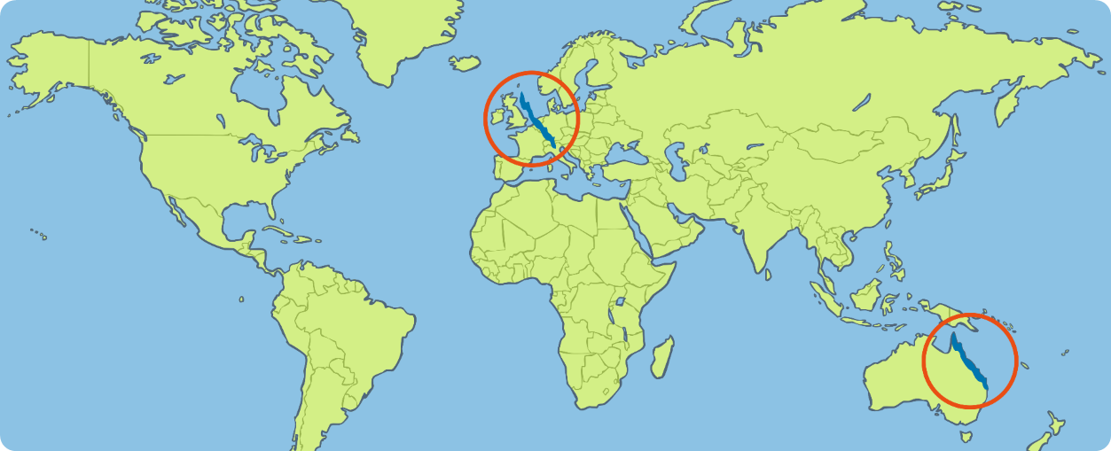
How Big Is the Great Barrier Reef?
4
It is the world’s largest reef.
It can even be seen from outer space.
It is bigger than the United Kingdom, Holland and Switzerland put together.
It is bigger than Tasmania and Victoria put together.

Slide 14
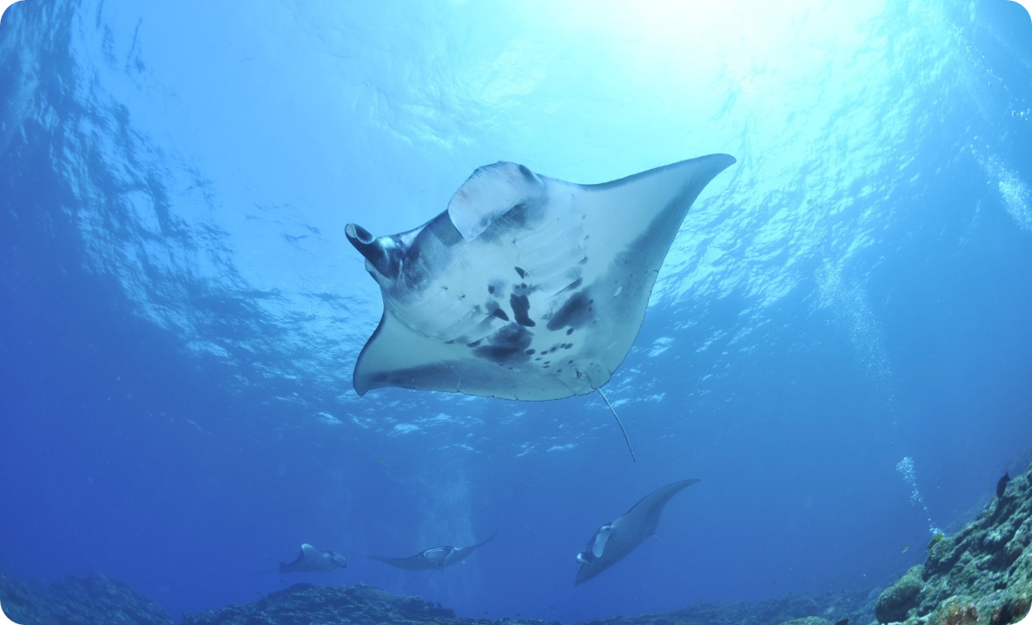
Animals of the Great Barrier Reef
4
manta ray

Slide 15
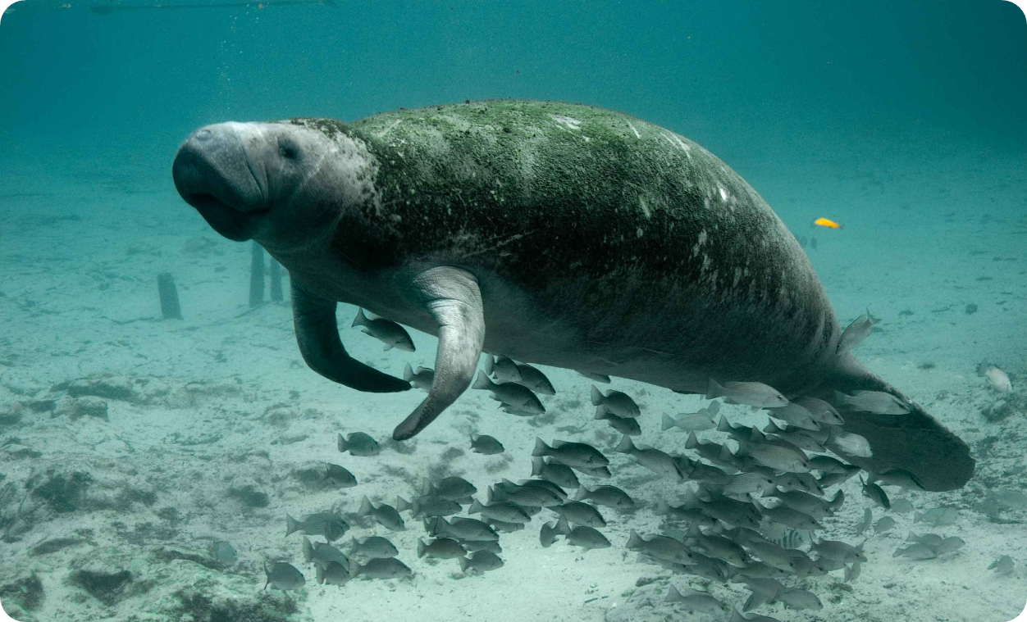
Animals of the Great Barrier Reef
4
dugong

Slide 16
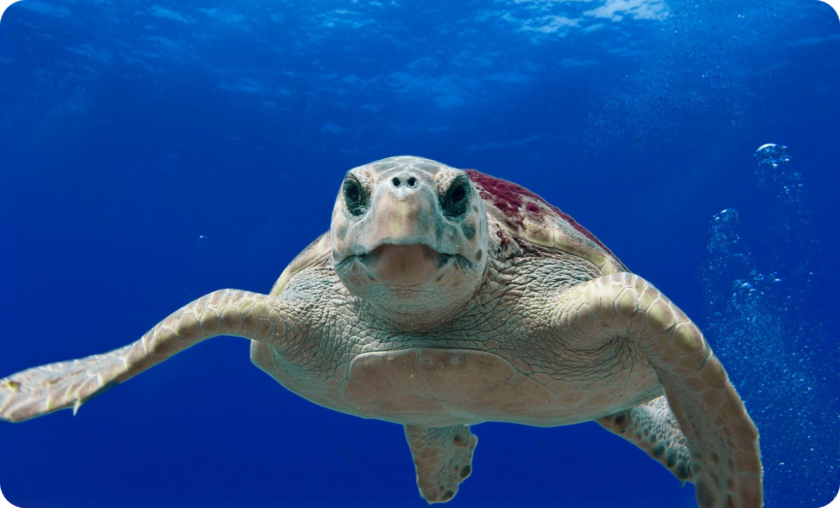
Animals of the Great Barrier Reef
4
loggerhead turtle

Slide 17
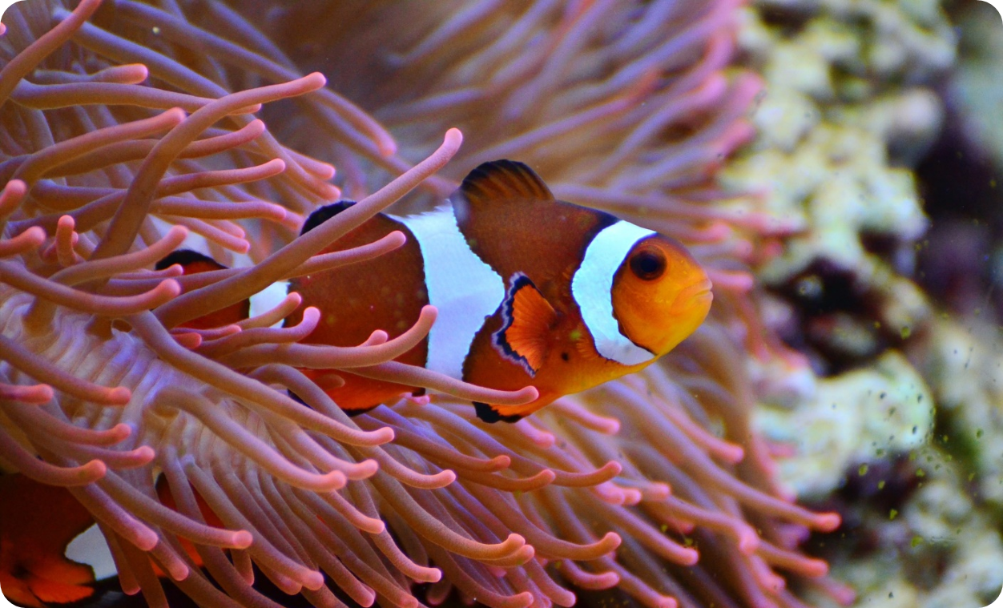
Animals of the Great Barrier Reef
4
clownfish

Slide 18
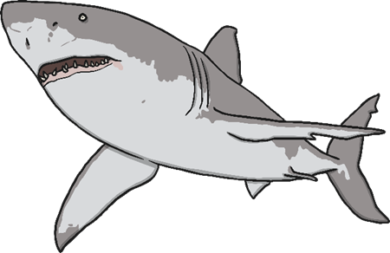
Indigenous People and the Great Barrier Reef
4
Aboriginal and Torres Strait Islander people are the traditional owners of the Great Barrier Reef.
Aboriginal and Torres Strait Islander people have used the sea to give them food for thousands of years.
Today, food from the sea is still important to Aboriginal and Torres Strait Islander people who still collect food and prepare meals using their traditional foods.
Creeks, rivers, beaches, islands, coastal and sea areas provide bream, catfish, cod, eels, prawns, crayfish, oysters, periwinkles, stingrays, sharks, crabs, dugongs, bird eggs, clam and many other things.

Slide 19
4
Notes:
Be sure to view as slideshow to play the ‘What am I?’ game.

Slide 20
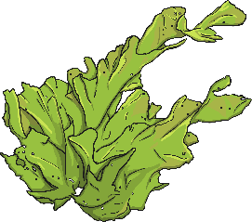

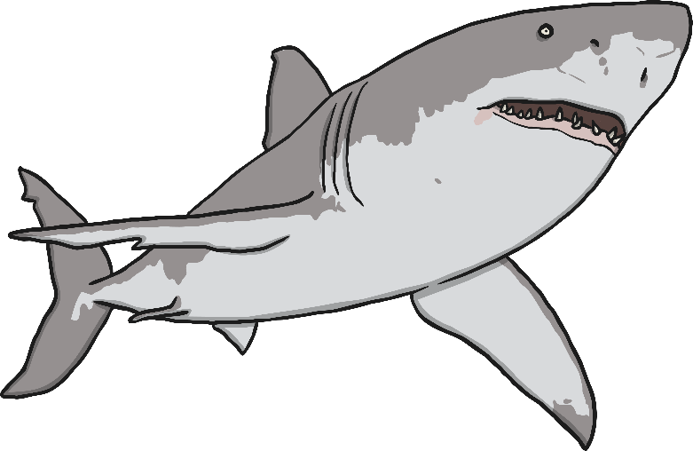
What am I?
4
Click the seaweed for clues.
I have very rough sharp skin..
I have an amazing sense
of smell..
I am a predator of the sea.
What am I?
A shark!

Slide 21
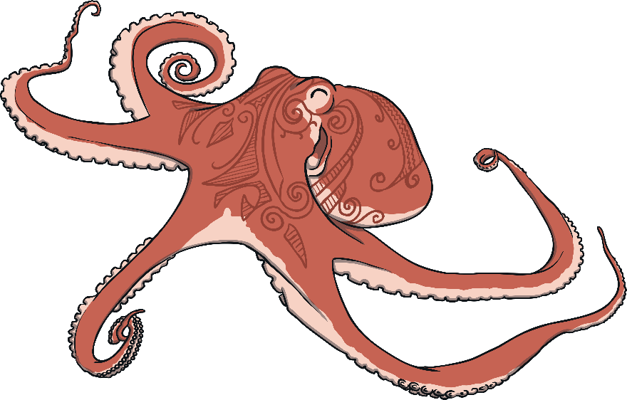
What am I?
4
Click the seaweed for clues.
I am mildly poisonous.
I have a great, big head.
I have rows of suckers on my
many legs.
What am I?
An octopus!

Slide 22
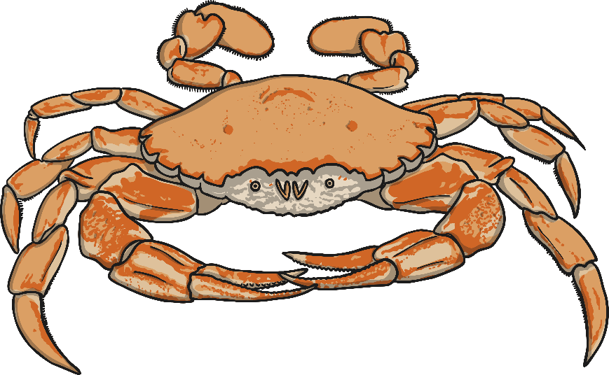
What am I?
4
Click the seaweed for clues.
I have 10 legs.
I am a crustacean.
I have sharp pincers.
What am I?
A crab!

Slide 23
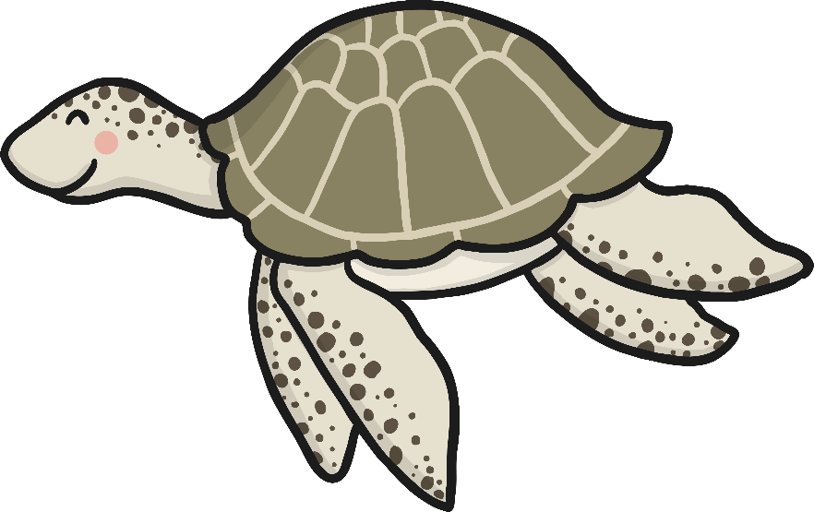
What am I?
4
Click the seaweed for clues.
I have 4 flippers.
I have cousins that live
on land.
I have a shell that protects me.
What am I?
A turtle!

Slide 24

What am I?
4
Click the seaweed for clues.
I look harmless but I am
very poisonous.
Some Japanese people like
to eat me.
I can blow myself up to be twice
as big when I am in danger.
What am I?
A pufferfish!

Slide 25
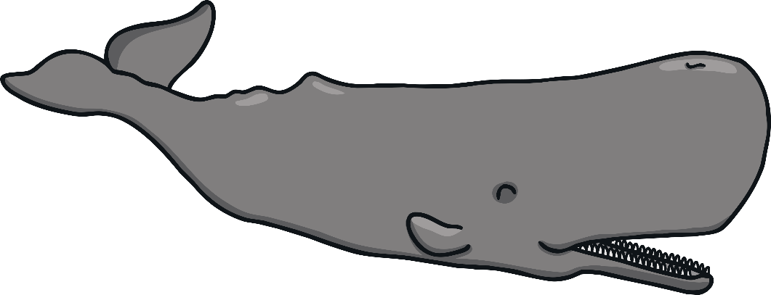
What am I?
4
Click the seaweed for clues.
I am a mammal.
I have a blowhole.
I can grow to be very big.
What am I?
A whale!

Slide 26
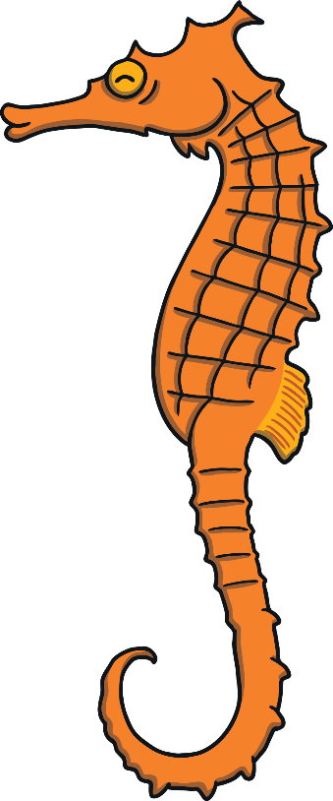
What am I?
4
Click the seaweed for clues.
Unusually, the males of my
species becomes pregnant.
I am an endangered animal.
Despite my name, I am actually
A fish.
What am I?
A seahorse!

Slide 27
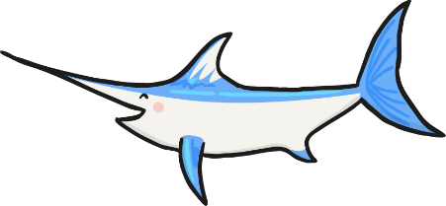
What am I?
4
Click the seaweed for clues.
I have a very long and
sharp nose.
I am one of the fastest
swimmers in the ocean.
I am most active at night.
What am I?
A swordfish!

Slide 28
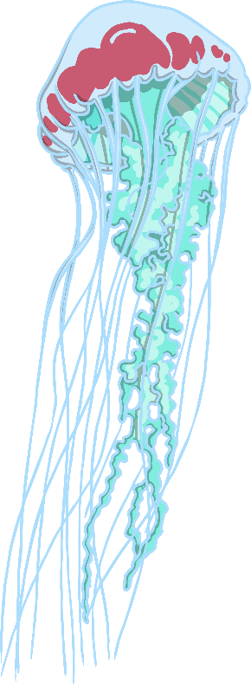
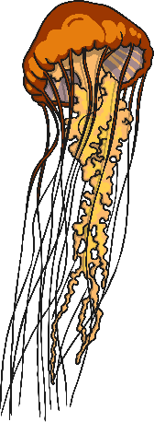
What am I?
4
Click the seaweed for clues.
I can be smaller than a pinhead
or bigger than a human.
I have no brain.
I can sometimes change colours.
What am I?
A jellyfish!

Slide 29
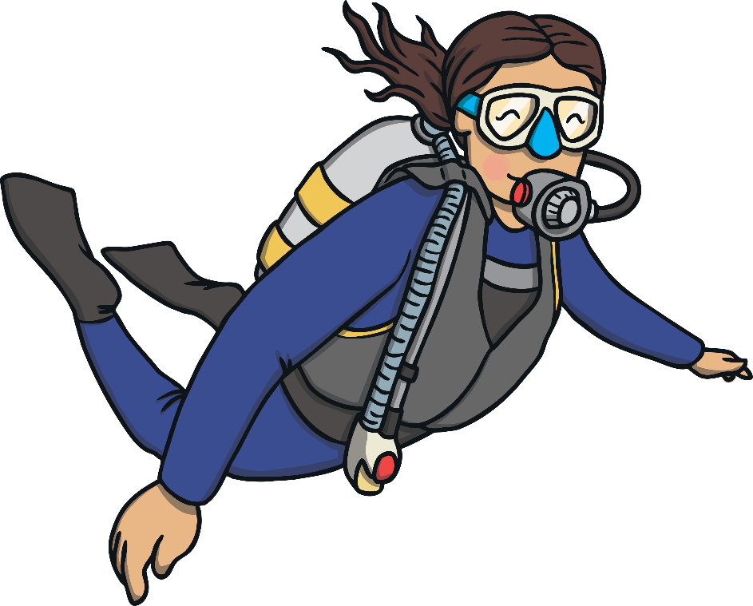
What am I?
4
Click the seaweed for clues.
I am a mammal.
I use special equipment to
Breathe underwater.
I spend most of my time on land.
What am I?
A scuba diver!

Slide 30
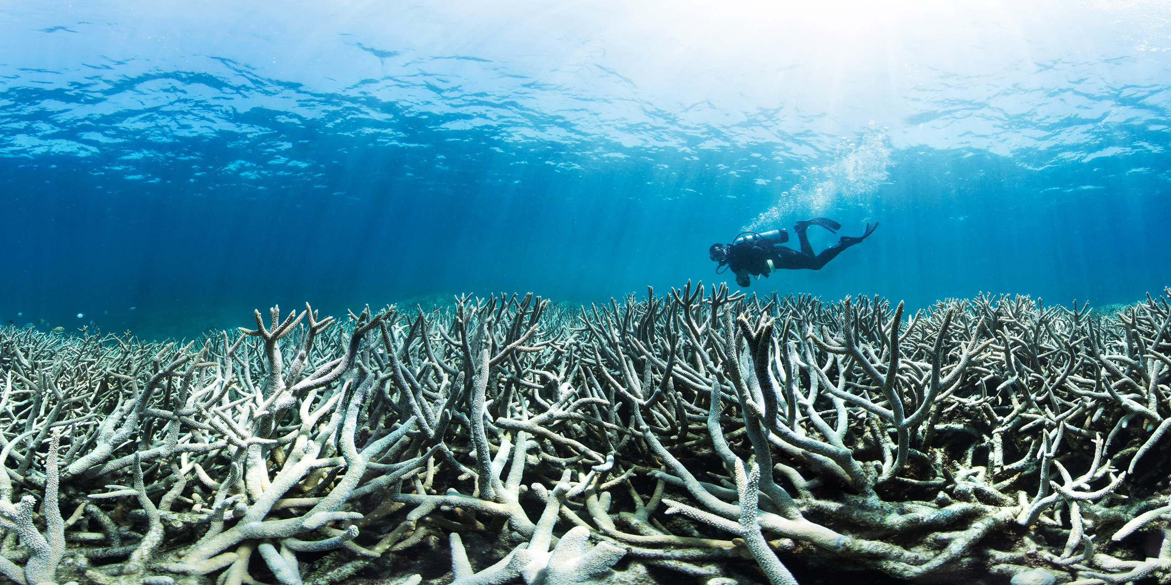
Here are 3 activities to do related to the Great Barrier Reef:
5
Great Barrier Reef Word Search
Great Barrier Reef Reading Comprehension
The Great Barrier Reef at Risk
(Answers are included so that work can also be marked.)
Notes:
Each file is able to be downloaded from Week 7 page on the website.

