Slide 1
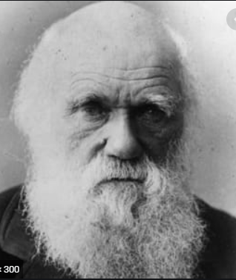
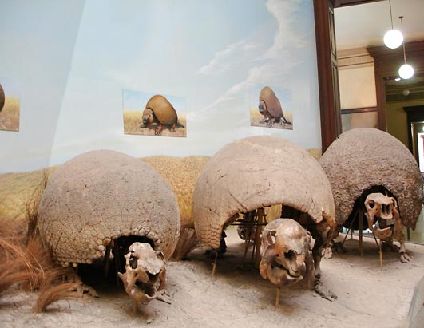

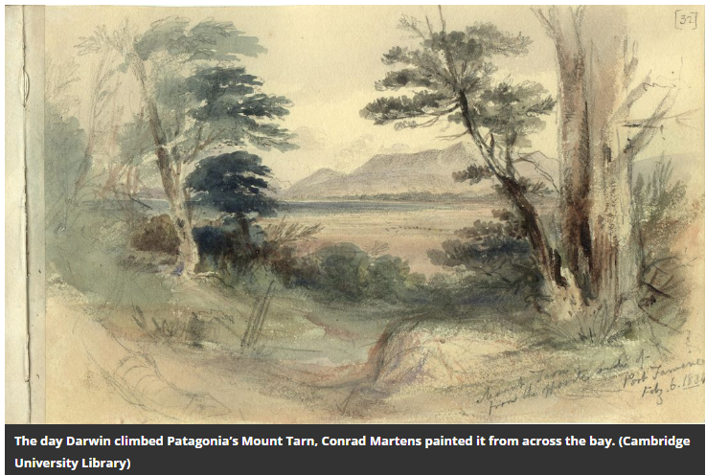
Evolution and Inheritance
Summer 2
Lessons 1 - 2

Slide 2
Lesson 1
L.O: To recorded initial ideas about evolution and inheritance
L.O: To be able to classify true and false statements.
S.C.
to recognise that living things have changed over time
to begin to identifying scientific evidence that has been used to support or refute ideas or arguments
Vocabulary
Evolve
Chronological
Evolution
Inheritance

Slide 3
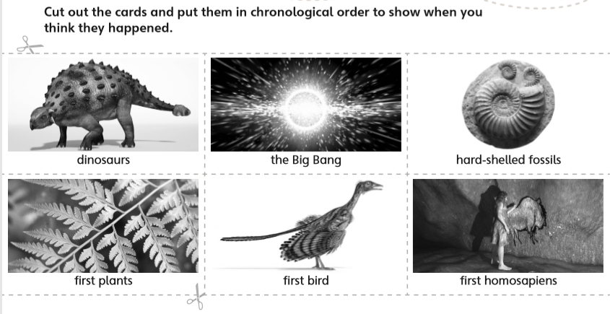
HOW do you think living things evolve? Why?
Discuss the chronology of each event as a group.

Slide 4
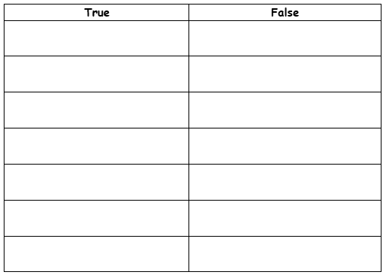
Task 2
L.O: To be able to classify true and false statements.
Look at the statements below and copy into the correct column.
Adaptations can happen as features are passed on over a long period of time.
Inheritance is the passing on of features from parents to offspring.
Human life has existed since a thousand years ago.
Charles Darwin created the theory of evolution.
Evolution has stopped.
All our features are passed on from our fathers.
Birds have evolved from dinosaurs.
Evolution shows how living things stay the same over time.

Slide 5
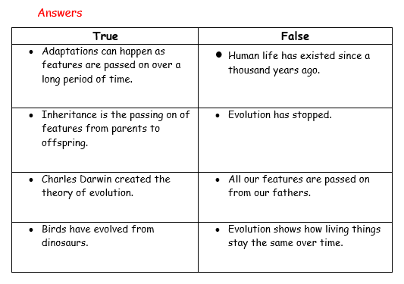

Slide 6
Lesson 2
L.O: To observe features that can demonstrate evolution.
L.O: To be able to classify true and false statements.
S.C.
to recognise that living things have changed over time
to begin to identifying scientific evidence that has been used to support or refute ideas or arguments
Vocabulary
Evolve
Chronological
Evolution
Inheritance

Slide 7
L.O: To observe features that can demonstrate evolution.
RECAP:
The Inklings of Darwin's Master Theory
Much of Darwin's adventure was spent studying the southern coast of what is today Argentina and Chile.
A collection of Glyptodons -- giant armadillo-like fossils -- are on display at the La Plata Museum in Argentina. On Darwin's voyage, he studied the glyptodon and other giant mammals.
By comparing the fossils of armadillos and sloths to the living creatures he observed around him, Darwin started to develop what was to become his master theory that species evolve over time.
But still, it took the whole journey -- through the Brazilian rain forest, up the Andes Mountains, across the South American Pampas and to the plains of Patagonia -- for Darwin's theory to actually crystallize.

Slide 8
L.O: To observe features that can demonstrate evolution.
NOTES FOR TEACHERS:
Either take class outside and collect leaves from different trees, or collect the leaves of different trees before the lesson for each of the children to have.
Children should attempt at drawing th leaves into their books, as this is a good observational skill to practise in science. They should then label their leaves. This is a good point for the children to see if they remember the names of the different parts of the leaves.
Move on to the next tasks.

Slide 9
Mild
Task 1: HOW do you think the tree leaves evolved?
Draw the different leaves into your book.
MILD: Write a paragraph giving your suggestions and
Spicy / Hot
Task 1: HOW do you think the tree leaves evolved? Why?
SPICY: Create a Carroll diagram to show your initial comparison.
HOT: Write a short report (including an introduction and conclusion) specifying the similarities and differences in more detail.

