Slide 1

PowerPoint 8 – Biography writing

Slide 2
Guide for parents/carers,
Always read the ‘notes’ section at the bottom of the slides for specific instructions before beginning the lesson.
Read the slide and set the tasks or challenges for the child/ren. There is no rush and you do not have to do everything, but be aware that the lessons follow and build on from one another, so try not to skip lessons but rather work in order and stop when you feel is best for your child. When next PowerPoints appear, don’t feel pressured to skip ahead if you have not finished everything yet, do what is best for you ☺
Some slides will have one task, others more. You can break these down however you like e.g. All the tasks on one slide can be spread across a few days or done in one day, but please do not do too much in a day! The slides are numbered to help you differentiate between the different tasks.

Slide 3
Art
1
Choose a sea creature (either your own choice or one of the following examples). Study it closely. Can you identify any of its parts? What shapes, textures, colours do you see?
Draw a large picture that is anatomically correct of your sea creature. This then needs to be coloured accurately, reflecting the image you are copying from.
You can use pencils, felt tips, paint, collage, pastels etc. or whatever else you have access to. These should be A4 or larger. I will ask to see these during our next zoom call.

Slide 4
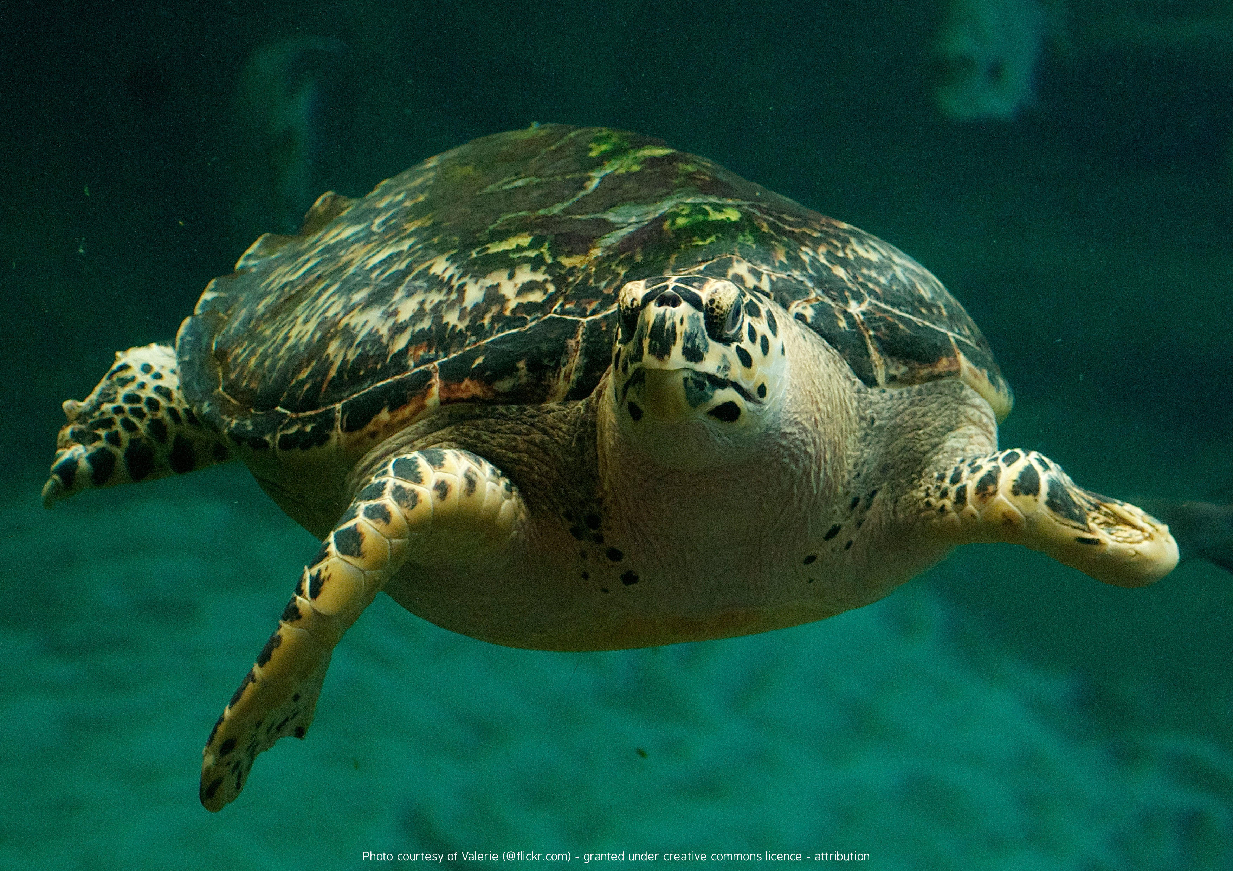
1

Slide 5
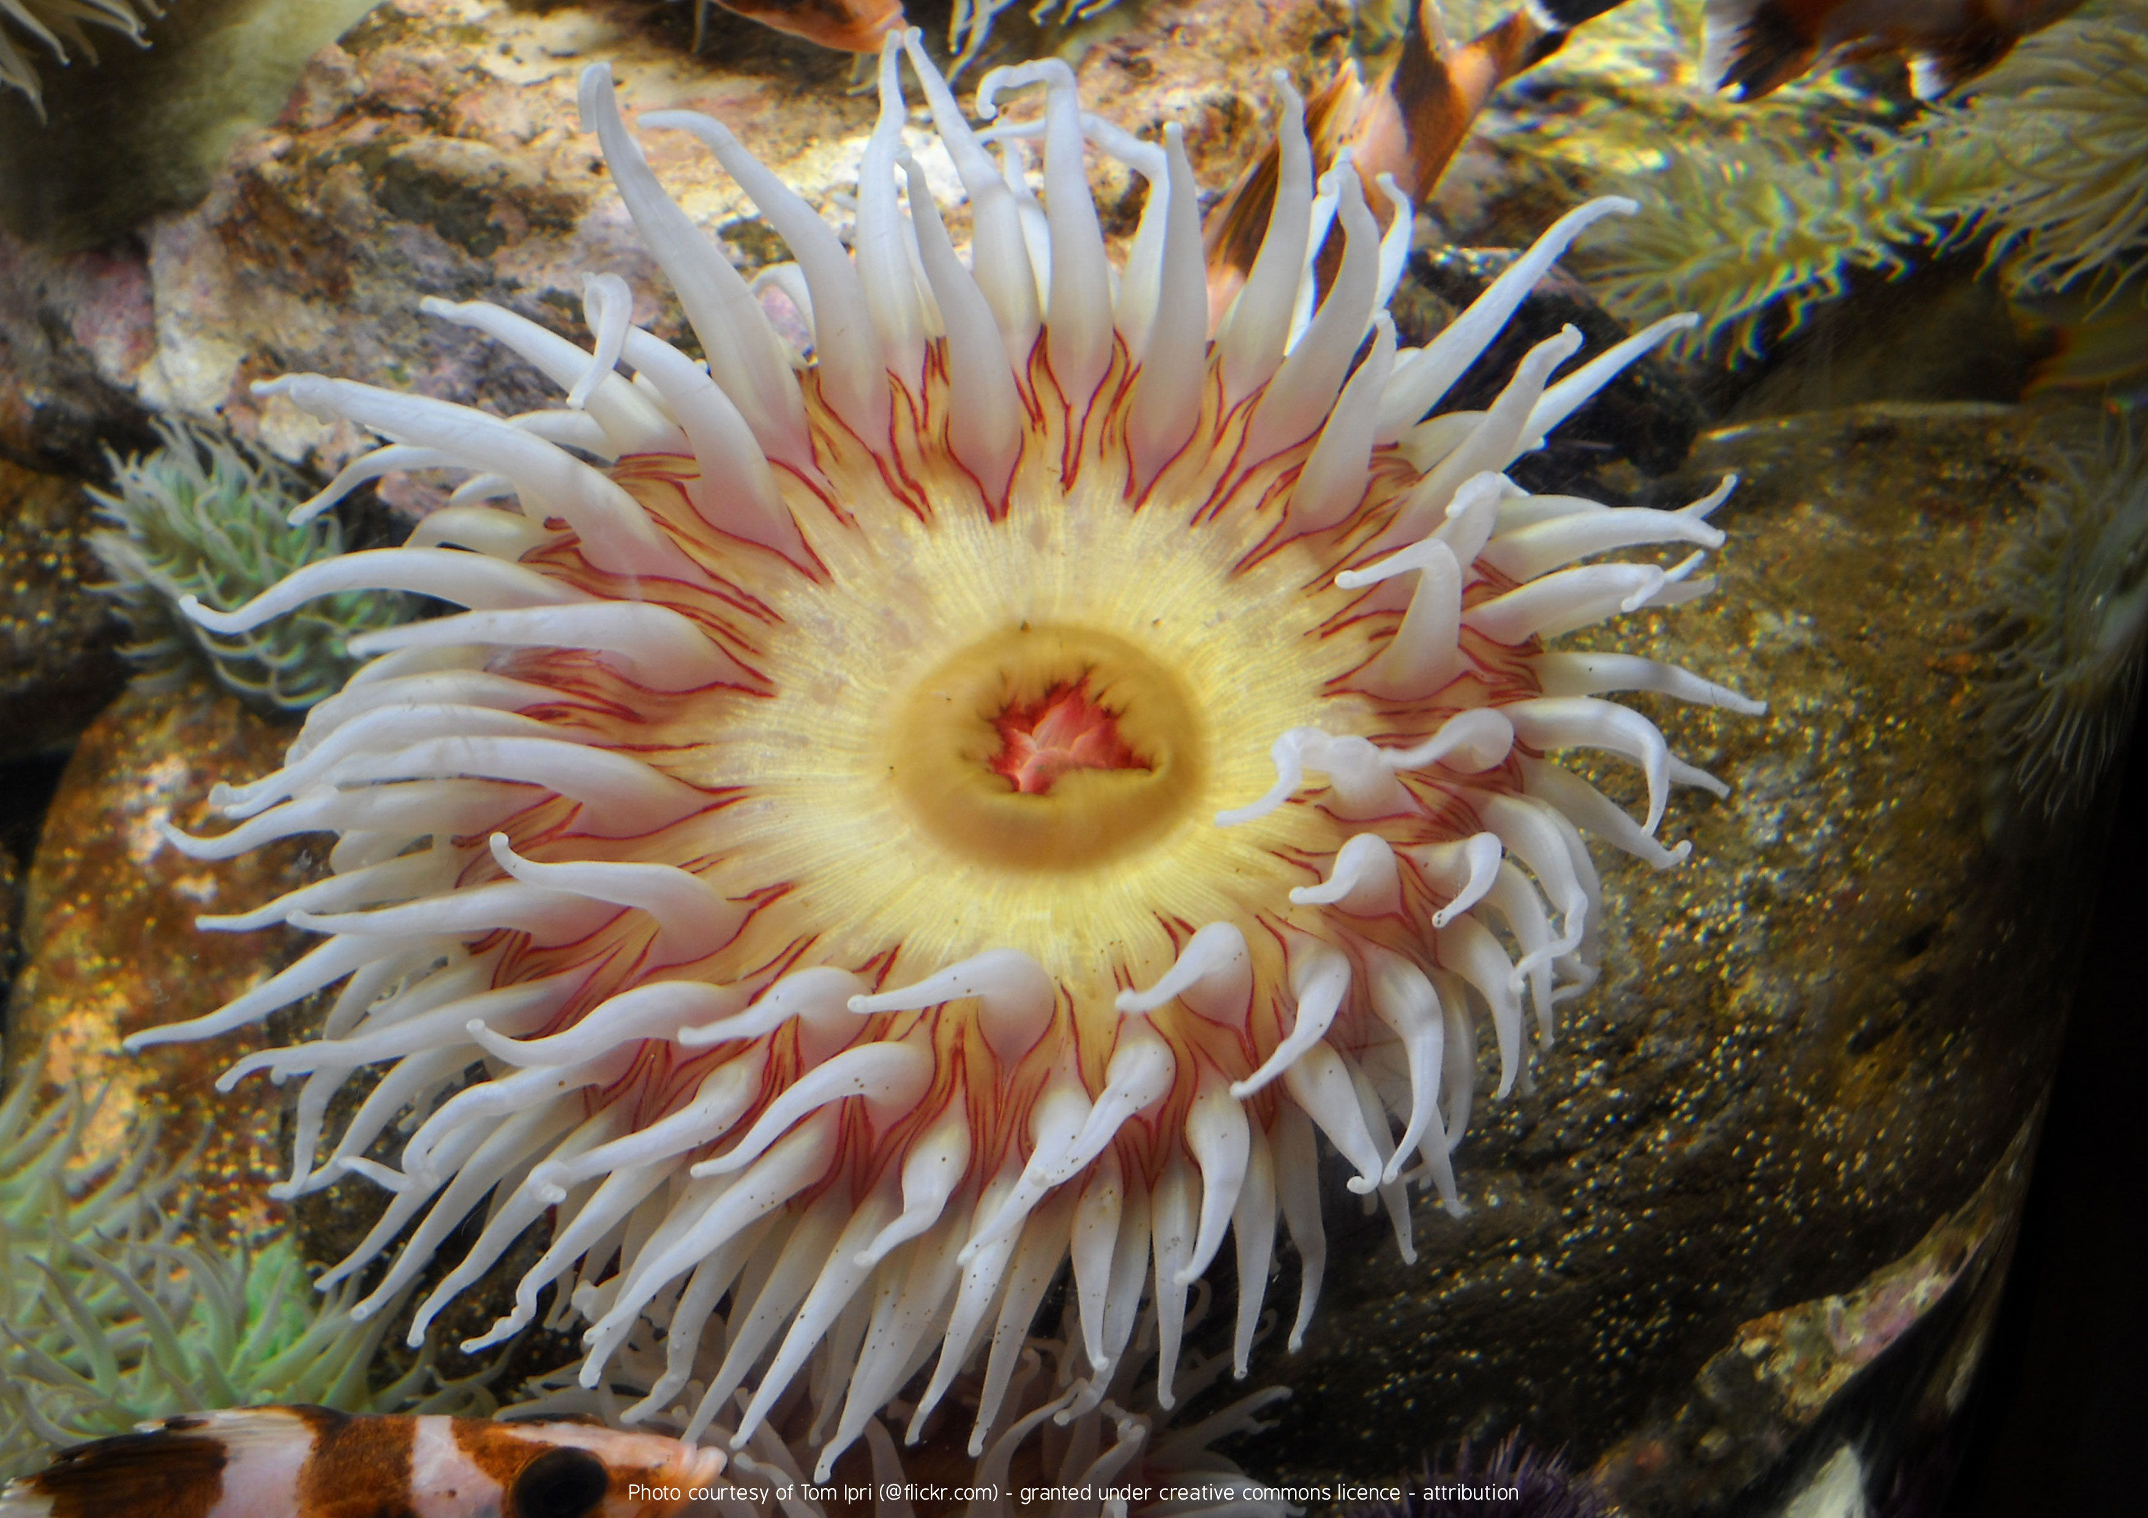
1

Slide 6
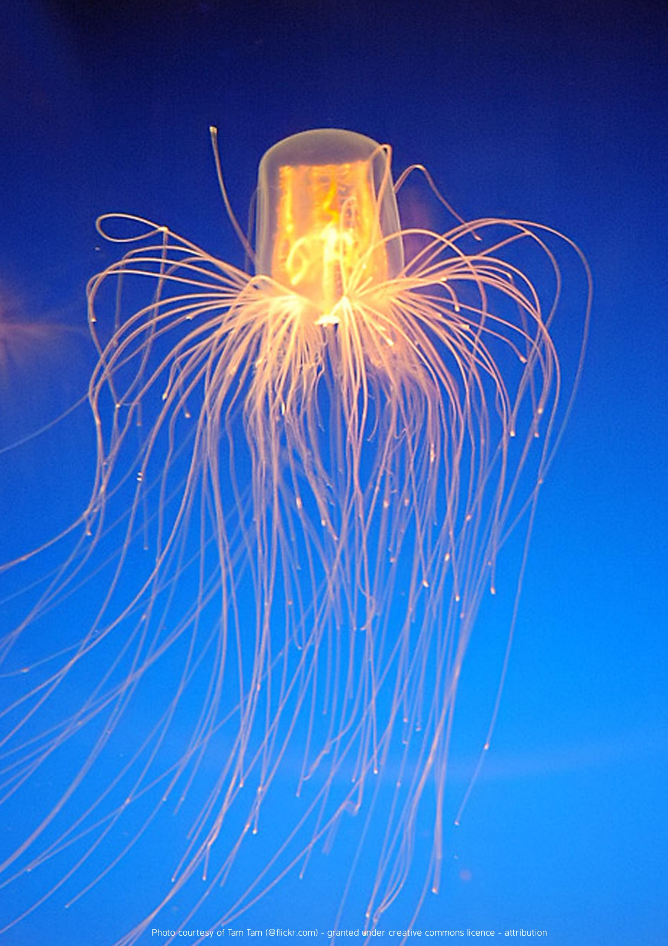
1
Notes:
Jellyfish

Slide 7
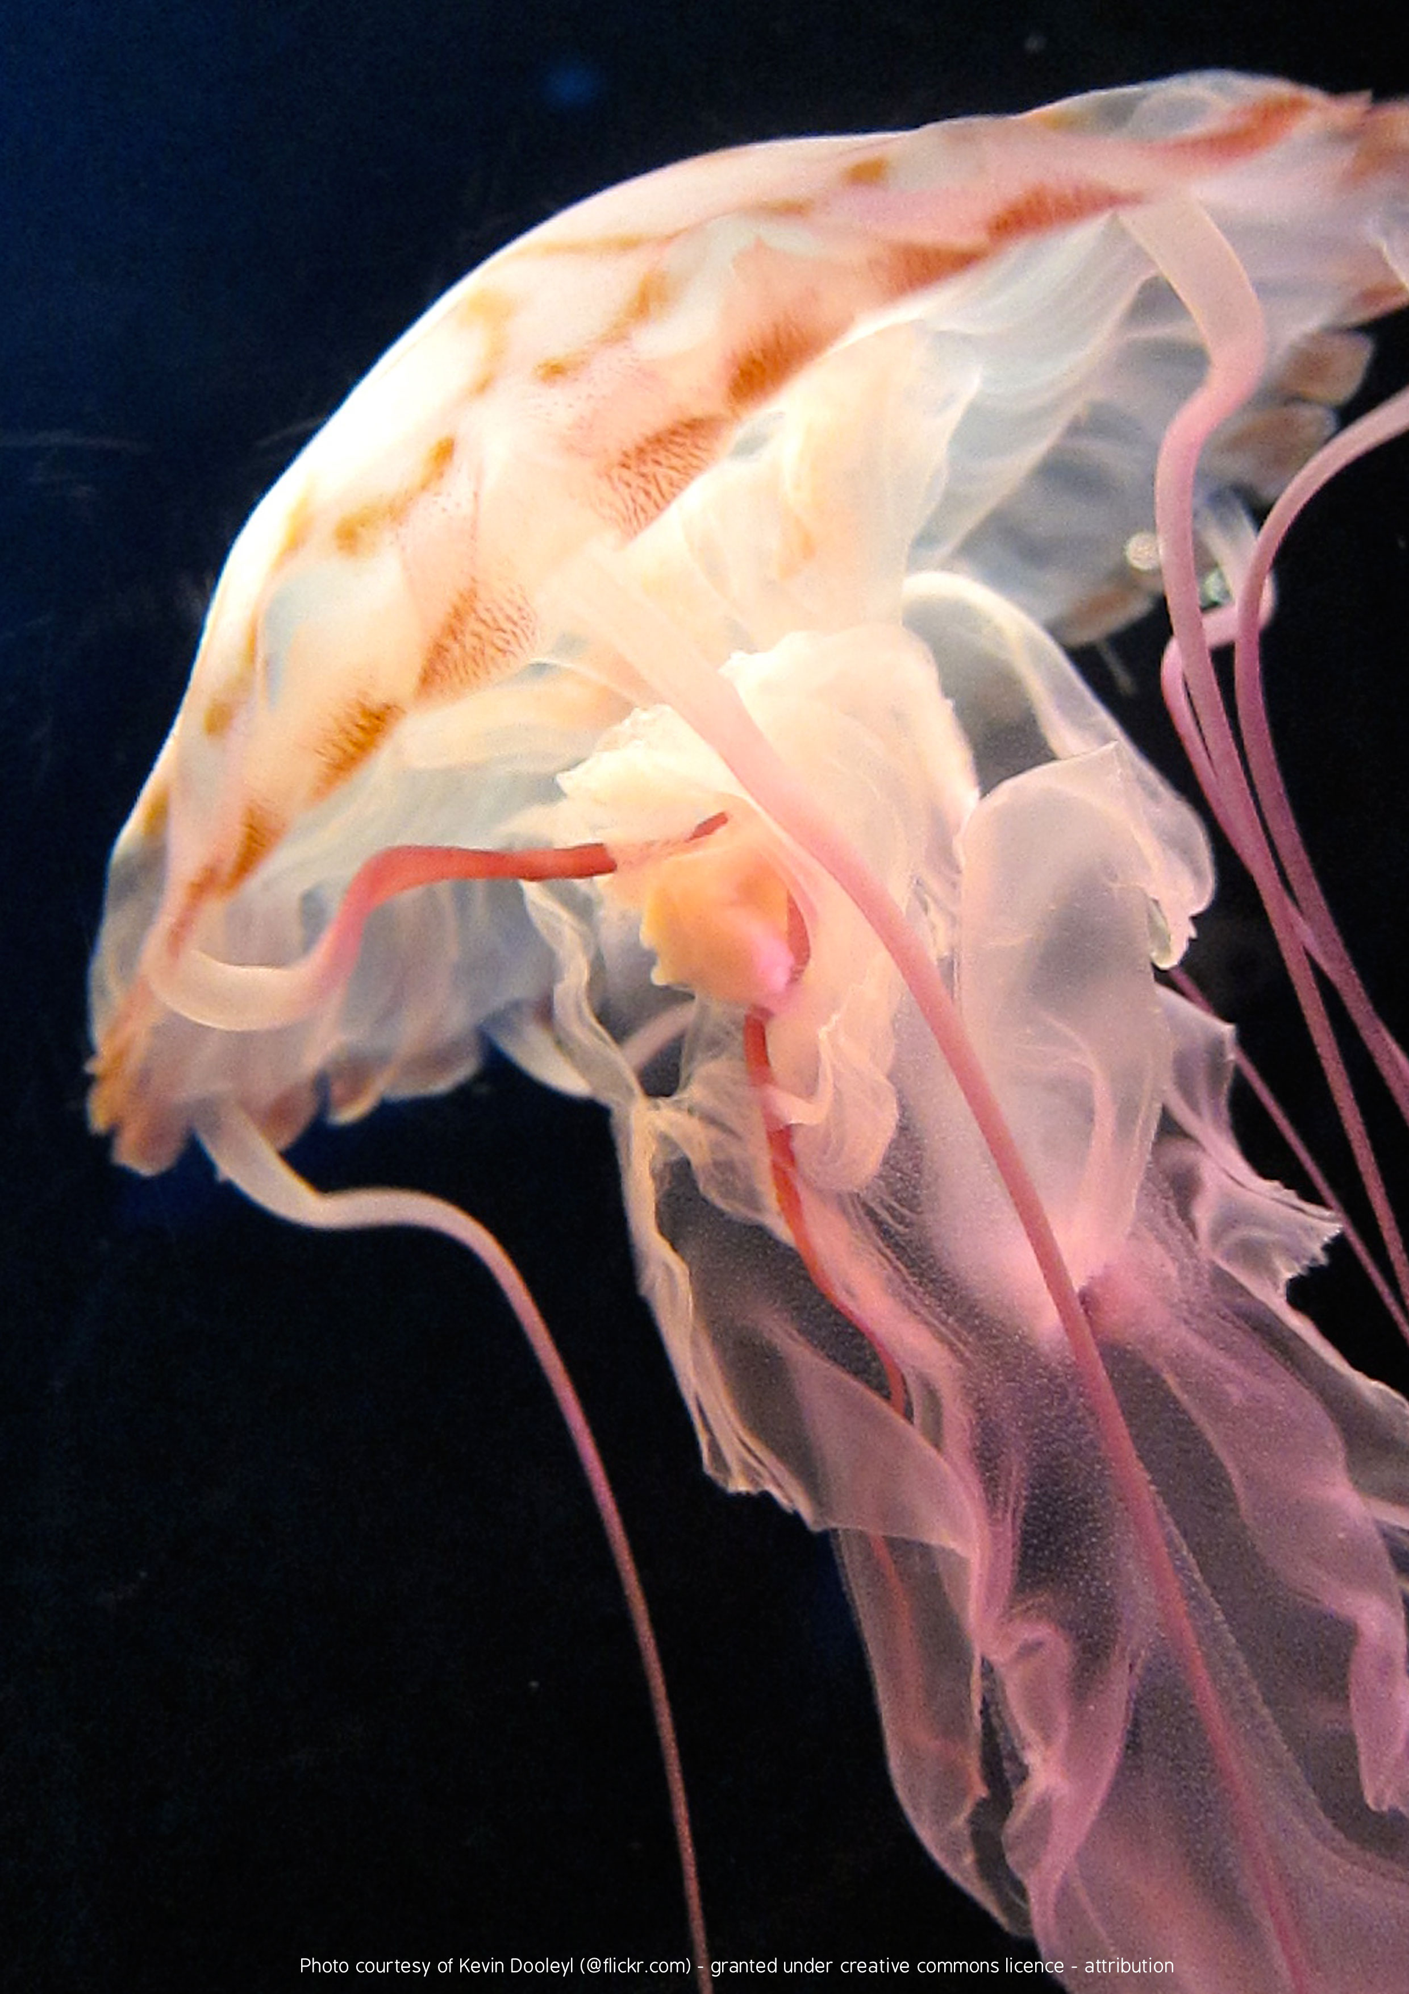
1
Notes:
Jellyfish

Slide 8
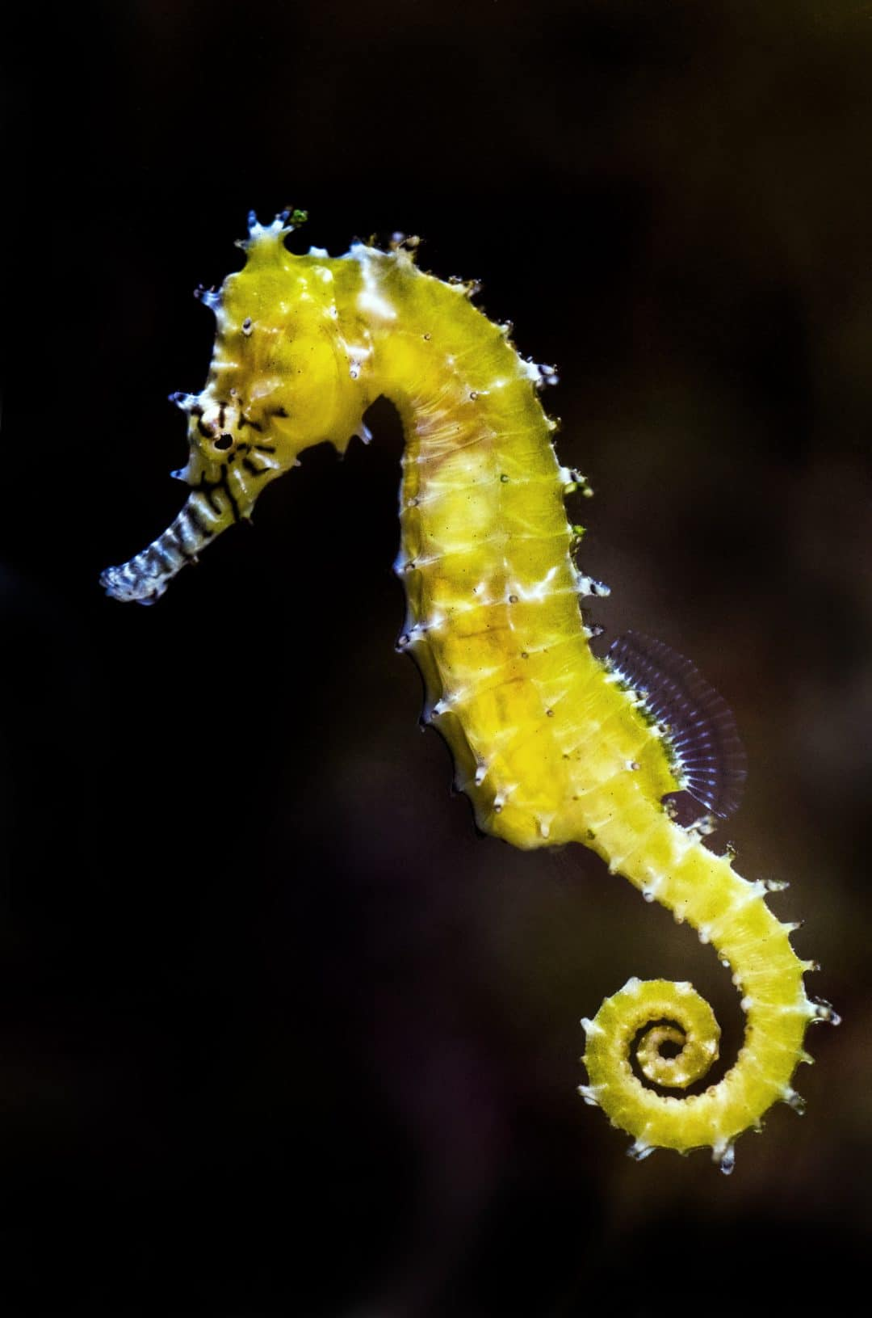
1
Notes:
Seahorse

Slide 9
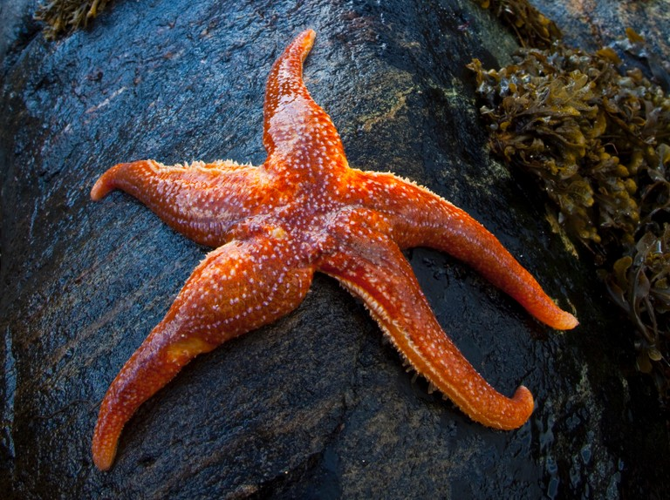
1
Notes:
Starfish

Slide 10
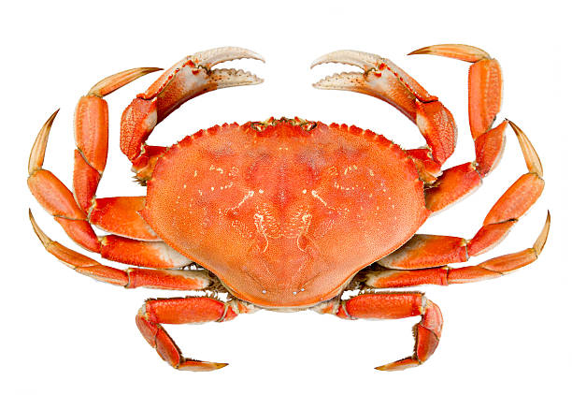
1
Notes:
Crab

Slide 11
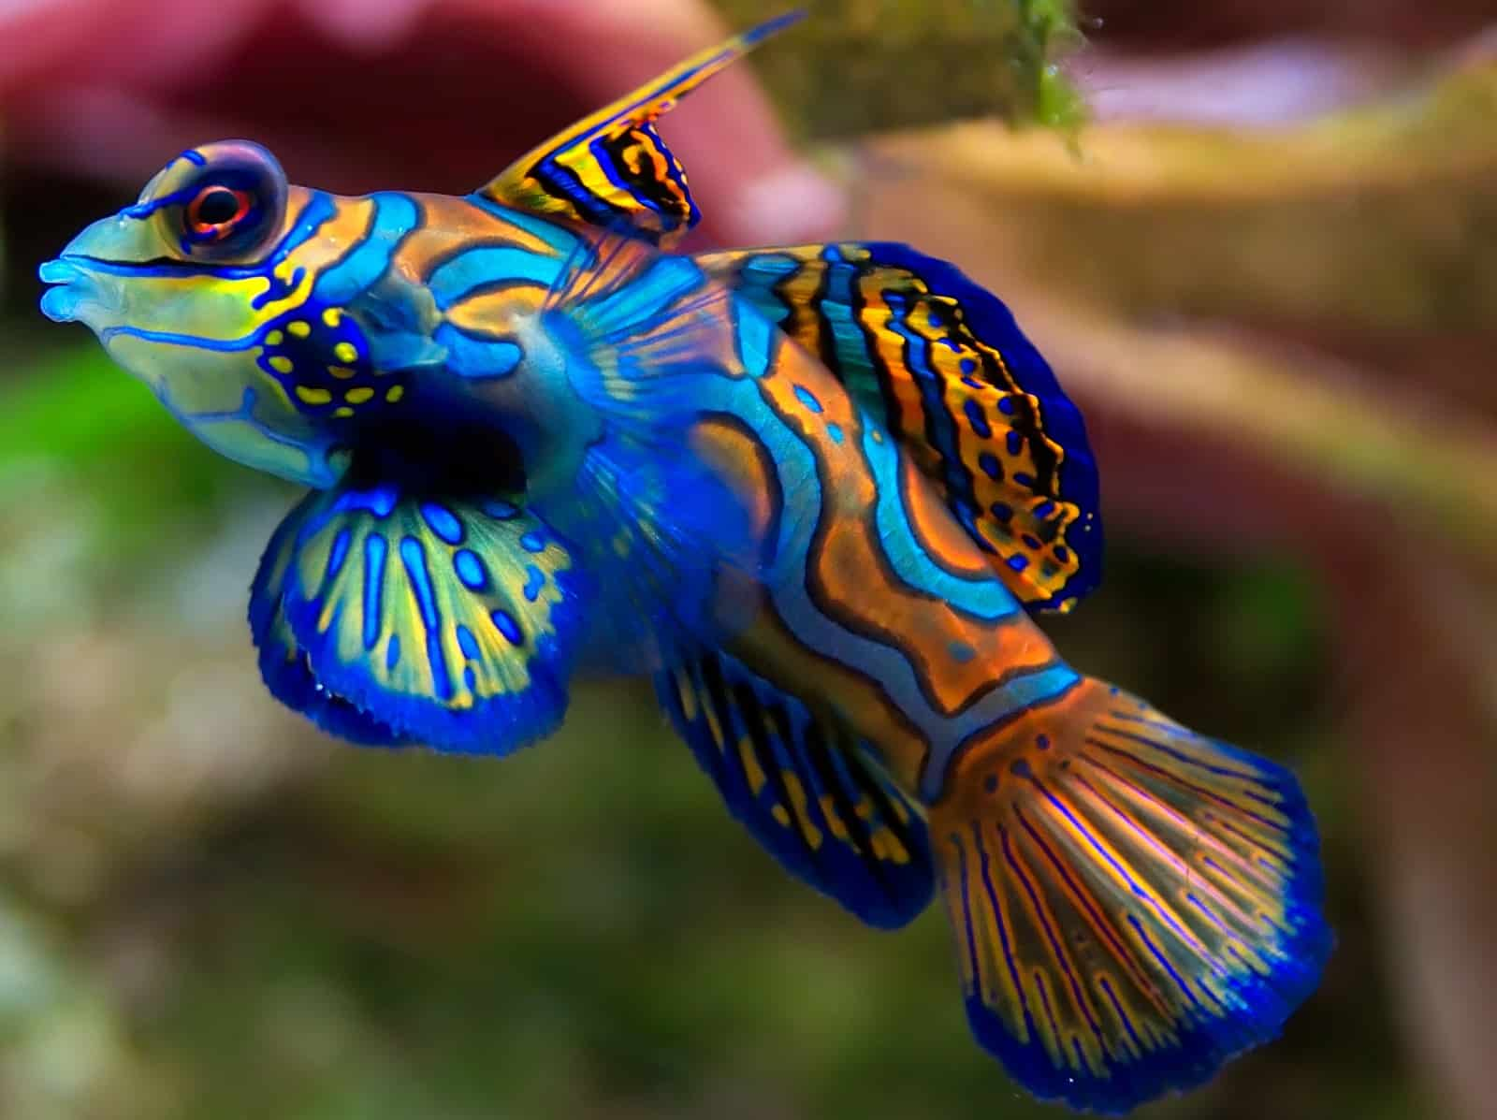
1
Notes:
Dragonet fish

Slide 12
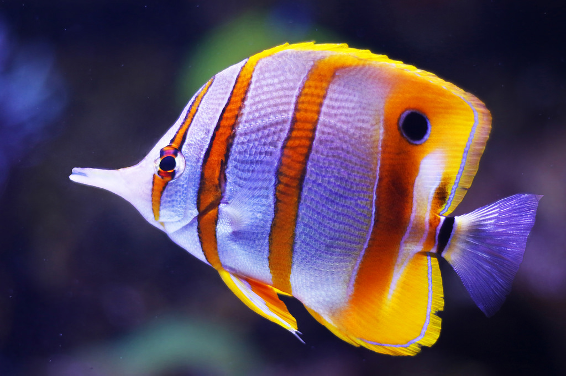
1
Notes:
Butterfly fish

Slide 13
2
Science

Slide 14
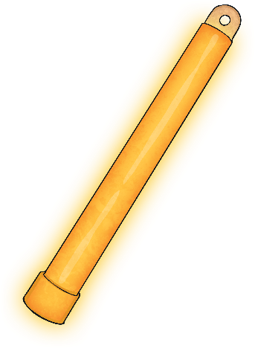
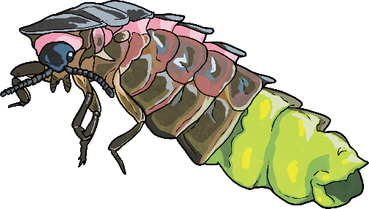
When the Lights Go out
2
Items that glow in the dark can be mysterious and fascinating.
Did You Know?...
Long before things such as glow sticks came along, some plants, fungi and animals were glowing in the dark. The production of light by a living organism is known as bioluminescence.

Slide 15
Let There Be Light!
2
Biologist William Beebe helped discover many marine species in the deep sea that glowed. These organisms had glowing spots in certain helpful places or glowing patterns on their bodies. Some glowing organisms that are found in the water include;
Anglerfish
Crystal jellyfish
Bathocyroe fosteri (jellyfish)
Tomopteris
Moon jellyfish
Atolla jellyfish
Clusterwink snail
Black dragonfish
Other glowing organisms can include certain types of;
Small invertebrates
Fungi
Flies
Worms
Snails
Why do YOU think some of these creatures can create their own light?
What do you think their habitats might be like?

Slide 16

Why?
2
It is thought that bioluminescence is used by organisms to lure prey, communicate, deal with a build-up of harmful chemicals and protect against predators.
Answers Coming to Light
We still do not know why many organisms use bioluminescence. Research is being done by scientists to discover why some living things want or need to create their own light. They are trying to answer questions like;
Why would a fungi use light?
What use is light to a worm living in the dark soil?
How is the light helpful to the organism creating it and other organisms?
The search is on to find more living things that can create their own light. However, discovering them is a real challenge as they can only be seen in the dark.

Slide 17
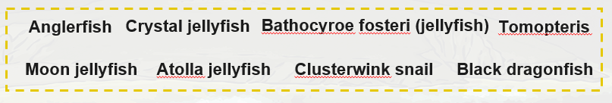
Create an information poster about one of these bioluminescent creatures:
2
Research the sea creature online and find out as much as you can. This post could be done on paper or on the computer. You could draw, stick or copy and paste a large picture of the creature in the middle then write facts all around it. Don’t forget to put the name of the creature on it! We will also be sharing these during our next zoom meeting.

Slide 18
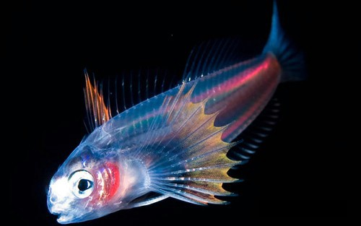
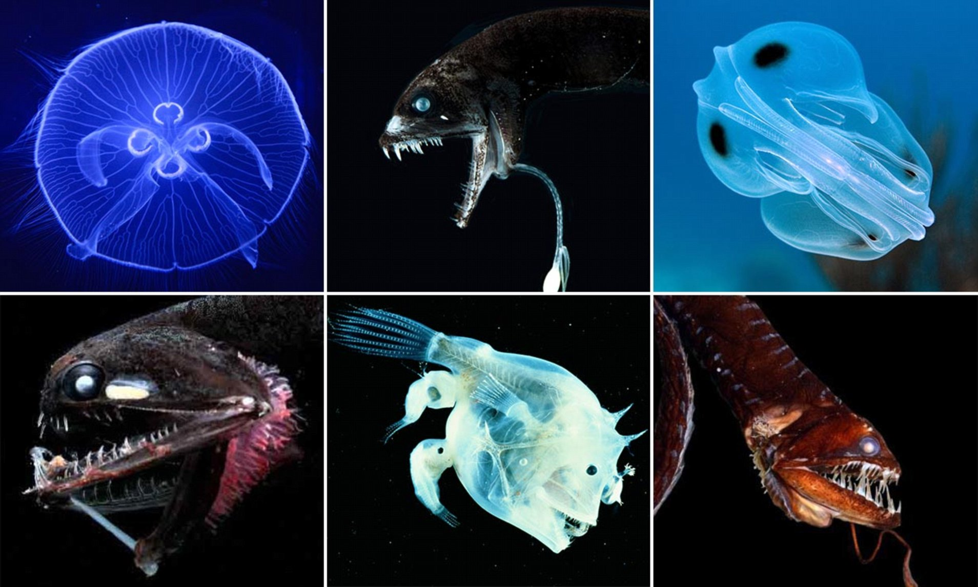
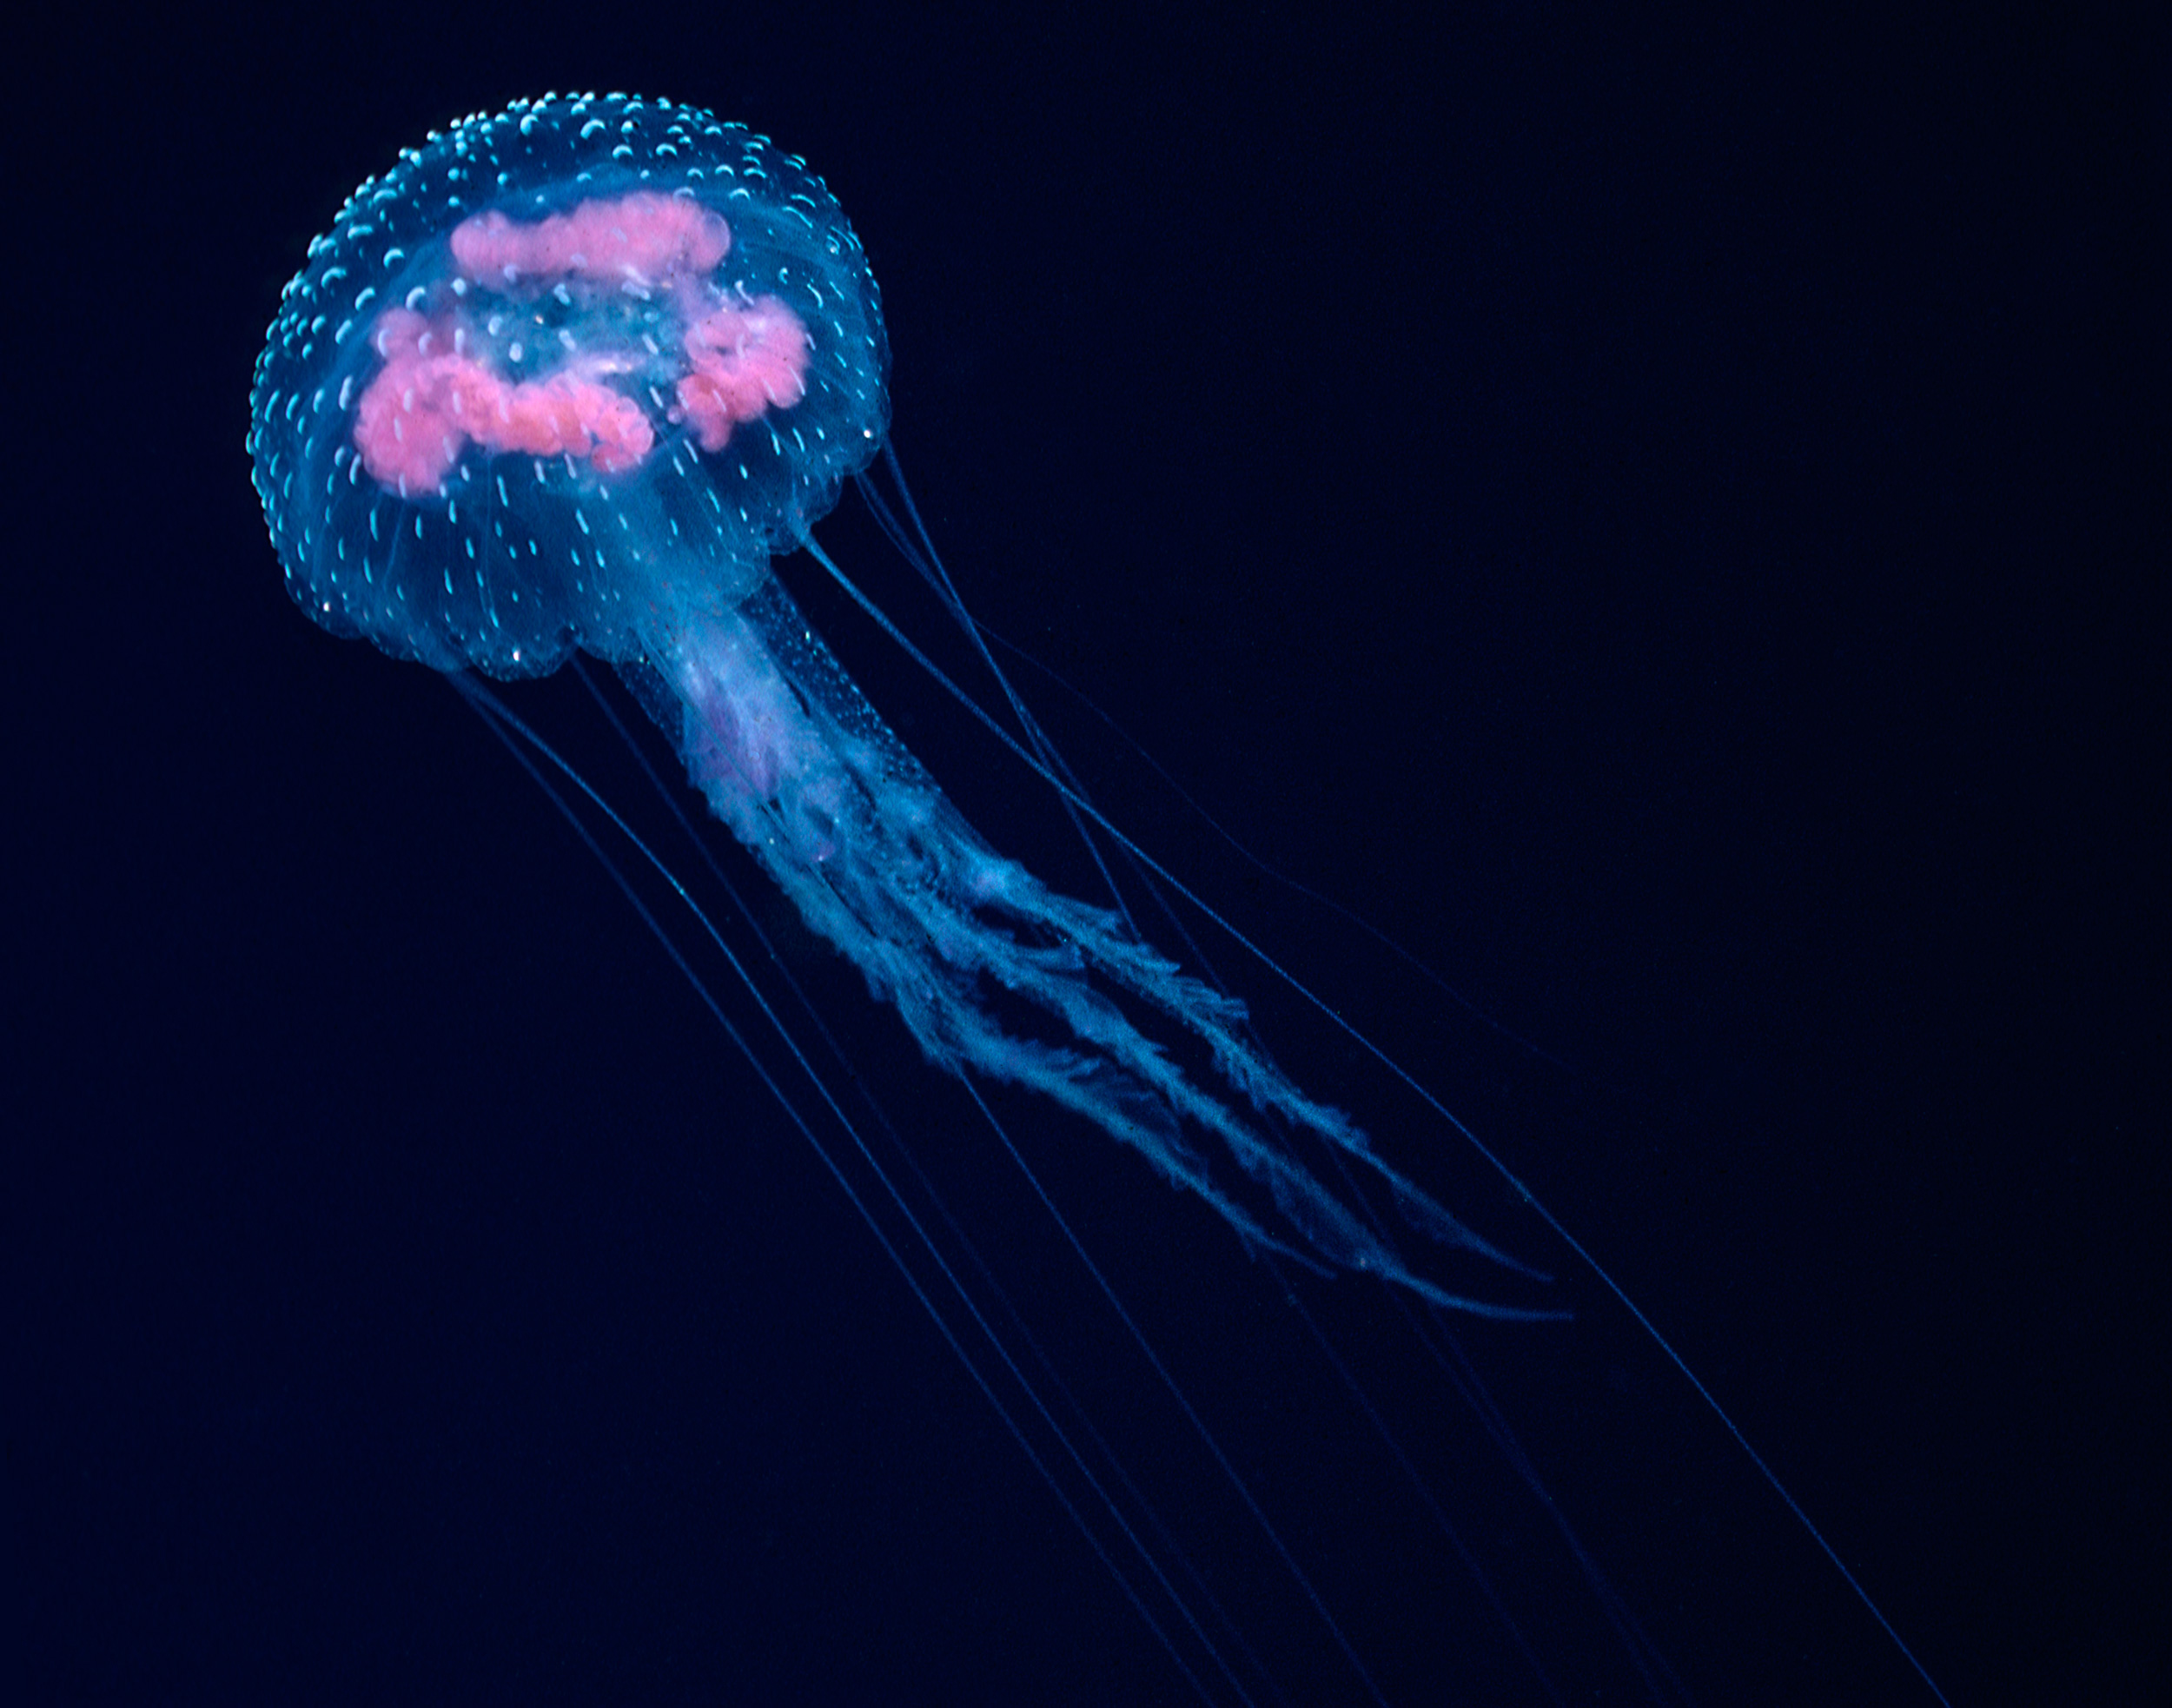
Art & Science
3
Design, create and label your very own mysterious create of the deep. Your new creature should have bioluminescent abilities. Use the pictures of tropical fish from before and the bioluminescent fish below to help you. Mix and match some features until you’ve created your new deep sea creature.

Slide 19
Literacy – writing in role
4
https://www.youtube.com/watch?v=UXl8F-eIoiM
https://www.youtube.com/watch?v=9HXXQBz6Vv0
Watch these videos and try to imagine what it would be like to live right at the bottom of the sea.
What would it be like?
Create a word bank. Don’t forget to up-level your vocabulary!
Notes:
Word bank prompts: cold, dark, pitch black, freezing, sunless, hopeless, lonely, empty, silent, terrifying, eerie, lost, etc. Build up a bank together (written down) of as many words as you can think of to describe what it would be like to be down there.

Slide 20
Writing in role
4
Using your word bank and ideas from the pictures and videos. I would like you to write in role as a bioluminescent fish. Perhaps you could add some more ideas to your word bank at this point. Are you a predator? Are you big or small? Is your light all over your body or just a certain part/s? How do you feel? What is your environment like? Think deeply.
Remember to use personal pronouns when writing in role… e.g. I, my, me etc.
Introduction (what type of fish, where are you, how you feel briefly)
Appearance
Environment
Thoughts and feelings
Hopes for the future
Notes:
This should be 3-5 paragraphs, based on the child’s ability. (Each bullet point could be a short paragraph)

Slide 21
RE – The Story of Jonah and the Big Fish
5
https://www.youtube.com/watch?v=2LzhwHinO1k
Once you have watched the story, answer these questions:
Why did God want Jonah to go to Nineveh?
Why do you think Jonah did not want to go there?
What happened to Jonah when he disobeyed God and why do you think God chose this punishment for him?
What did Jonah learn after leaving Nineveh?

Slide 22
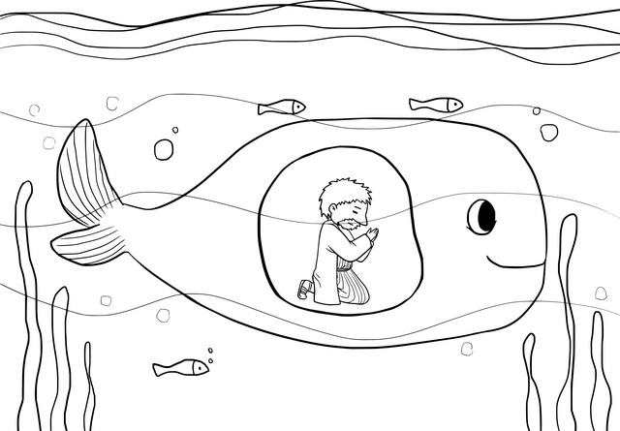
RE and Literacy – Writing in role
5
Imaging you are Jonah, in the belly of the big fish. You are praying to God for mercy and forgiveness for not following and spreading his word to those who needed to hear it.
Write a prayer to God as Jonah.

