Slide 1
PSHE and History
Equality and celebrating difference

Slide 2
A message to the parents…
With everything that is happening in the US and UK recently, I felt it was my duty to help educate our children, alongside you, about equality and the celebration of difference.
We are all one family.
I have designed this PowerPoint to explore what equality truly means and to encourage children to understand that this does not necessarily mean the same for everyone. I have put it together to be explored, discussed and for the tasks to be completed WITH the child… or even as a family.
Please do not feel obliged to do this if you do not feel comfortable or confident discussing it. But I want you to know, even as adults, it is okay for our children to know that we do not always have all of the answers. But that we will try to learn along the way.
Some of the events that have occured have been distressing and you may want to skip two slides that is aimed specifically at children who are already aware of what happened in America a few weeks ago and about the protests that have taken place since. THIS IS OPTIONAL. The entire lesson is OPTIONAL. Please do NOT feel ANY pressure. I just wanted to create a resource for parents who were looking for a child-friendly way to approach discussions on equality.
I hope you are all well and continue to stay safe,
Ms Foster

Slide 3
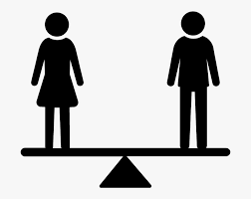
What does the word ‘equality’ mean?
Have a think.

Slide 4
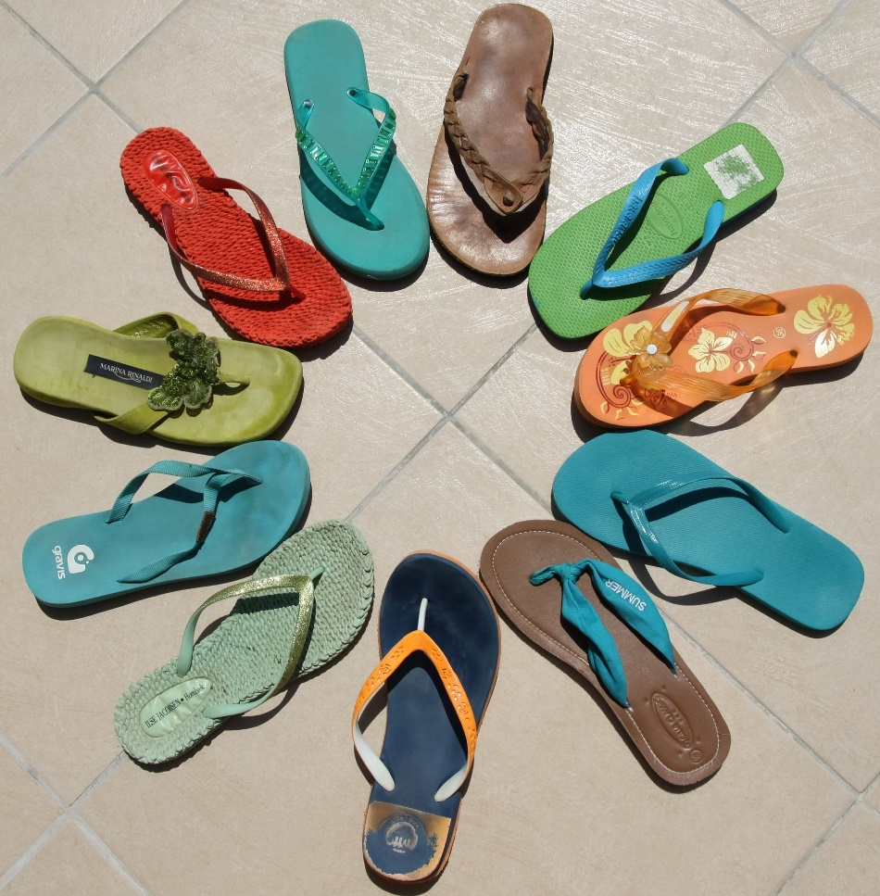
What Is Equality?
Equality is:
understanding that everyone is different but that we are all people;
knowing that everyone has the right to be treated fairly;
treating others with respect.

Slide 5
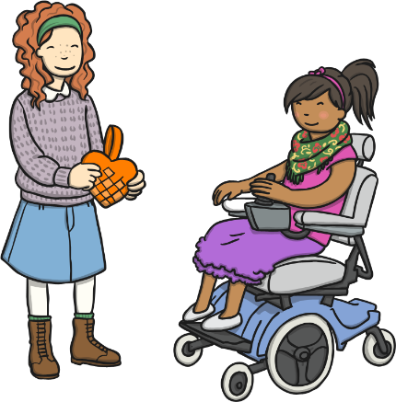
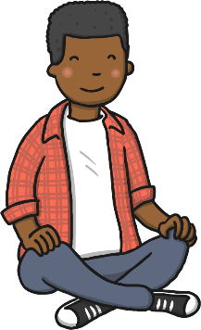
We Are All The Same
we all have likes
we all have needs
we are all people
we all have feelings
we all have thoughts
Can you think of anything else that makes us the same?
Discuss

Slide 6
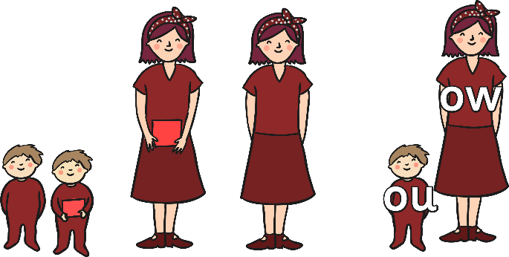
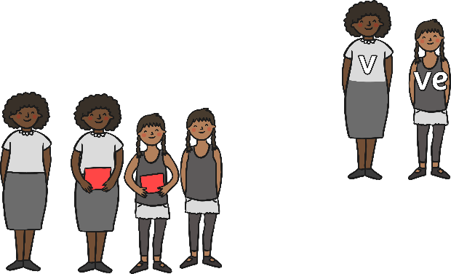
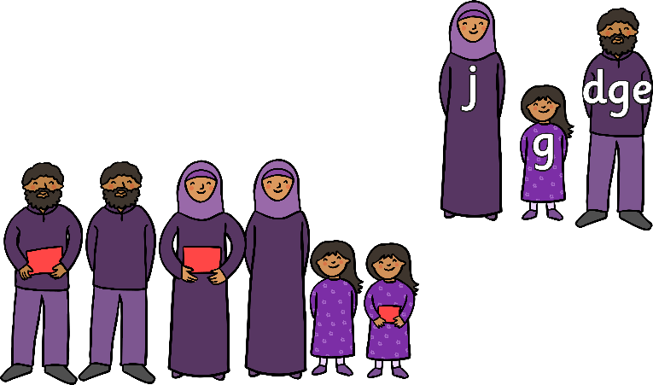
What Things Make Us Different?
eye colour
hair colour
our personalities
what we like
skin colour
where we live
Can you think of anything else that makes us different?
Discuss

Slide 7
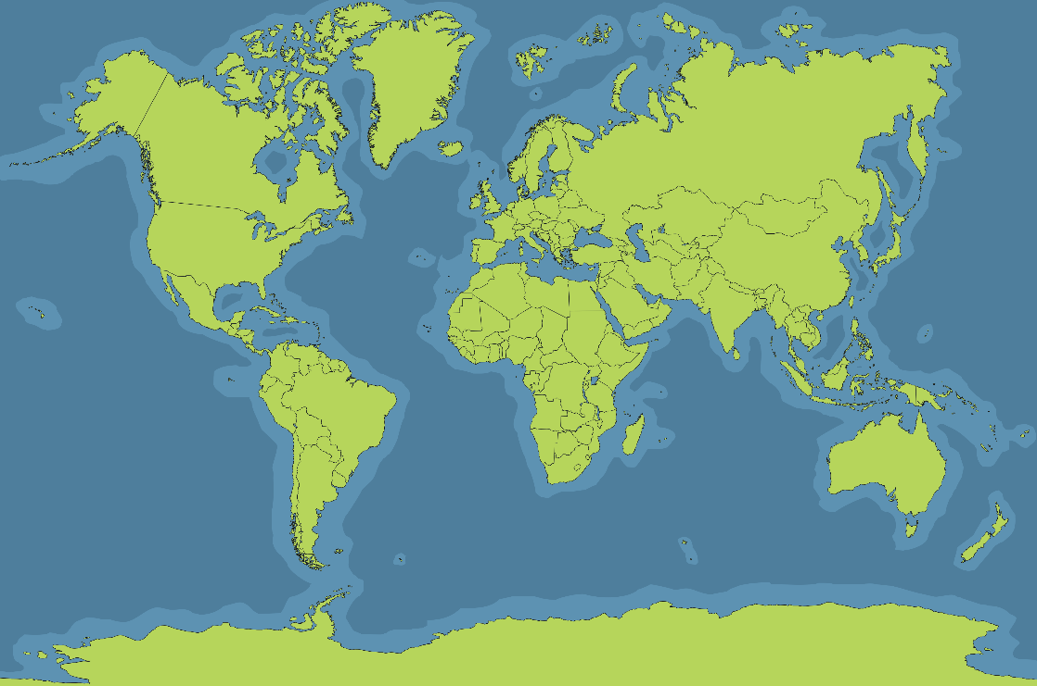
Why are People Different
Lots of people in this country have come from other countries – or their, families came from other countries. This is a good thing, because it means we have a mix of lots of different people living together.
We call this mix of different people living together diversity.
Look at this map of the world.
Do you or anyone in your family come from a different country? Do you know anyone who comes from a different country? Do you have any family who live in a different place?

Slide 8
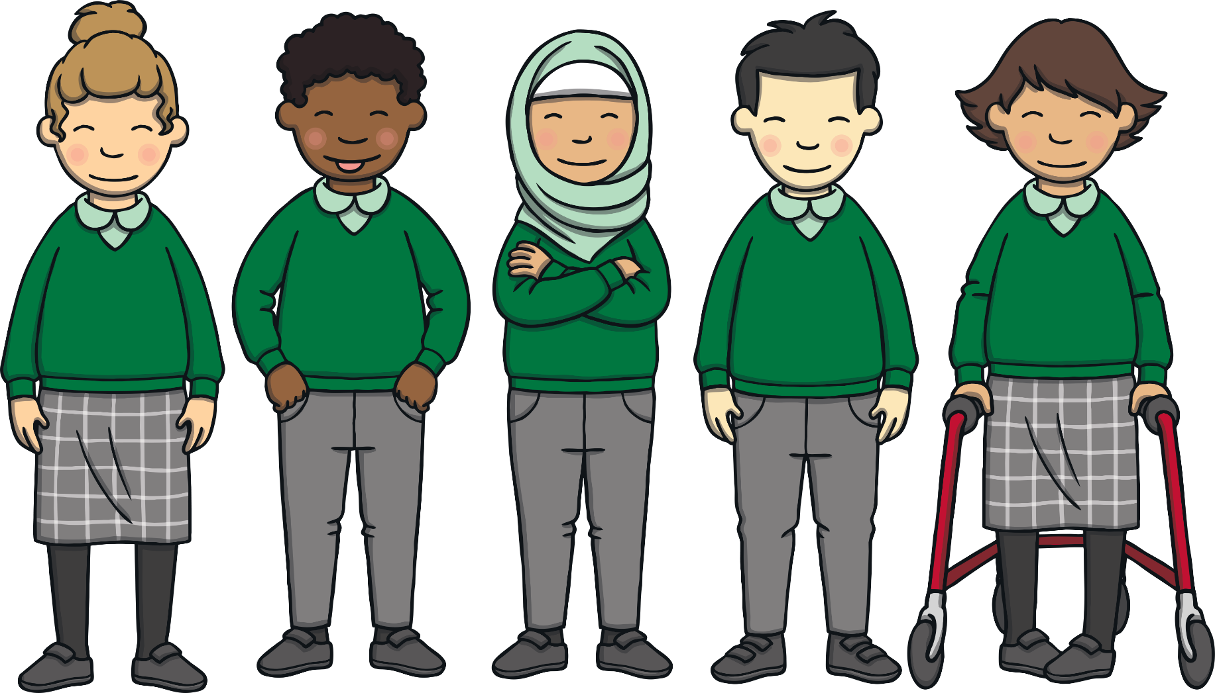
Respecting Differences
It is very important to respect people’s differences and not make fun of them. Being different is what makes us all special and interesting!
If you are unkind about the ways someone is different, this is called discrimination.

Slide 9
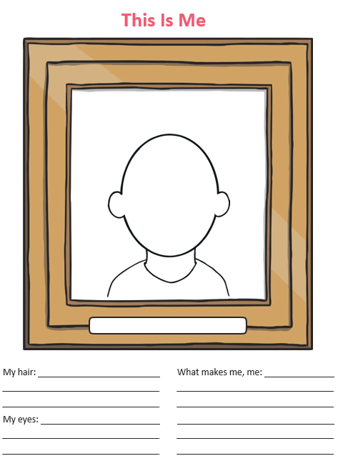
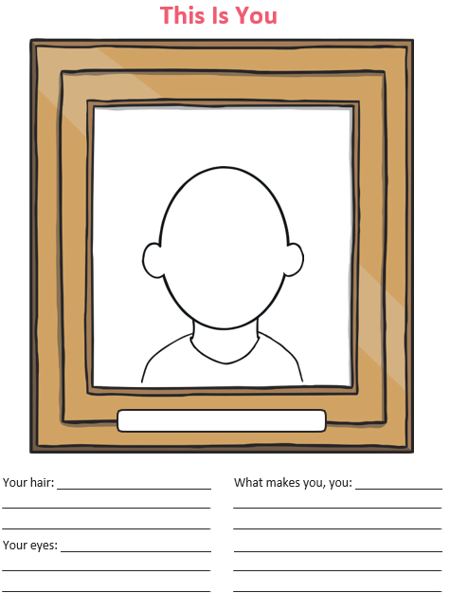
Notes:
Pick a friend or somebody you know that is different inside and out to you to do the ‘This is You’ page about.

Slide 10
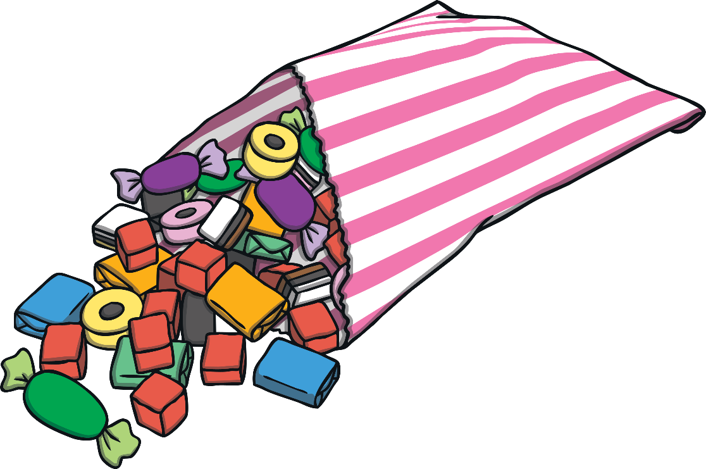
What If…?
What if your teacher shared some sweets with the class and gave
two to each boy but said that the girls could only have one?
Is this right?
Is this fair?
What could the teacher do
to treat the children more fairly?
Discuss

Slide 11
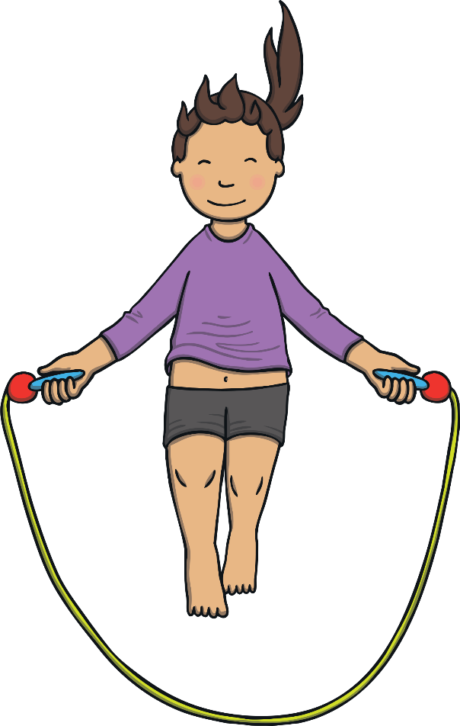
What If…?
What if your class are skipping in PE and your teacher says
that only children with brown hair are allowed a turn?
Is this right?
Is this fair?
What could the teacher do
to treat the children more fairly?
Discuss

Slide 12
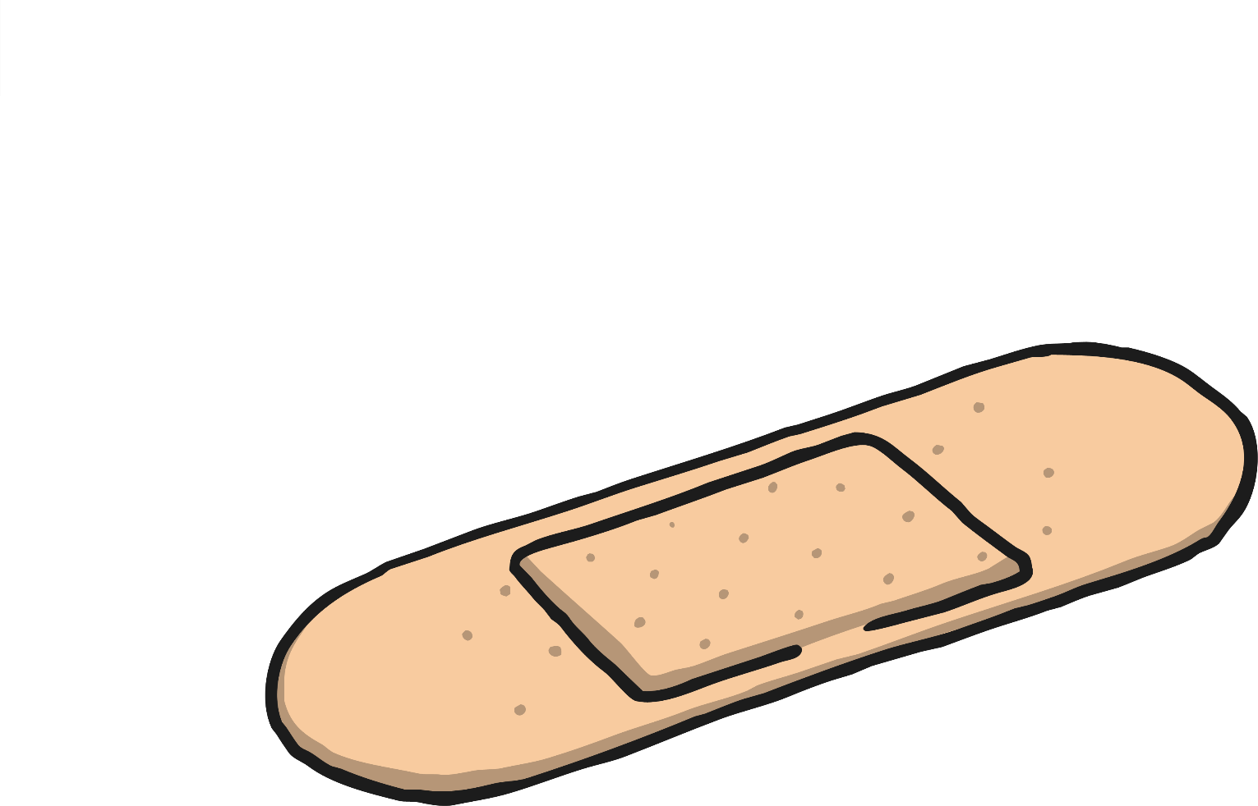
What If…?
What if you fall and hurt your knee and the teacher gives everyone
in the class a plaster for their knee so that it is fair.
Is this right?
Is this fair?
Does equality always mean that everyone has be treated the same?
Discuss

Slide 13
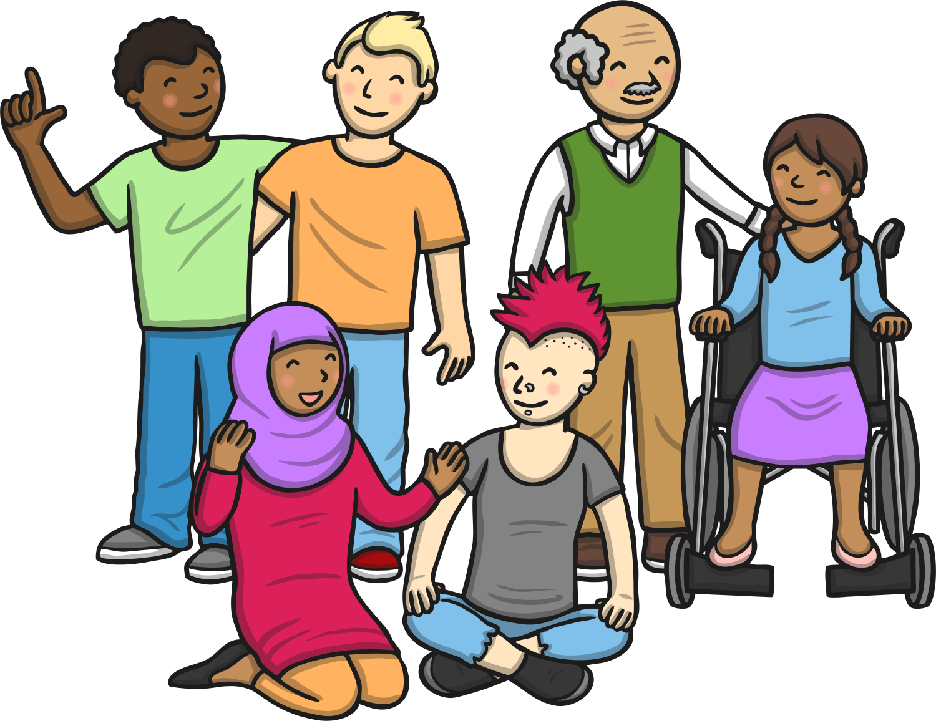
Remember, equality is when we make sure that everyone is treated fairly. It doesn’t mean that everyone has to be treated the same.
Can you think of an example of where treating someone or a group of people differently, makes things fairer for them?
Discuss

Slide 14
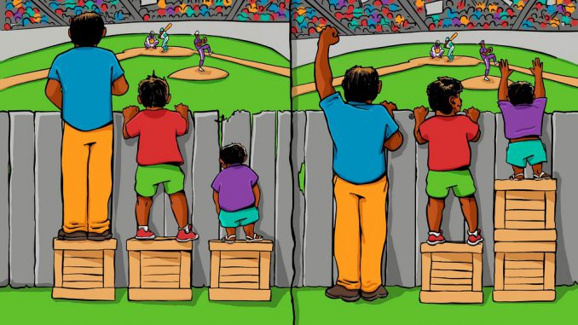
Can you explain this image?
Which one is fairer and why?

Slide 15
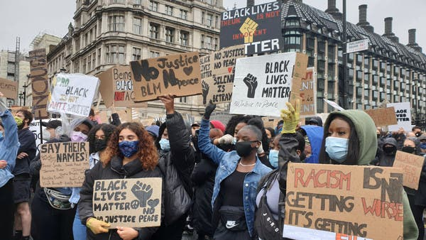
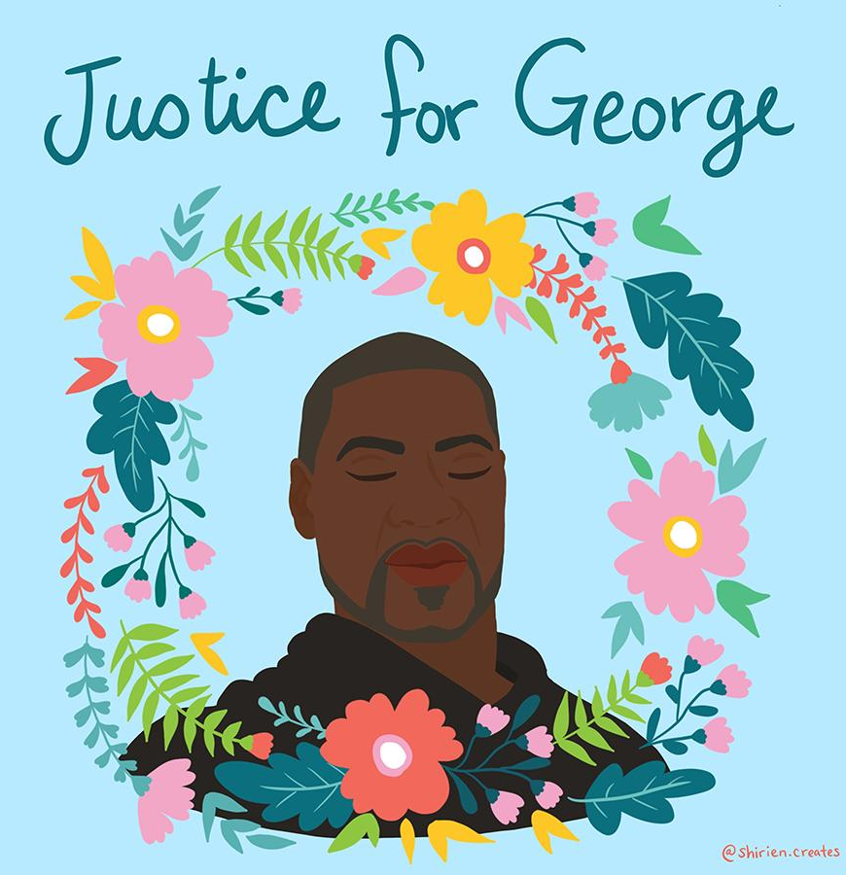

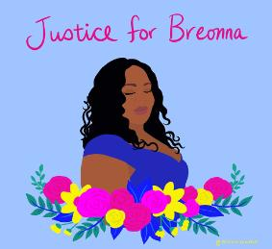
Why do you think we are discussing equality today? Is there anything you’ve seen or heard about recently related to issues of equality?
Notes:
If you do not wish to discuss the protests or are unsure how to, please feel free to skip this slide and the next.

Slide 16
Do you have any thoughts and/or feelings that you would like to share about what’s been happening in America and Britain?
This is a safe space to share your ideas and for us to learn about how we can make a difference and create a fairer world for ourselves and everybody throughout our lives.
Notes:
If you do not wish to discuss the protests or are unsure how to, please feel free to skip this slide and the next.

Slide 17
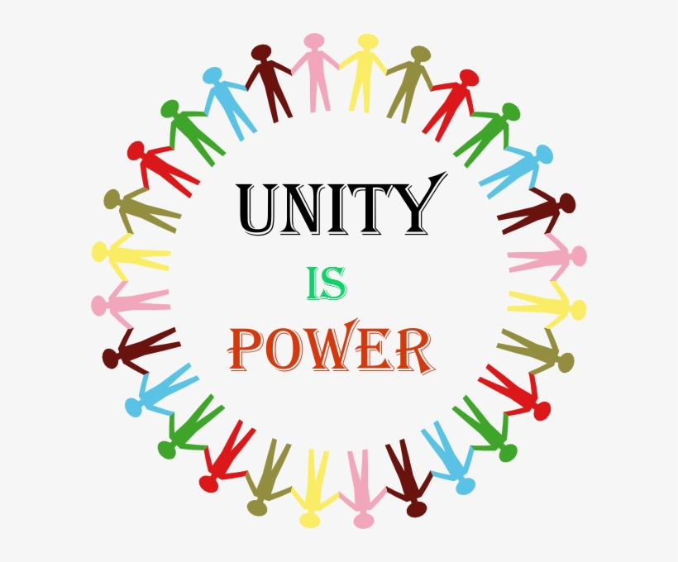
What do you think this means?

Slide 18
How does discrimination make you feel?
If you thought you were being bullied because of your differences, what do you think you should do?
If you heard someone being unkind about differences at school, who would you tell? What would you do?
If you heard someone being unkind about differences at home, who would you tell? What would you do?

Slide 19



Can you create your own symbol that represents: unity/peace/equality/justice?

Slide 20
Let’s learn some terms:
Activist – A person who campaigns for change
Civil rights – The right that every human has to be free and equal
Culture – the arts and ideas of a group of people
Discrimination – unfair treatment of people based on their differences e.g. age, race, gender, ability
Equality – fair rights and opportunities
Segregation – separating and isolating people because of their difference e.g. skin colour

Slide 21

What sorts of things can we do to make the world a kinder, fairer place?
Notes:
Create a poster! Share this with us during our next Zoom call!

