Slide 1
Monday
Today we are going to practise adding and subtracting 1000 to four-digit numbers
Then we will use a visual representation to add together four digit numbers
After this we will attempt some reasoning relating to what we have learnt today.

Slide 2
Adding 1000
When you are adding 1000 to a number, only the digit in the thousands column needs to change. It needs to increase by 1. Digits in the other column do not change.
e.g. 345+ 1000= 1345
2367+ 1000= 3367
5123+1000= 6123

Slide 3
In this video, a child explains this using counters.
https://www.youtube.com/watch?v=XlIkwIfV_XQ

Slide 4
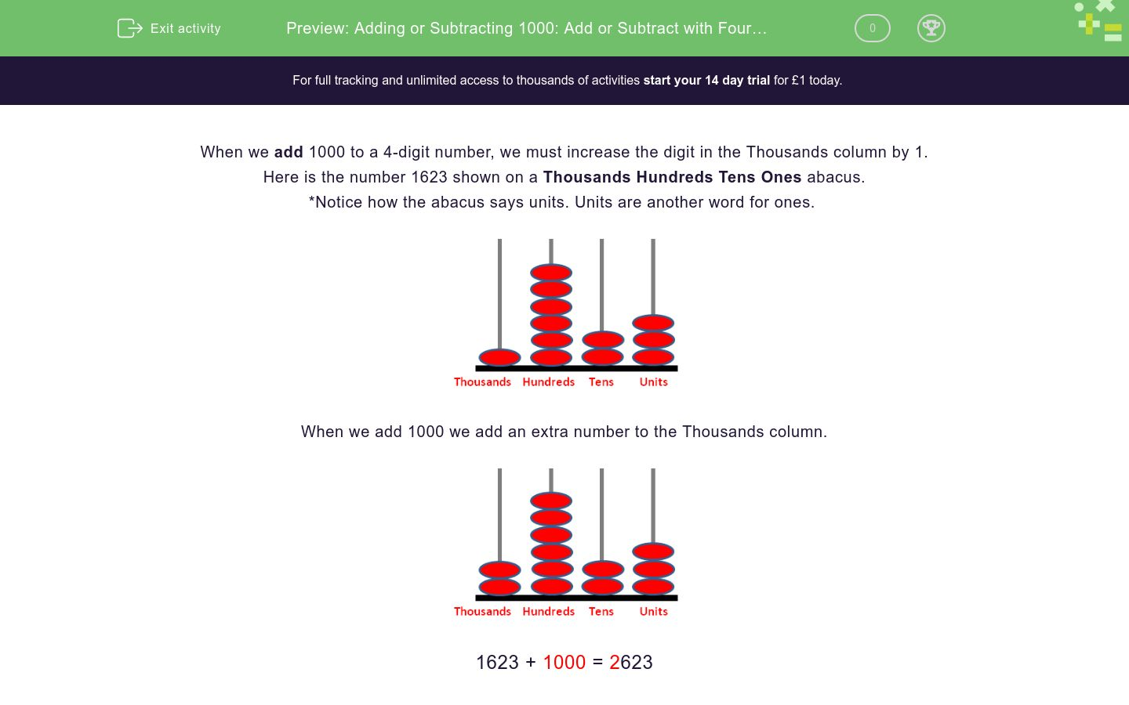

Slide 5
Subtracting 1000
When you are subtracting 1000 to a number, only the digit in the thousands column needs to change. It needs to decrease by 1. Digits in the other column do not change.
E.g. 5463-1000= 4463
7890-1000= 6890
9999-1000=8999

Slide 6

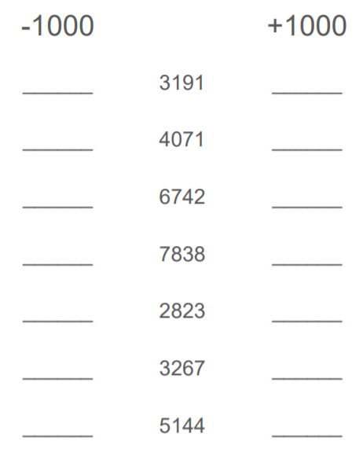
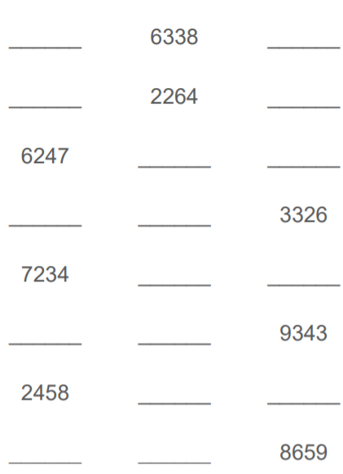

Slide 7
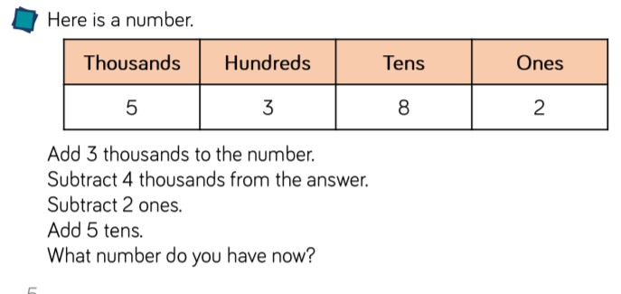

Slide 8
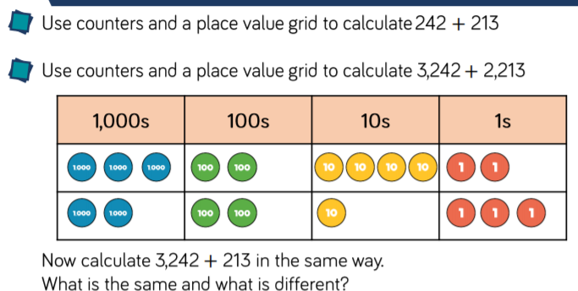

Slide 9
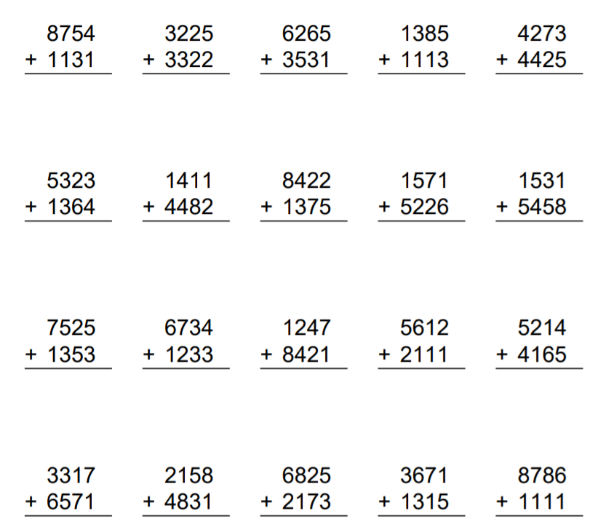

Slide 10
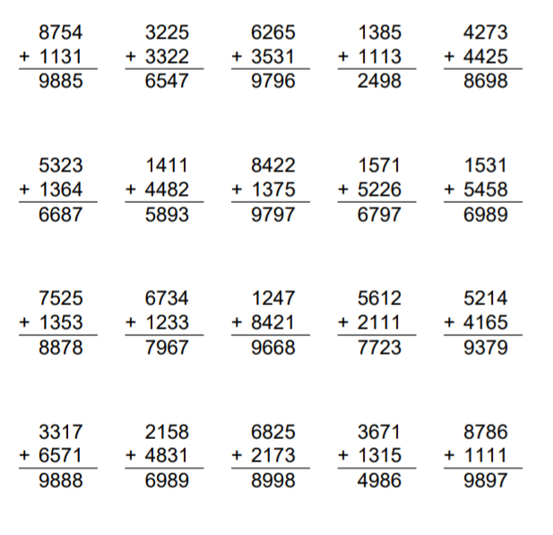

Slide 11
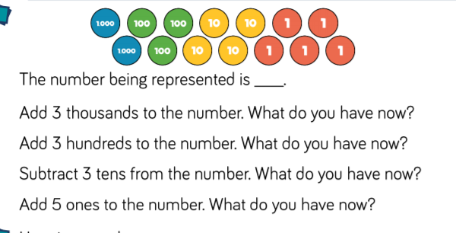

Slide 12
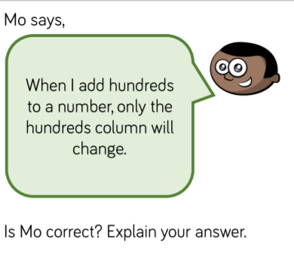

Slide 13
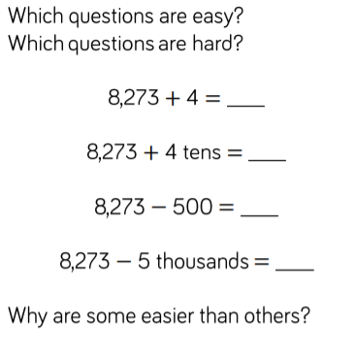

Slide 14


