Slide 1
Tuesday 16th June 2020
Wednesday 17th June 2020

Slide 2
LO: To add four digit numbers with one exchange
Before starting today’s work, please make sure that you have had a go at all the work on the previous PowerPoint for Monday. It is really important that you attempt the reasoning questions as well as just calculations.

Slide 3
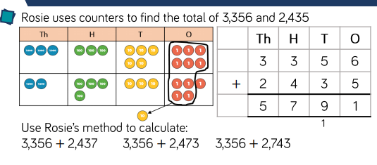
Now carry out these calculations using Rosie’s method. (Either draw it or use your own counters)
In the units column Rosie has had to add together 6 and 5. Together these two numbers add together to make 11. You cannot write two-digits in one-column so she has exchanged ten units and put an extra counter in the tens column. This means there are now nine counters in the tens column and only one counter in the units column.

Slide 4
Here are some videos to help you.
https://www.youtube.com/watch?v=yrF7Ltphy08
https://www.youtube.com/watch?v=xtYzaAF5IdQ
Now team up with a parent or a sibling to play this game.
If you are in school, you will not be able to have a partner close by but you can still do five or six calculations and then work out your score. Each member of year 4 can then compare their score to find a winner.

Slide 5
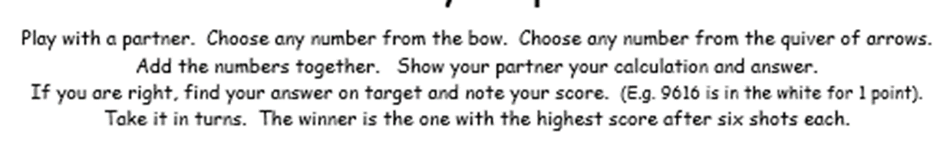
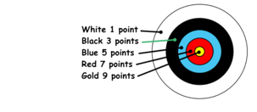
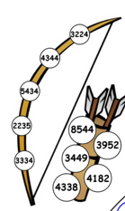
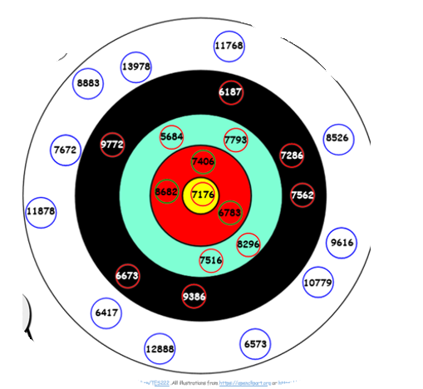

Slide 6
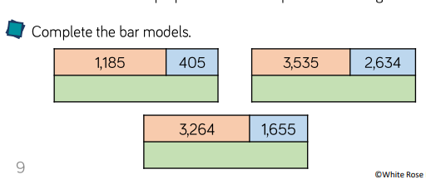
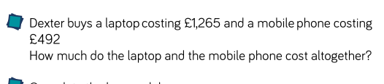
Notes:
Answers: 1590, 6169, 4919, 1757

Slide 7
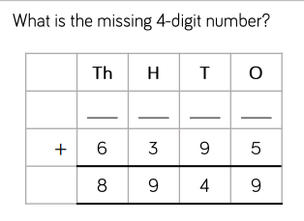
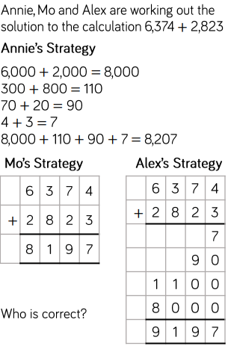
Notes:
Answers: 2554

Slide 8
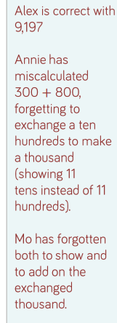
Answers:

Slide 9
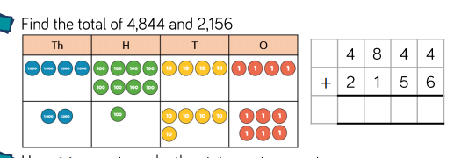
LO: To add four digit numbers with more than one exchange

Slide 10
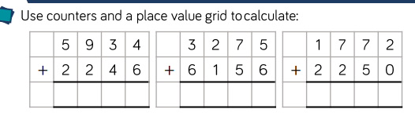
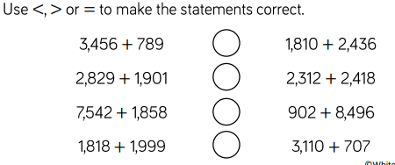
Notes:
Answers: 8180, 9431, 4022

Slide 11
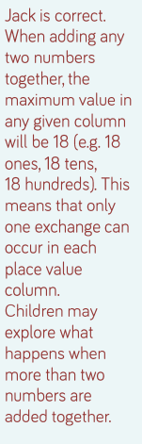
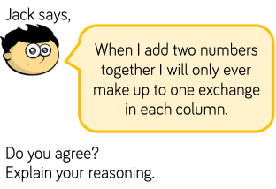
Move to see a good answer.
Explore:
Do you need to ever exchange two units, two tens, or two hundreds when you are adding two-digits

Slide 12
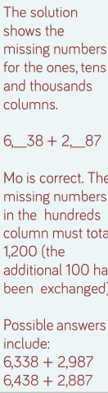
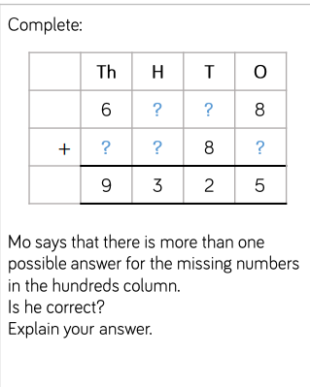
Move

