Slide 1
Thursday

Slide 2
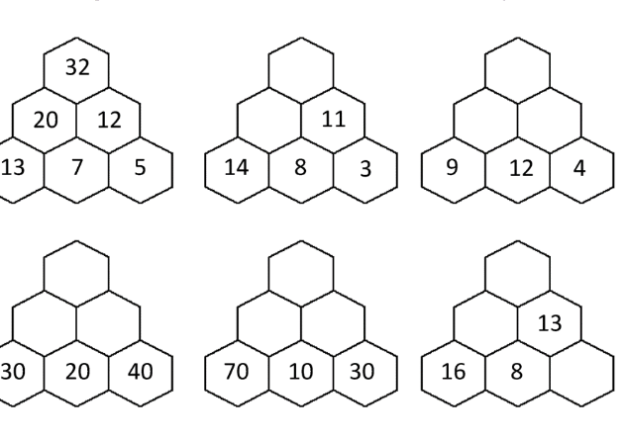
Starter:

Slide 3
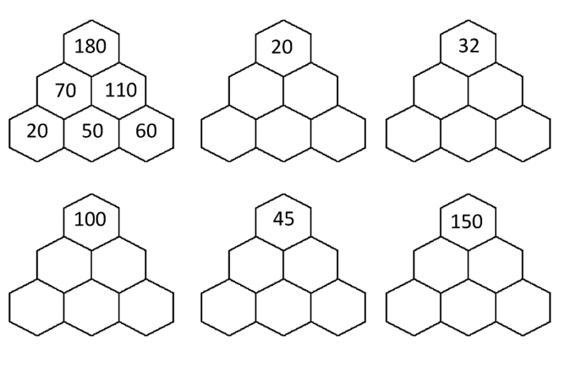

Slide 4
Thursday
L.O: To subtract multiples of 100 and 1000.
https://www.youtube.com/watch?v=PmsJkhps7gE
https://www.splashlearn.com/math-skills/second-grade/subtract-within-1000/subtract-multiples-of-100

Slide 5
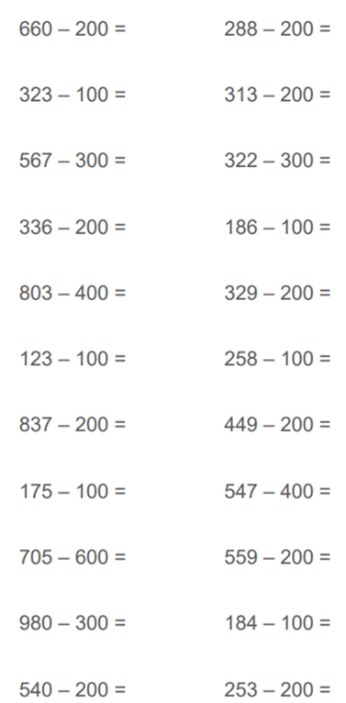

Slide 6
Friday
LO: To subtract a two-digit number from a two-digit number without an exchange

Slide 7
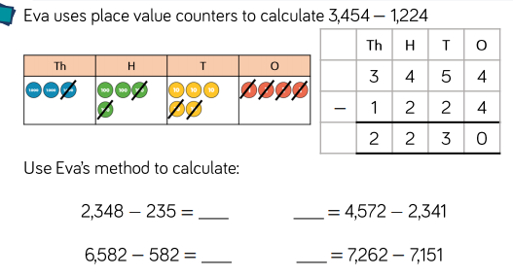

Slide 8
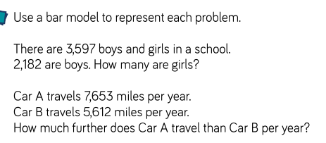

Slide 9
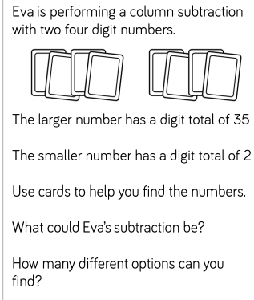
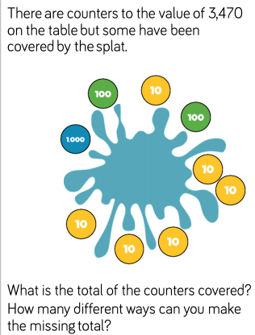

Slide 10
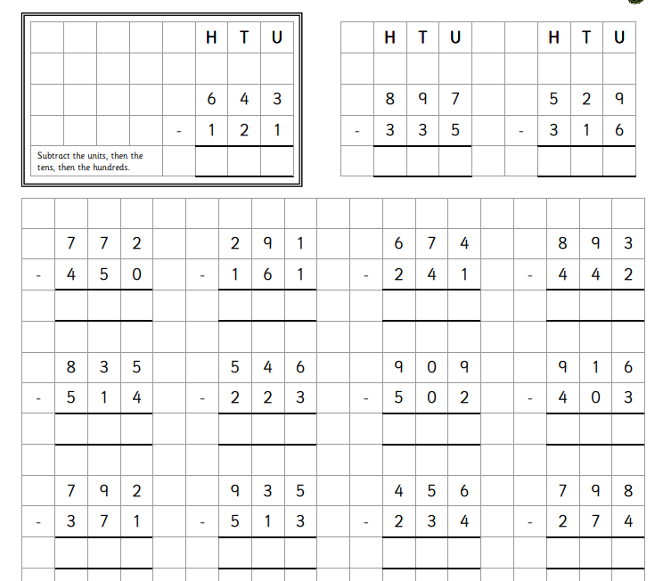

Slide 11


