Slide 1

Road Trip, USA!
PowerPoint 2 – Science, Computing, Literacy, History

Slide 2
Guide for parents/carers,
Always read the ‘notes’ section at the bottom of the slides for specific instructions before beginning the lesson. There may be documents to download, resources, or key information you will need for/about the lesson.
Read the slide and set the tasks or challenges for the child/ren. There is no rush and you do not have to do everything, but be aware that the lessons follow and build on from one another, so try not to skip lessons but rather work in order and stop when you feel is best for your child. When next PowerPoints appear, don’t feel pressured to skip ahead if you have not finished everything yet, do what is best for you ☺
Some slides will have one task, others more. You can break these down however you like e.g. All the tasks on one slide can be spread across a few days or done in one day, but please do not do too much in a day! The slides are numbered to help you differentiate between the different tasks.

Slide 3
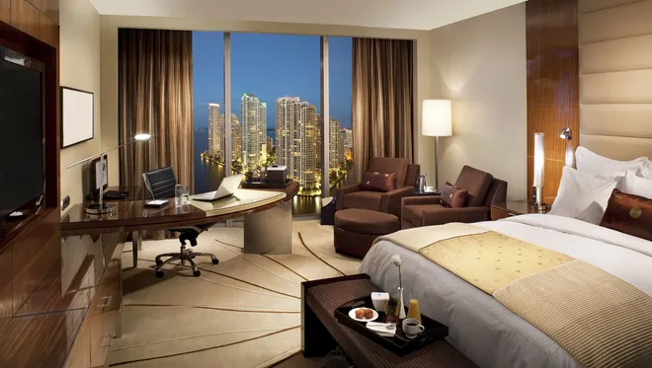
Science – Electricity
https://www.bbc.co.uk/bitesize/clips/zwqd7ty
L1
Have a look at this luxury New York hotel room. Imagine you are staying here on your road trip. Lucky you!
Can you identify the appliances which require electricity in order to work?
Notes:
Answers: TV, computer, laptop, lamps

Slide 4
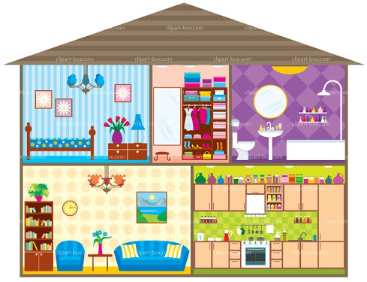
Have a look around the room you are in…
https://www.bbc.co.uk/bitesize/clips/zqb7tyc
L1
List all of the appliances which run on electricity.
Which of these items must be plugged in all the time and which can be charged using electricity and then used in a ‘wireless’ fashion?

Slide 5


What sort of electrical items might you pack in your suitcase for a road trip to the USA?
L1
Draw or print the outline of a suitcase. Draw in and label electrical items that you might take on a road trip e.g. a hairdryer!
hairdryer
Notes:
The suitcase outline is available to download: Road Trip, USA – 2 – Lesson 1 – suitcase outline

Slide 6

Computing
L2

Slide 7
How We Communicate
L2
'Communicate' means to share information.
Write a list of all the ways you can think of that people use to communicate?

Slide 8

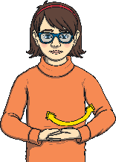





Some Ways We Communicate:
L2
talking
using sign language
writing letters
talking on a telephone
using pigeons to deliver messages (a long time ago)
using computers, tablets or smartphones

Slide 9
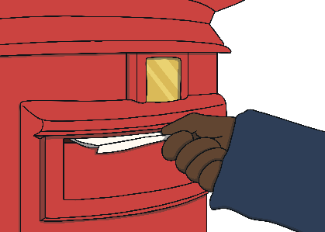






Sending Mail
L2
People often send letters through the post.
It takes at least one whole day for a letter to go from one place to another.
How can we speed up the way we send written information?

Slide 10



Email
L2
People use computers, phones or tablets to send emails. This is like a letter sent digitally through the Internet.
Emails are sent instantly through a computer network.
Emails can take just seconds to go from one computer to another.
An email can travel to a computer on the other side of the world through the Internet.
Many adults use email every day. You can start using email on your own when you get a little older. If a child uses email, it is important they do this with a responsible adult.

Slide 11





Why Is Email a Good Thing?
L2
Can you think of a reason why email is a better way of communicating than sending a letter through the post?
Letters are usually only sent to one place. It is not very easy for someone to share your private letter with lots of other people.
Email is very quick. Your message can be sent to the other side of the world in seconds.
VS
Your message or email details could end up in the wrong hands. People could share your private message
or personal details more easily.
Letters take longer - sometimes days or even weeks - to reach their destination.

Slide 12

How to Send an Email
L2
Tia is going to have a birthday party at the zoo.
She needs to let her friends know where it is and when to come.
She has decided that using email would be the best way to invite her friends.
She has asked her dad to help her send an email.

Slide 13
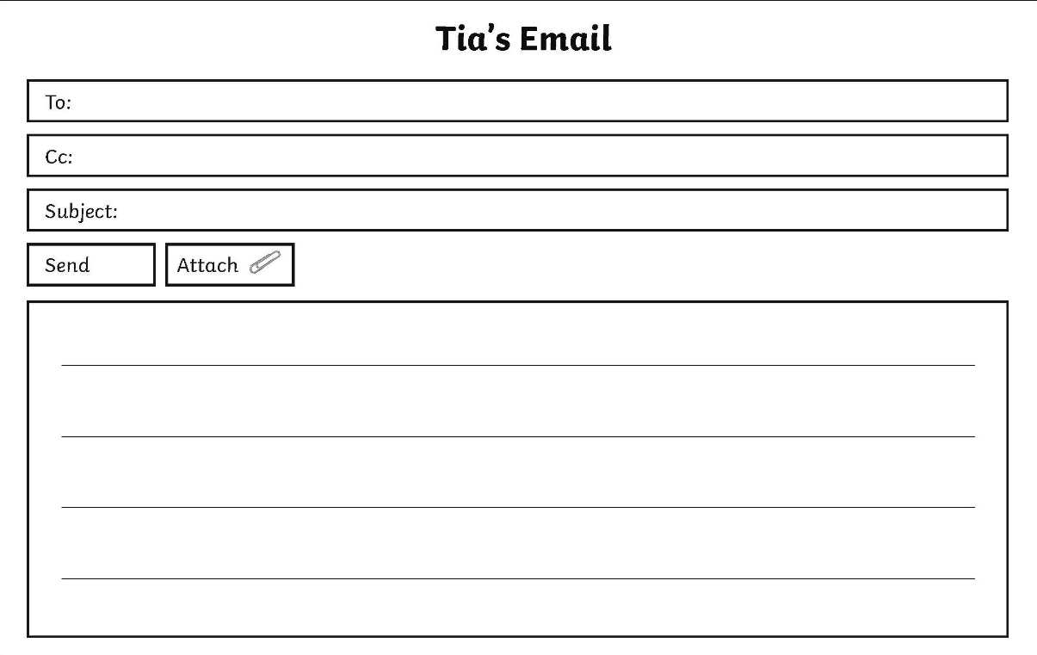
How to Send an Email
L2
Instead of a home address, people have an email address. It always contains the @ symbol. This address tells the email where to go.
Abdi@myemail.com
Here, you can type the email addresses of any other people you want to be able to see the email.
lilly@myemail.com
Tia's Party
This is were you type what the email is about.
Hi everyone
I'd like to invite you to my party at the zoo next Saturday at 1 o'clock.
Please let me know if you can come.
From Tia
Here, you can start typing your message.
Don't send personal information in an email to people you don't know.
Send
When you're ready, click

Slide 14

Opening Emails
L2
Tia has had some replies from her party invitation email.
Which ones do you think are safe to open and which ones should she delete straight away?
Sometimes we receive emails from people we don't know.
Some of these emails can cause harm to your computer or are from people looking to use your information in the wrong way.
Name Subject Date
Ben RE: Party 10th Nov
Harry RE: Party 10th Nov
Not West Bank Tell us your address! 10th Nov
Amelia RE: Party 10th Nov
Creepy Croc FREE TOYS 10th Nov

Slide 15
Opening Emails
L2
If you see RE: in the subject of an email, it means the email is a reply from an email you sent.
Tia knows Ben, Harry and Amelia. They are sending a reply to her email. These emails are safe to open.
Name Subject Date
Ben RE: Party 10th Nov
Harry RE: Party 10th Nov
Not West Bank Tell us your address! 10th Nov
Amelia RE: Party 10th Nov
Creepy Croc FREE TOYS 10th Nov

Slide 16
Opening Emails
L2
If you see an email from a sender you don't know, don’t open it.
Always show a trusted adult. If it looks like the email is offering you things that seem too good to be true or asks for personal information, do not open the email. You should delete these emails.
If you see an email from a sender you don't know, don’t open it.
Always show a trusted adult.
Name Subject Date
Ben RE: Party 10th Nov
Harry RE: Party 10th Nov
Not West Bank Tell us your address! 10th Nov
Amelia RE: Party 10th Nov
Creepy Croc FREE TOYS 10th Nov

Slide 17
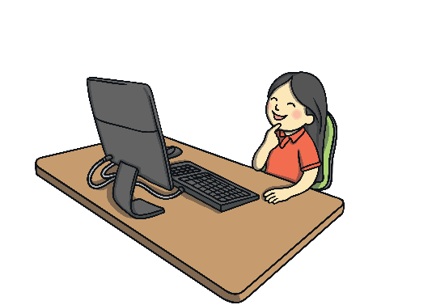
How to Send an Email
L2
Tia is confused. She has some questions about
her emails. Can you help her decide what to do?
Write your advice in full sentences.
Is it OK to give out information about my party to my friends?
When I get replies, how will I know if an email is safe to open?
Who should I not give this information to?
Who should I speak to if I have any questions about my emails?

Slide 18
How to Send an Email
L2
Tia is confused. She has some questions about
her emails. Can you help her decide what to do?
Is it OK to give out information about my party to my friends?
When I get replies, how will I know if an email is safe to open?
Yes, email is a great way to communicate with friends and family.
Your email replies will be from people you know. If you see an email from someone you don’t know, tell a trusted adult straight away.
Who should I not give this information to?
Who should I speak to if I have any questions about my emails?
Don’t give the information to anyone you don't know.
Speak to a trusted adult, like a parent or a teacher.

Slide 19

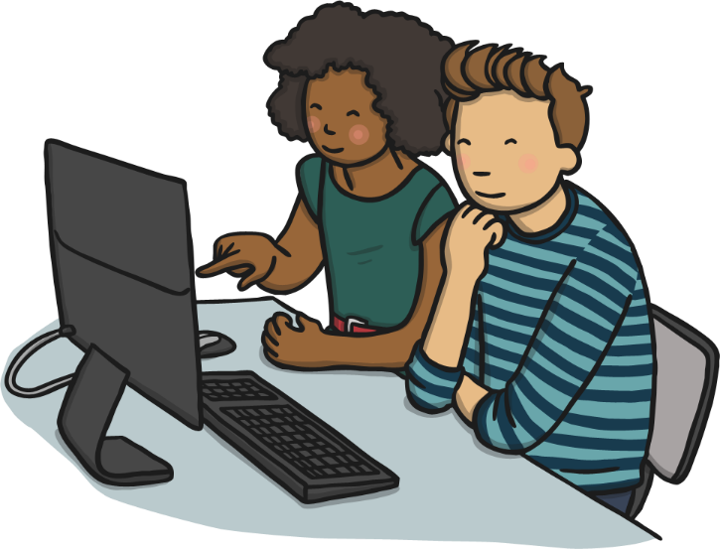
Emergency Email
L2
It's Tia's birthday party on Saturday. She has just realised that she told all her friends the wrong time! She said it was at 1 o'clock and she should have said 2 o'clock.
Tia needs to let her friends know the correct time.
Imagine you are Tia.
Create a new email to
send to your friends.

Slide 20
Literacy – writing an email
L3
Imagine that you are on your second stop on your road trip, check your route. Where are you?
Your hotel and hotel room were not up to scratch. You want to write an email complaining about some issues. You want a refund for your stay.
When you are writing to complain, you must still try to be as polite as possible. You should be honest about your experience and explain also how it made you feel. You have to describe and explain the problems in detail. You will be writing to the hotel manager.
Create a mind map of some possible issues you could have experienced at your hotel.
Notes:
For example: cold food at the buffet, swimming pool too cold, uncomfortable bed, bathroom not cleaned properly etc.

Slide 21
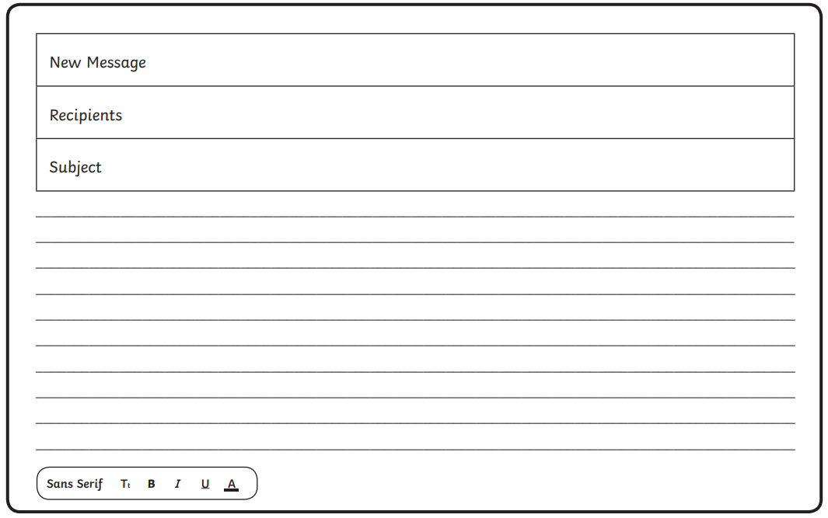
Literacy – writing an email
L3
The ‘recipient’ is who you are sending your email to.
For the email address use:
hotelmanager@___ _hotel.com
(in the space, put the name of the state e.g. hotelmanager@nevadahotel.com )
This is like the title of your email… this could simply be ‘Complaint from guest’.
Steps to Success:
Greeting e.g. To the hotel manager
Opening statement e.g. brief sentence about why you are writing.
Paragraph 1 – detailed information about specific issues you had during your stay. Don’t forget: describe, explain, feelings
Paragraph 2 – what you want to happen e.g. a refund for your stay, an extra free night stay etc.
Sign off - Top tip: Yours faithfully is used when signing off an email to somebody you do not know, followed by your name.
Notes:
The email template is available to download: ‘Road Trip, USA! – 2 – Lesson 3 – email template’ or simply set this out in writing in workbook. The template is not necessary.

Slide 22
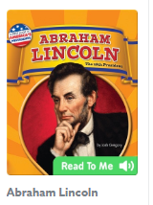
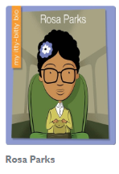

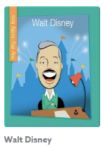



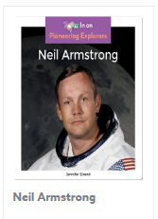
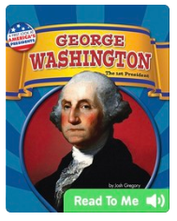

History – Timeline of American Icons
L4
Here are 10 famous Americans from history:
Do you know any of these historical figures already?

Slide 23
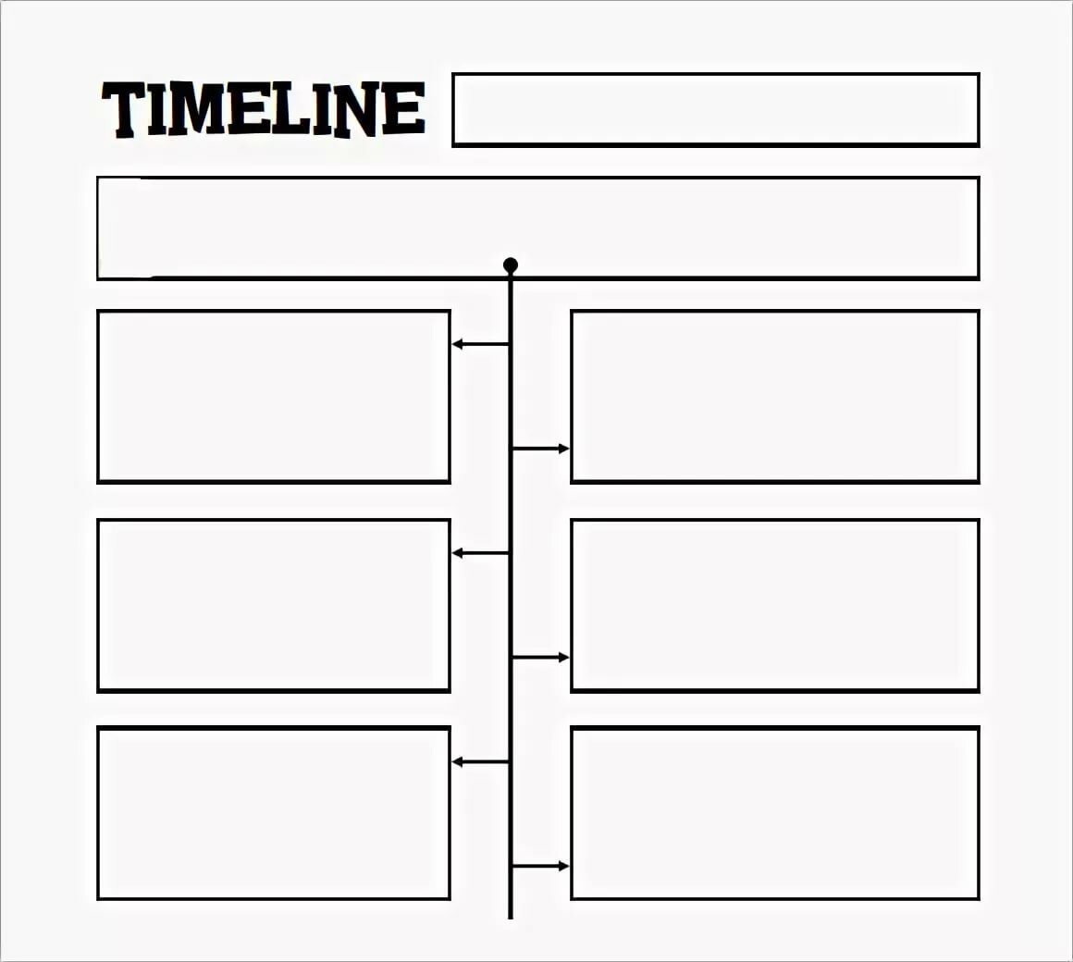
History – Timeline of American Icons
L4
You are going to find out when these Americans were born and a little bit of information about them. You will then arrange this information, in order, on a vertical timeline.
Historical American Figures
Here are 10 important American figures through time and some of their achievements:
Sacagawea, born May 1788, was a famous native American explorer.
Your teachers would love to see this in our next zoom! Make it clear to read and eye-catching.
Notes:
I would encourage you to set this timeline out independently, however I have attached a frame for those who would like one: ‘Road Trip, USA! – 2 – Lesson 4 – vertical timeline template’
I’d like to see these on zoom… feel free to print or draw pictures!!

Slide 24
MUST be completed with an adult.
L5
America, like every country, has both very positive and some negative history.
Part of PSHE is to understand how we can make the future a brighter, fairer place for all of us.
In order to do this, we must understand the way things are now and have been, so that we can learn and grow from it.
To ignore the past is to let history repeat itself.

Slide 25
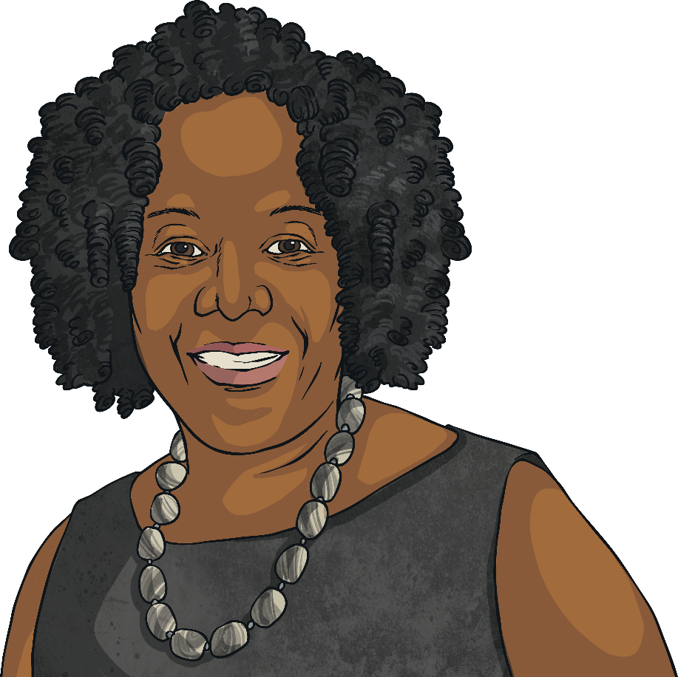
Who Is Ruby Bridges?
L5
Ruby Bridges, born in Tylertown, Mississippi, in 1954, was the first African-American child to go to a white school after desegregation in southern America. At this time, she was only six.

Slide 26
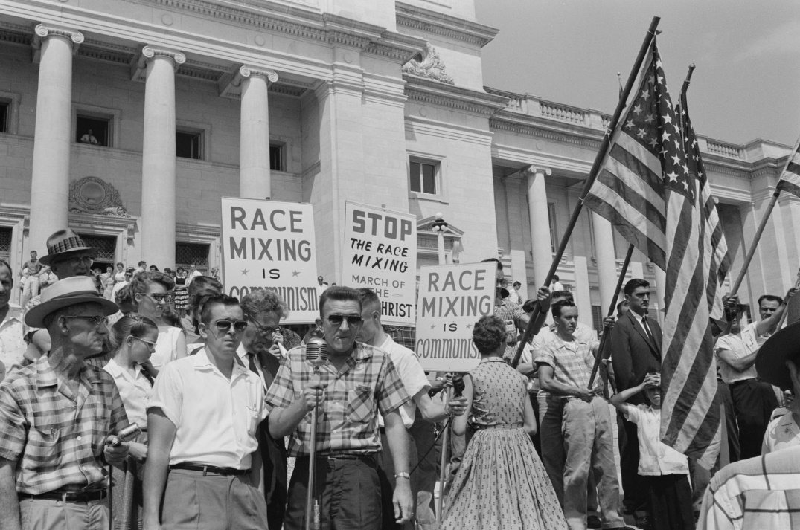
School Segregation
L5
In 1954, the Supreme Court in America ruled that schools should no longer be segregated. This was coincidentally the same year that Ruby was born. Even though it became law to desegregate schools, it took a number of years for African-American children to be able to go to white schools and, even then, there was a lot of resistance.
Little Rock, 1959. Rally at state capitol, protesting the integration of Central High School.

Slide 27
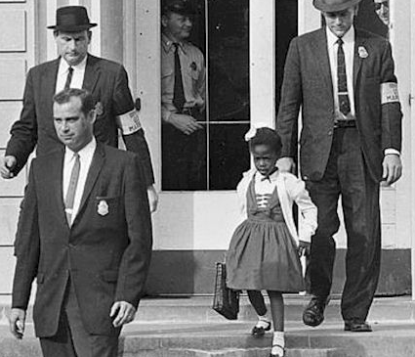
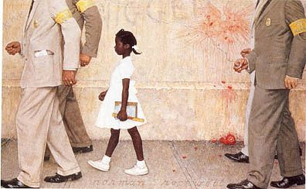
The First Day at School
L5
People expected there to be trouble for Ruby when she started at the William Frantz School. To keep her safe, she was driven and walked into school by four US Federal Marshals. At school, there were crowds of people protesting, shouting rude names and throwing things because they did not want African-American children coming to the white school.
There was so much trouble that the white children had been kept at home, so there were no classes that day. A famous painting was done by Norman Rockwell of this iconic walk to school called ‘The Problem We All Live With’.

Slide 28
The First Year
L5
Only one white teacher, Mrs Henry, agreed to teach Ruby. Mrs Henry’s choices also made her unpopular with the white parents, but she did not care and saw Ruby as an important individual. Other parents kept their white children away from Ruby, so, for a whole year, there was only Ruby and Mrs Henry together in one classroom for lessons, break times and even for meals.
Thankfully, after the first year, white children started to return to Ruby’s class and the Federal Marshals stopped taking her to school. She had found the first year very hard and knew that children did not want to play with her because of the colour of her skin.

Slide 29
L5
Ruby went on to be successful. She graduated from high school and had a good career. She had four sons and is now a civil rights activist focusing on making life fair for black and white people living together.

Slide 30
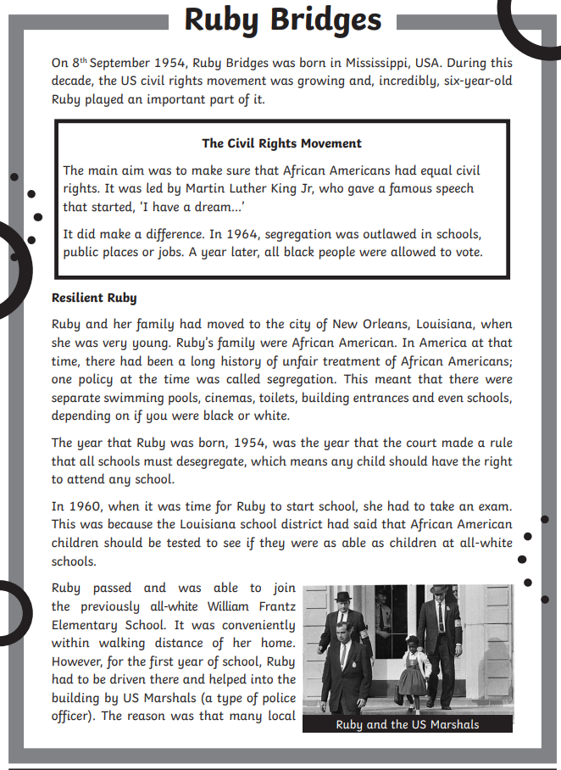
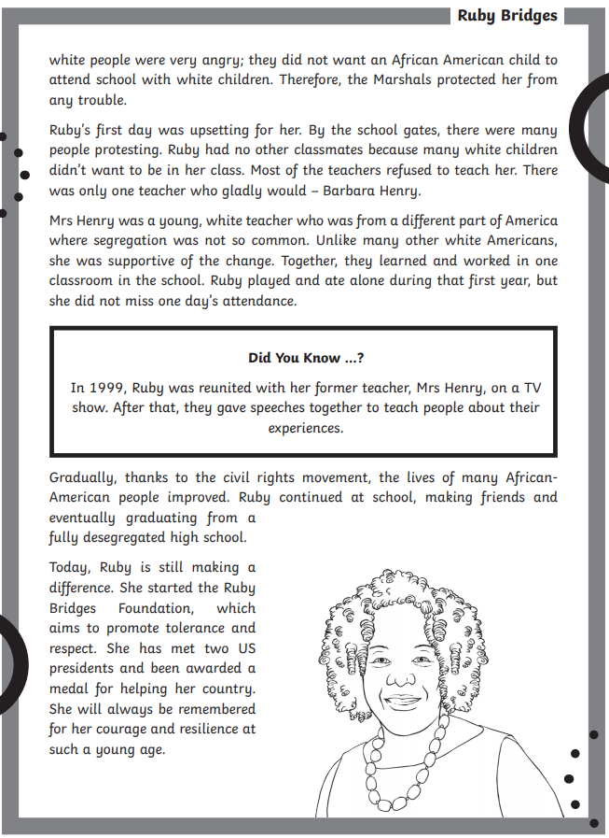
L5
Notes:
The children will answer questions based on the slides and the text above.

Slide 31
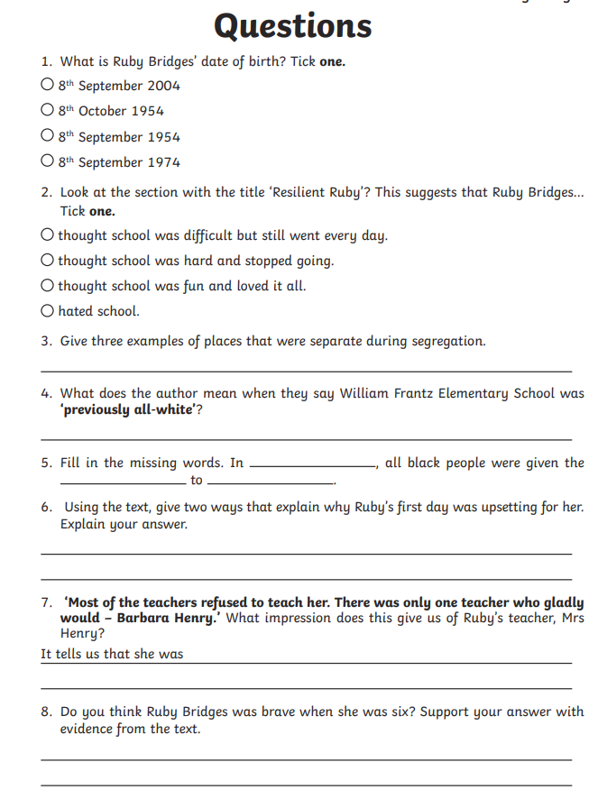
L5
Write this out and answer into your workbooks, or print the resource.
Notes:
The document is: Road Trip, USA! – 2 – Lesson 5 – Ruby Bridges reading comprehension

Slide 32
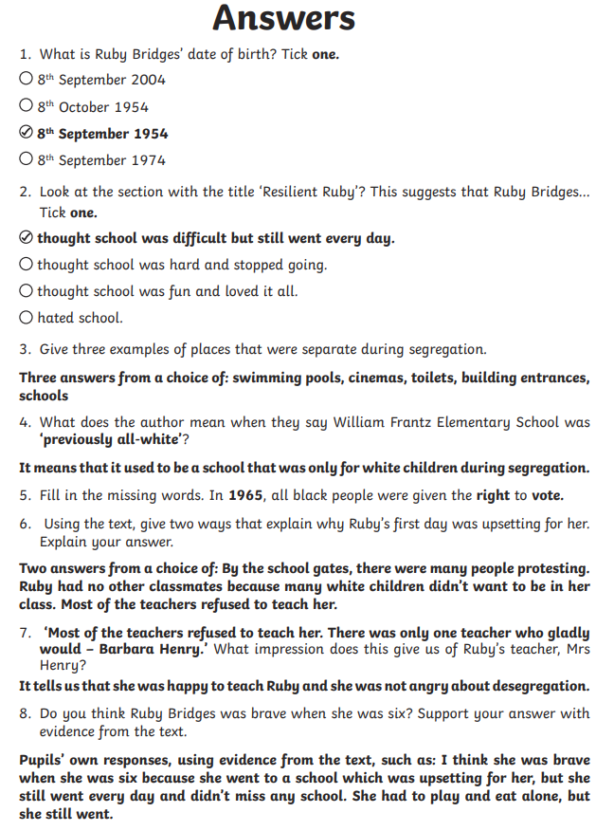
L5

