Slide 1
Monday
22.6.20
LO: To subtract three-digit numbers with one exchange

Slide 2
143 – 27 =
1
1
6
3
40
143
27
Step 1 Subtract the units column.
- We have 3 – 7, is this possible?
NO
3
30
13
H T U
Step 2 Look at the tens column.
- We can use some tens.
- We can exchange some tens and
add them to the units column.
3
1
7
Step 3 Look at the tens column. There is 4 tens.
- We can use 1 ten, leaving 3 tens.
- So we exchange 1 ten from the tens column and
add them to the units column. Making 13 units.
1
1
6
Step 4 Now the units column has 13 units.
We can subtract 7 from 13. 13 – 7 = 6
- Look at the tens column, 3 tens – 2 tens. 30 – 20 = 10
- Look at the hundreds column. 1 hundred – 0 = 1 hundred.
Step 5 Now record your answer = 116
How can you check you have the correct answer?

Slide 3
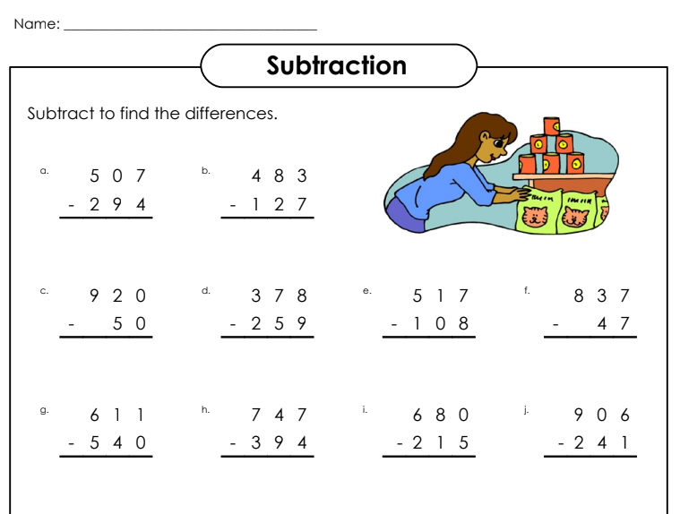
Practise the column method with three-digit numbers.

Slide 4
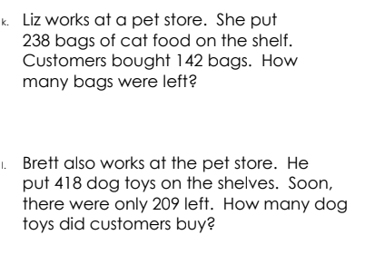
Solve these subtraction word problems:

Slide 5
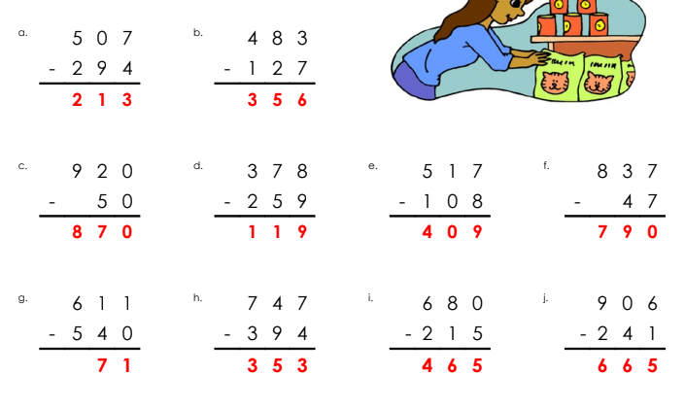
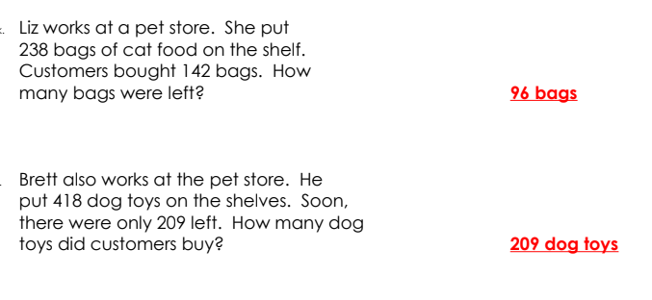
Answers:

Slide 6
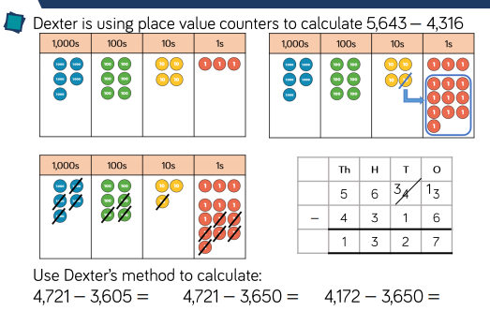
Tuesday
23.6.20
LO: To subtract four-digit numbers with one exchange

Slide 7
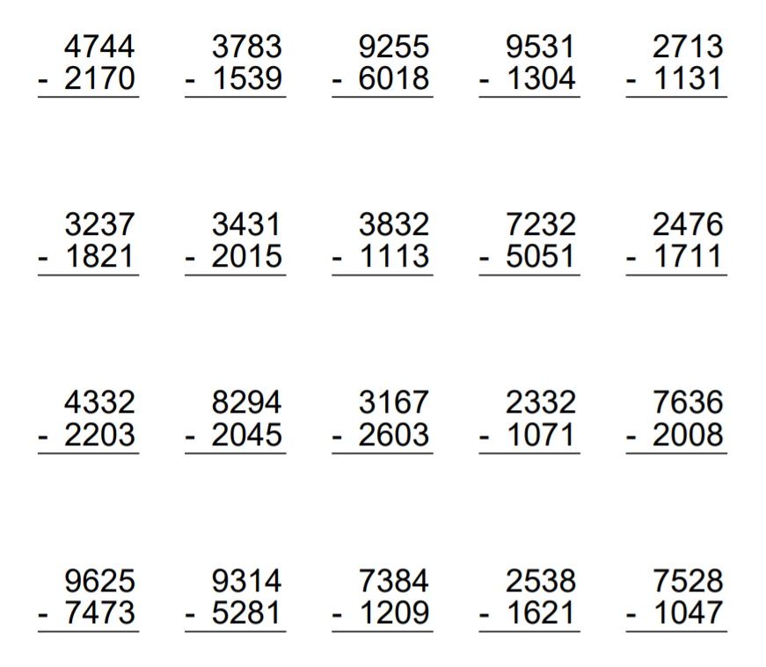
Now practise with four digits

Slide 8
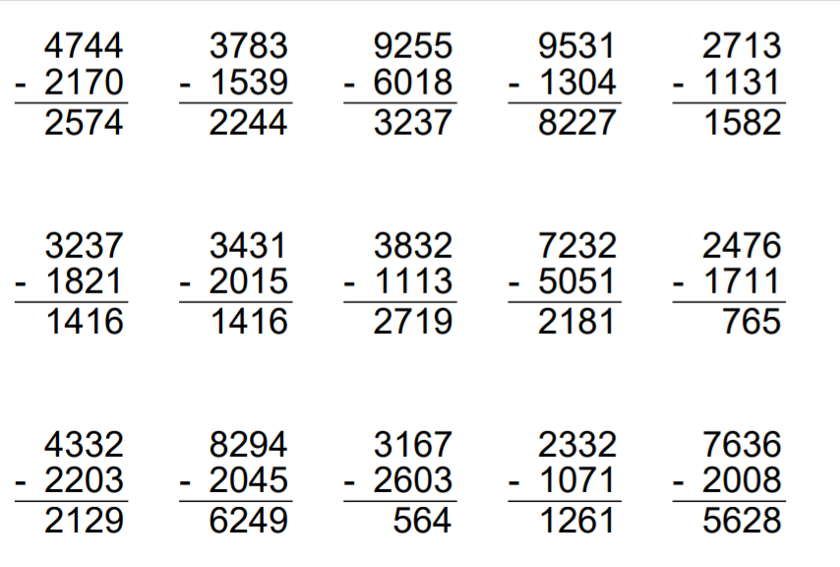
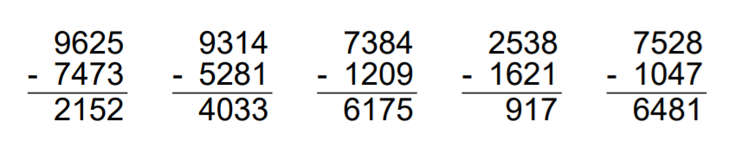
Answers:

Slide 9
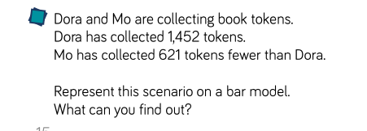
Solve the word problem:

Slide 10
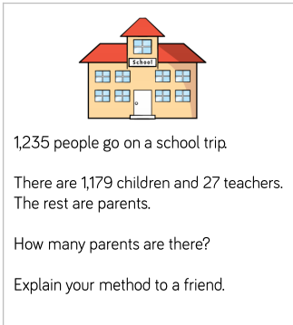
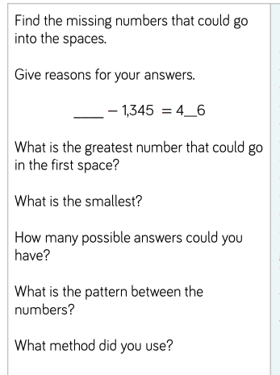

Slide 11
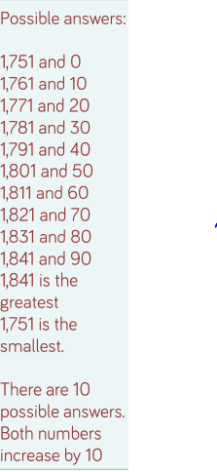
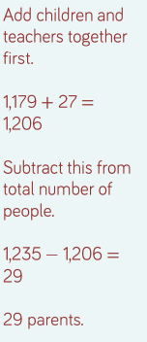
Answers:

