Slide 1
Wednesday
24.6.20
To subtract four-digit numbers with more than one exchange.
https://www.youtube.com/watch?v=KrHvbjSk8kk
https://www.youtube.com/watch?v=SLm5CM4sDGI
https://www.youtube.com/watch?v=SLm5CM4sDGI

Slide 2
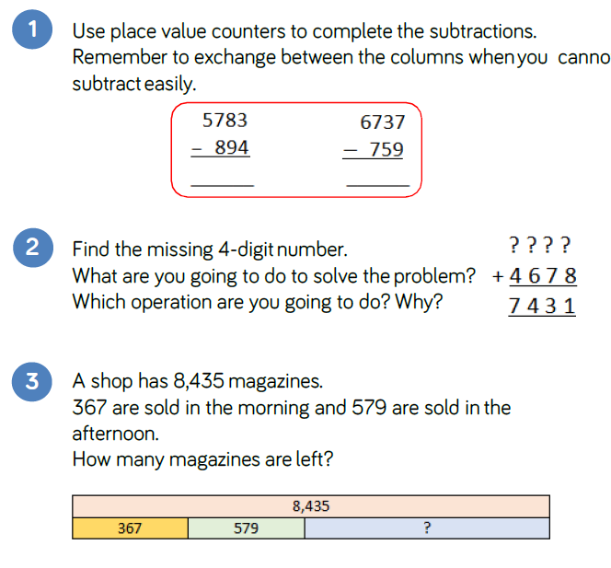
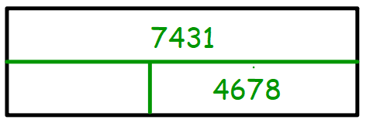
Solve these problems:
These problems require multiple exchanges. Be sure to borrow/exchange each time.

Slide 3

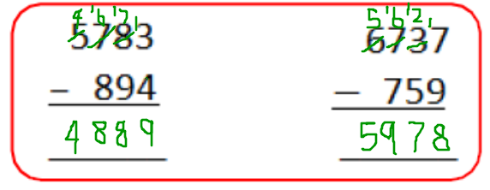
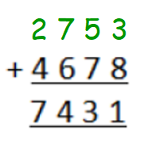
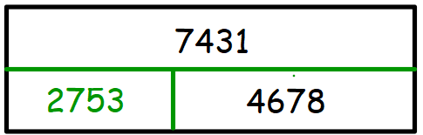
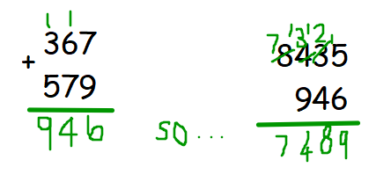
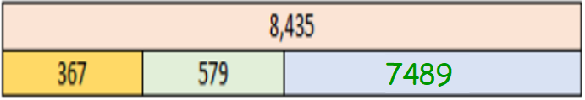
Answers:
To solve this problem, you should have performed the inverse: 7431 – 4678. This would leave you with the missing part.
7489 magazines are left.

Slide 4
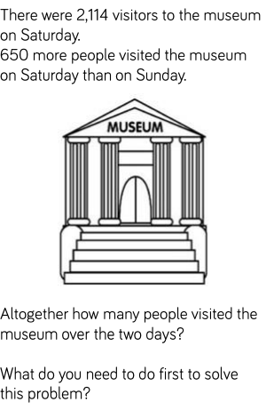
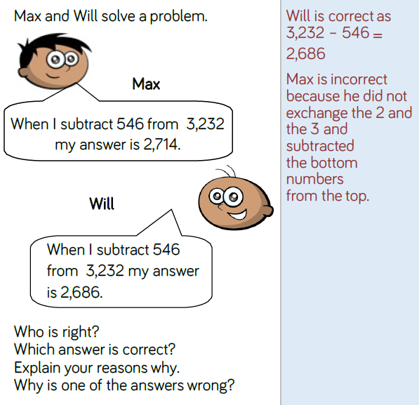
Solve these problems:

Slide 5
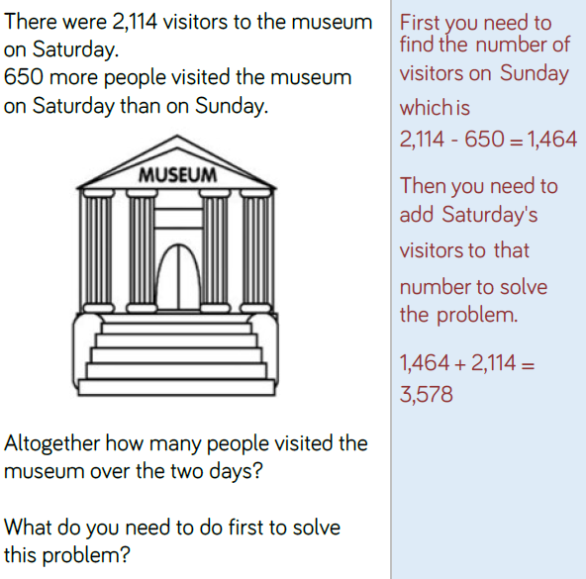
Answers:

Slide 6
Thursday
25.6.20
To subtract four-digit numbers with more than one exchange.
Recap on the videos, if you need to:
https://www.youtube.com/watch?v=KrHvbjSk8kk
https://www.youtube.com/watch?v=SLm5CM4sDGI
https://www.youtube.com/watch?v=SLm5CM4sDGI

Slide 7
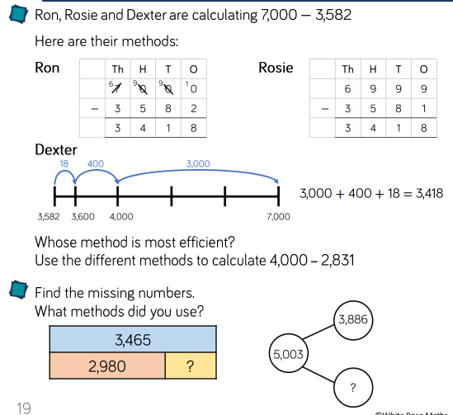

Slide 8
Answers:
These are all efficient methods, but some will work better for you than others:
If you are confident with exchanging multiple times, Ron’s method is for you.
If you prefer not to exchange, then Rosie’s method of moving 1 from 7000, making it 6999, and taking it away from 3582 instead to become 3581 is for you.
If partitioning is a simpler way to break down larger subtraction problems, then Dexter’s method is for you.
4000 – 2831 = 1169
3465 – 2980 = 485

Slide 9
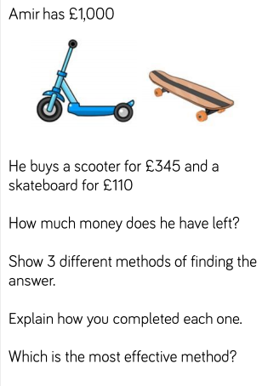
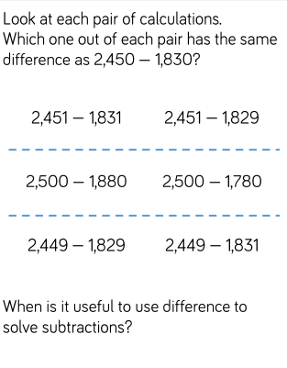

Slide 10
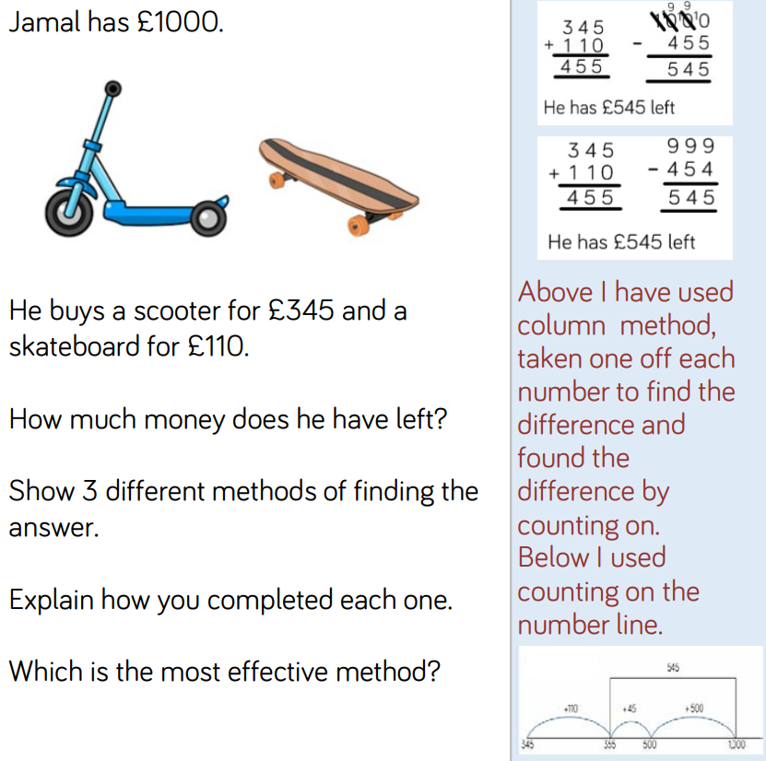
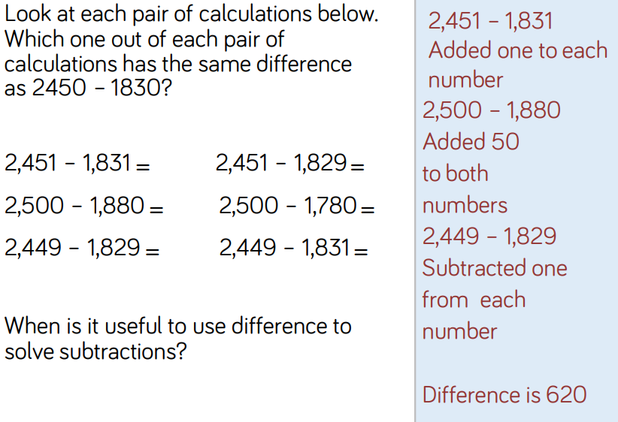
Answers:

Slide 11
Friday
26.6.20
To subtract four-digit numbers with more than one exchange.
Recap on the videos, if you need to:
https://www.youtube.com/watch?v=KrHvbjSk8kk
https://www.youtube.com/watch?v=SLm5CM4sDGI
https://www.youtube.com/watch?v=SLm5CM4sDGI

Slide 12
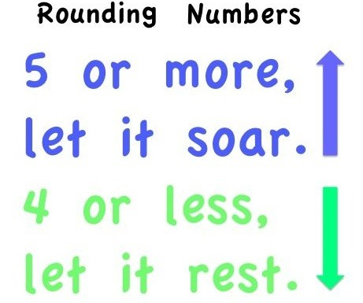
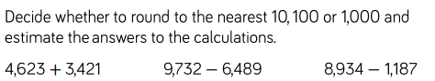
Recap on rounding:
to 10
It is similar when rounding to 100s.
50 or more, let it soar.
49 or less, let it rest.
For example:
450 would round up to 500,
but 449 would round down to 400.
It is similar when rounding to 1000s.
500 or more, let it soar
499 or less, let it rest.
For example:
4500 would round up to 5000,
but 4499 would round down to 4000.
For example:
45 would round up to 50,
but 44 would round down to 40.
Now try:

Slide 13
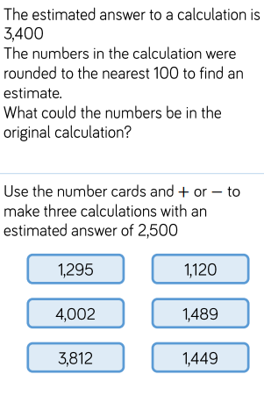
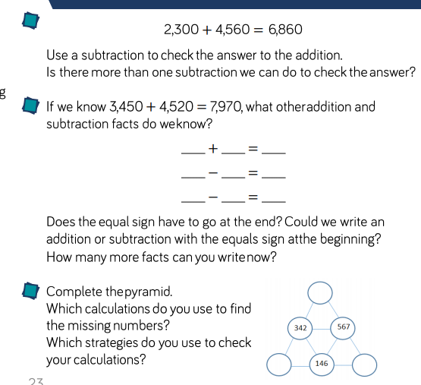

Slide 14
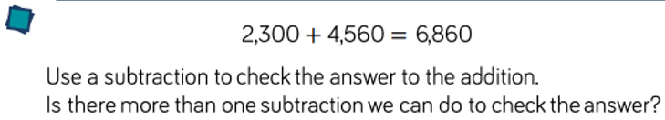
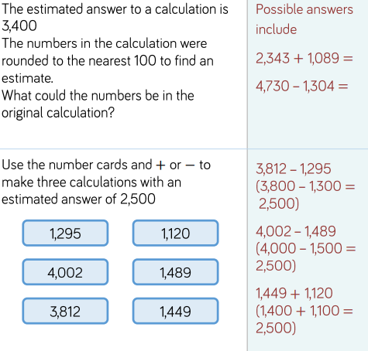
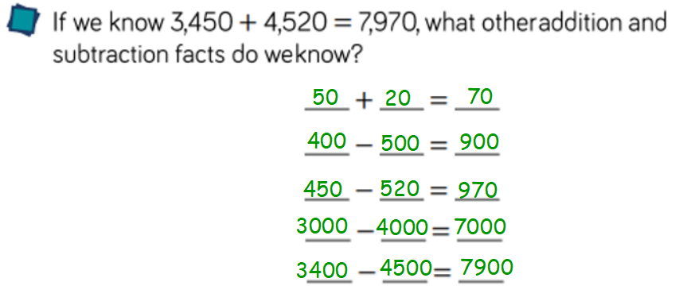
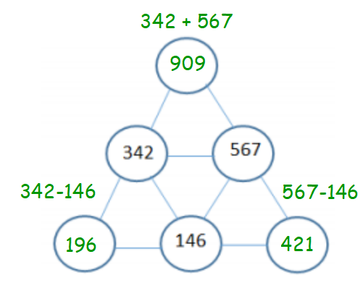

Answers:
6860 6860
4560 or 2300
2300 4560
So the calculation is correct.

Slide 15
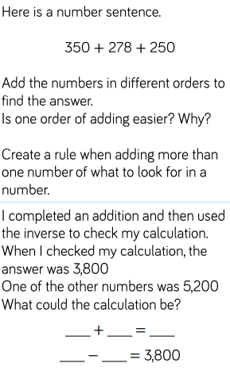
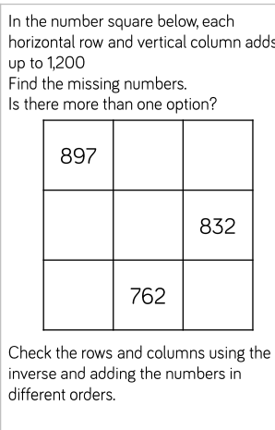

Slide 16
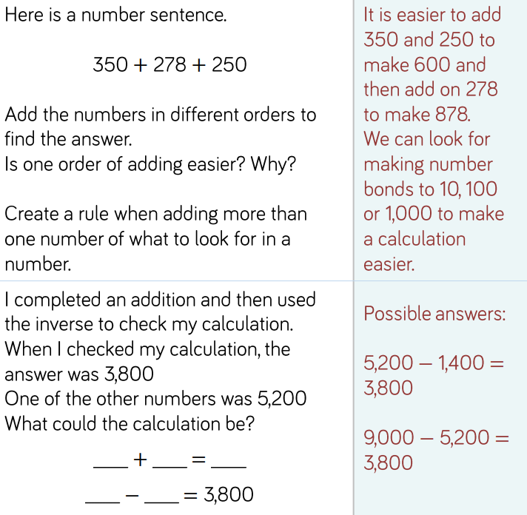
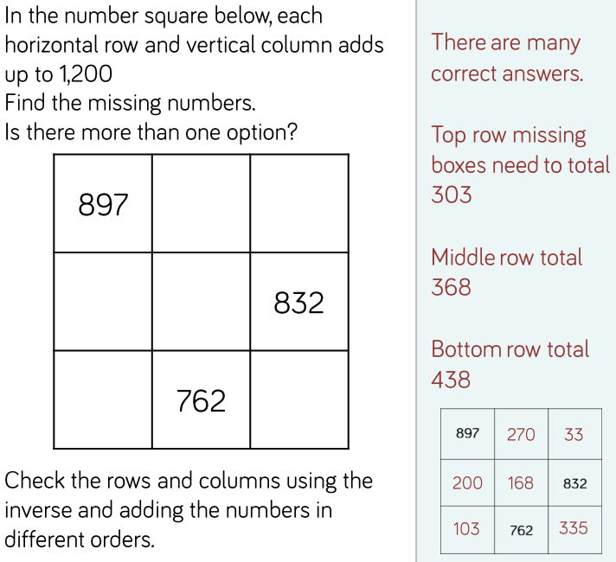
Answers:

