Slide 1
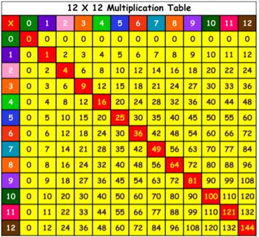
Multiplication and Division
Home Learning
Week 1

Slide 2

https://www.timestables.co.uk
http://www.maths-games.org/times-tables-games.html
https://www.topmarks.co.uk/maths-games/7-11-years/multiplication-and-division
https://www.youtube.com/watch?v=igoGDE5hLjw
Notes:
Interactive times tables games to be used as starter activities/plenaries throughout the topic
Rainbow tests to be given on Tuesday, Wednesday and Friday.
Start tables practise in computing lesson before main lesson begins.

Slide 3
29. 6.2020
LO: To multiply numbers by ten and one hundred

Slide 4
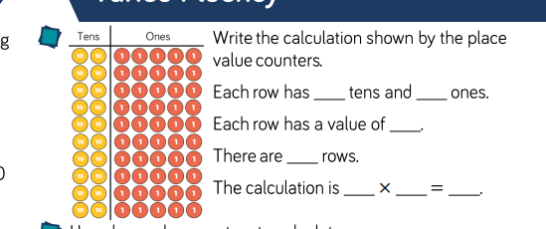

Notes:
Children to understand that

Slide 5
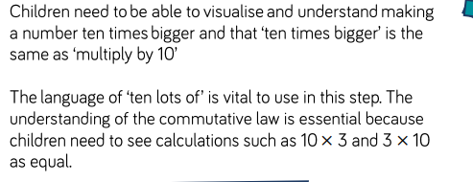

Slide 6
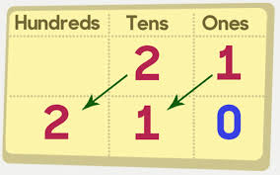
What is happening when we multiply by ten?

Slide 7
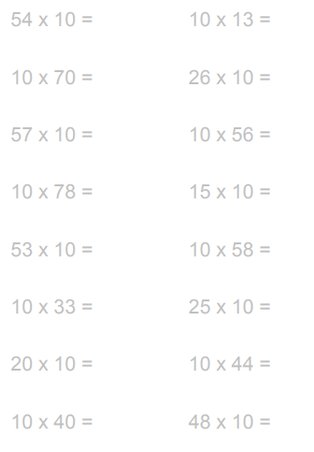
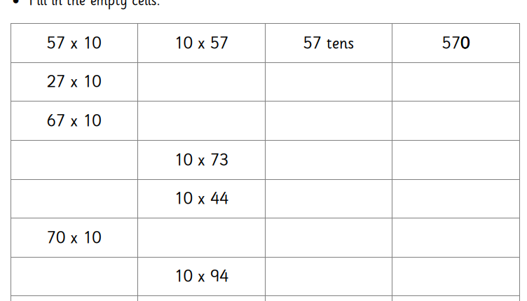
Fluency 1
Notes:
LA- TU x 10 with counters and place value grid.
MA- TU x 10 and extention

Slide 8

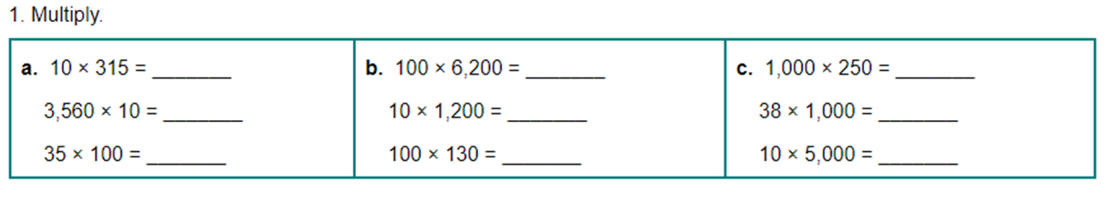
Fluency 2
Notes:
HA

Slide 9
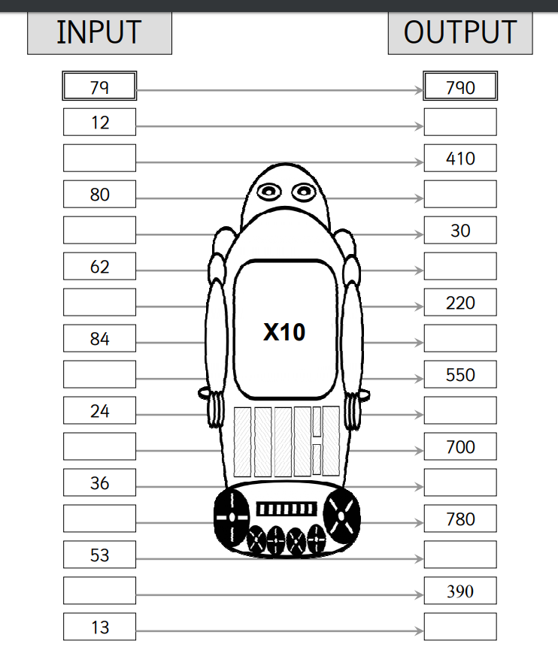
Notes:
LA. MA extention

Slide 10
Notes:
LA. MA extention

Slide 11
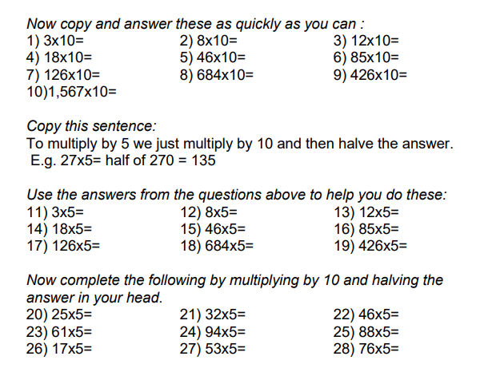
Extension
Notes:
HA extension
Next Step- Is multiplying be ten easy? Explain your answer.

Slide 12
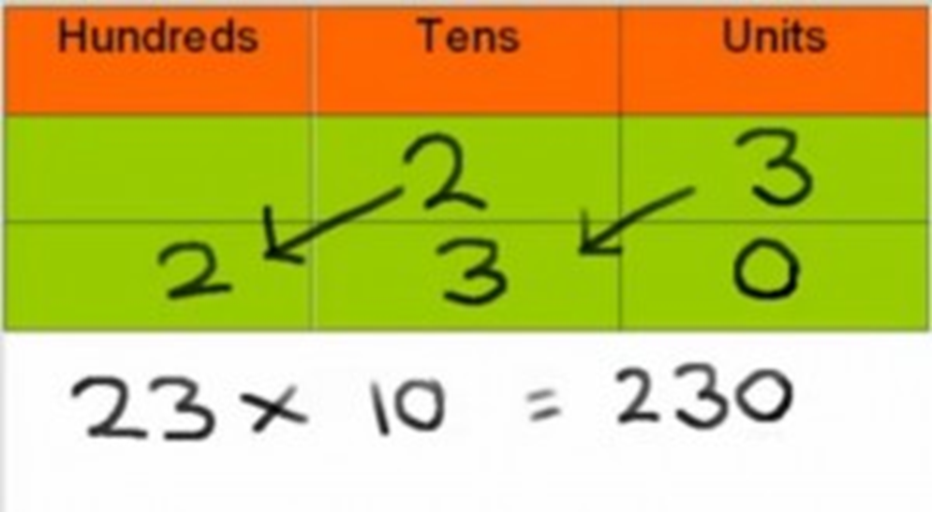
30.6. 2020
LO: To multiply numbers by ten and one hundred
Notes:
Summarise what happens when you multiply numbers by ten.
When you multiply numbers by ten, the digits move one place to the left. A zero is place in the units column.

Slide 13
When you multiply a number by ten, each of the digits move one place to the left. A zero is then placed in the units column.

Slide 14
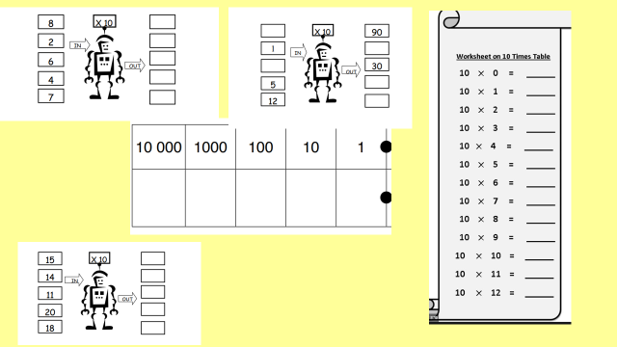

Slide 15
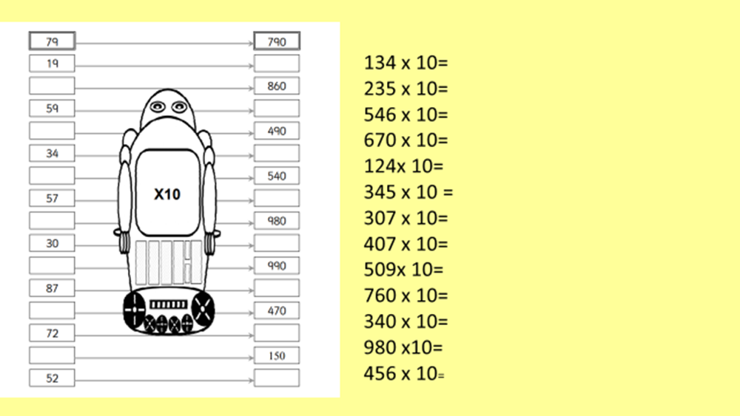
Notes:
MA/HA

Slide 16
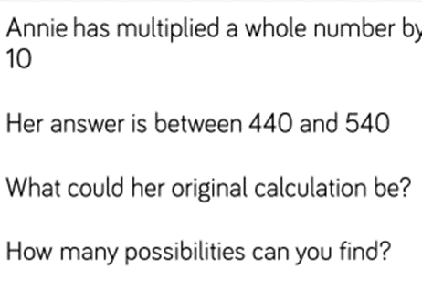

Leonor has multiplied a number by 10.
Her answers is between 320 and 420.
What could her original calculation have been?
How many possibilities can you find?
Notes:
Leonor has multiplied a number by 10.
Her answers is between 320 and 420.
What could her original calculation have been?
How many possibilities can you find?
For reasoning: Share working for Annie question.
Model to children what a good answer to this question should be.
Then children are to attempt the Leonor question independently.

Slide 17


Slide 18
Andrew has multiplied a number by ten. His answer is between 690 and 740. What could his original calculation have been.
How many possibilities can you find?
B. Kayla has multiplied a number by ten. Her answer is between 450 and 510. What could her original calculation have been?
How many possibilities can you find?

Slide 19
Think about this in advance!
Use a visual representation to show these calculations.
13 x 10=
15 x 10=
21 x 10=
215 x 10=
You need one colour to represent a ten and one colour to represent a unit.
Notes:
HA- Choose their own calculation and get everyone to guess what is it from the representation they have drawn.

Slide 20
Next Step Task
Reasoning.
I need to do this calculation. 26 x 5.
To do this I am going to do 26 x 10 which is 260.
Then I will half 260 to get 130.
26 x 5 = 130.
Am I correct? Explain.

Slide 21
Multiply all of these numbers by ten.
54
24
67
123
45
67
145

Slide 22
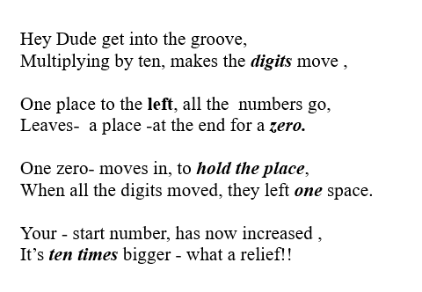
Multiplying by ten rap
Notes:
Plenary. https://www.bbc.co.uk/bitesize/topics/z36tyrd/articles/z2fkwxs

Slide 23
1.7.2020
LO: To multiply numbers by 100.

Slide 24
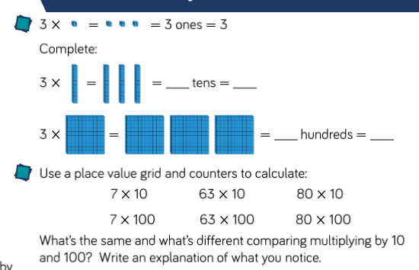
Notes:
Opening.
What do you notice when multiplying a number by 100.?
What does the answer end in?
What is happening to the digits?

Slide 25
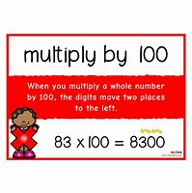
What happens when we multiply a number by 100?
When multiplying by one hundred each digit moves two places to the left to make the number 100 x bigger.
As the digits move, we need to put a zero in both the tens and the units column.

Slide 26
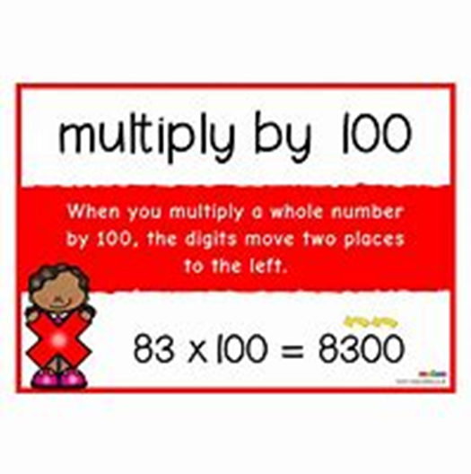
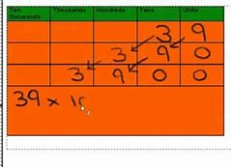
What calculation takes place here?

Slide 27
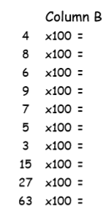
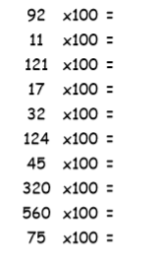
Notes:
Complete calcualtions and choose 5 to represent as a visual representation.

Slide 28
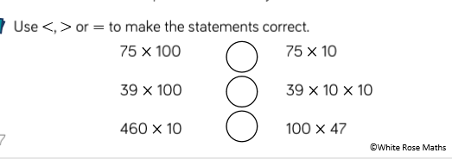
Multiplying by 100

Slide 29
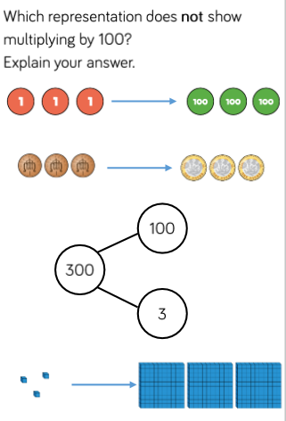

Slide 30
Reasoning Task.
Laila multiplies a number by 100 and her answer is between 600 and 1200. What could her original calculation have been?
Show all possibilities.
Benjamin thinks of a number and multiplies it by 100. Her answer is somewhere between 1200 and 2200. What could her original number have been?
Show all possibilities.

Slide 31
Multiplying by 50.
I want to do the following calculation. 17 x 50.
I do 70 x 100= 1700.
What shall I do next?

Slide 32
Multiply these numbers by 50.
13
14
16
18
19
23

Slide 33
2.7.2020
LO: To divide by 10 and 100.

