Slide 1
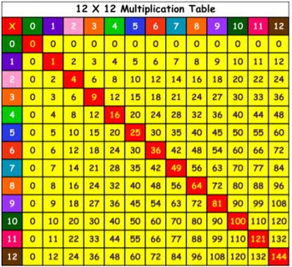
Multiplication and Division
Home Learning
Week 10

Slide 2

https://www.timestables.co.uk
http://www.maths-games.org/times-tables-games.html
https://www.topmarks.co.uk/maths-games/7-11-years/multiplication-and-division
https://www.youtube.com/watch?v=igoGDE5hLjw
Please make a big effort to learn your tables !!!!
Notes:
Interactive times tables games to be used as starter activities/plenaries throughout the topic
Start tables practise in computing lesson before main lesson begins.

Slide 3
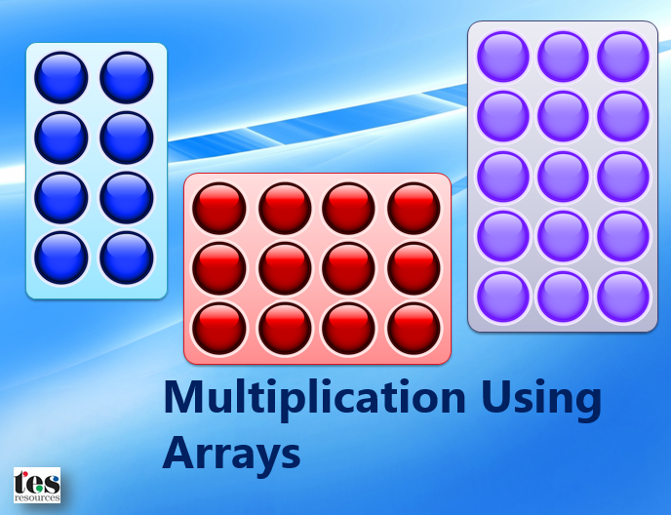
2.7.2020
LO: to solve multiplication problems using arrays
Use the arrays powerpoint to help you!
Notes:
Monday
Whole class to go through “arrays intro” ppt (see planning folder)
Bring in egg boxes for working wall – draw and write the array
Chocolate- draw and write the array
Where else do you see arrays?

Slide 4
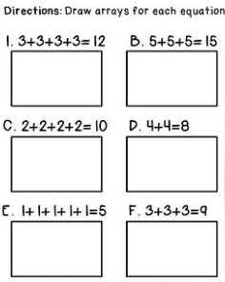
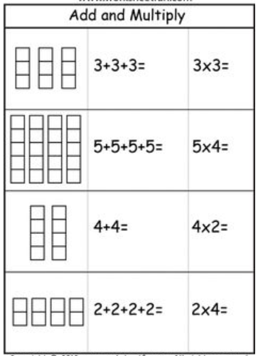
Notes:
Monday
You can to work practically with counters to create the arrays and then answer the questions
After looking at powerpoint examples- use chocolate to break up and children write the array that matches. Counters needed.

Slide 5
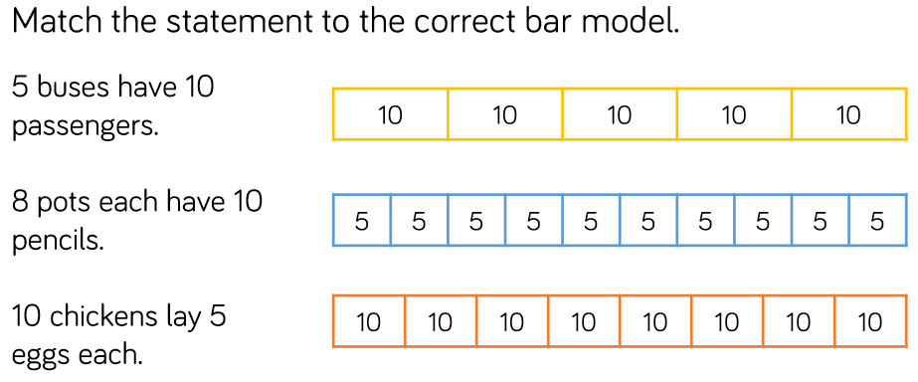
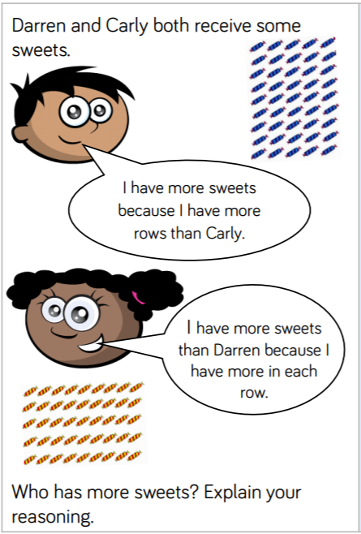
Notes:
Monday
LA/MA extension/ next step

Slide 6
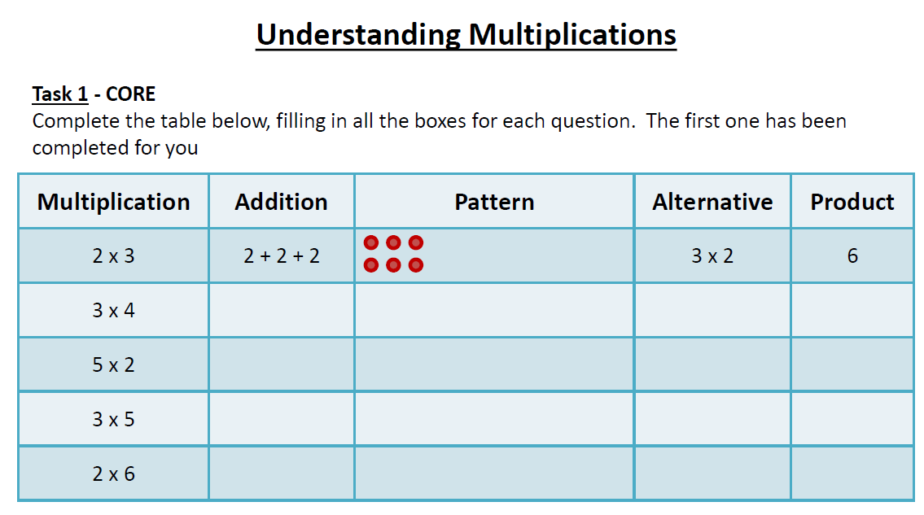
Notes:
Monday
Whole class- can also draw array for alternative.

Slide 7
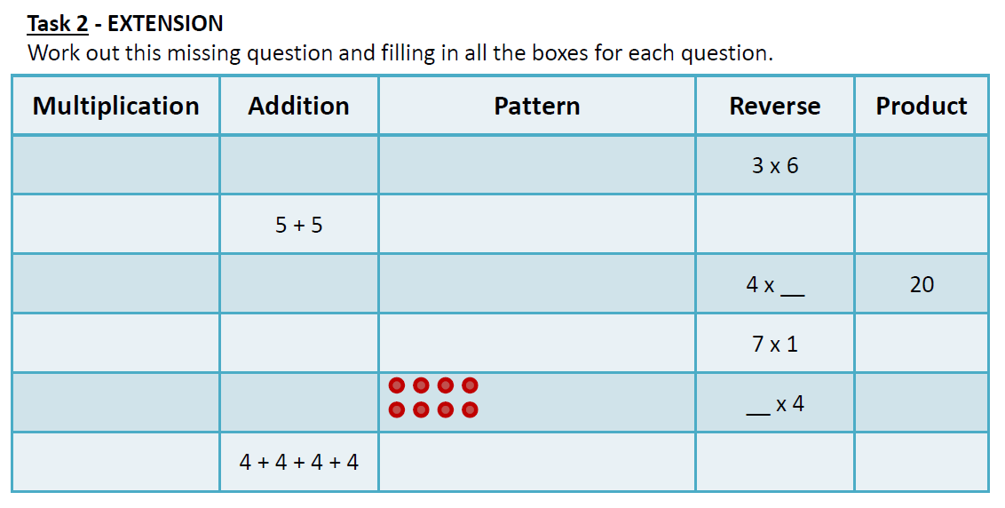
Notes:
Monday
HA extension

Slide 8
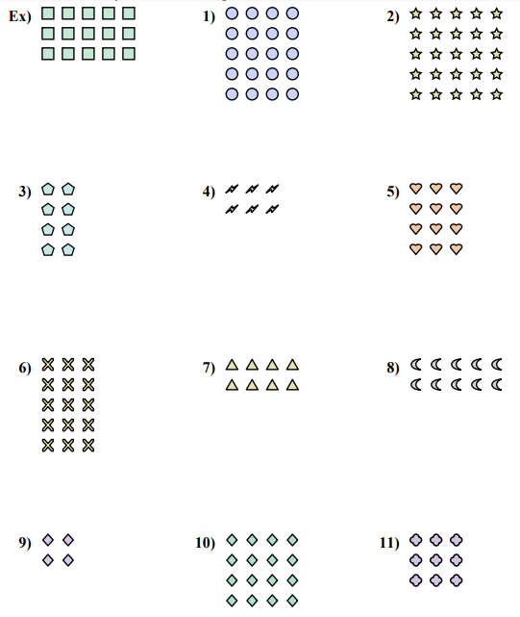
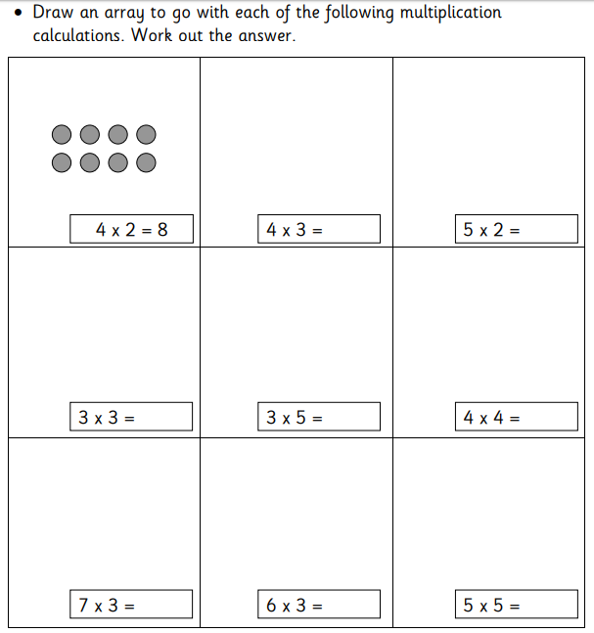
Notes:
Tuesday
LA to write each question as a repeated addition sum, then multiplication sum and solve
Counters available to help if necessary

Slide 9
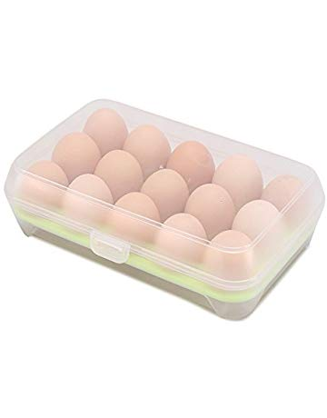
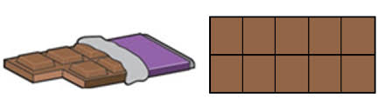


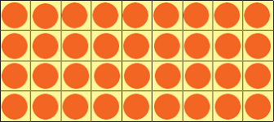
Write an multiplication fact to match each array.
Notes:
Images on the board- children discuss and record the repeated additions and arrays that mathv

Slide 10
LO: to use arrays to solve multiplication word problems
3.7.2020
Notes:
Tuesday
Reminder of what an array is.
Pictures of arrays- what is the repeated addition and multiplication sum that matches the picture.- this leads straight into what the LA are going to be asked to do.

Slide 11
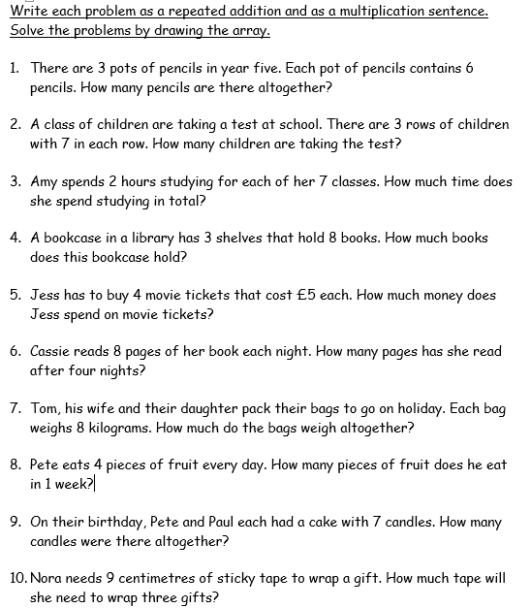
Notes:
Wednesday – model first two word problems
MA/HA
Example 1- establish that 3 is the number of groups and 6 is the number in each group so it is 3 groups of 6. 3 x 6
2) 3 x 7
For each question children need to decide which number is how many groups and which number is how many in each group.
Children to have copy of questions and draw arrays to match in books. They also need to write the repeated addition and the multiplication sum.

Slide 12
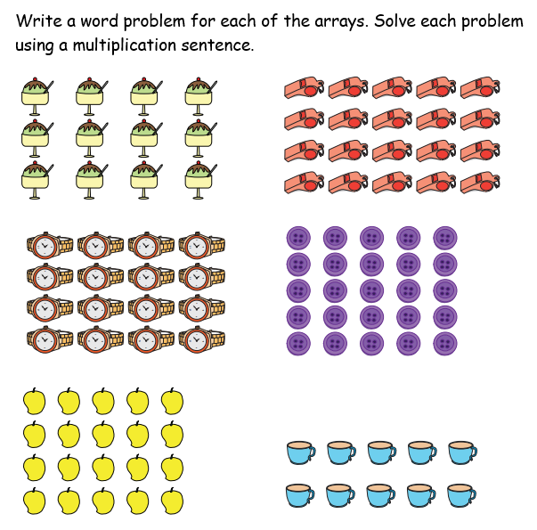
Notes:
Tuesday
HA extension

Slide 13

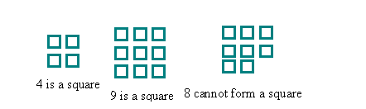
Extension 2:
Question 1 Begin with a particular whole number and make as many different rectangular arrays as possible. (Rectangles include squares.) For example, for the number 12, the possible rectangular arrays are:
Question 2 Search for numbers that can form square arrays.
Notes:
HA extension 2

Slide 14


