Slide 2
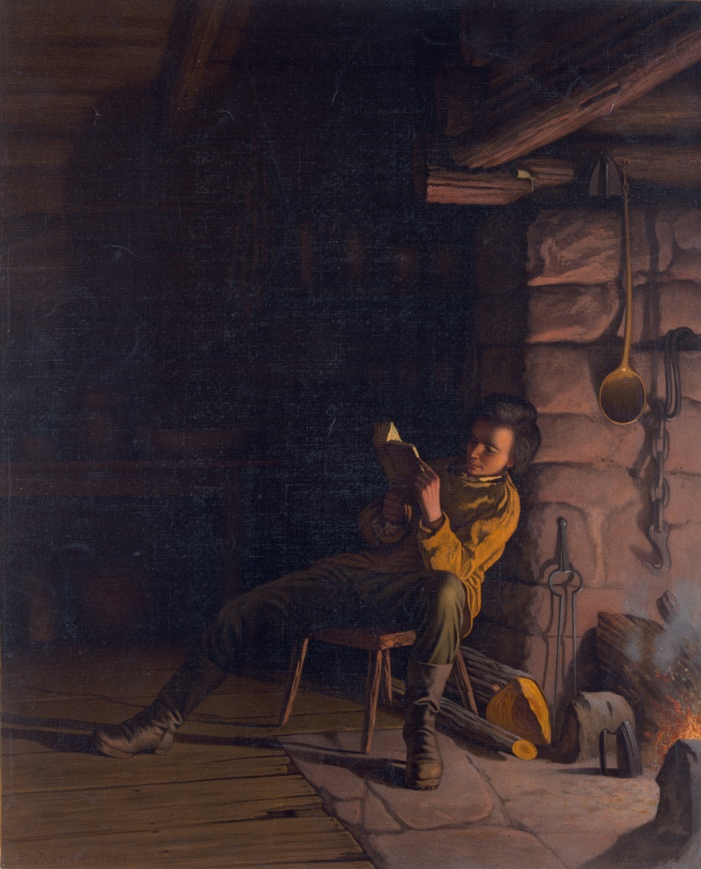
Who?
Abraham Lincoln
Born February 12, 1809
Assassinated April 14, 1865 (age 56)

Slide 3
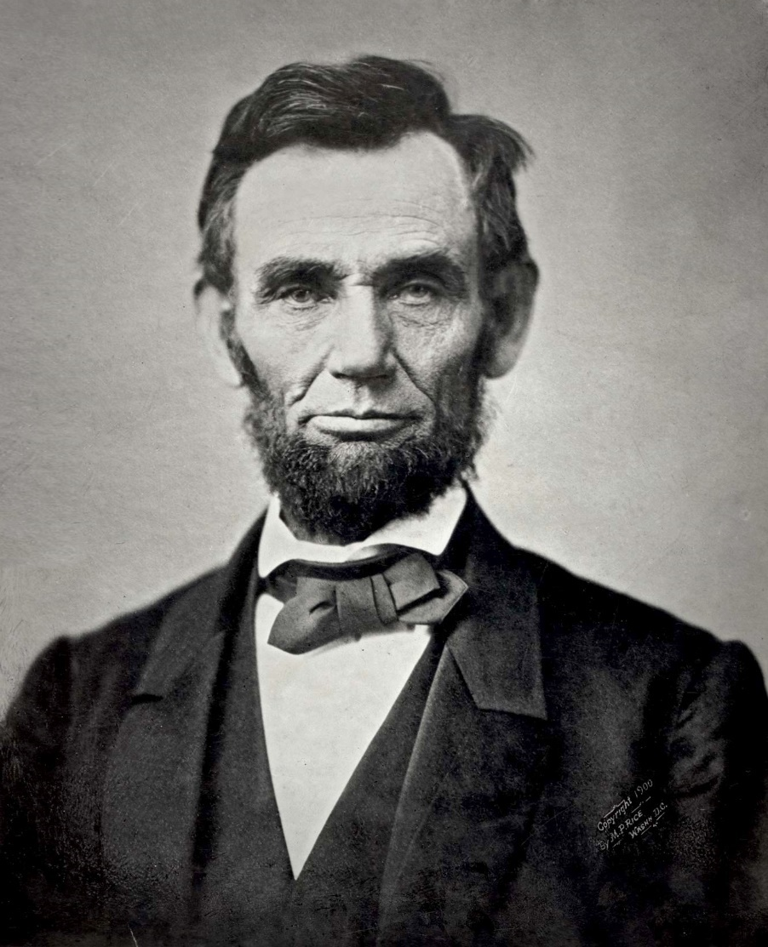
What?
Postmaster
Self-taught lawyer
Politician
16th president of the United States of America

Slide 4
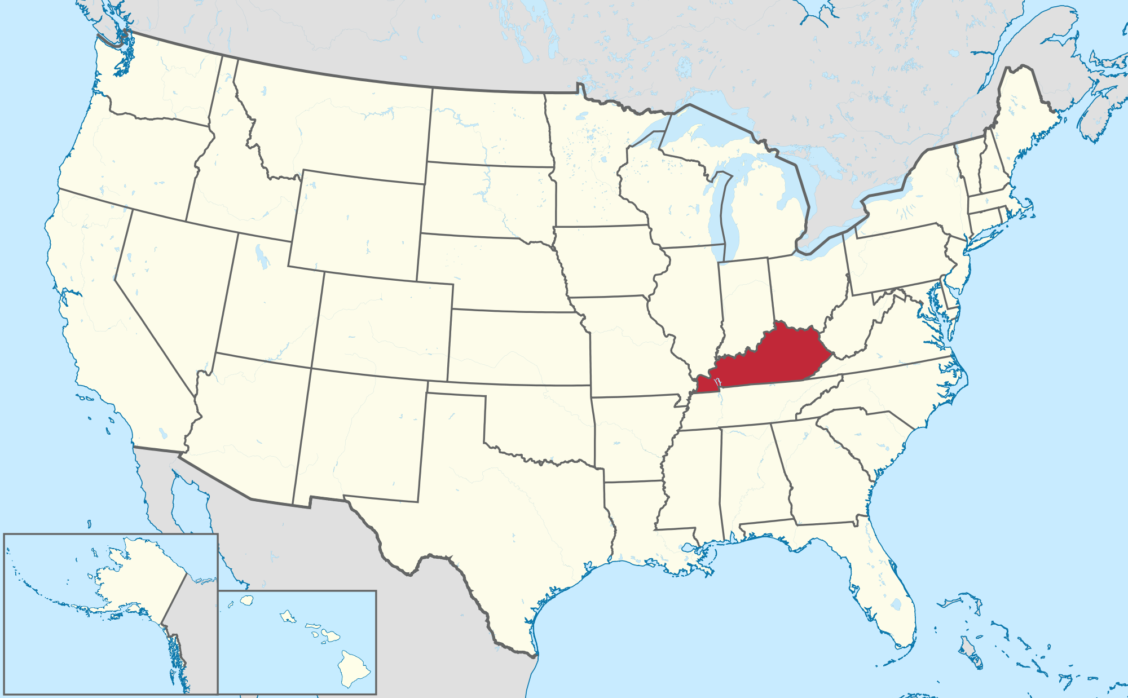
What?
Born in Hodgenville, Kentucky
As a child, attended school for less than a year
Did not go to college

Slide 5
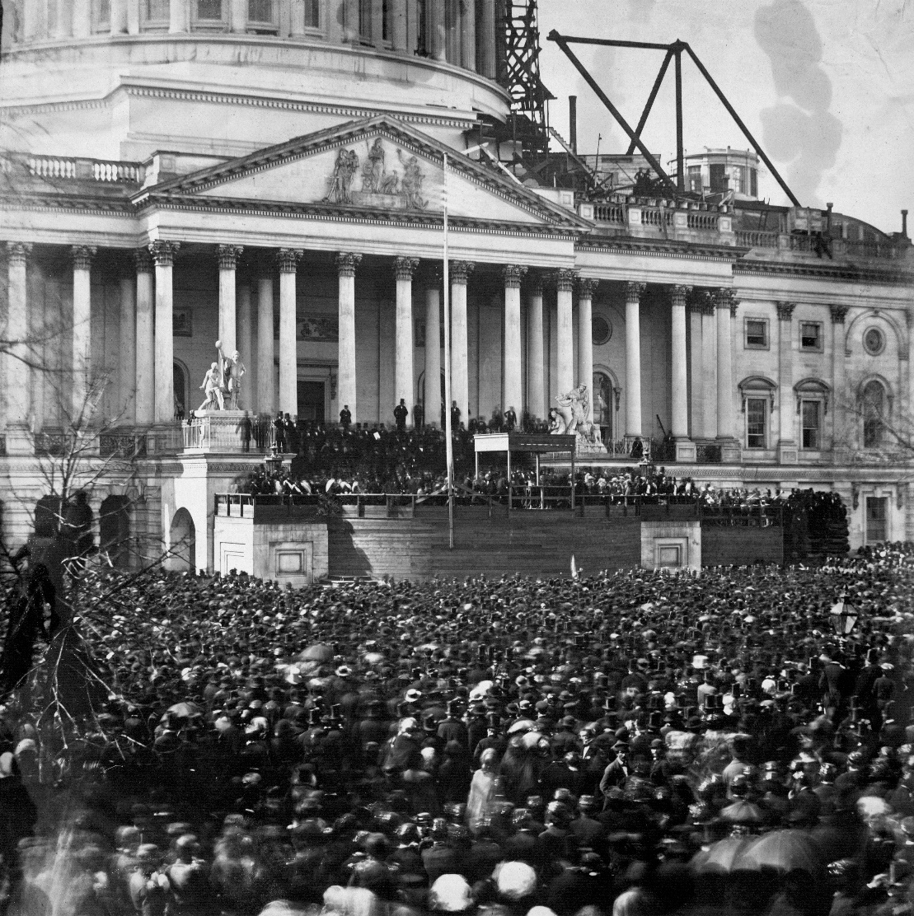
What?
Served one term as president from 1861 to 1865

Slide 6
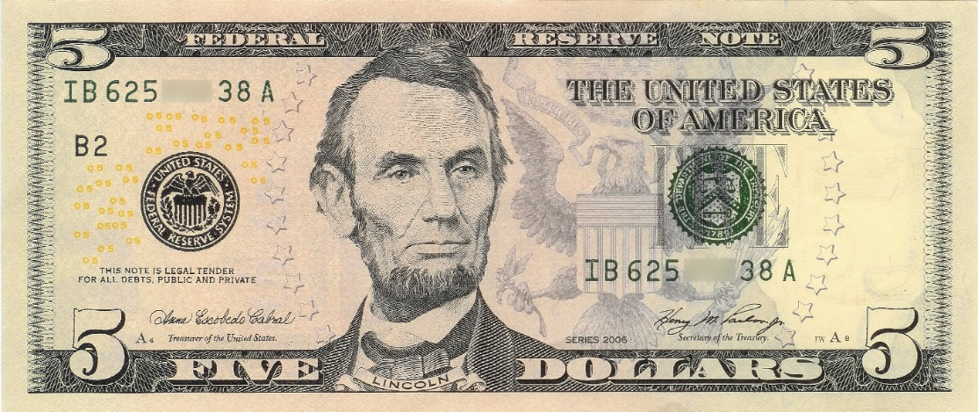
Presidential Accomplishments
Issued the Emancipation Proclamation that signaled the beginning of the abolishment of slavery in the USA
Established the United States National Banking System and the national currency
Formed the United States Department of Agriculture (USDA) to regulate farming, agriculture, forestry, and food

Slide 7
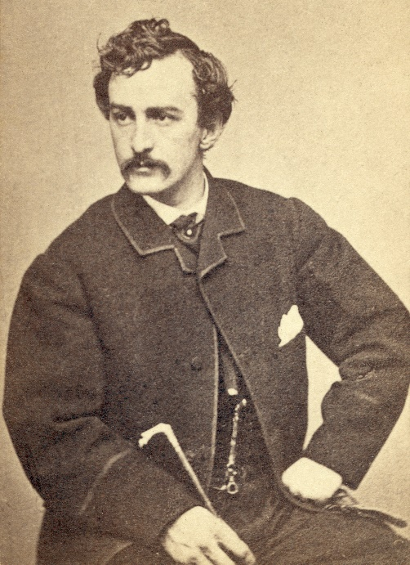
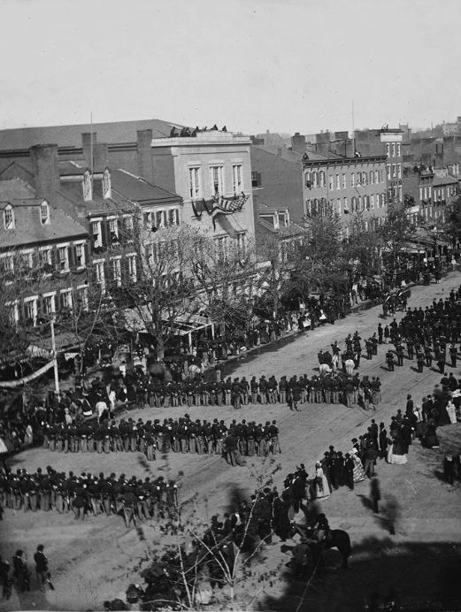
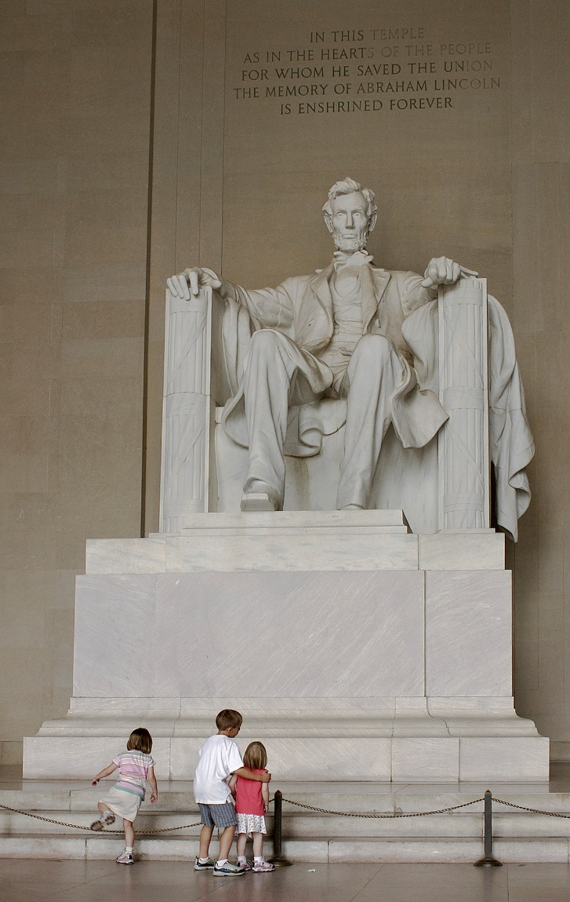
Assassination
John Wilkes Booth assassinated President Abraham Lincoln on April 14, 1865. Booth, who was fiercely opposed to Lincoln’s mission to abolish slavery, shot the president in the head while he was watching a play at a theater in Washington, D.C.

Slide 8
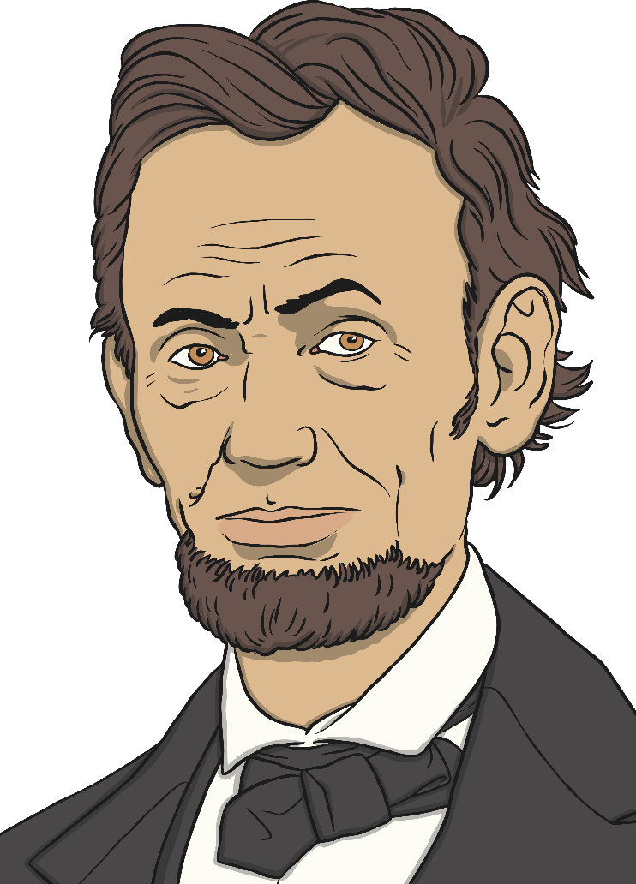
Presidential Accomplishments
Four score and seven years ago our fathers brought forth on this continent, a new nation, conceived in Liberty, and dedicated to the proposition that all men are created equal.
Abraham Lincoln

Slide 9
https://www.ducksters.com/biography/uspresidents/abrahamlincoln.php
Notes:
For a child-friendly fact file, please follow the link above.

