Slide 1
Maths
Multiplication and Division

Slide 2
6.07.2020
LO: To use our 6x, 9x and 7x table to solve other calculations

Slide 3
Go to:
Mixed multiplication Test (6x, 7x, 9x)
https://www.mathsisfun.com/timestable.html
https://www.coolmath4kids.com/quizzes/multiplication
Or simply get a parent to test you.

Slide 4
Starter.
  12 18 24 30 36 42 48 54 60 66 72
  14 21 28 35 42 49 56 63 70 77 84
  16 24 32 40 48 56 64 72 80 88 96
  9 18 27 36 45 56 63 72 81 90 99 108
Questions
Is there any number which is a multiple of 6, 7, 8 and 9
Does any number/s appear in more than 2 sets of tables? What multiplication facts are these the answers to?
What do you notice about the multiples of 6 and 8?
Are all the multiples of 6 multiples of any other numbers
Are all the multiples of 9 multiples of any other numbers?
What do you notice about the multiples of 7?
Notes:
Everyone completes starter: SEN to count up in steps of the different numbers and then use this to answer questions relating to the tables.

Slide 5
3 x 6 = 18 6 x 9= 54
Use this to work out:
6 x 3=
30 x 6=
300 x 6=
3000 x 6=
60 x 3=
600 x 3=
6000 x 3=
Use this to work out:
9 x 6=
60 x 9=
600 x 90=
6000 x 9=
90 x 6=
900 x 6=
9000 x 6=
Notes:
Teacher goes through these as examples.

Slide 6
3 x 7 = 7 x 9=
Use this to work out: Use this to work out:
30 x 7=
300 x 7=
3000 x 7=
7 x 3=
70 x 3=
700 x 3=
7000x 3=
70 x 9=
700 x9=
7000 x9=
9 x 7=
90 x 7=
900 x 7=
9000 x 7 =

Slide 7
Fluency
For each of these calculations, show the basic multiplication fact that you used to help you.
400 x 9= g) 80 x 7= m) 60 x 30= s) 50 x 600
300 x 7= h) 90 x60= n) 40 x 60= t) 900 x 8=
10 x 60= i) 80 x 70= o) 70 x 6= u) 40 x 60=
60 x 6= j) 40 x 6= p) 400 x 7= v) 500 x 7=
60 x 70= k) 7 x 40= q) 500 x 9= w) 70x 80=
80 x 9= l) 90 x 9= r) 700 x 80= x) 600 x 7=
Notes:
MA/HA fluency.

Slide 8
How many days in 25 weeks?
There are _______ in a week.
____ x 7 = 35
There are _____ days in 5 weeks.
20 x 7=
There are _____ days in 20 weeks.
____ + ______ =_____
Therefore there are ______ days in 25 weeks.

Slide 9
Children are being organised into rows as follows.
In each row there are 4 girls and 5 boys which means there are 9 children in each row.
How many children in 6 rows?
How many boys in 6 rows?
How many girls in 6 rows?
How many children in 10 rows?
How many boys in 10 rows?
How many girls in 10 rows?
How many children in 60 rows?
How many boys in 60 rows?
How many girls in 60 rows?
How many children in 100 rows?
How many girls in 100 rows?
How many boys?
Draw a quick visual representation of this problem.

Slide 10

7.7.2020
LO: To use bar models to solve multiplication word problems

Slide 11
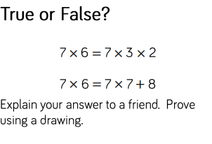
Next Step

Slide 12
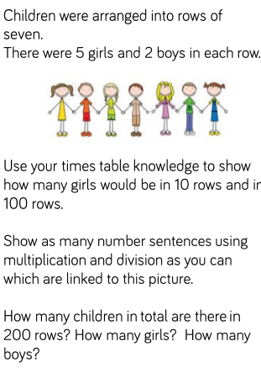

Slide 13
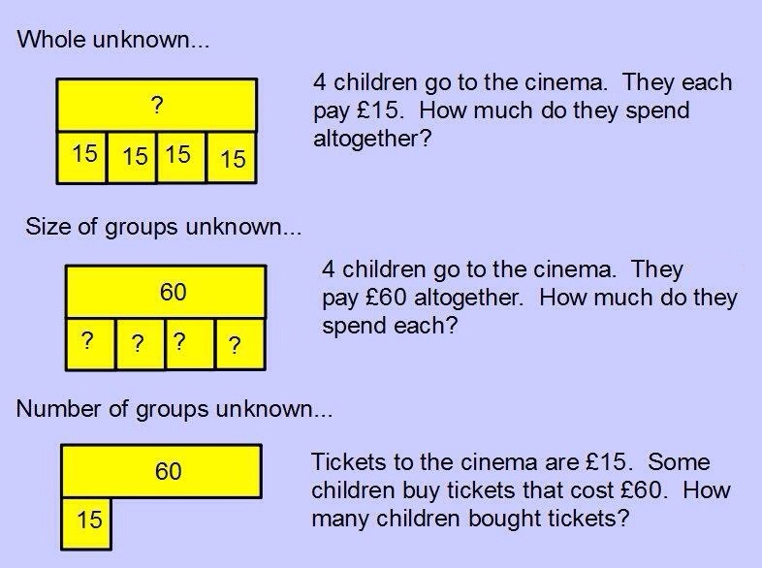

Slide 14
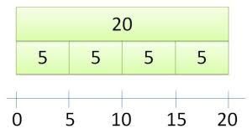
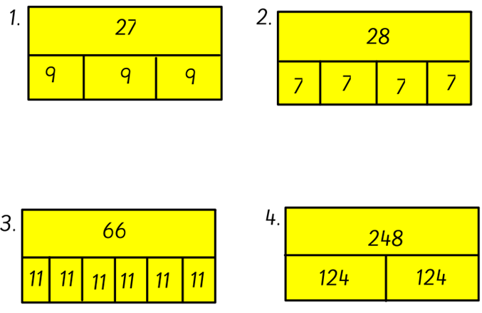
What multiplication facts match the following bar- models?

Slide 15
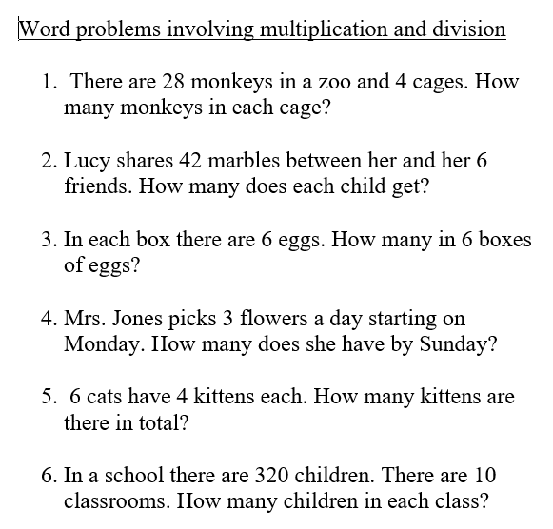
Use a bar-model to represent these multiplication word problems.

Slide 16
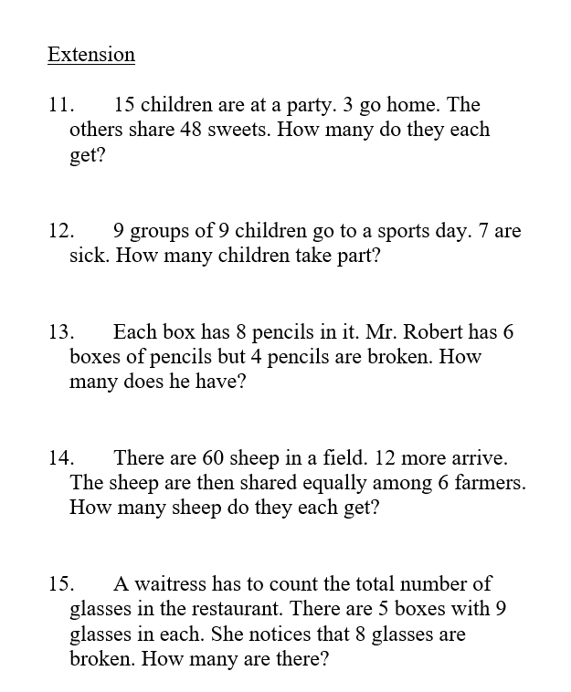

Slide 17
Notes:
Ha extension
Measures

Slide 18
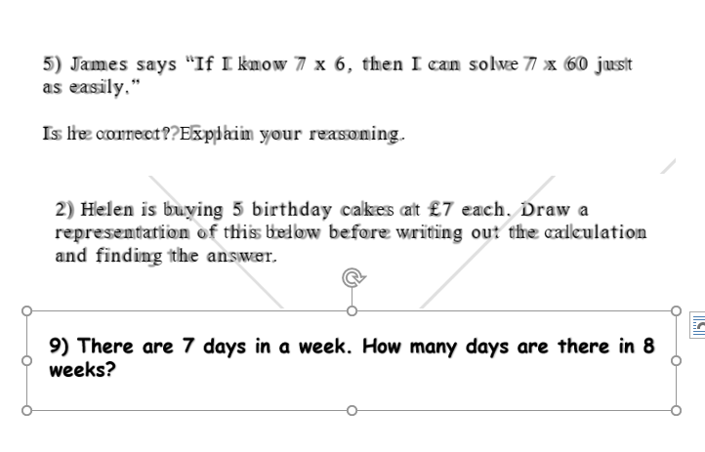

Slide 19
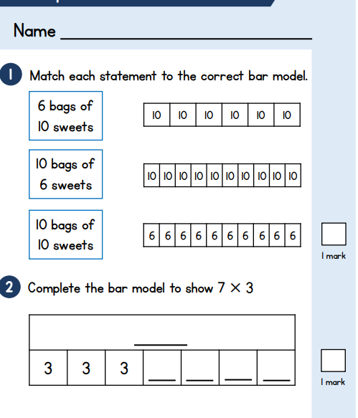
Wednesday 8th - Multiplication Assessment.

Slide 20
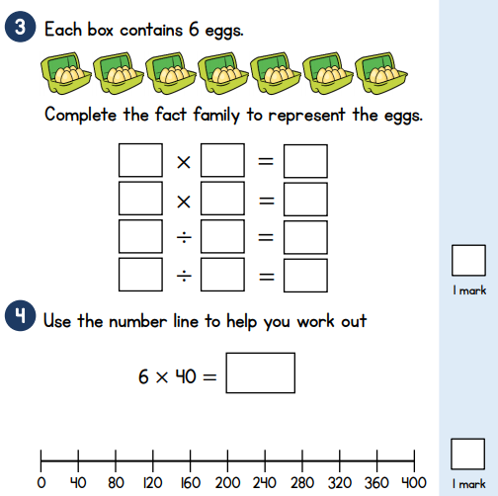
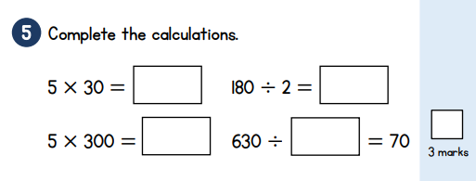

Slide 21
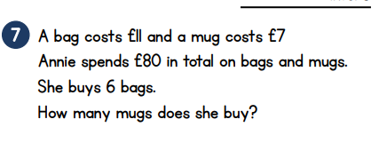

Slide 22
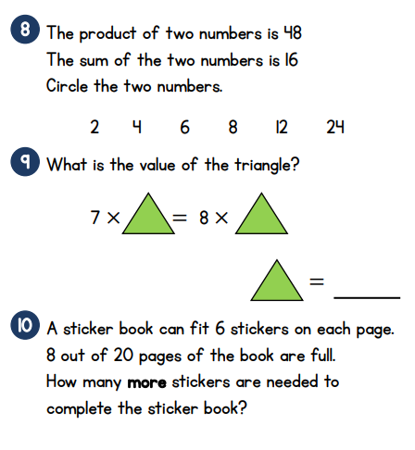

Slide 23
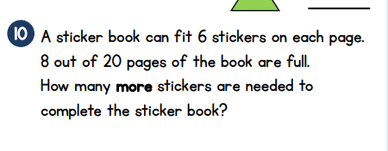

Slide 25

Thursday 9th July 2020
LO: To solve problems relating to the multiplication tables.

Slide 26
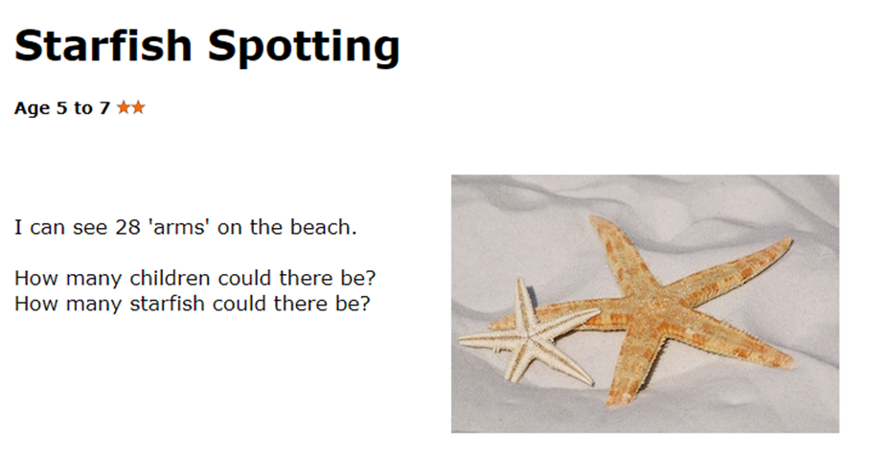
Notes:
Use of equipment for SEN (labelled starfish – 5 legs, human, 2 legs) people and starfish given to sen. Everyone starts on this problem. Model how to write down multiples of 2 and 5. and find examples pf mutliples or 2 and 5 that add to 28. e.g. 4 starfish x 5 legs is 20 and then four children to make 8 legs. Can they find any more?

Slide 27
How to solve this:
Write out the 2x and the 5 x table.
Look for multiples of 2 and 5 that add together to make 28.

Slide 28
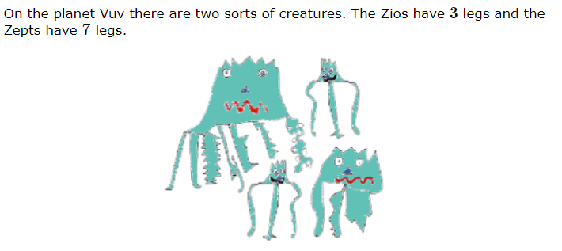
LO: To solve problems relating to the 7x tables.

Slide 29
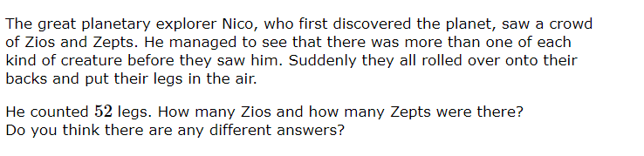

Slide 30
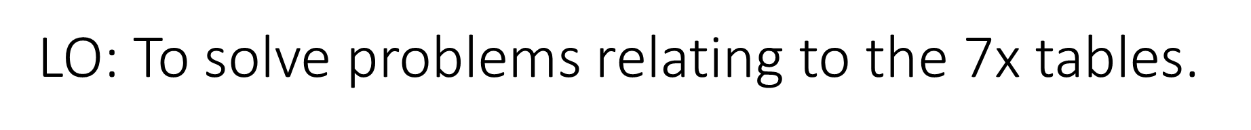
Zios and Zepts
What do we need to do to solve this?
Multiples of 3 and multiples of 7.
We need to find a multiple of 3 and a multiple of 7 that add together to make 52.
Here they are:
3 +49=52 (1 x 3+ 7 x 7) and so that means 1 Zio and 7 Zepts
45+ 7=52 (15 x 3+ 1 x 7) and so that means 15 Zio and 1 Zept
24+28=52 ( 8 x3 + 4x 7) and so this means 8 Zios and 4 Zepts

