Slide 1
Friday 10th July
Today is time to go over some more problems from the Autumn Term.
Do you remember the Deca Tree problem?
This problem will test your skills of multiplying by 10 and 100.

Slide 2
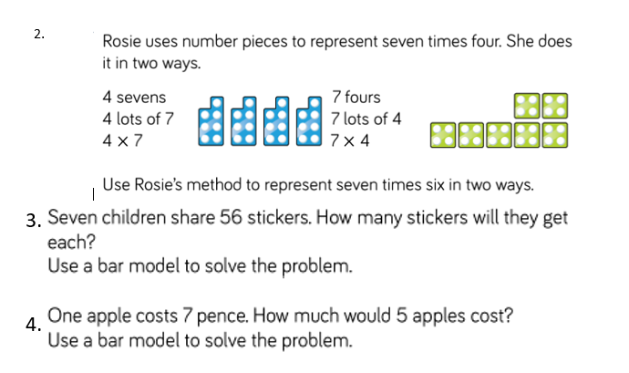

Slide 3
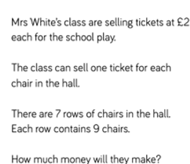
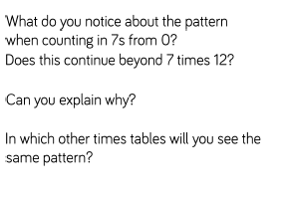

Slide 4


