Slide 1
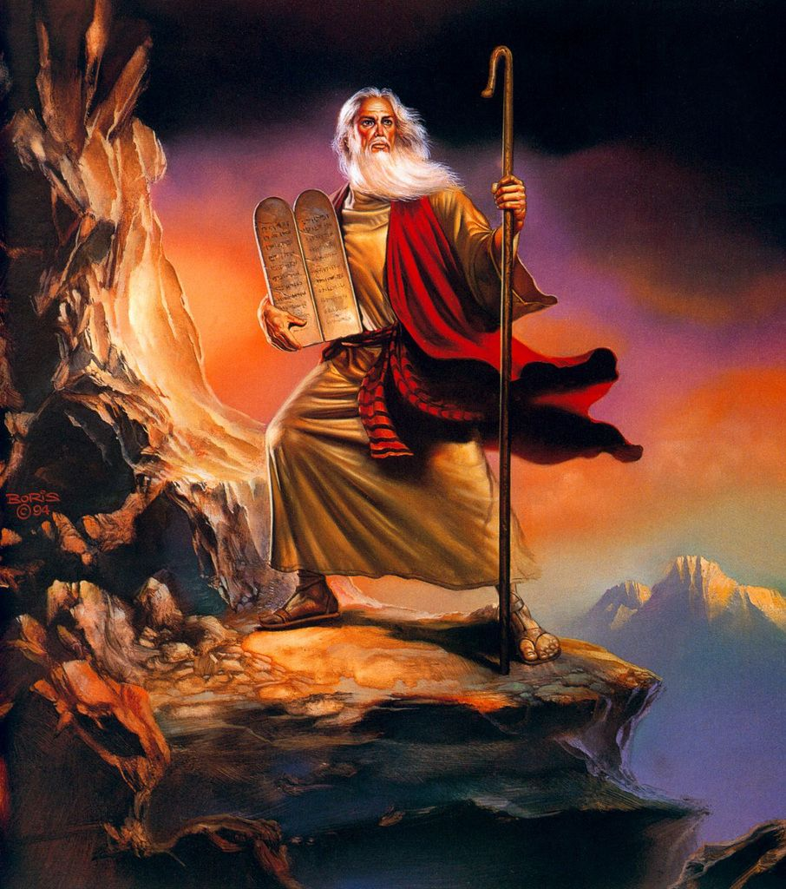
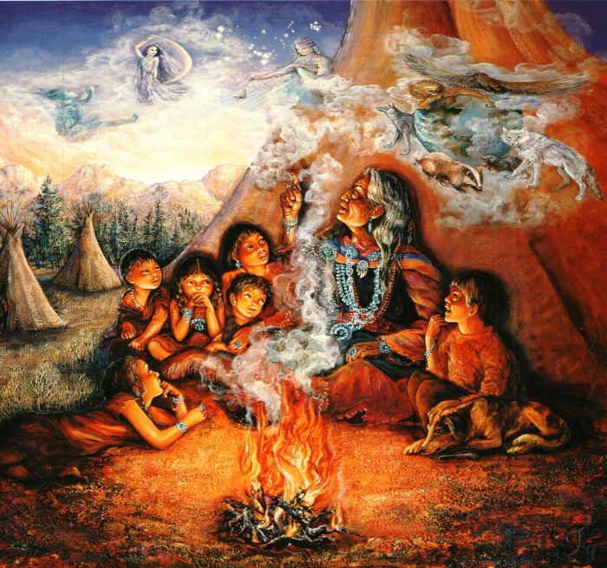
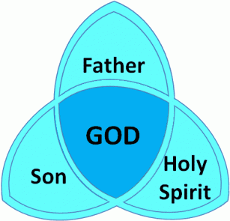

RE
Comparing Christian and Native American beliefs

Slide 2
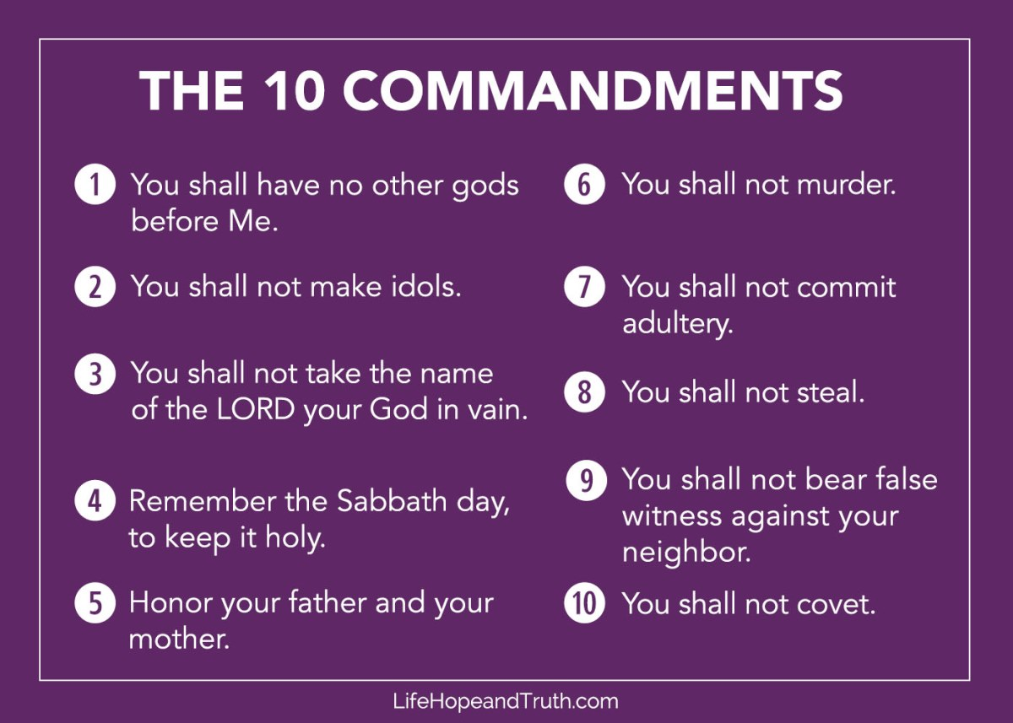
Have a look at the 10 commandments of Christianity:

Slide 3
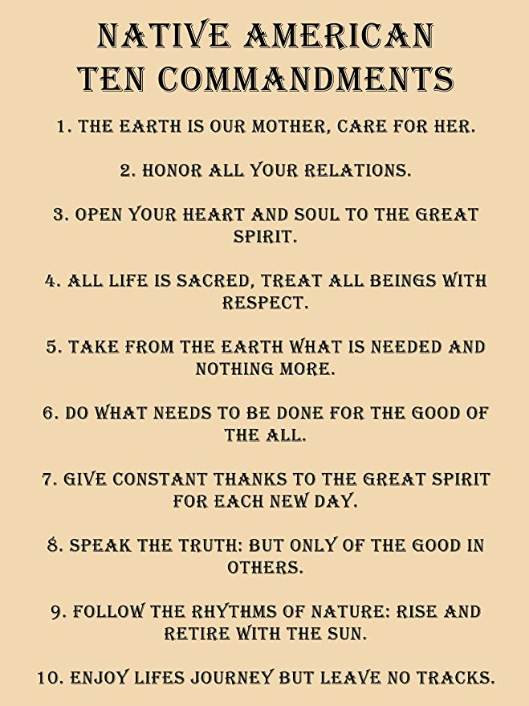
Have a look at the 10 commandments of Native Americans:

Slide 4
Task: Write a paragraph comparing the similarities and differences between the commandments.

