Slide 1
Week 12
Monday
There is squared paper to download for this learning.
L.O: To calculate the perimeter of rectilinear shapes.

Slide 2
What is Perimeter?
How can we find perimeter?
What does the word ‘rectilinear’ mean?
Notes:
Whole class discussion. What might the beginning of the word rectilinear mean? (Answer: a shape made up of lines that meet at right angles.)

Slide 3
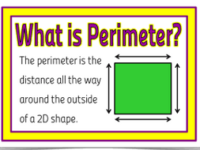
Notes:
Copy definition.

Slide 4
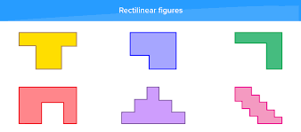
A shape made up of straight lines. (Made up of rectangles.)
Notes:
Give children 4 cut out rectangles. They cut them out neatly quickly and explore different rectilinear shapes that they could make. Everyone in pairs.

Slide 5
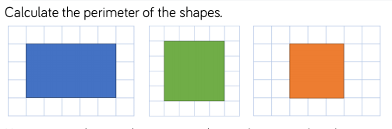
Each square represents 1cm.
Notes:
Remind them of what perimeter means. To start with we can just find perimeter by counting squares. Get different children up to count the perimeter of these squares and model on board how to set this out.

Slide 6
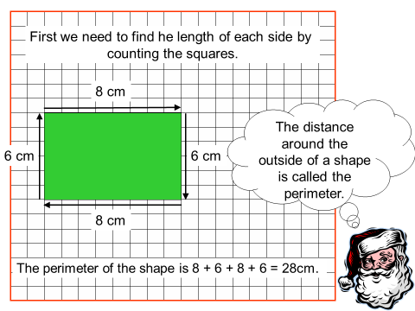
Notes:
Another model oh how to set this out.

Slide 7
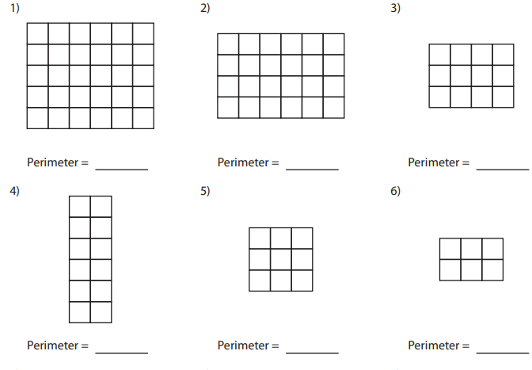
Find the perimeter of each shape:
Each square represents 1cm.
Notes:
LA/ MA

Slide 8
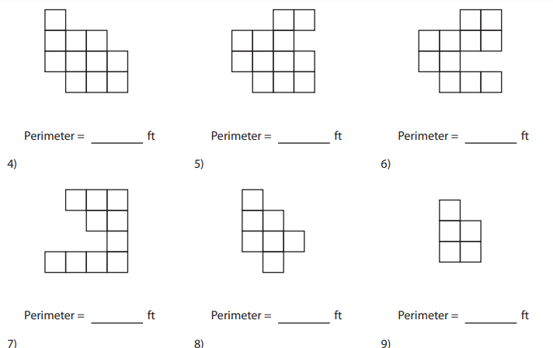
Each square represents 2ft.
Notes:
Ma/HA

Slide 9
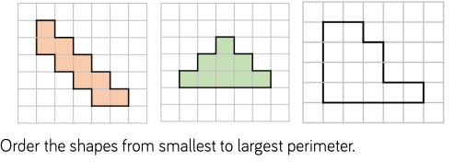
Notes:
Process: find the perimeter of each shape, compare and order.

Slide 10
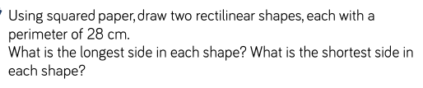
Notes:
HA extension

Slide 11
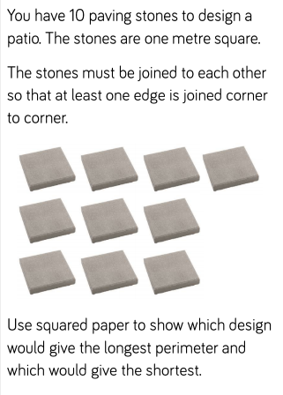
Week 12
Tuesday

Slide 12
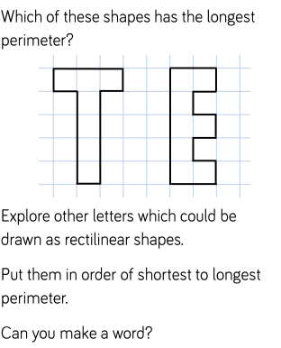

Slide 13
Week 12
Wednesday
L.O: To solve problems relating to perimeter.

Slide 14


