Slide 1


Gentleness
“Let your gentleness be evident to all. The Lord is near.”
- Philippians 4: 5-7

Slide 2


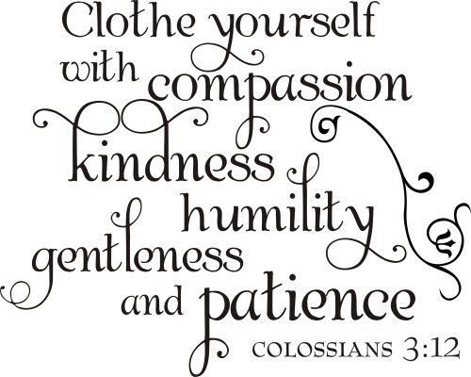
What does it mean to be gentle?
Gentleness is similar to kindness, but it involves having a softness of heart toward other people.
Gentleness means treating each person with care
Everyone carries gentleness within the core of their being.

Slide 3


A gentle person is calm, kind and soft of heart
They are strong and full of self-control
A gentle person takes time, between something happening and responding to it. They do not react immediately, but take time to choose how to respond and then do so calmly.
Their character is consistent, reliable, and steady. They are aware of the needs of the people around them and are willing to bring their natural and peaceful way to them.
The gentle person attracts friends and the trust of others because of this strength
Think of who in your class is a gentle person

Slide 4
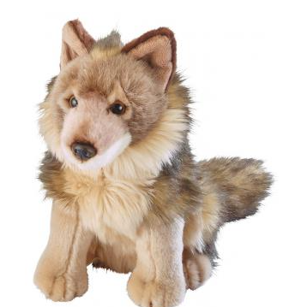
Wolfie
When Patrick’s grandma returned from a holiday, she brought him a special stuffed animal – one that resembled a wolf. Patrick had never seen such a wonderful teddy. He loved wolves, and although he had other toy animals, Patrick had never had one that looked like a wolf.
Patrick named his new teddy “Wolfie.” He took Wolfie to bed with him every night and felt safe when he cuddled Wolfie.
At first, Patrick was gentle with Wolfie, but soon he started treating his new teddy roughly. If his mum or dad did not read him an extra bedtime story, or if he had to go to bed early, he would throw Wolfie to the floor. “Don’t do that,” Patrick’s parents cautioned, “or Wolfie will get hurt.” But Patrick didn’t listen. Sometimes, when he was feeling frustrated, Patrick would even punch or hit Wolfie.
One day, Patrick had a fight with his sister. While he was still feeling very angry, he went to his room and kicked Wolfie against the wall. But as Wolfie fell to the floor, Patrick noticed a large tear in Wolfie’s side. Wolfie’s stuffing was even starting to fall out.

Slide 5
Patrick called, “Mummy, I’ve hurt Wolfie! Come quickly!” Patrick’s mother came running. When she got to his room, she found Patrick holding Wolfie and crying. She hugged Patrick and said that she would help him try to fix Wolfie.
Together they picked up the stuffing and pushed it back into the large hole in Wolfie’s side. Wolfie looked a little better, but he was still lumpy and torn. Patrick’s mum got out her sewing machine and did her best to fix the tear.
When she was done, Wolfie looked like himself again, but he had a large scar down his side where Patrick had kicked him. Although the hole had been fixed, it was still obvious that the fabric had once been torn.
Patrick loved Wolfie as much as ever and took care to be gentle with Wolfie. Every day, when he saw the scar on his special teddy’s side, he remembered how important it was to be gentle with his toys and his friends. He didn’t want to cause anymore scars.
We hurt others through our words or actions, but can’t always see the damage.

Slide 6
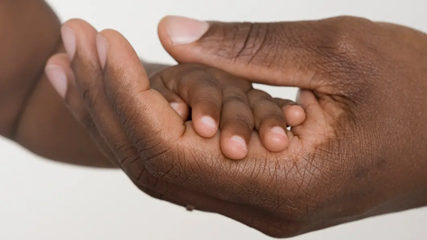

Questions for discussion
Are you ever rough with your toys?
Have you ever hit a person?
Did you know that hitting can really hurt people and toys?
Do you ever speak unkindly to your toys?
Do you ever say mean things to your friends or brothers and sisters?
How do you think God wants us to treat each other?

Slide 7

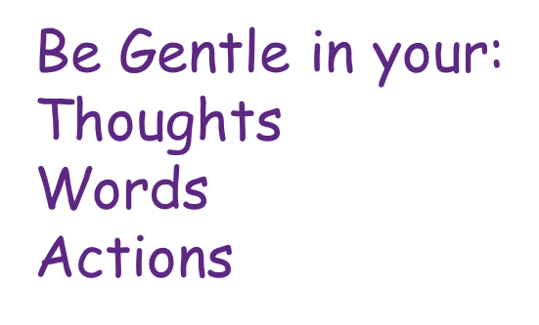
How to be more gentle
Decide What You are Going to Do:
Rather than reacting, gentle spirits embrace their ability to choose.
If something happens or somebody says something that you don’t like:
Stop, think, make a good decision, use kind words, show empathy

Slide 8
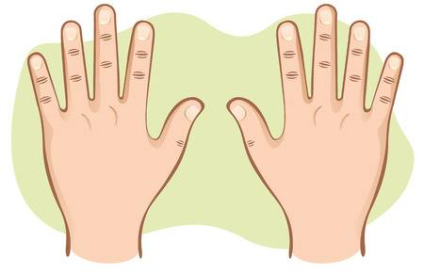

Give a friendly wave
Hug someone who is sad
Help other
people
Share with
others
Gentle Hands
Clap when someone
does something good
Never hurt others

Slide 9


Use Kind words
Tell people nice things to make them happy
Never argue and shout
Never use unkind names
Offer to help
Say I love you

Slide 10

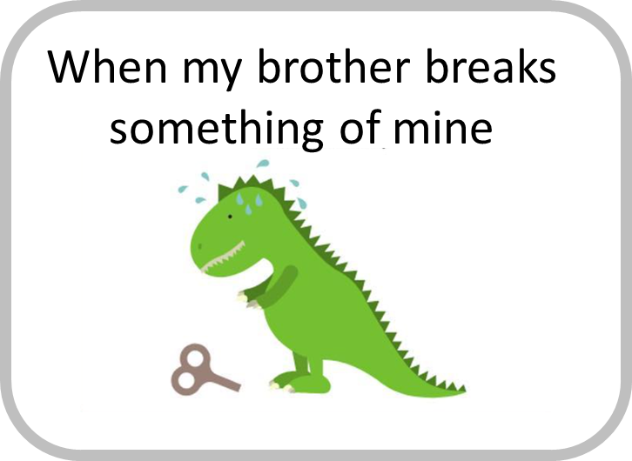
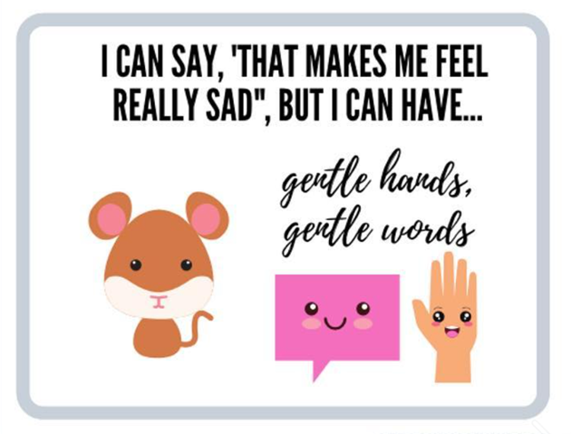
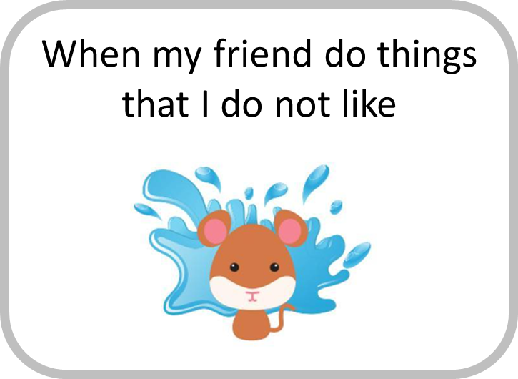


Slide 11

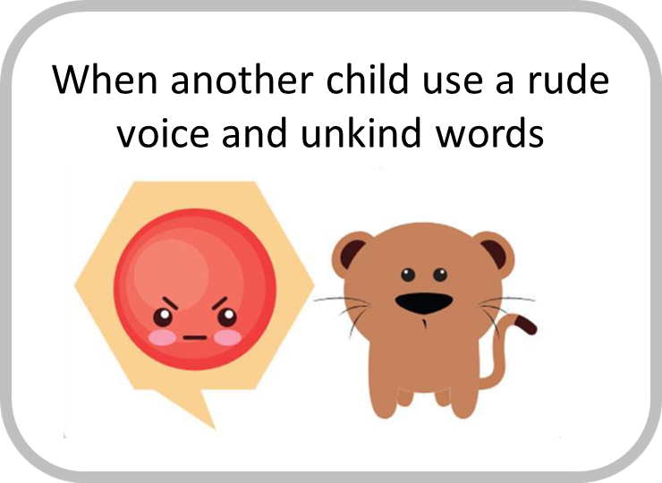
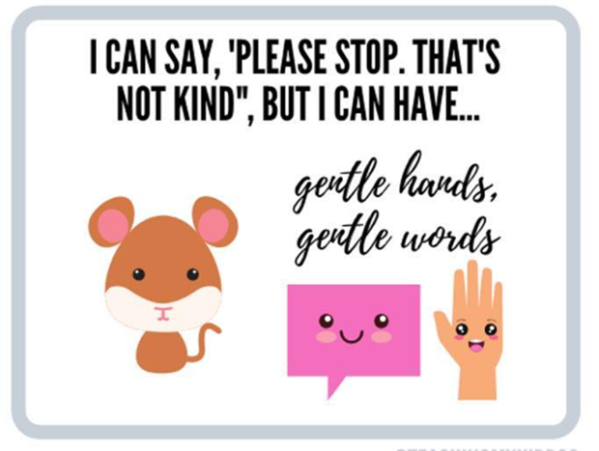
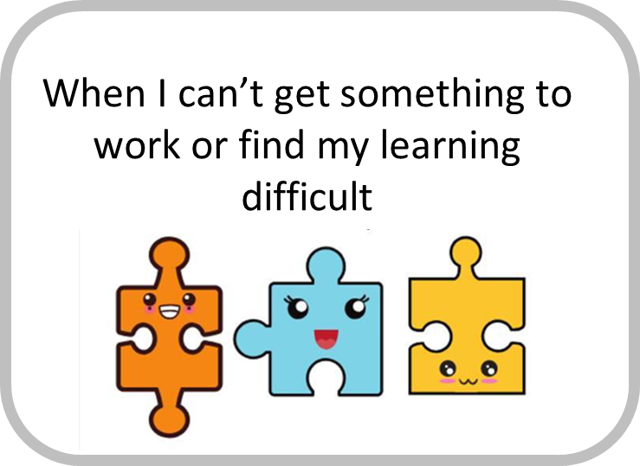
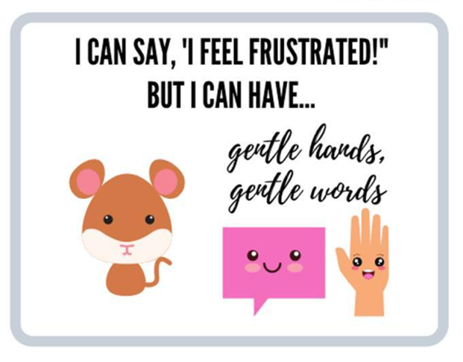

Slide 12

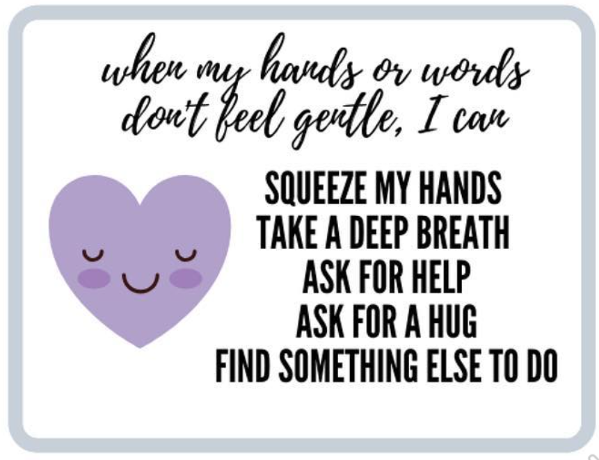


Slide 13
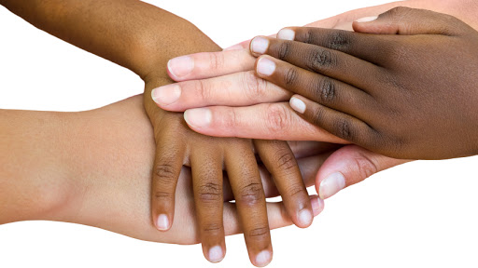
The benefits of being gentle
Gentleness makes me like Jesus
Gentleness makes God happy
Gentleness builds
friendships
“God blesses those who are gentle. The whole earth will belong to them!”
Matthew 5:5
Gentleness earns
respect
Gentleness is
persuasive
Gentleness defuses conflict
Gentleness communicates love

Slide 14
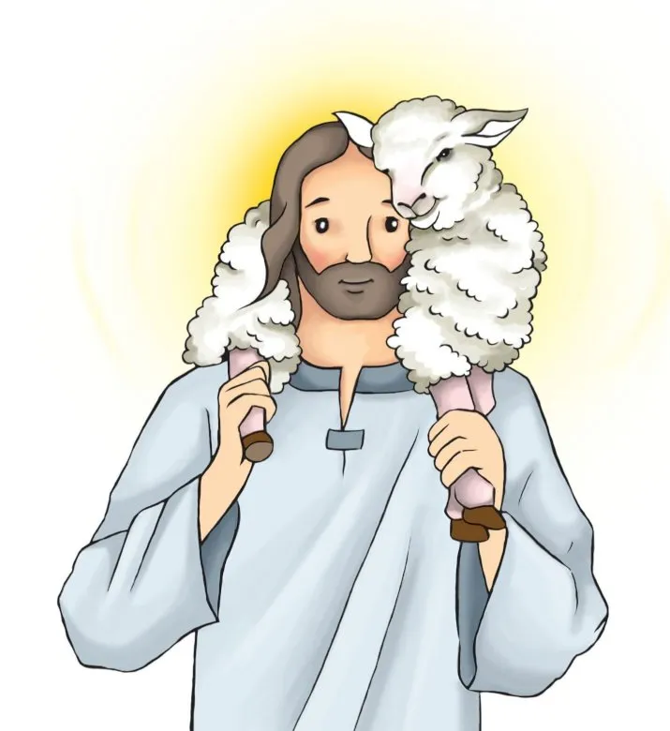
Father,
You tend Your flock like a gentle shepherd, gathering lambs in Your arms and carrying them close to Your heart. You said, “I am gentle and humble in heart” and you offer us rest for our souls. Thank you for being our gentle Father.
Lord, I desire to have a gentle spirit, which is of great worth in Your sight. Please send Your Spirit to shape my heart to be kind and tender. I humbly ask You to forgive me for being harsh and acknowledge my need for Your Spirit to live in me. Please remind me often of Your gentle grace and prompt me to offer Your love and forgiveness to others.
Amen

