Slide 1


Brothers and Sisters All
Lord, father of our human family,
You created everyone equally.
Pour into our hearts a spirit
of fraternal love.
Move us to build a better world,
a world without hunger,
poverty, violence and war.
May our hearts be open,
to all the people and
nations of the earth.
May we see the
goodness and beauty
that you have sown in each of us,
so that we can join together
with shared dreams.
Amen
PRAYING TOGETHER
FOR THE
HEALING OF OUR PLANET

Slide 2

Compassion
Compassion, kindness, service of neighbour
“When the Lord saw her, he had compassion for her.” (7:13),

Slide 3
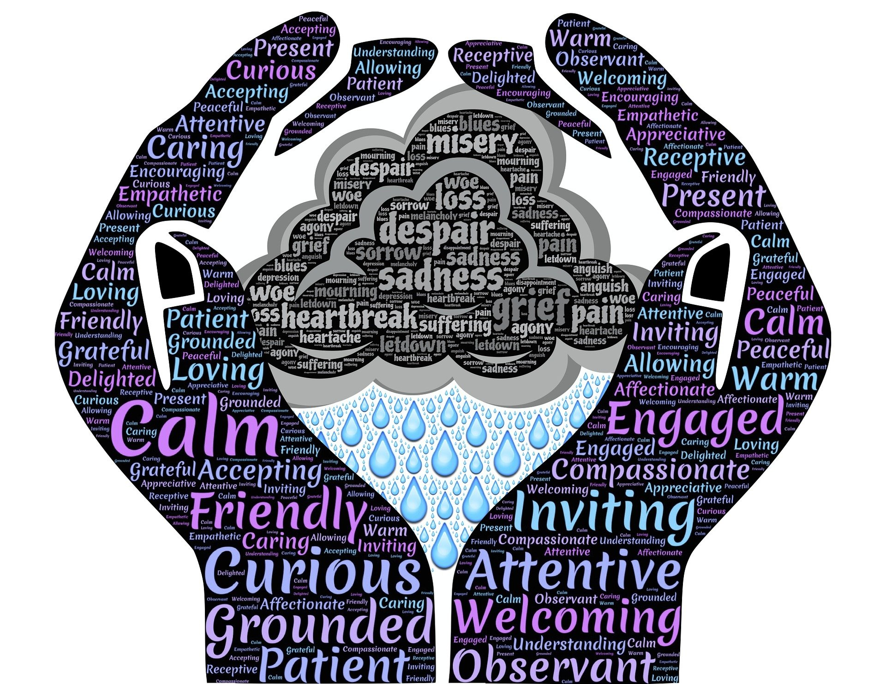
Showing concern or sympathy
for others
It is not just feeling sorry for someone
It is acting on your concerns

Slide 4
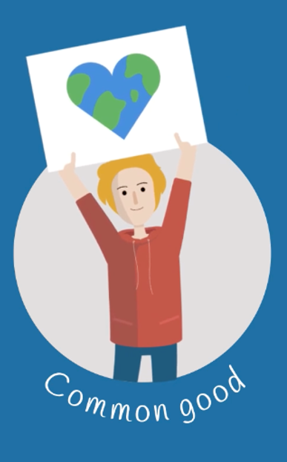
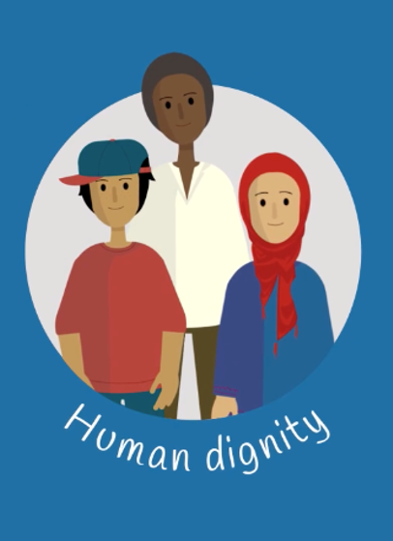
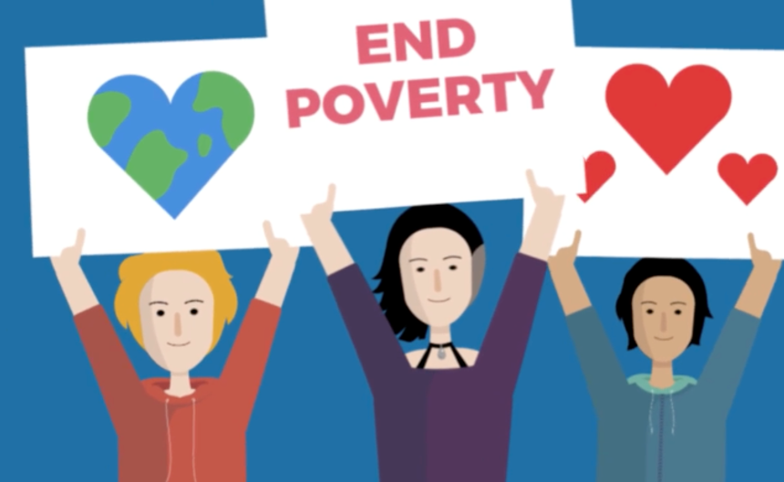
Kind Compassionate children…
Put others needs before their own
Help others because they want to
Listen and provide sympathy when it is needed
Show kindness without expecting rewards
Tell others that they care
Share with others
Recognise and help those less fortunate than themselves
Raise money for charity
Try to make the world a better place

Slide 5
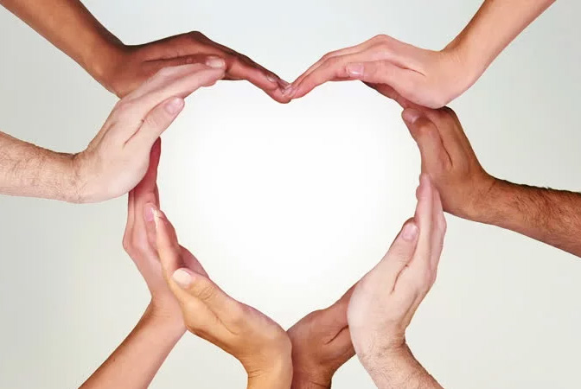
What do compassionate
people say?

Slide 6
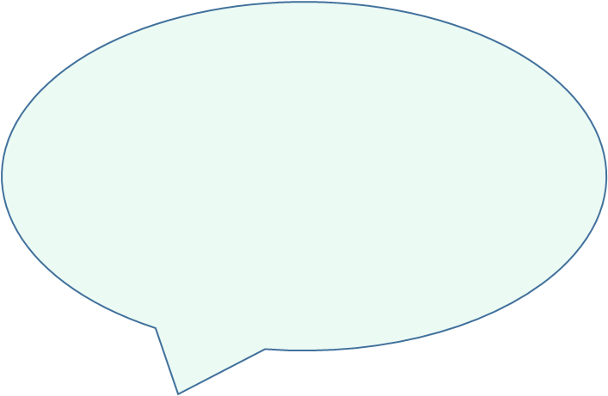
That happened to me once- I know how it feels
You look upset, what would you like to do?
That must really hurt, I’ll get the first aider
What can I do to help?
Do you want me to get someone to help?
I’m sad that you got hurt

Slide 7
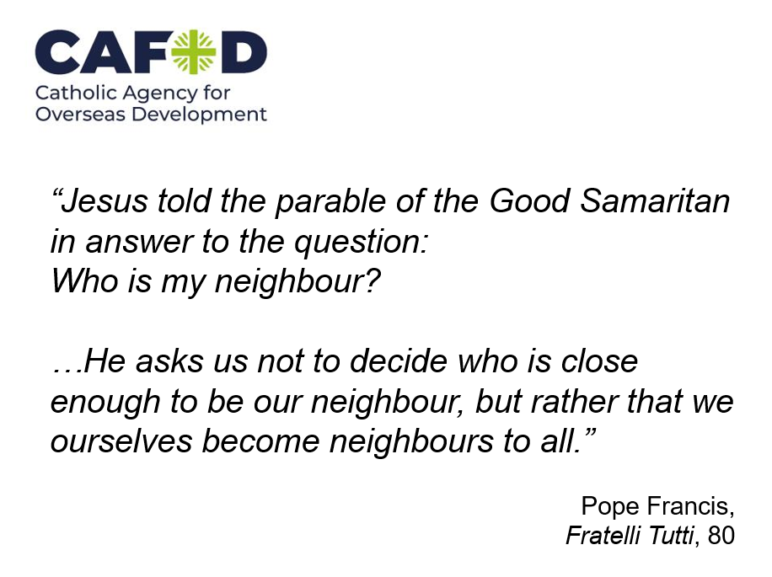
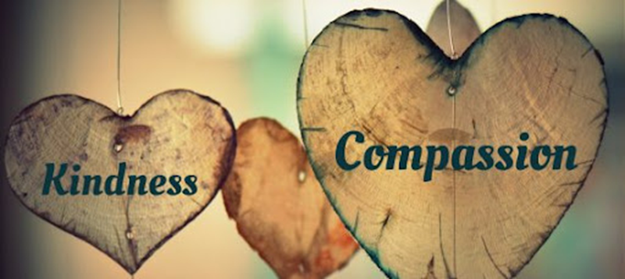

Slide 8
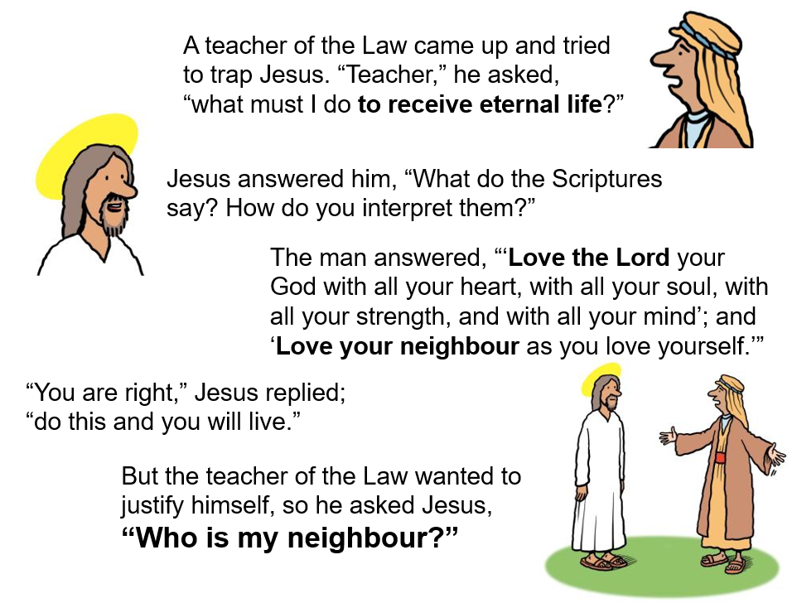


Slide 9
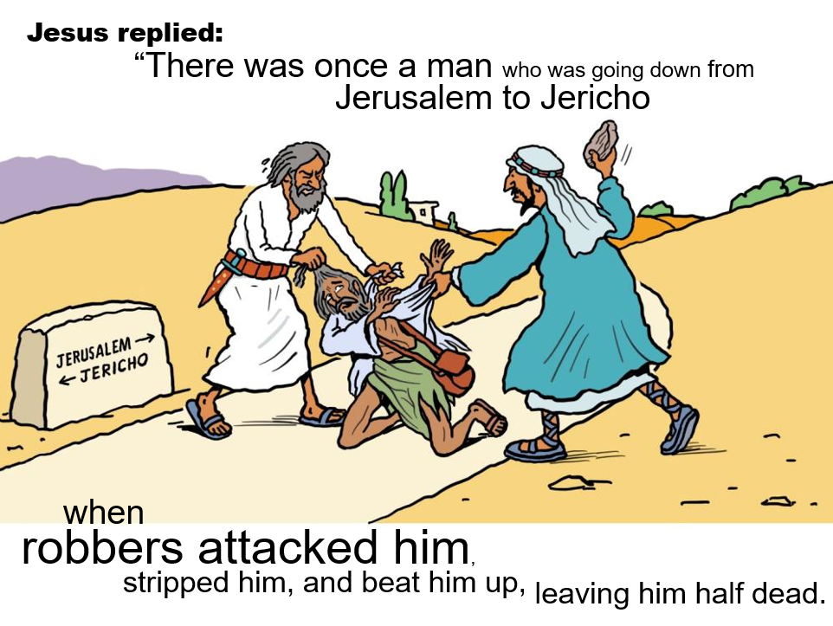


Slide 10
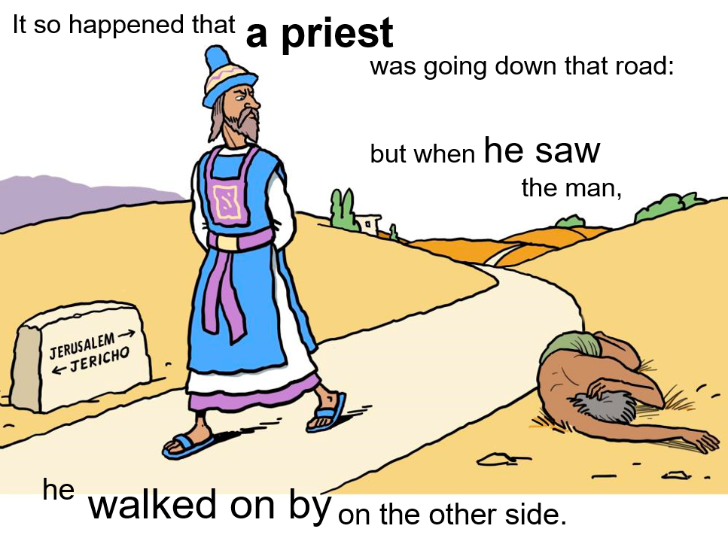

Slide 11
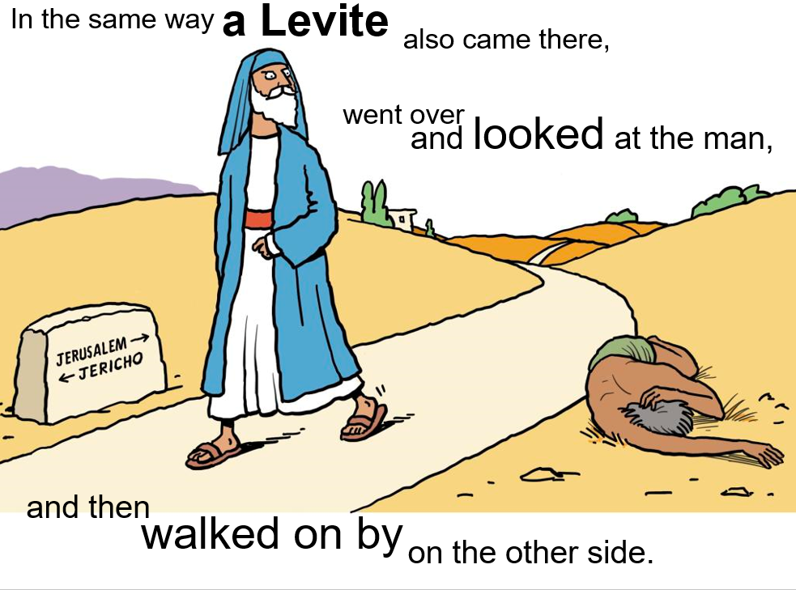

Slide 12
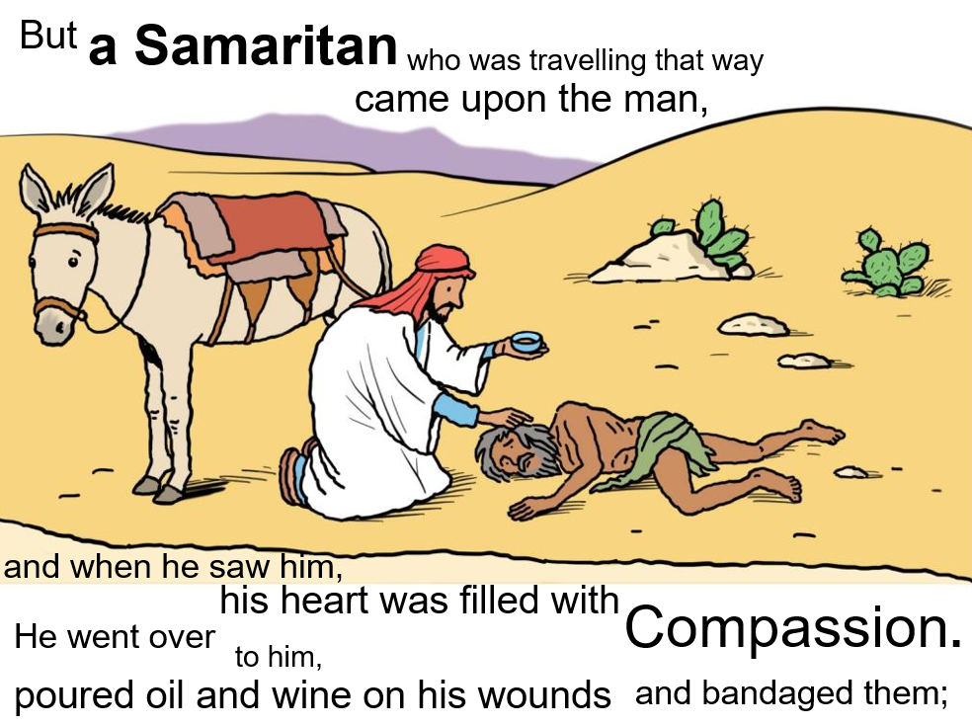

Slide 13
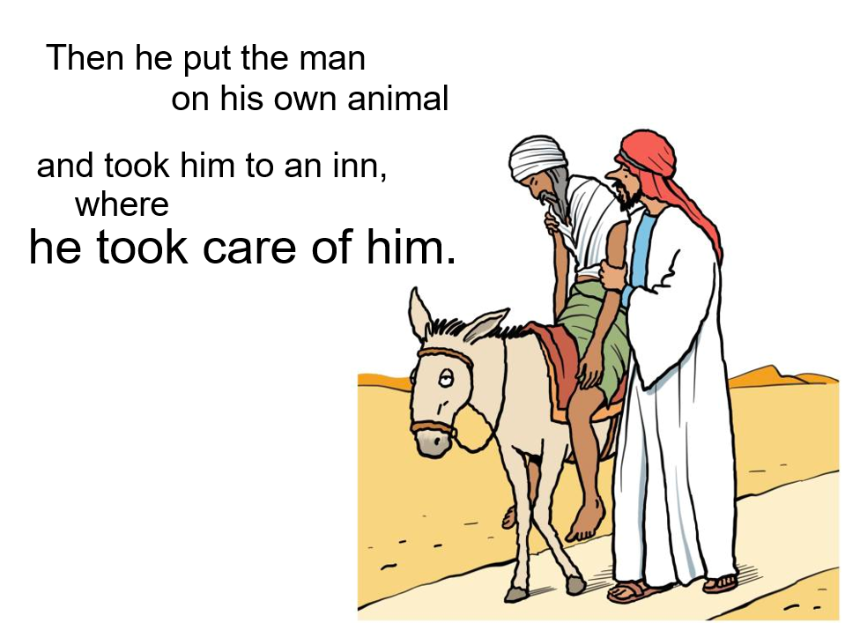

Slide 14
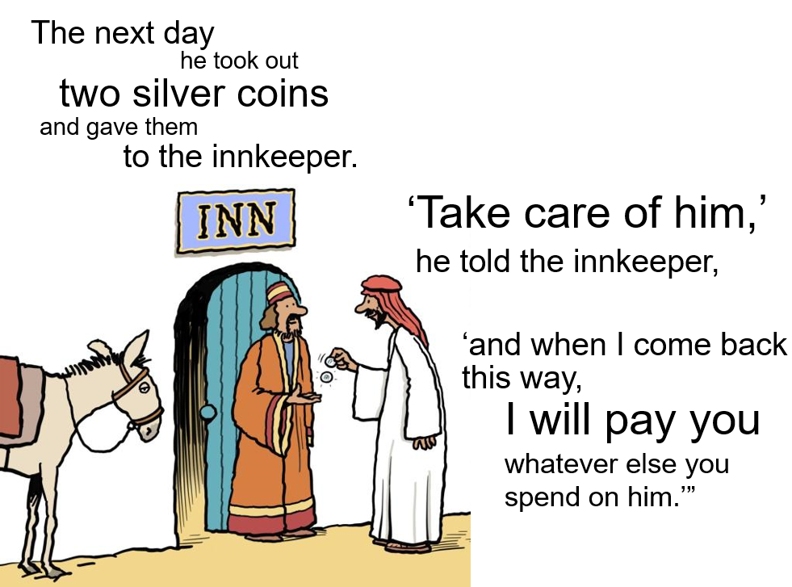

Slide 15
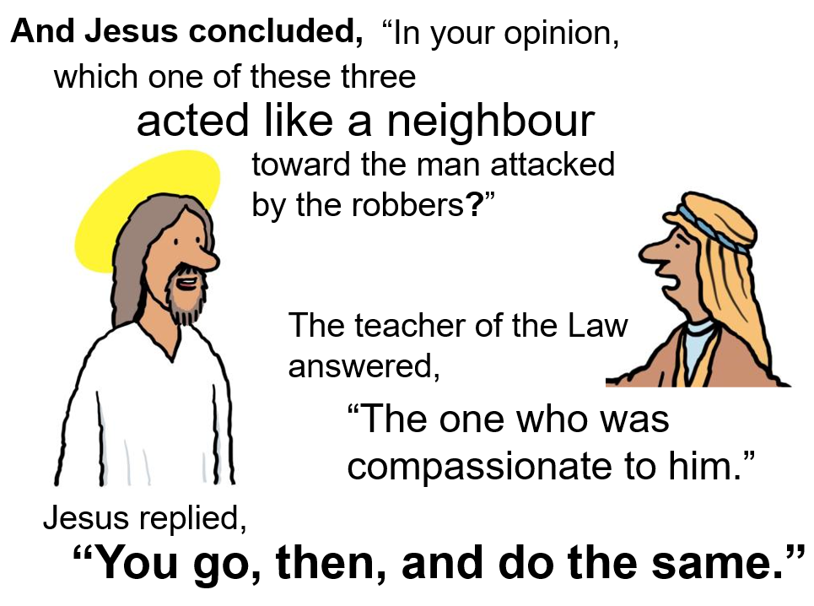

Slide 16
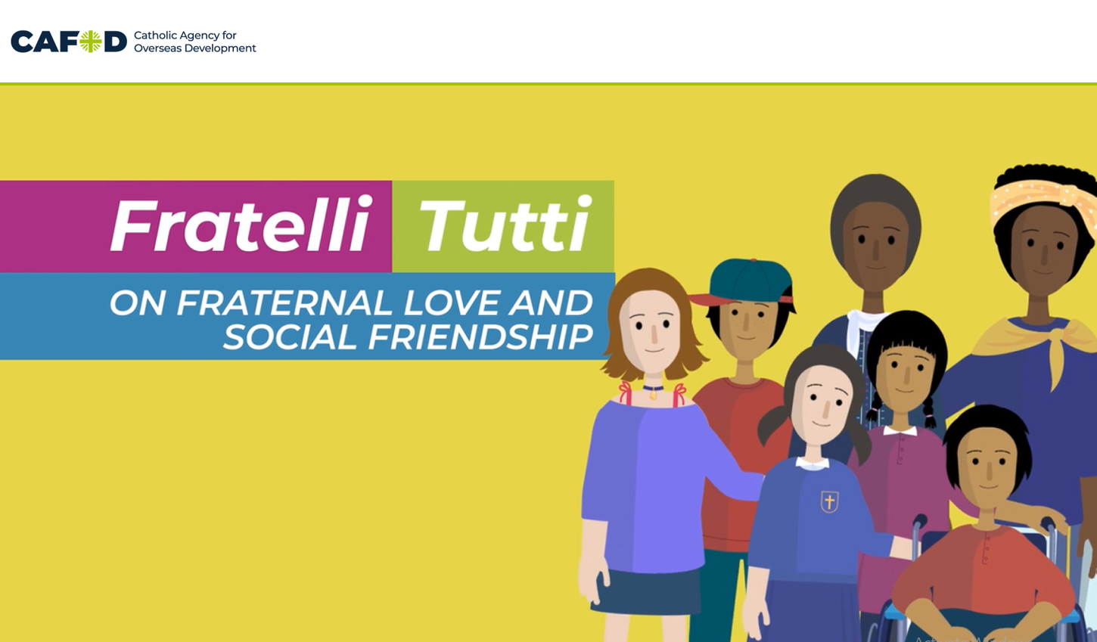


Slide 17

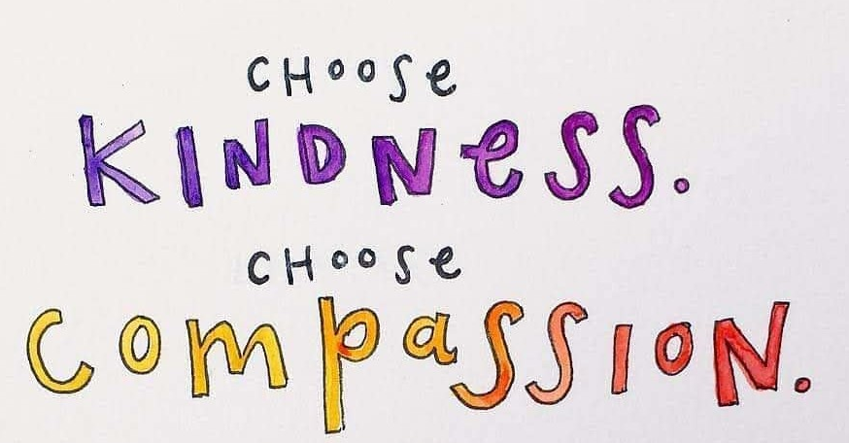
Tips on becoming more compassionate
and caring:
Be a good listener
Look people in the eye, when they speak
Look for children who are alone on the playground
Stick up for someone
Do one nice thing for a friend or family member weekly
Recycle
Protect God’s creation, by being ‘green’

Slide 18
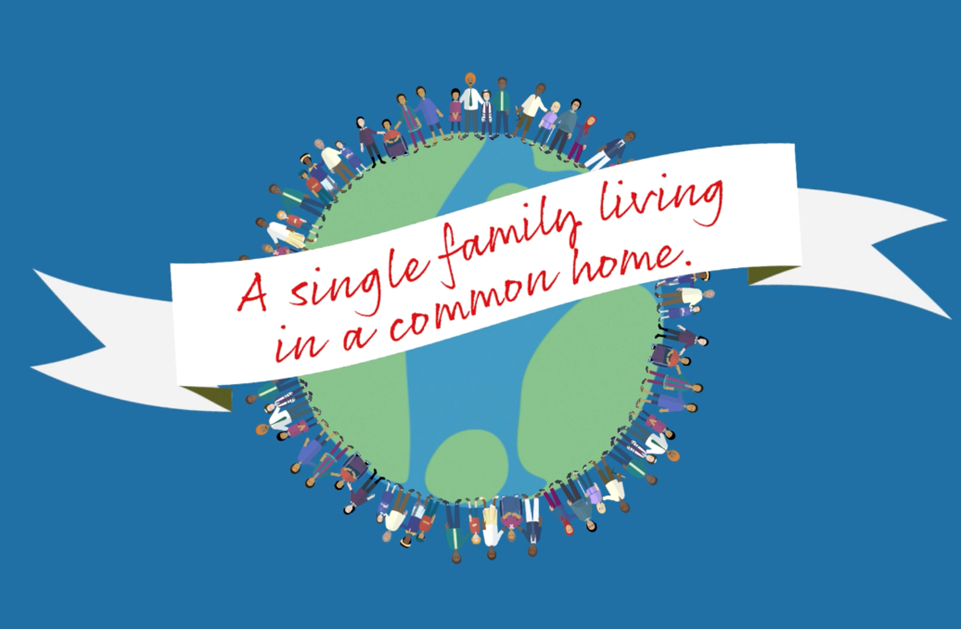
Put Compassion into action
Be friendly to someone who needs a friend
Do things at home without being asked
Be generous with your time
Donate to charities
Put someone else’s needs before your own
Look for ways to help in your community
Try to understand when someone is sad
Be kind to all people
Treat all people fairly
Be an up stander not a bystander
Forgive someone who has hurt you
Protect our planet

