Slide 1

Justice
Fairness and Equality

Slide 2

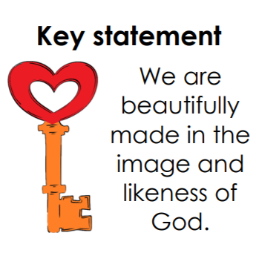
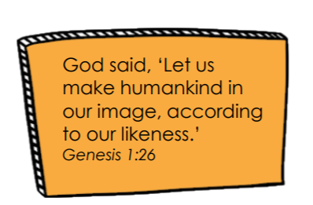
Created in God’s Image
God created all of us in His own image.
God said, “Let us make man in our image, after our likeness. So God created man in his own image, in the image of God he created him; male and female he created them.” Genesis 1:27
Every human being is unique because he or she was willed by God as an unrepeatable person.
Every human being was created out of love, and redeemed with even greater love.
The dignity of each and every human being is essential.
We are called to treat all people with the greatest respect, knowing that they are loved by God.

Slide 3
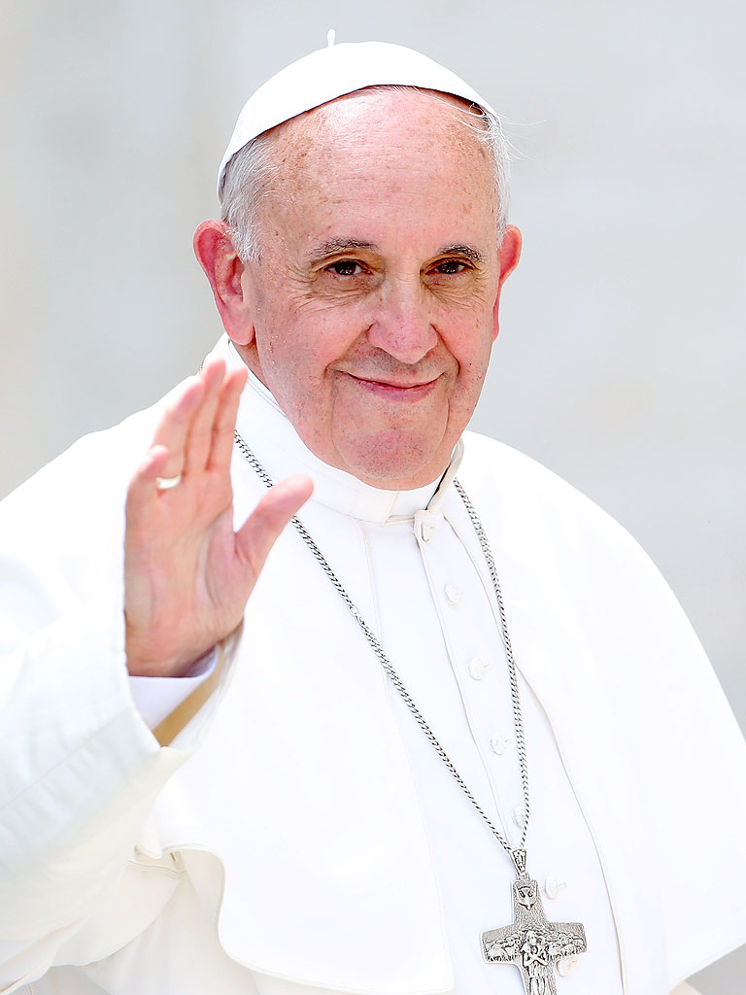
“Every person is worthy of our giving… they are God’s handiwork, his creation. God created that person in his image, and he or she reflects something of God’s glory.
Every human being is the object of God’s infinite tenderness, and he himself is present in their lives.”
Pope Francis,
Evangelii Gaudium

Slide 4
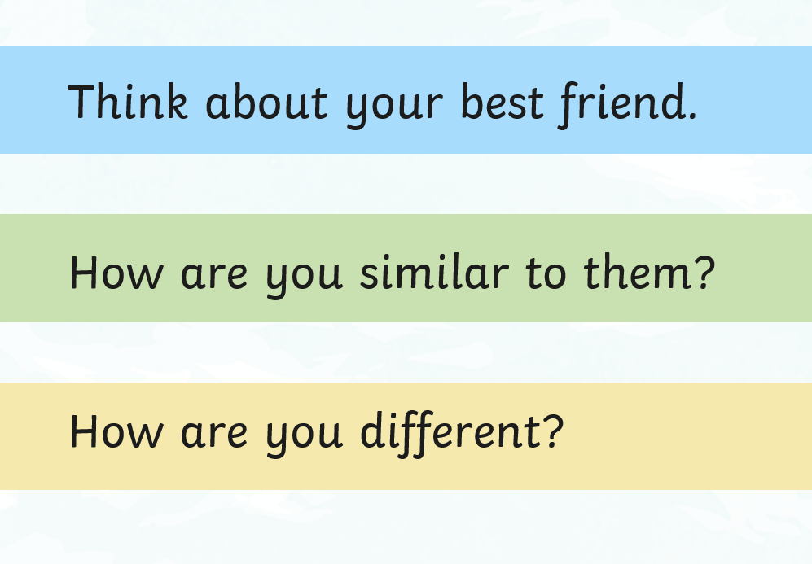
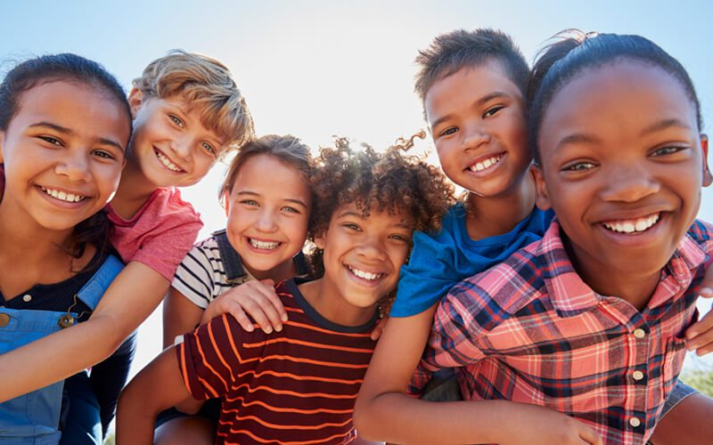
We are all unique

Slide 5
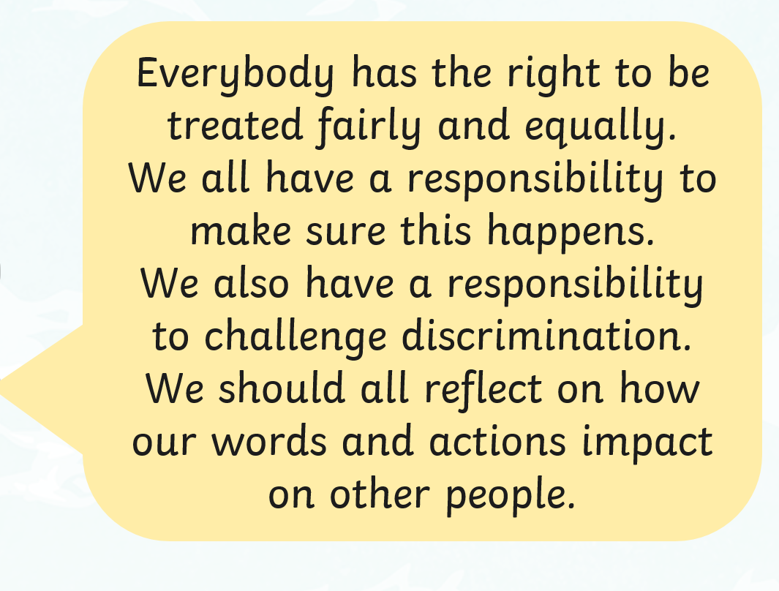
Identity & Race
What makes you who you are? Is it your interests and hobbies? Your talents? How about your beliefs or appearance?
A race is a grouping of people who share some of the same physical features (such as skin colour and hair texture) and non-physical features (such as culture, history, religious beliefs and language).

Slide 6
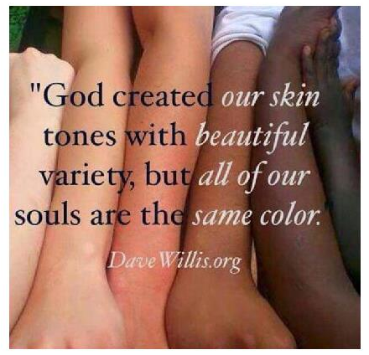
God made us equal &
loves each one of us equally

Slide 7


What is Equality?
Equality is when people are treated fairly and equally. Everybody around the world should be treated equally, no matter where they live, where they are from, the colour of their skin, the language they speak or their accent.
It means treating everyone as individuals, with respect and consideration.
It is about acknowledging and appreciating diversity and difference.

Slide 8

What is Racism?
Have you ever heard someone use a word in a negative way to describe someone because of their skin?
Maybe you have seen someone be unkind to another because they have a different accent.
Perhaps you have heard nasty comments, or seen them on social media, aimed at a whole group of people.
This is racism. This is not acceptable. Racism can happen anywhere.

Slide 9
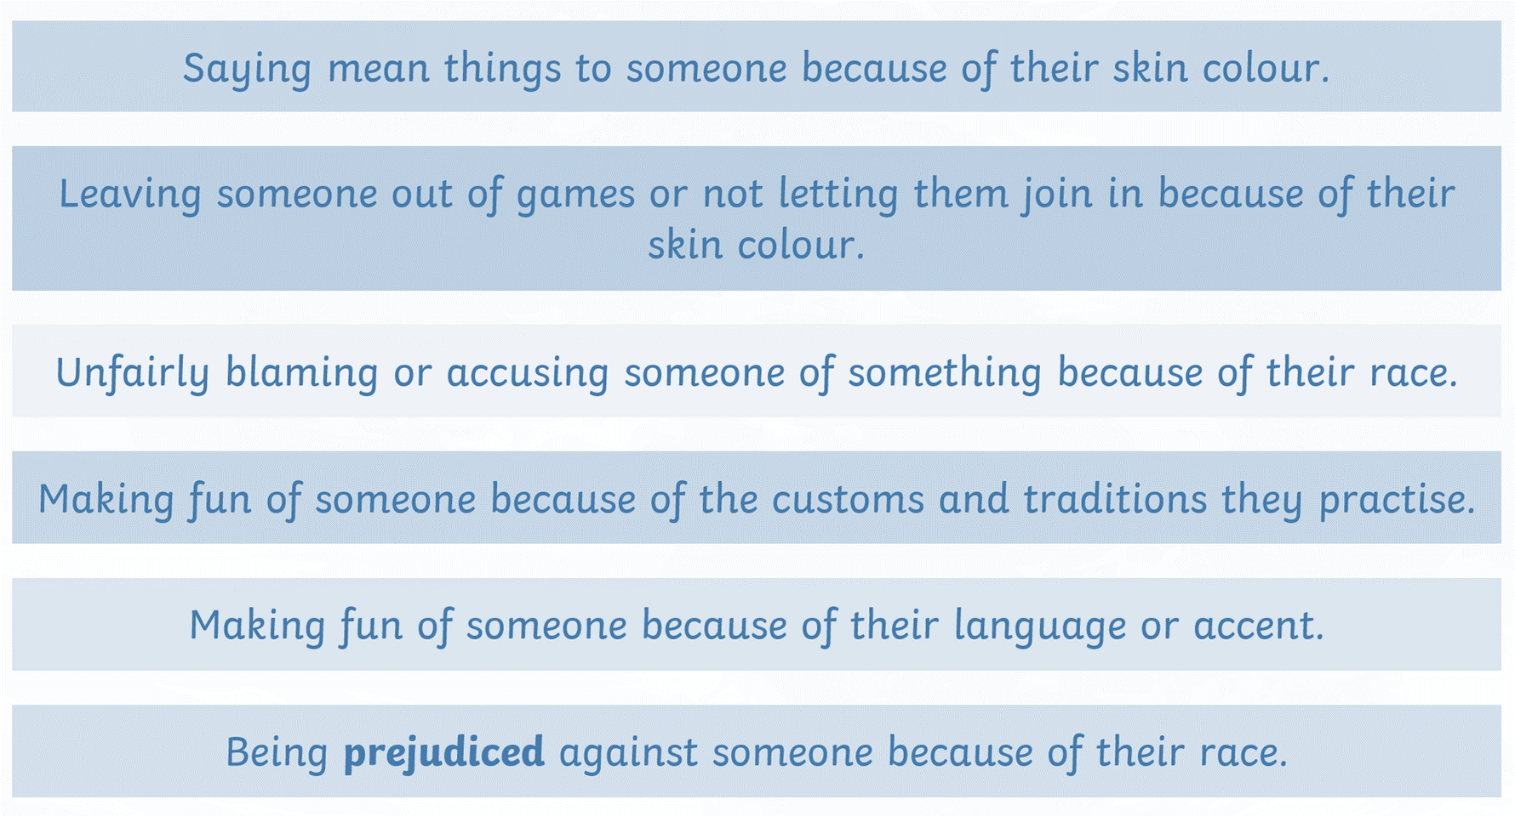
Examples of Racism

Slide 10

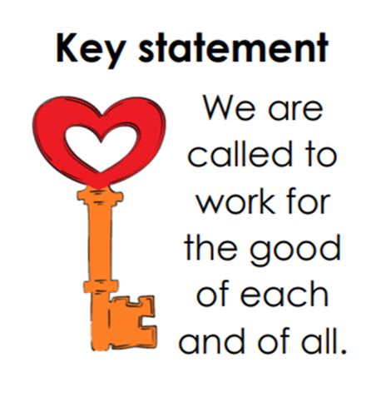
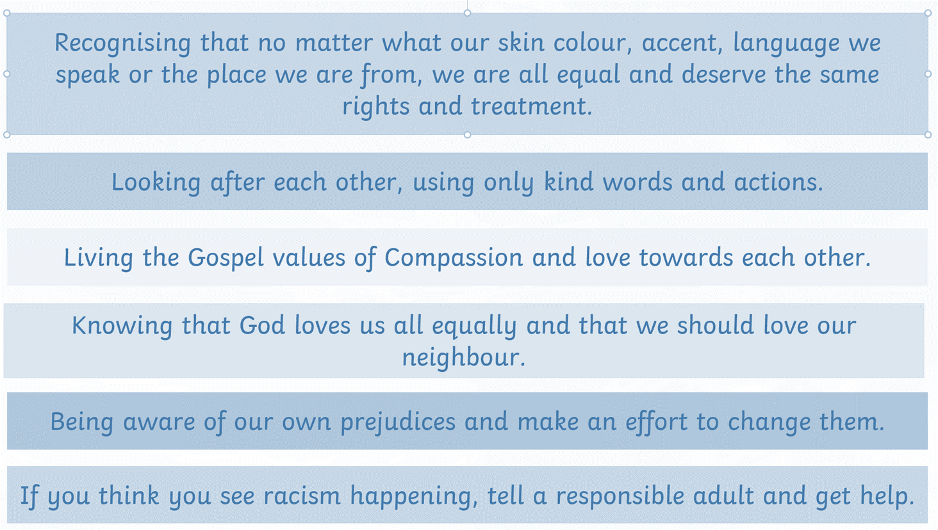

At St Chad’s we say no to racism by:

Slide 11




Slide 12

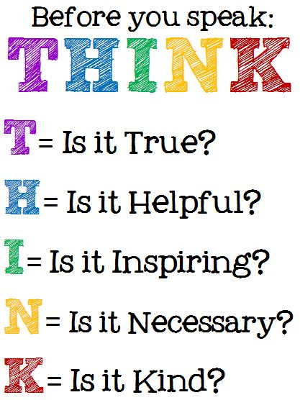

Slide 13
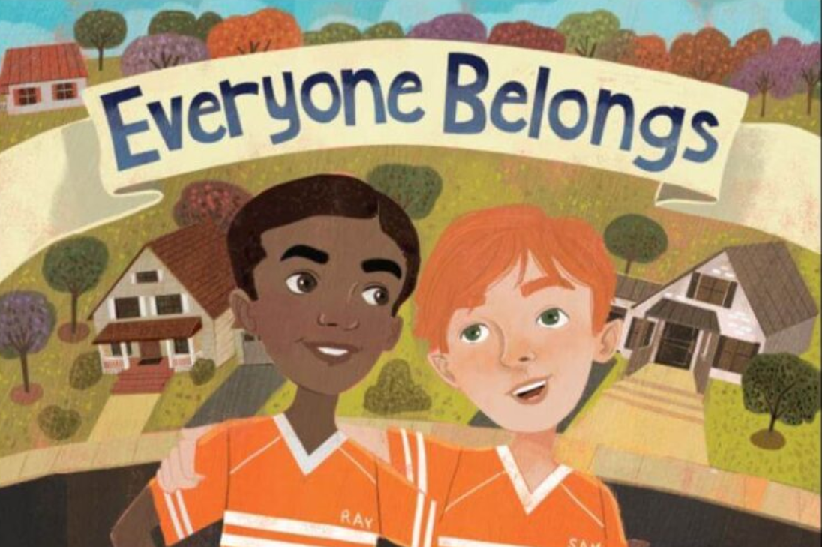

Slide 14
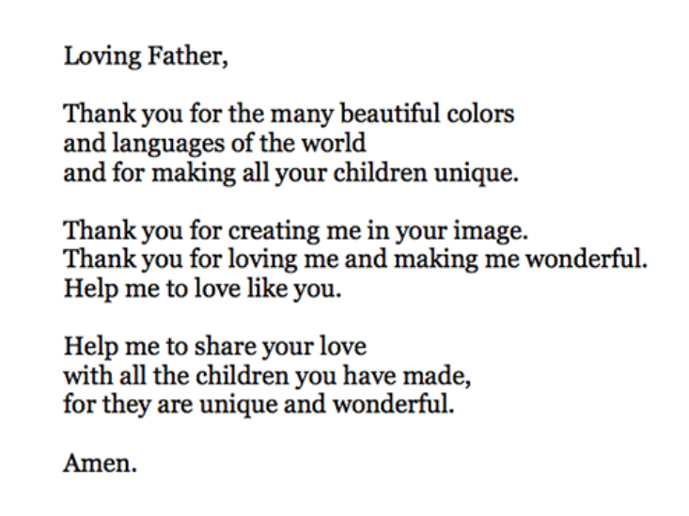
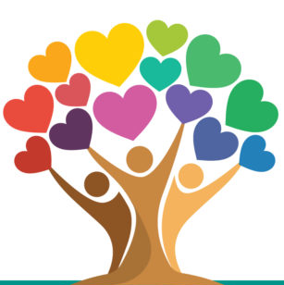
We are All In God’s Image

Slide 15


