Slide 1
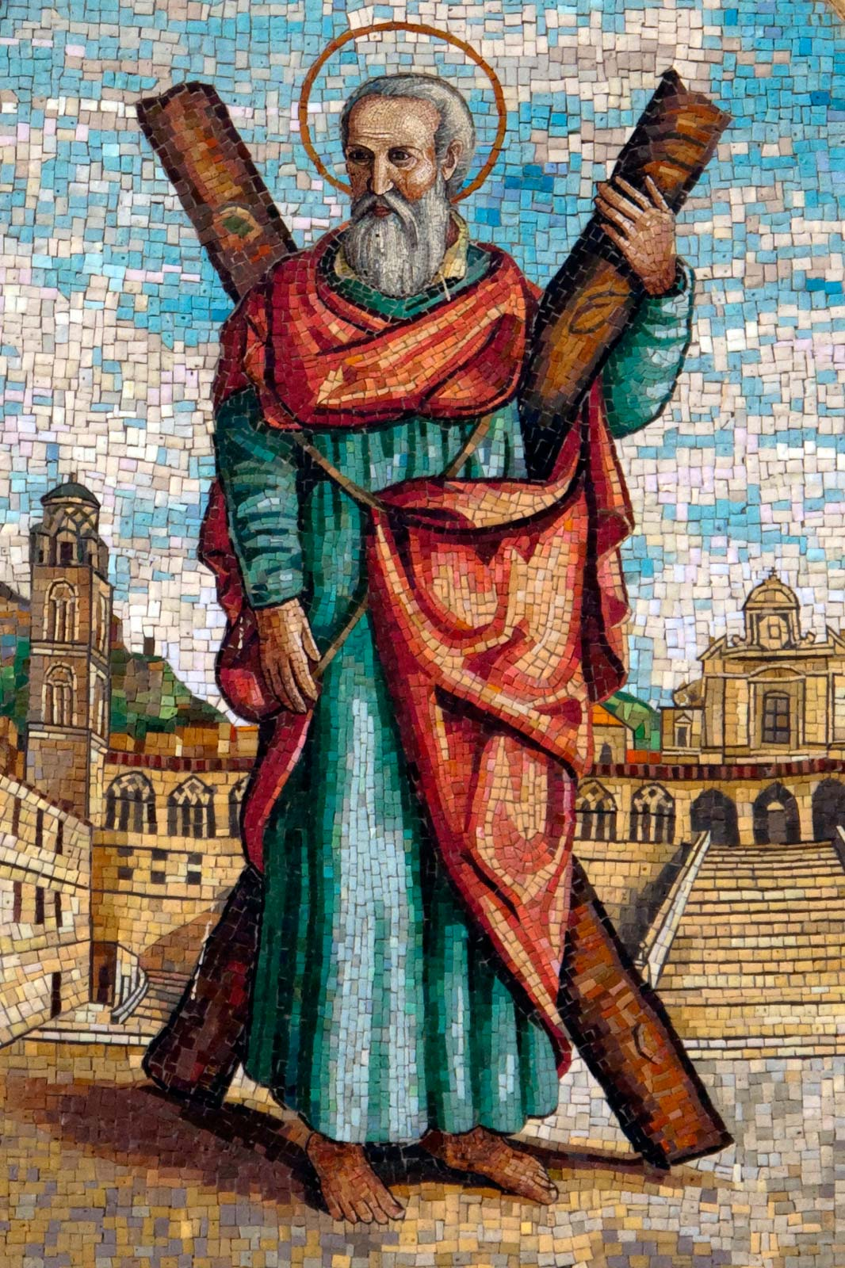
St. Andrew the Apostle
Feast Day: November 30th
Notes:
Reader 1 and 2

Slide 2
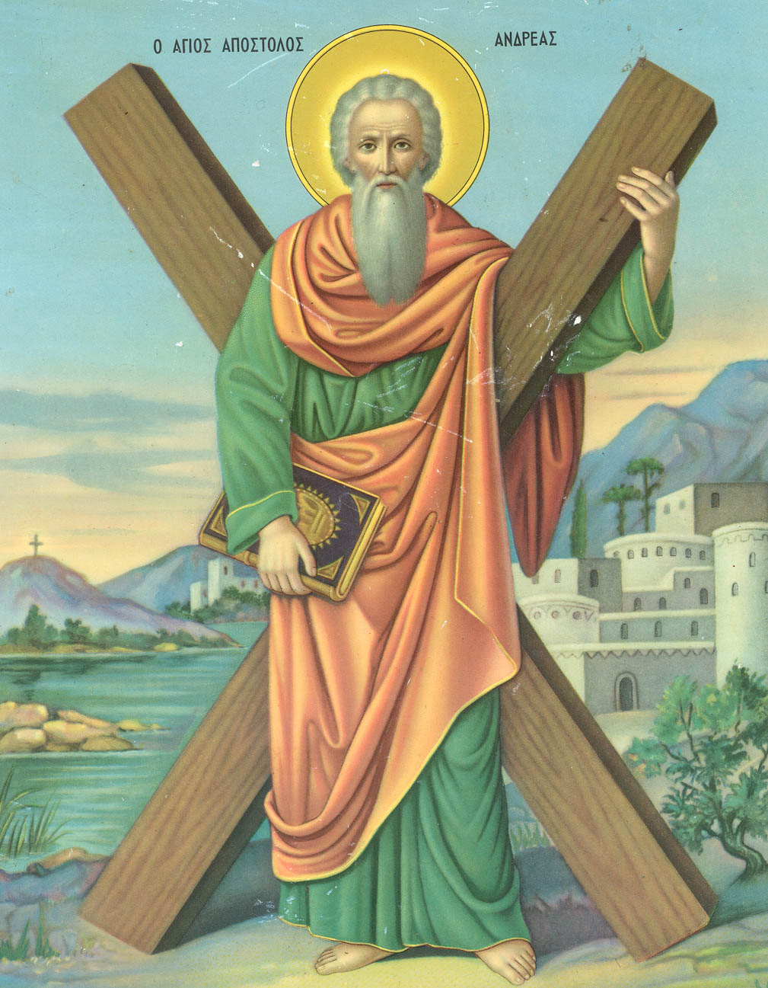
We Gather…
devoted
loving
brave
loyal
humble
chosen

Slide 3
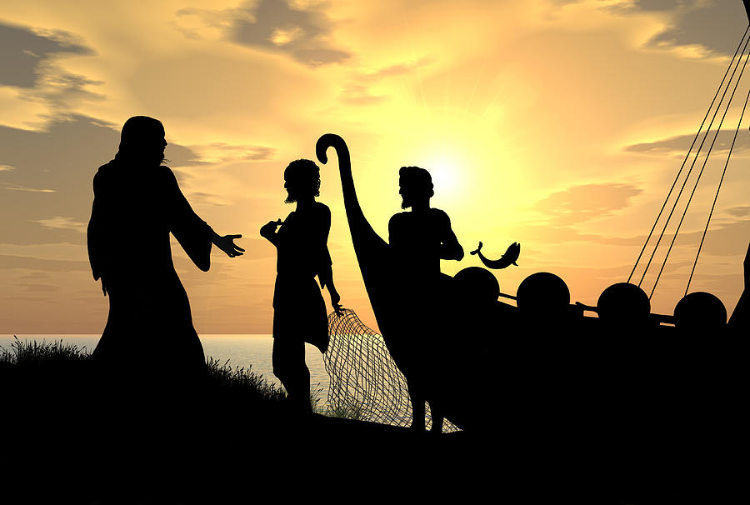
We Listen…
A reading from the Holy Gospel according to Mark.
‘As Jesus walked along the shore of Lake Galilee, he saw two fishermen, Simon and his brother, Andrew, catching fish with a net. Jesus said to them, “Come with me and I will teach you to catch people”. At once they left their nets and went with him.
He went a little further on and saw two other brothers, James and John, the sons of Zebedee. They were in their boat getting their nets ready. As soon as Jesus saw them, he called them and they left their father, Zebedee, in the boat with the hired men and went with Jesus.

Slide 4
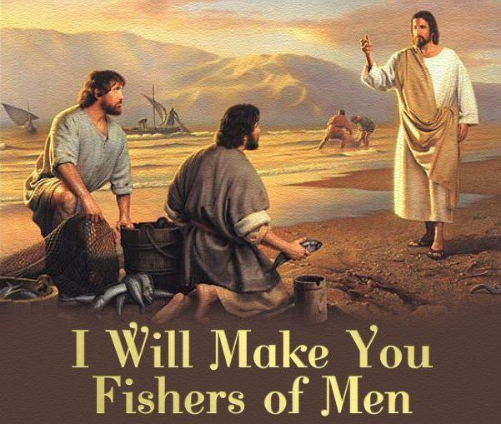
We Reflect…

Slide 5
We Pray…
To help us to be faithful and committed friends to one another.
All: give us the power, O Lord.
To help us be faithful friends and followers of Jesus, like Saint Andrew was.
All: Give us the power, O Lord.
To help us follow Saint Andrew’s example and share the good news with others.
All: Give us the power, O Lord.
To help us find the peace of Christ in our lives.
All: Give us the power, O Lord.
To help us love one another as you love us.
All: Give us the power, O Lord.

Slide 6
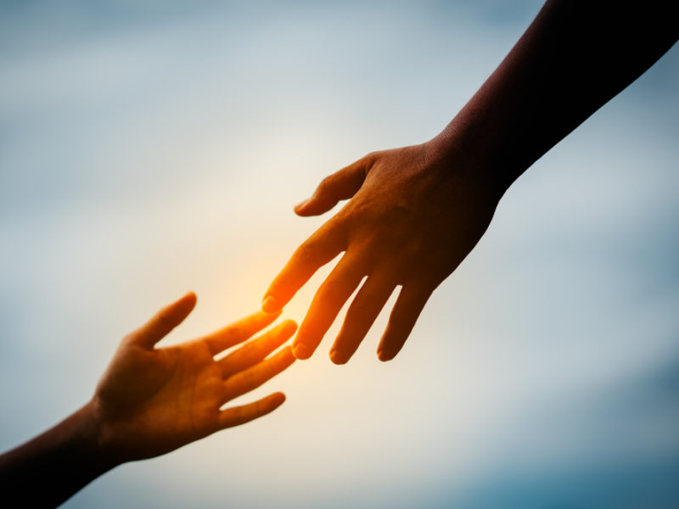
We Go Forth…
What will you do today to try and live like St. Andrew did?

Slide 7
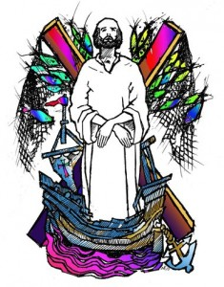
Closing prayer
Loving God,
We think of Andrew, called first among your disciples,
Leaving his nets to follow Jesus,
Leaving his life behind to answer your call,
We thank you for Andrew, an example to all who follow you
Trusting blindly in your promise, trusting in a better life with you.
Amen

Slide 8
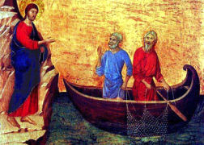
Follow me, follow me
Leave your home and family
Leave your fishing nets and boats upon the shore.
Leave the seed that you have sown
Leave the crops that you have grown
Leave the people you have known and follow me.
The foxes have their holes
And the swallows have their nests
But the Son of man
Has no pace to lay down.
I do not offer comfort,
I do not offer wealth,
But in me will all happiness be found

Slide 9
Follow me, follow me
Leave your home and family
Leave your fishing nets and boats upon the shore.
Leave the seed that you have sown
Leave the crops that you have grown
Leave the people you have known and follow me.
If you follow me,
You must leave old ways behind.
You must take my cross
And follow on my path
You may be far from loved ones,
You may be far from home,
But my father will welcome you at last.

Slide 10
Follow me, follow me
Leave your home and family
Leave your fishing nets and boats upon the shore.
Leave the seed that you have sown
Leave the crops that you have grown
Leave the people you have known and follow me.
Although I go away
You will never be alone.
For the Spirit will be
There to comfort you.
Though all of you may scatter,
Each follow his own path,
Still the Spirit of love will lead you home.

Slide 11
Follow me, follow me
Leave your home and family
Leave your fishing nets and boats upon the shore.
Leave the seed that you have sown
Leave the crops that you have grown
Leave the people you have known and follow me.

Slide 12


