Slide 1
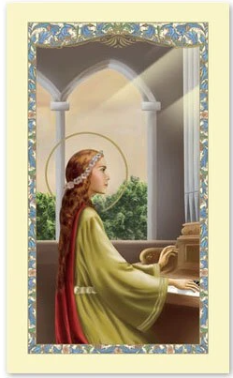
Saint Cecilia – Feast day 22nd November 2021.
“Arise, soldiers of Christ,
throw away the works of darkness
and put on the armour of light.”
St Cecilia

Slide 2

As we gather today let us light this candle and remember Saint Cecilia who is the patron Saint of music and our class.
Please join us in making the sign of the cross – In the name of the Father, and of the son…..
Yesterday was the 22nd of November. It is the feast day of Saint Cecilia. She lived about 17 hundred years ago.
Saint Cecilia is a symbol of the Church's belief that music is an important part of worshipping God. It is a form of prayer. Music in the Church is as important as paintings, statues and candles. The Church says that when sacred action is celebrated with song, everyone should sing. The voices of the faithful should ring out. This of course means that anyone who has a talent for singing or playing music should use that talent, or the talent will be wasted.
Let us now pray to the lord as we sing and celebrate the life of our special class Saint. We will sing Children of God in one family …

Slide 3

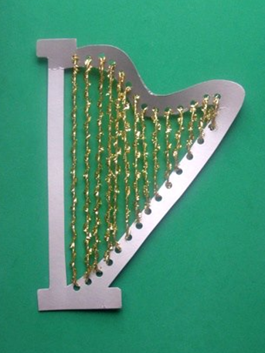


As we gather we thank God for all our special talents .
As the music plays we will pass round the pebble and reflect on the special talent we have been given .
I thank God for the talent of …….
Children to write talent onto a musical note and place in basket.
We offer up our talents and gifts to Saint Cecilia and ask her to guide us on this her special day.
As we gather we prayer to God thanking him for our talents
“Dear God,
Thank you for your amazing power and work in our lives, thank you for your goodness and for
your blessings over us.
Thank you for your great love and care.
Thank you for your sacrifice so that we might have freedom and life.

Slide 4
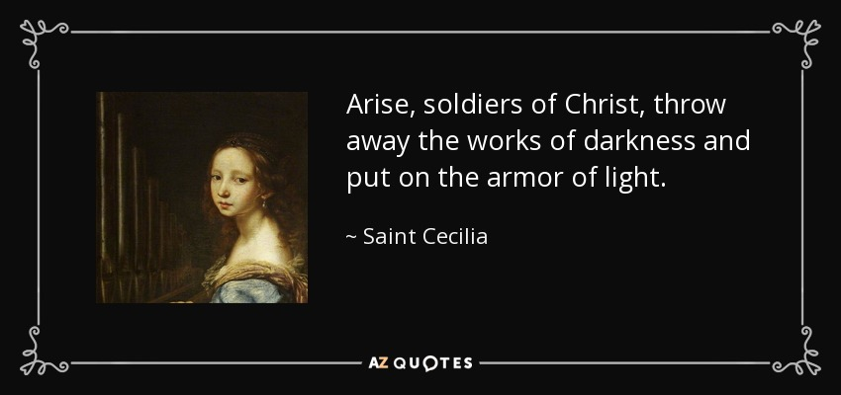
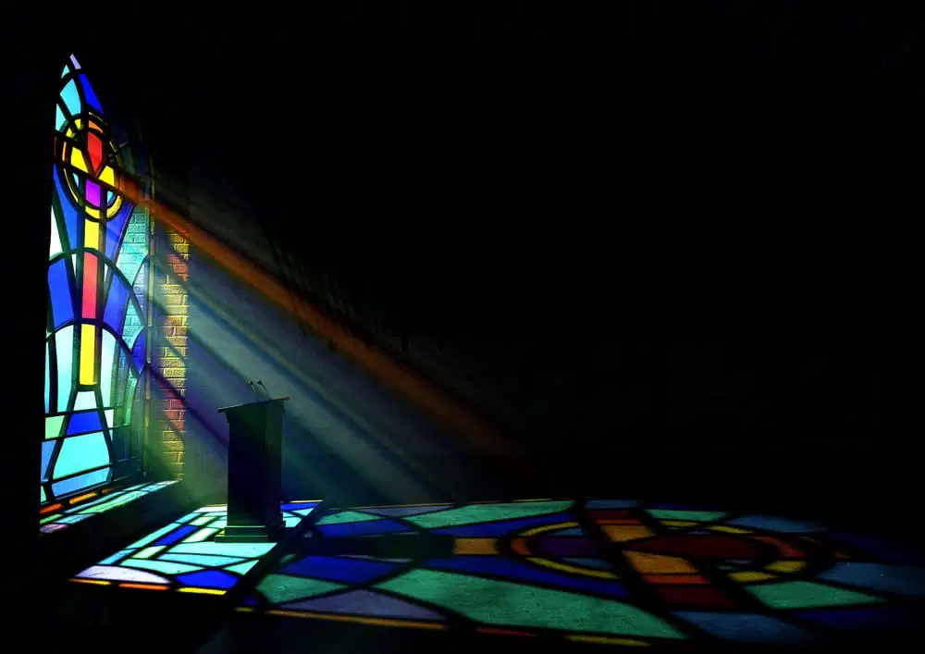
Saint Cecilia called us all to be soldiers of Christ and to let our own lights shine by doing good deeds and living out our gospel values through our choices we make in our every day lives.
Every Christian is called to be a soldier in the army of God. We are called to for fill our vocation through our baptism.
Soldiers are called to counter evil with the overwhelming, overcoming good that flows from a heart in love with God.
Soldiers in Christ bless everyone around them and labour to bring the Kingdom of Heaven on earth, by the way we treat others and the world that has been given to us.
It is important that we allow ourselves through prayer to share Gods light with everyone.
We will now listen to the gospel reading thinking carefully about how we can put on our armour of light and let our light shine

Slide 5
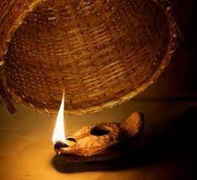
We listen…
As we listen to the word let us consider Christians are a reflection of the light of God. When we do not let God work through us then His light does not reach the world. Trying to keep God to ourselves is like hiding a light under a bowl. Do you let your light shine? Is your life a reflection of God’s glory? Do you put on your armour of light and let it shine for all to see?
Let us listen to the parable that Jesus told the people.
Jesus told the people the parable about the salt after he told them another parable. Mark 4 21-23
Jesus said, “You are the light of the world. A city on a hill cannot be hidden. Neither do people light a lamp and put it under a bowl. Instead they put it on its stand, and it gives light to everyone in the house. In the same way, let your light shine before men, that they may see your good deeds and praise your Father in heaven.”

Slide 6




What do you think Jesus meant when he said:
“You are the light of the world”
Did he mean we are not human but that we are fragments of light? Of course not. He was saying a parable to tell the people something very important.
Many people in this world do not know about God. Jesus said that it is like they are in a very dark place. They need someone to give them some light so that they can see. When Christians obey God then it is like a light is shining. People see Christians doing good things and it makes them want to follow God.
If we do good things it is like our light is shining. If people never see us do or say good things then it is like we are putting a big bowl over our light. No one can see a light under a bowl.
Sometimes we get embarrassed or shamed and we don’t want people to know that we are Christians. Has that ever happened to you? If we are ashamed to do good things then it is like putting our light under a bowl.
Jesus is telling us that for the Christian message to spread and develop, followers must proclaim and show their faith.

Slide 7
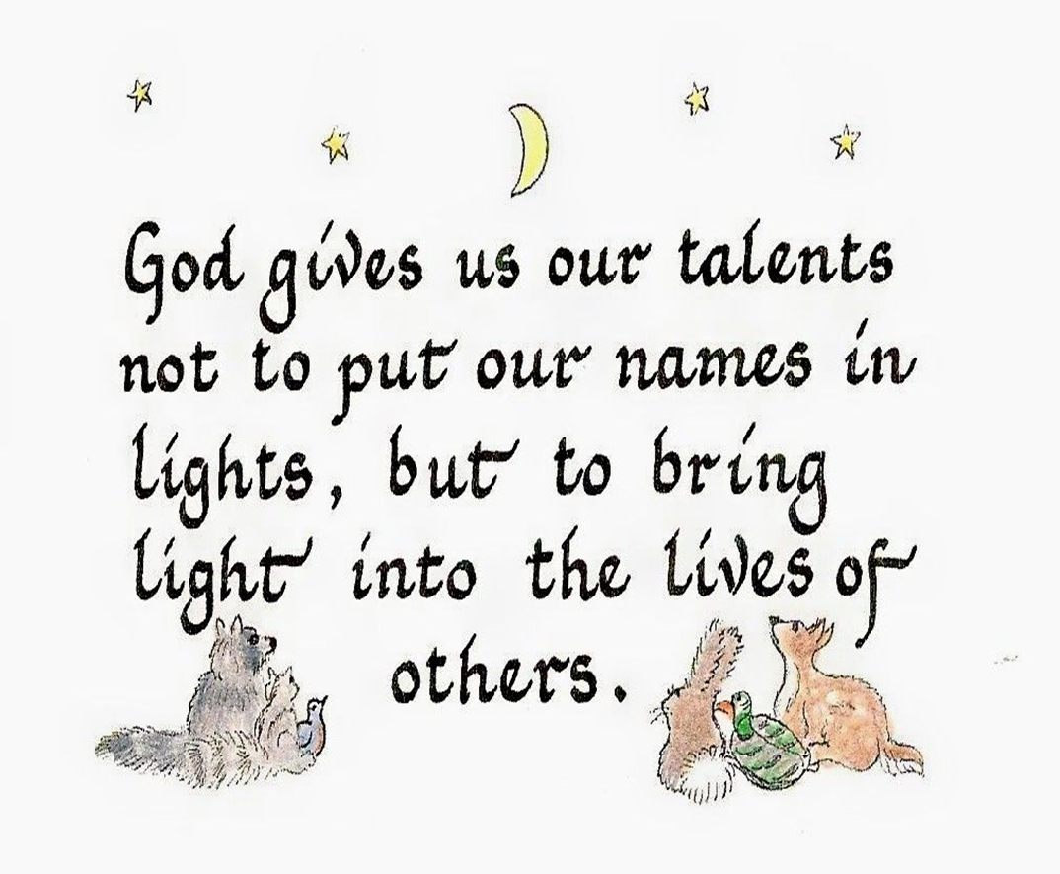
We Reflect…
Let us also reflect on the message that Saint Cecilia gives us about being soldiers of Christ by defending our faith and spreading the love and word of God to all
We should also share our talents and let their light into the lives of others as well as living by our gospel values.

Slide 8
We Pray…
St. Cecilia, we ask for your intercession because you generously offered your life for the love of Jesus, who you were devoted to with your heart and soul. Graciously hear our prayers.
Lord Hear us
St Cecilia, we thank God for the wonderful graces he bestowed upon you to make your life holy and pleasing . Help us to celebrate the graces Jesus bestows upon us. Help us to appreciate our talents and share the light and joy they bring to everyone.
Lord hear us.
St Cecilia, help us, like St Cecilia to forgive those who have hurt us. Help us to sacrifice ourselves in practising our faith so that others may be lead closer to the light of Christ and the Church through our example.
Lord Hear Us
St Cecilia help us share the gift of prayer through song like St. Cecilia, a powerful protector and patron of music. We strive to pass our days faithfully and innocently like holy St. Cecilia so that we may come to Heaven where we may praise You in concert with her.
Let us pray by sharing our talent of singing as we share our light with others ,,,, this little light of mine
God our Father.

Slide 9


We go Forth…
As we leave lets think about how we can be soldiers of Christ and put on our armour of light.
We can make the world a brighter place when we live a Christian life.
No one sees the light if we do not share our faith.
Each child to take a let your light shine card to fill in after.
Take your message of light and the message of Saint Cecilia with you today to shine out for all to see,
Join us as we sing Shine Jesus Shine.
Please take a prayer card to keep the light of Saint Cecilia in your heart everyday.

