Slide 1

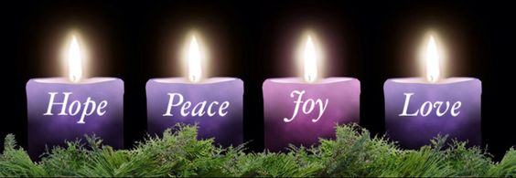
Advent
I wait for the Lord, my soul waits, and in his word I put my hope.
Psalm 130:5

Slide 2


A Candle is burning - Hope
A candle is burning, a flame warm and bright;
A candle of Hope, in December’s dark night.
While angels sing blessings form heavens starry sky,
Our hearts we prepare now for Jesus is nigh.
A candle is burning, a flame warm and bright;
A candle of Hope, what a wonderful sight.
Though troubled and worried yet we will not fear.
Our hearts are now hopeful, for Jesus is near.
Notes:
To the tune of Away in a manager

Slide 3


We Gather…
My little Lord Jesus, I love You and thank You for this Advent season. Please help me to understand all that You have done for me.
Your loving mother held You in her heart and brought You into this world. Help me to do the same.
Amen.

Slide 4

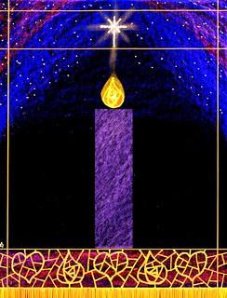
In the weeks leading up to Christmas we wait in hope for the arrival of Jesus - God made man - who would show the people of the world how to live together: forgiving errors, acting with kindness, supporting the needy, promoting peace, striving for justice.
By living like this, we continue to make Christ’s presence known on earth every day: delivering to all people the true gift of Christmas, God’s love.

Slide 5
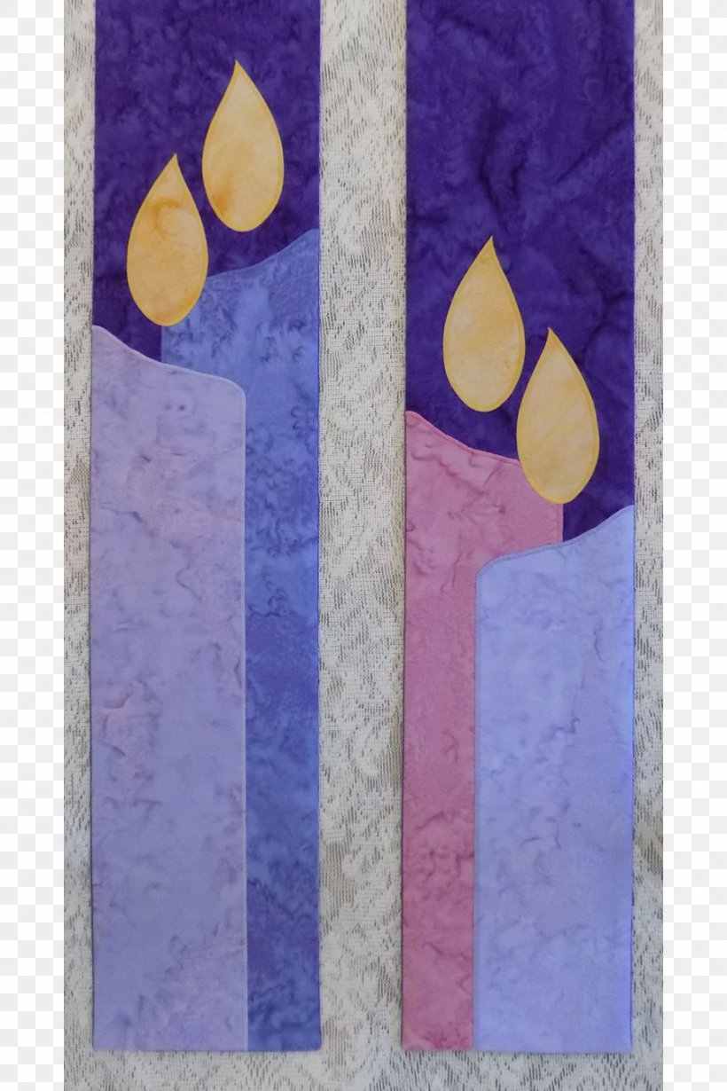
We Listen…
The light of just one candle can push away the darkness. As we light this first candle of Advent, we begin our journey to Christmas.
The first candle of Advent is called the Hope candle; as we anticipate Christmas, let us remember those who first spoke the promise of the coming Christ child.
HOPE
A reading from the prophet Isaiah 63:19, 64:3, 4,7
You guide those who act with integrity
and keep your ways in mind.
Lord, you are our Father;
we the clay, you the potter,
we are all the work of your hand.
Notes:
For us to become the Light of the World as Jesus commands, we are supposed to first, possess the virtues of Christ, hear His teachings and follow Him and secondly, become good examples to others in an open manner by exhibiting all good things that Christ taught us.

Slide 6

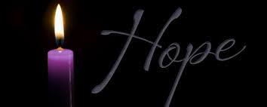
We Reflect…
God calls us to share his love with all people, everywhere - let’s now think about ways we can bring hope to those who need God comfort this Advent Season.
Even if our efforts only seem small, like lighting a candle in a dark room, we must trust that with God’s grace we can shatter darkness and bring hope.

Slide 7

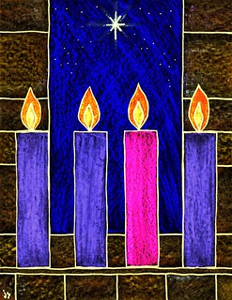
We Reflect…
It is important that as children of God we follow the example of Jesus, who brought hope to the hopeless by showing them support and care.

Slide 8

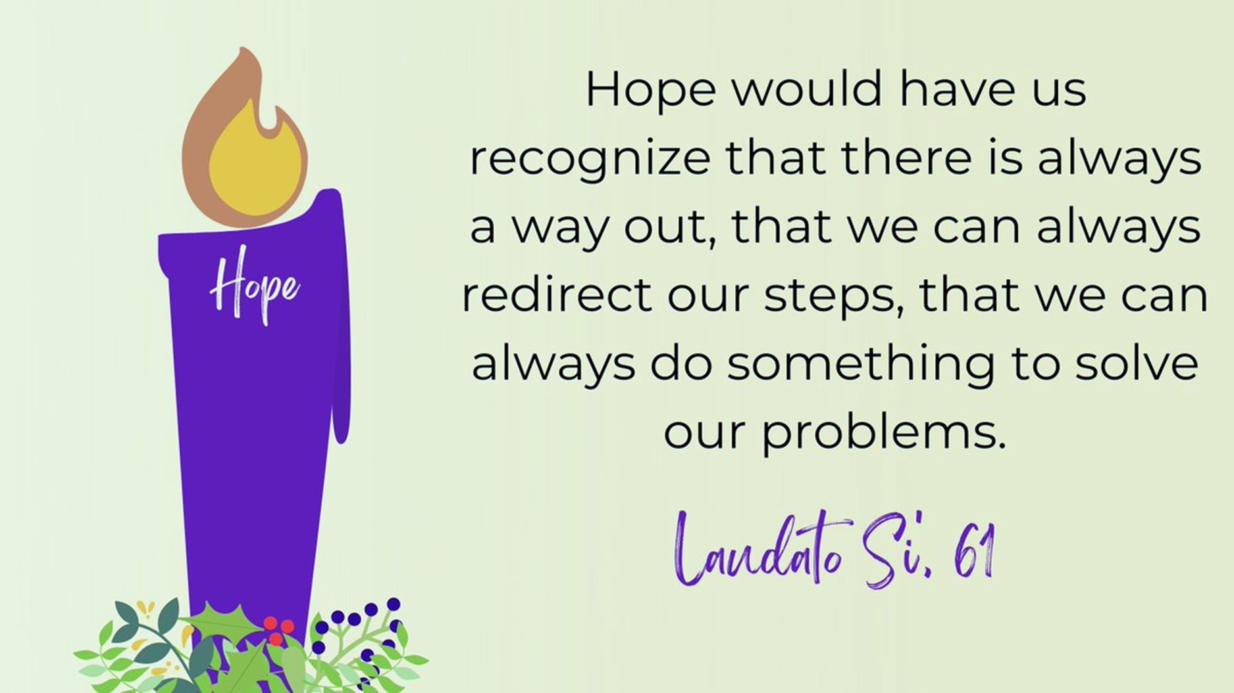
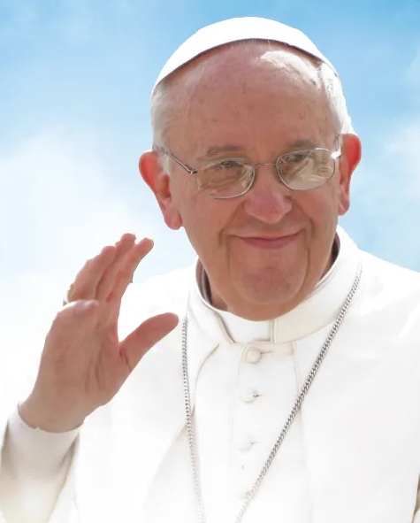

Slide 9

We Pray…
God of hope, who brought love into this world,
be the love that dwells between us.
God of hope, who brought peace into this world,
be the peace that dwells between us.
God of hope, who brought joy into this world,
be the joy that dwells between us.
God of hope, the rock we stand upon,
be the centre, the focus of our lives always, and particularly this Advent time.

Slide 10
In this Advent of expectation
draw us together in unity,
that our praise and worship
might echo in these walls
and also through our lives.
In this Advent of expectation
draw us together in service,
that the path we follow
might lead us from a stable
to a glimpse of eternity.
In this Advent of expectation
draw us together in mission,
that the hope within
might be the song we sing,
and the melody of our lives

Slide 11


We Go Forth….
Draw around your hand and write out, how you will bring hope to others, so that they may know the love of Christ, as we wait for his birth.
Together we will make a school an Advent Wreath, showing how all children in St Chad’s will live the Gospel Value of Hope this Advent Season.

Slide 12

God of hope
Be with us in our Advent journey
to the stable and beyond,
Be with us in our meeting
and in our travelling together,
Be with us in our worship
and our praying together,
Our God of hope.

Slide 13


Slide 14

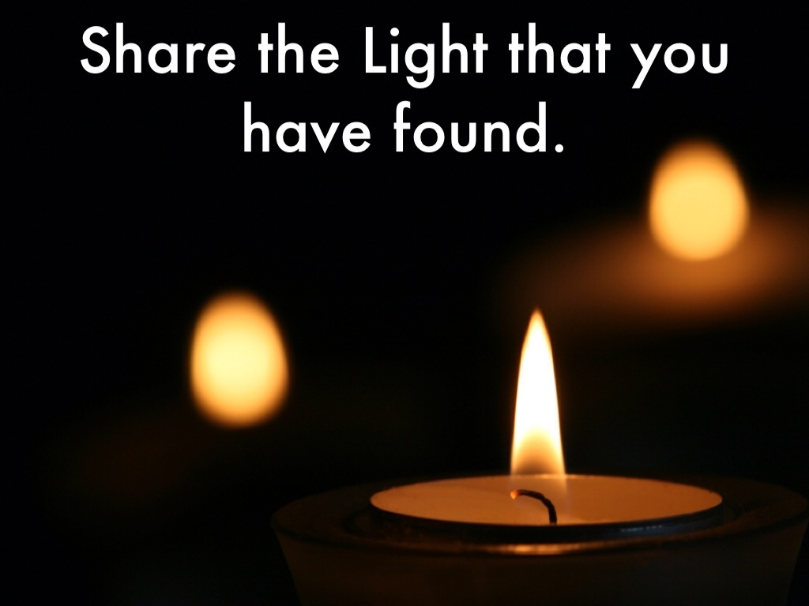
We Go Forth…
Light the Candles
Jesus said ‘You are the light of the world’. May the light of the candle and the warmth of its flame fill our hearts with the light and warmth of God’s love. May we share this light and warmth with each other.
Accept this light as a sign of your ministry as teacher: A light to make known the truth.
All:
We pray that God may bless each one of us, in each lesson and hour of the day,
that we may transform the lives of the pupils entrusted to our care.
Teach with love of learning, with enthusiasm and truthfulness,
sharing with generosity our own learning and experience.
Act and speak with integrity and compassion,
forgiving as we would wish to be forgiven.
All this we pray through Christ our Lord.
Amen.

Slide 15



