Slide 1






Slide 2
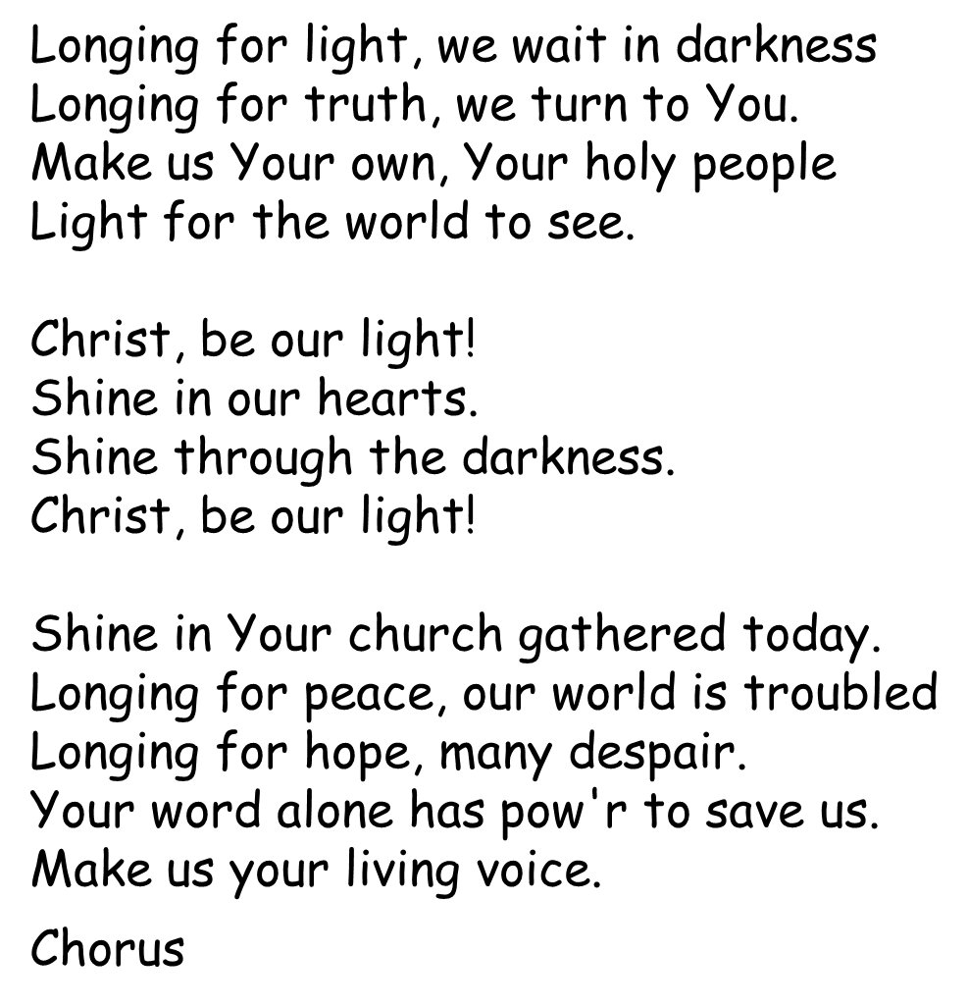

Christ be Our Light

Slide 3
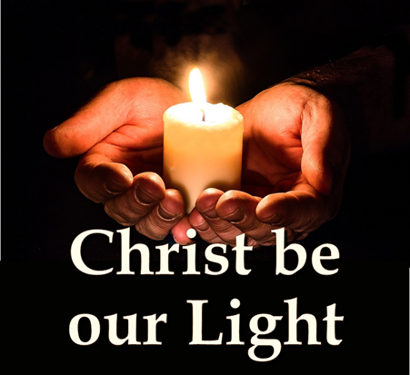
Shine in Your church gathered today.
Longing for food, many are hungry
Longing for water, many still thirst.
Make us Your bread, broken for others
Shared until all are fed.
Chorus
Longing for shelter, many are homeless
Longing for warmth, many are cold.
Make us Your building, sheltering others
Walls made of living stone.
Chorus
Many the gift, many the people
Many the hearts that yearn to belong.
Let us be servants to one another
Making Your kingdom come.

Slide 4
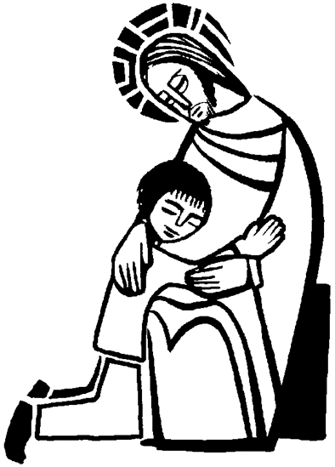
Penitential Rite
Sorry Prayers
The response to each prayer is:
Forgive us Lord

Slide 5
Gloria
Gloria XX, Gloria XX, in excelsis Deo.
Gloria XX, Gloria XX, in excelsis Deo.
Lord God, heavenly King,
peace you bring to us;
we worship you, we give you thanks,
we sing our song of praise.
Gloria XX, Gloria XX, in excelsis Deo.
Gloria XX, Gloria XX, in excelsis Deo.
Jesus, Saviour of all,
Lord God, Lamb of God
you take away our sins, oh Lord,
have mercy on us all.

Slide 6
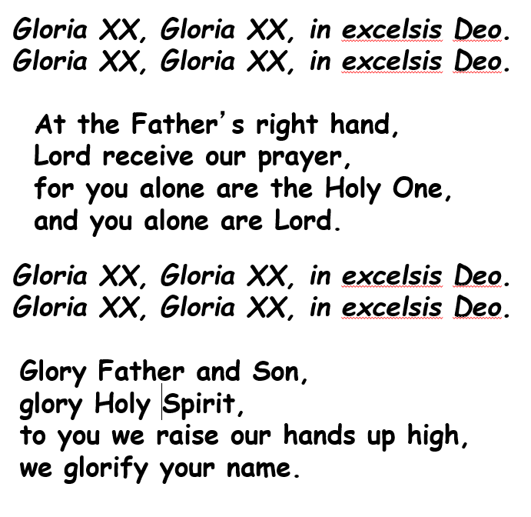

Slide 7

First reading
A reading from the 1st letter of Timothy
Be an example to all the believers
Do not let people disregard you because you are young, but be an example to the believers in the way you speak and behave, and in your love, your faith and your purity. Make use of the time until I arrive by reading to the people, preaching and teaching. You have in you a spiritual gift which was given to you when the prophets spoke and the body of elders laid their hands on you; do not let it lie unused. Think hard about all this, and put it into practice, and everyone will be able to see how you are advancing. Take great care about what you do and what you teach; always do this, and in this way you will save both yourself and those who listen to you.

Slide 8
Psalm
R:Great are the works of the Lord.
His works are justice and truth,
his precepts are all of them sure,
standing firm for ever and ever;
they are made in uprightness and truth.
R:Great are the works of the Lord.
He has sent deliverance to his people
and established his covenant for ever.
Holy his name, to be feared.
R:Great are the works of the Lord.
To fear the Lord is the first stage of wisdom;
all who do so prove themselves wise.
His praise shall last for ever!
R:Great are the works of the Lord.

Slide 9

Gospel Acclamation
We all sing:

Slide 10
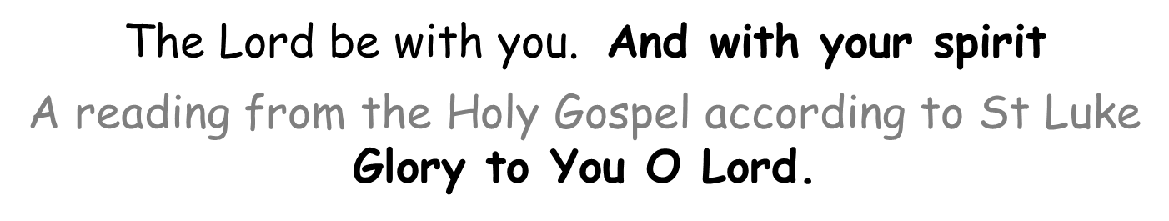
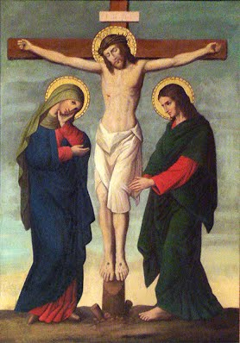


Slide 11

The Prayers of the Faithful
The response to each prayer is:
Lord hear us…
Lord Graciously hear
us

Slide 12


The Offertory Procession
We offer our school’s moto, ‘To Grow in Love and Live in Peace’, may it remind us to live out our mission, and of our commitment to put Christ at the centre of our school.
We offer our prayers books, our chance to speak with you and to get to know you in our daily lives. May you listen to our prayers this year.
We bring our school crest; may we remember to live as our patron Saint St Chad. May we be loving and peaceful everyday in our school, just as Jesus wants us to be.
We offer bread and wine, soon to be changed into the Body and Blood of Jesus.

Slide 13

The Liturgy of the Eucharist
Pray, brethren
(brothers and sisters)
That my sacrifice and
yours may be acceptable
to God, the almighty Father
May the Lord accept the
sacrifice at your hands
for the praise and glory
of his name,
for our good
and the good of all his holy church

Slide 14

Holy, holy, holy is the Lord
Holy, holy, holy is the Lord
Holy is the Lord God almighty
Holy, holy, holy is the Lord
Holy is the Lord God almighty
Who was, and is, and is to come,
Holy, holy, holy is the Lord

Slide 15
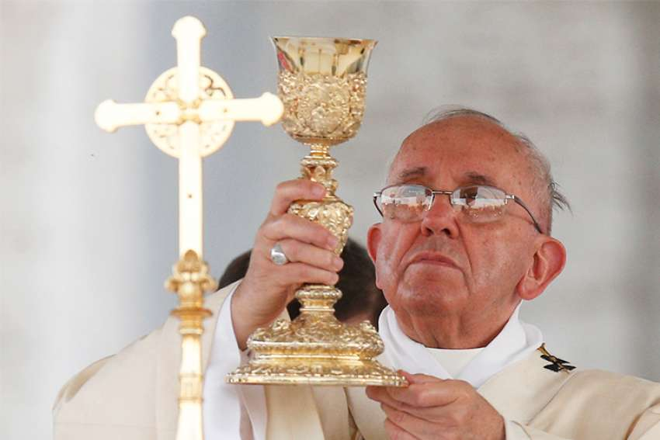
Memorial Acclamation
When we eat this bread and drink this cup, we proclaim your Death,
O Lord,
until you come again.

Slide 16

The Lord’s Prayer

Slide 17
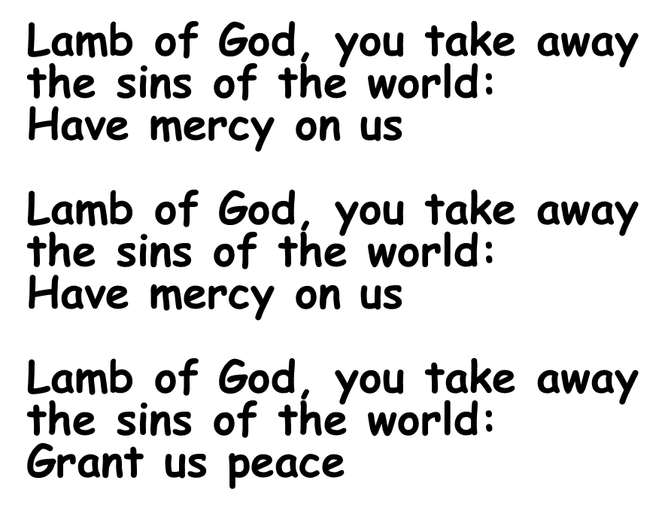


Slide 18

Invitation to Communion
Lord, I am not worthy
that you should enter under my roof, but only say the word
and my soul shall be healed.

Slide 19
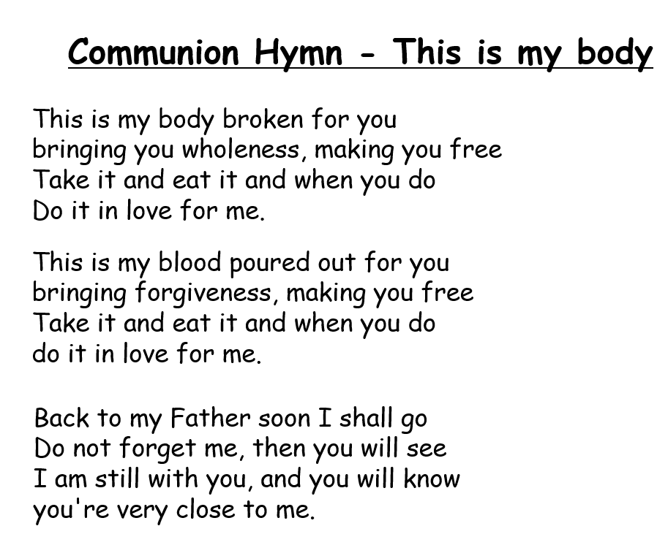


Slide 20


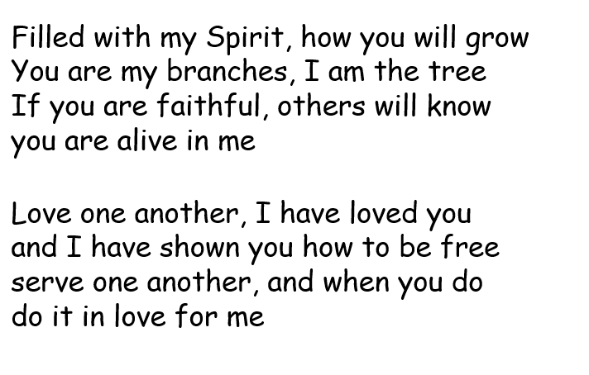

Slide 21

Blessing of Class Candles

Slide 22
Recessional Hymn
Lord the light of your love is shining
In the midst of the darkness shining,
Jesus light of the world shine upon us
set us free by the truth you now bring us.
Shine on me, shine on me.
Shine Jesus shine fill this land with the Father's glory
Blaze Spirit blaze set our hearts on fire.
Flow river flow
Flood the nations with grace and mercy.
Send forth your word Lord
And let there be light.
Let Your Light Shine

Slide 23

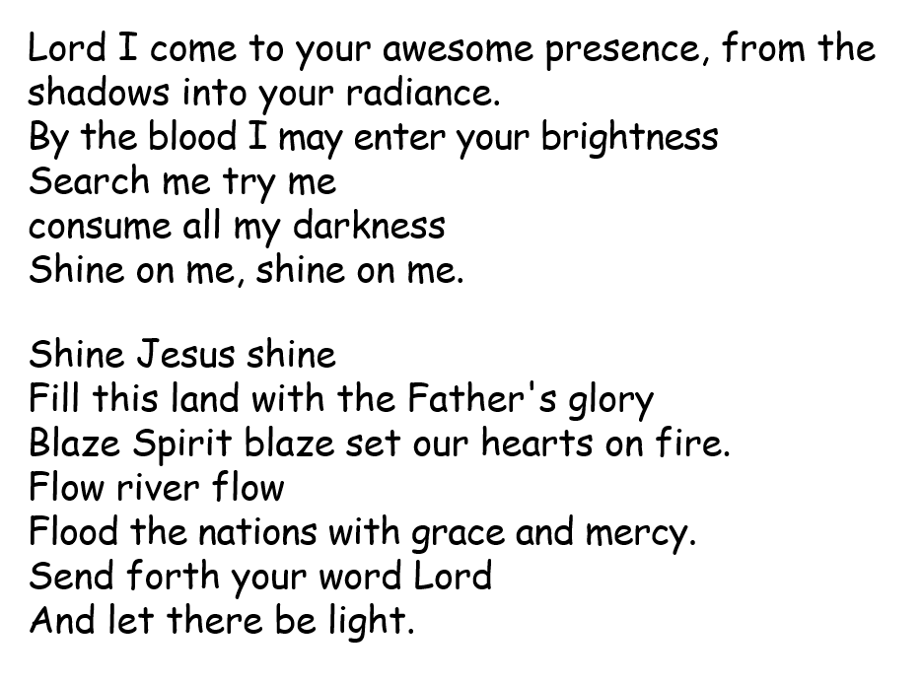


Slide 24
As we gaze on your kingly brightness,
so our faces display your likeness,
Ever changing from glory to glory mirrored here may our lives tell your story
Shine on me, Shine on me.
Shine Jesus shine
Fill this land with the Father's glory
Blaze Spirit blaze set our hearts on fire.
Flow river flow
Flood the nations with grace and mercy.
Send forth your word Lord
And let there be light.

Slide 25

Let Your Light Shine
this year

