Slide 1


Slide 2


We Gather …
Loving Father we gather before You,
knowing that we sin and need your Forgiveness.
Help us to be honest with ourselves,
as we examine our conscience.
Give us the courage to confess all that hurts our relationship with you and others

Slide 3

We Listen…
Scripture: Colossians 3:12 – 16
Because you are God’s chosen ones, holy and beloved, clothe yourselves with heartfelt mercy, kindness, humility, meekness and patience. Bear with one another: forgive whatever grievances you have against one another. Forgive as the Lord has forgiven you. Over all these virtues put on love, which binds the rest together and makes them perfect. Christ’s peace must reign in our hearts, since as members of one body you have been called to that peace.
The Word of the Lord.
All: Thanks Be To God
The Pope’s Lenten message for 2021,
He invites the faithful to:
“renew our faith, draw from the living waters of hope, and receive with open hearts the love of God.”

Slide 4
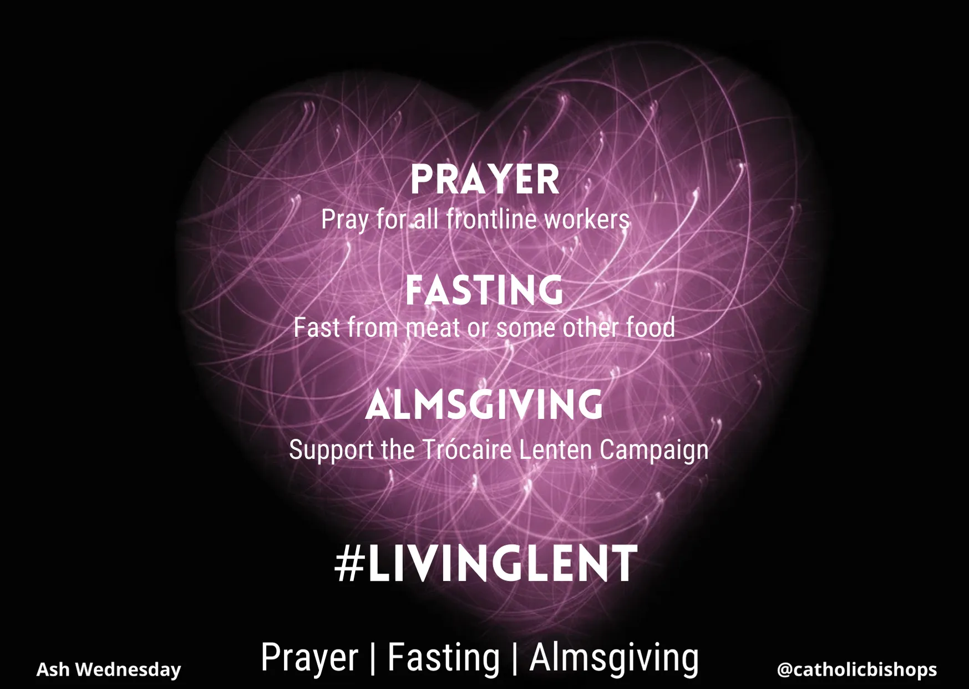
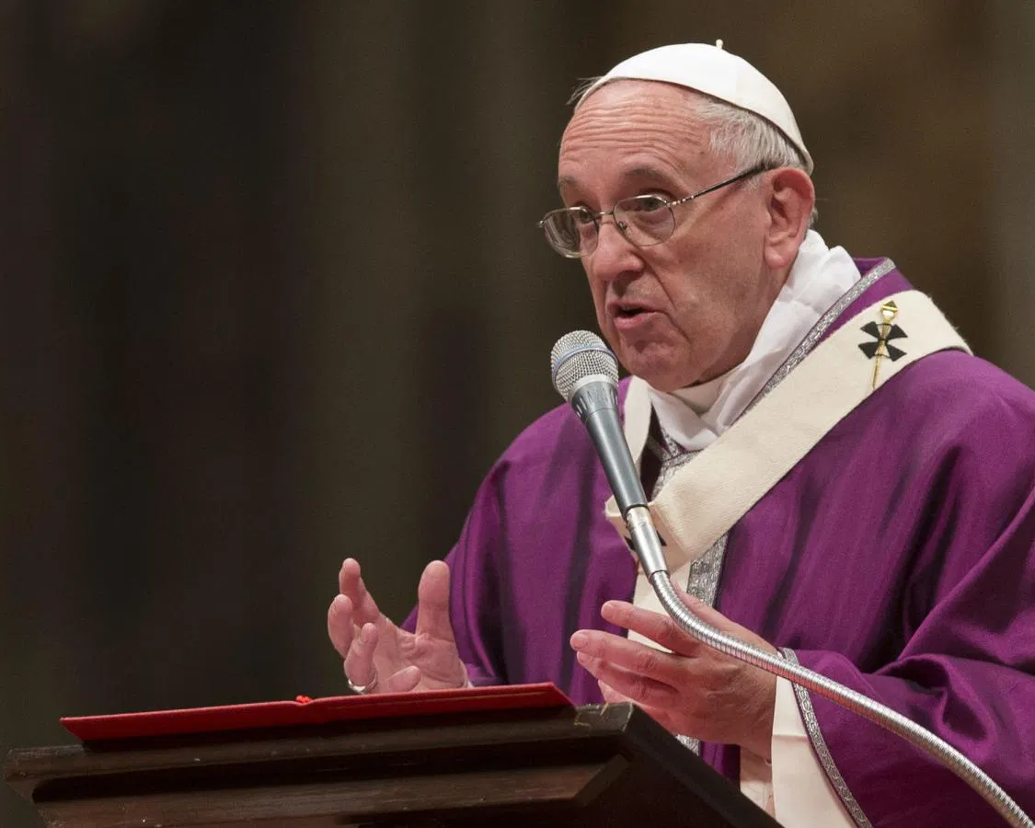
We Reflect…
Dear Brothers and Sisters,
Jesus revealed to his disciples the deepest meaning of his mission when he told them of his passion, death and resurrection, in fulfilment of the Father’s will. He then called the disciples to share in this mission for the salvation of the world.
In our Lenten journey towards Easter, let us remember the One who “humbled himself and became obedient unto death, even death on a cross” (Phil 2:8). During this season of conversion, let us renew our faith, draw from the “living water” of hope, and receive with open hearts the love of God, who makes us brothers and sisters in Christ.
At the Easter vigil, we will renew our baptismal promises and experience rebirth as new men and women by the working of the Holy Spirit. This Lenten journey, like the entire pilgrimage of the Christian life, is even now illumined by the light of the resurrection, which inspires the thoughts, attitudes and decisions of the followers of Christ.
Pope Francis

Slide 5




We Reflect…
The Pope’s Lenten message for 2021,
He invites us to:
“renew our faith, draw from the living waters of hope, and receive with open hearts the love of God.”

Slide 6

Examination of Conscience:
P: Let us reflect on our lives, so that we may come to an awareness of our sinfulness. We call upon God to show us the things we need to change in our lives so that we come back to Him totally.
Our Response: Forgive us, Jesus
Reader: For the times when we were mean and selfish to our brothers, sisters, classmates or friends: Forgive…
Reader: For the times when we chose not to say our prayers and spend time with Jesus: Forgive …
Reader: For the times that we did not try our best in school or did not do our homework: Forgive…
Reader: For the times we did not do our chores or did not help our parents when they asked for our help: Forgive…
Reader: For the times we lied to our parents, teachers, brothers, sisters, or friends: Forgive…
Reader: For the times we have cheated on a test or a game or copied homework: Forgive…
Reader: For the times we have taken other people’s things without permission: Forgive…
Reader: For the times that we were rude or talked back others: Forgive…
Reader: For the times when we made fun of other people: Forgive…
Presider: Kind and loving God, we ask forgiveness for all our sins. May we be truly sorry for the wrong things we have done and the good things we did not do. Help us to live as your people each day.
All: Amen

Slide 7
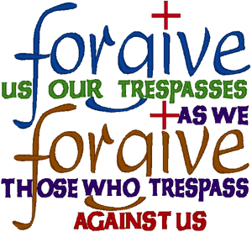
We Pray…
The Act of Contrition and Common Penance:
Presider: Let us together pray the Act of Contrition:
All: My God, I am sorry for my sins with all my heart. In choosing to do wrong and failing to do good, I have sinned against you whom I should love above all things. I firmly intend, with your help, to do penance, to sin no more, and to avoid whatever leads me to sin. Amen.
P: As our common Penance, we will all recite the Our Father together.
All: Our Father …

Slide 8
We go Forth…

