Slide 1



Here at St Chad’s we have tried to:
Enable you to achieve personal success
Let you realise your own potential
Allow you to develop and use your own gifts
Deepen you knowledge and understanding of your relationship with God
Develop the skills needed for the next stage of life
Enable you to express yourself openly
Empower you to dream and follow your dreams
Let you grow in wisdom
Encourage you to live life to the full.
Leavers’ Liturgy
2021

Slide 2

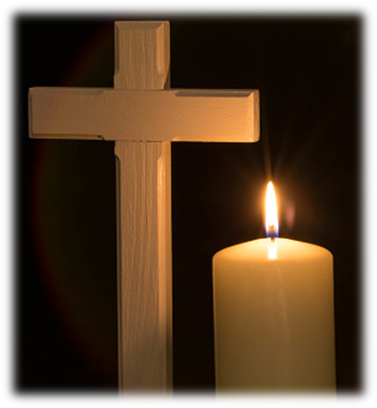


https://youtu.be/Gg55az3YlW4
The Blessing
The Lord bless you
And keep you
Make His face shine upon you
And be gracious to you
The Lord turn His
Face toward you
And give you peace
The Lord bless you
And keep you
Make His face shine upon you
And be gracious to you
The Lord turn His
Face toward you
And give you peace
Amen, amen, amen
Amen, amen, amen

Slide 3

We gather together on this special and spiritual occasion to give thanks to God for bringing these young people into our lives - the life of their family and the life of the Catholic school community here in South Norwood. We thank them for the joys they have brought to us in their time here at St Chad’s, and their sense of service to the community. We pray that they may continue in the act of endless giving in the next stage of their life, take the wisdom they have gained from their education and from those around them, and the wisdom they have discovered for themselves and use it to guide them through life.
Mrs. Mitchener

Slide 4

Here at St Chad’s we have tried to:
Enable you to achieve personal success
Let you realise your own potential
Allow you to develop and use your own gifts
Deepen you knowledge and understanding of your relationship with God
Enable you to express yourself openly
Empower you to dream and follow your dreams
Let you grow in wisdom
Encourage you to live life to the full.
Here at St Peter and St Paul Sixth Form we have tried to:
Enable you to achieve personal success
Let you realise your own potential
Allow you to develop and use your own gifts
Deepen you knowledge and understanding of your relationship with God
Develop the skills needed for adult life
Enable you to express yourself openly
Empower you to dream and follow your dreams
Let you grow in wisdom
Encourage you to live life to the full.
Mrs. Mooney

Slide 5
We Listen…
First Reading from the Book of Proverbs
My child, do not forget my teaching, but keep my commands in your heart, for they will prolong your life many years and bring you peace and prosperity. Let love and faithfulness never leave you; bind them around your neck, write them on the tablet of your heart. Then you will win favour and a good name in the sight of God and man. Listen my child, to a father’s instruction; pay attention and gain understanding. I give you sound learning, so do not forsake my teaching. For I too was a child to my father, still tender, and cherished by my mother. Then he taught me, and he said to me, “Take hold of my words with all your heart; keep my commands, and you will live. Get wisdom, get understanding; do not forget my words or turn away from them.
The Word of the Lord
Thanks be to God

Slide 6


A reading from the Gospel of John 15:12-17
My command is this: Love each other as I have loved you. Greater love has no one than this: to lay down one’s life for one’s friends. You are my friends if you do what I
command. I no longer call you servants, because a servant does not know his master’s business. Instead, I have called you friends, for everything that I learned from my Father I have made known to you. You did not choose me, but I chose you and appointed you so that you might go and bear fruit—fruit that will last—and so that whatever you ask in my name the Father will give you. This is my command: Love each other.
The Gospel of the Lord
Response: Praise to you Lord Jesus Christ

Slide 7
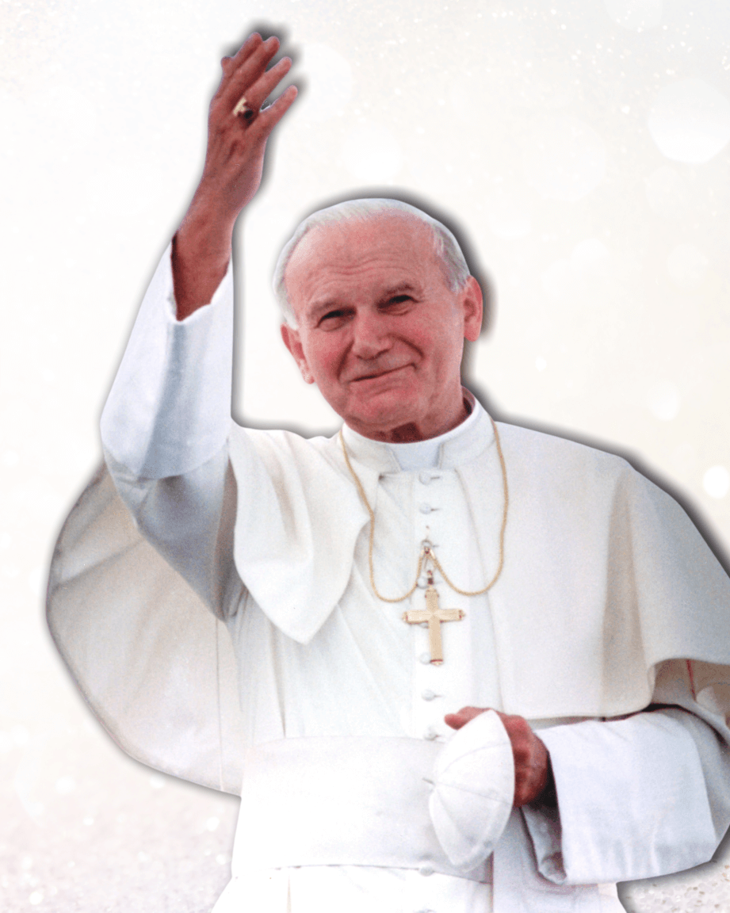
We Reflect…
“The Secret of Happiness”
“The path of goodness has a name; it is called love. In it we can find the key to every
hope, for true love has its root in God himself. As St John reminds us ‘we have
recognised for ourselves, and put our faith in, the love God has for us. God is love.’
The greatest proof of God’s love is that he loves us in our human condition, with our
weaknesses and needs. Nothing else can explain the mystery of the Cross. Christ’s
love is more powerful than sin or death.
St Paul explains that Christ came to forgive sins and that his love is greater than any
sin whatever, greater than my sins and those of anyone else. This is the Church’s faith.
This is the Good News of God’s love, which the Church has proclaimed down the ages
and which I proclaim to you today: God loves you with an everlasting love.
He loves you in Christ Jesus his Son.
Loving is essentially a giving of oneself to others, a conscious decision of
the will to go out to others. To be able to love properly one must give freely.
This is the secret of happiness.”
Pope John Paul II

Slide 8
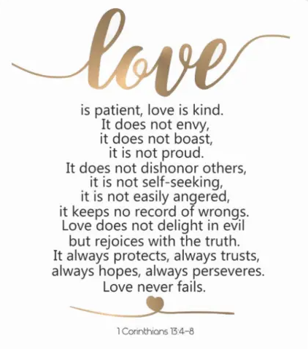

Take your Mission forward
On the back of your prayer card, write down 3 acts of kindness, you will demonstrated during your first week in your new school.
Class of 2020 -21

Slide 9
We Pray…
We gather together on this special occasion, we thank you for the gift of wisdom. As you granted Solomon, your servant, the gift of wisdom in order that he may serve you better, may you continue to instil in us that very same gift so that we too can work in your name.
Lord, in your mercy
Hear our prayer
May we take the experiences and lessons that we have learnt so far in our life and use them to become even better people. May you help us to strive to be the best representatives of God that we can be.
Lord, in your mercy
Hear our prayer
We pray for those that have guided us along our way and have brought us safely to where we are now - our parents, our teachers, our priests, friends and our community. We thank them God for all they have done in helping us to develop and grow.
Lord, in your mercy
Hear our prayer
We now look forward to the next stage of our life, may we continue to allow you into our lives, including you in all things that we do and have the confidence to take on challenges of life, knowing that you are always by our side.
Lord, in your mercy
Hear our prayer

Slide 10

We Go Forth…
Closing Prayer
God our Father, bless us as we leave St Chad’s.
Bless us as we leave this place where you have been present among us.
Bless all those who have given their time to us.
Bless all those that work and study here,
May we go forth from here, confident in ourselves, and willing to serve others, with love and kindness.
We make this prayer through Christ our Lord.
Amen

Slide 11

We are children, children of the Light
We are shining in the darkness of the night
Hope for this world, joy throughout the land.
Touch the hearts of everyone, take everybody’s hand.
Come and gather round the flame, share the light in his name
We the children of the light
As the wind blows where it will, spread the news to everyone
There’s still plenty of time, for we have just begun.
Chorus
Join the song of all the earth, we’ve a dream a dream to share
And a promise of re-birth
Let the earth feel the warmth of his love here in our hearts
We’ve still many a dream and promises to keep

Slide 12


Slide 13
Be kind, like Christ
Grow in Love, Live in Peace

