Slide 1

Welcome to
Year 1

Slide 2
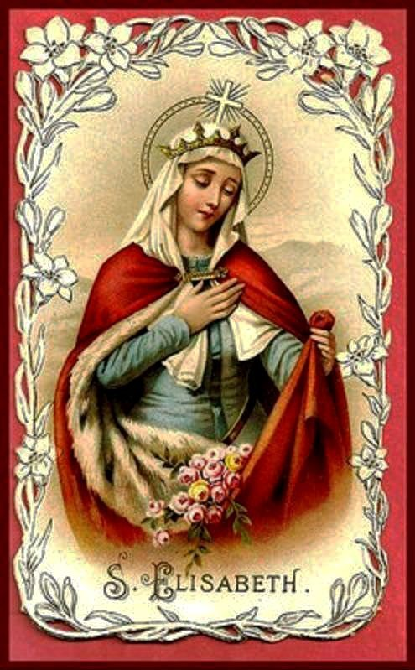
St Elizabeth
Mrs Campbell
Miss Butler

Slide 3
Uniform
Correct uniform must be worn at all times including school trips.
Labels: please label all uniform
Shirts: tucked in, top button done up
Ties: should be purchased from school office.
Socks: Boys: grey or black socks. Girls: Grey tights or socks. White socks with summer uniform.
Correct school coat: black coat with school badge.
Jewellery: stud gold earrings
Hair: long hair must be tied back with a grey, white, yellow, or black hairband. No beads. No shaved patterns.
Shoes: No laced shoes.

Slide 4

PE
St Elizabeth – Tuesday & Friday
Children to come into school in kits on their PE day.
Yellow polo shirt with school logo
Black plimsolls or trainers (only laces if they can tie them)
Black shorts/Black jogging bottoms (depending on the weather, what they wore in Reception)

Slide 5
Clothing and bags
ALL school clothes, PE kit, book bags and water bottles need labels.
Bags to come into school every day.
Water bottles in school each day.
Please teach your child how to put their tie on and do/undo buttons.
Black velcro or buckle shoes. No ankle boots, laces, trainers or shoes with flashing lights.

Slide 6

Reading
Please listen to your child read every night.
Ask questions to assess their understanding of the text/pictures.
Daily group guided reading has begun in class.
Books will be changed twice a week.
Books will only be changed if there is a parent signature to show they have read at home.
It is suggested that you allow your child to read the book more than once to reinforce understanding of text. There are usually questions and ideas that you can ask your child in the books.

Slide 7
Handwriting
The children need to develop their handwriting and so we encourage you to work with them at home by practicing correct letter formation.
We will be focussing on this in class each day.

Slide 8
Homework
Set on Friday return by Wednesday morning or earlier
Reading (every day)
Phonics homework
Spellings - high frequency words (HFWs) these will be send home weekly after half term.
Other homework will be issued when relevant, for example Maths or topic work.

Slide 9

General
Please ensure you are dropping your child off at the gate and picking up your child promptly each day – 8.30am and 3pm. (we are not available to speak to in the mornings)
Labelled water bottles: Should be brought in from home each day. Only water.
Collection: Please inform the class teacher or the office if someone else will be collecting your child.
Questions: It is more difficult to talk when we are dismissing children. Please communicate any questions or queries via the school office or if necessary, an appointment can be requested.
Parents evening: TBA
Phonics Year 1 meeting: TBA

Slide 10
Rules for Children
Our one school rule that governs all rules is to
‘Be Kind’.
We encourage the children to look at and listen to the adults and other children when they are speaking.
To speak in a clear voice.
To be respectful.
To follow instructions.
To keep hands and feet to themselves.
To say please and thank you.
Always try their best!

Slide 11
Transition
A carousel of learning activities and adult focus tasks.
Time for play.
Teaching sessions include whole class and group work.
Leading to a more structured day with 5 lessons.
Children are encouraged to complete their work and do their best.

Slide 12
Saint Feast Days
St Elizabeth’s feast day – 5th November 2022
Friday 3rd November at 2.30pm, parents are invited to attend our class liturgy celebrating our Saint’s Feast Day. More details will be sent out closer to the time.

Slide 13
Thank you and have a lovely evening!

