Slide 1



Year 6
Welcome to Meet the Teacher evening
18th September 2024

Slide 2

Staffing
St Brigid - Mrs Mooney.
St Therese – Mrs Mitchener.
Support staff
Mrs Bowler and Mrs Streek.

Slide 3
Curriculum

Slide 4

Uniform and appearance
Please refer to the school website for the full uniform list.
Children are expected to arrive and leave school looking respectable at all times.
Correct uniform must be worn on school trips as children are representing the school.
Shirts must be tucked in, ties worn at waist length, and top buttons done up.
The only jewellery to be worn is a pair of stud earrings.
Hair - Fasteners are in school colours only, grey, white, yellow, or black. No hair extensions or shaved designs are allowed, and long hair must be tied back.

Slide 5
P.E. Kit
P.E. kit – All children to have yellow polo shirt (with school badge), black shorts, long black tracksuit bottoms, (no logos) St Chad’s P.E black jumper (with school badge), P.E. socks, plimsolls and plain white/black trainers.
P.E. is taught on:
St Brigid – Monday
St Therese - Thursday.

Slide 6
Assessment
Assessment will be ongoing.
SATs will take place from 8th -11th May
Sept – Baseline
Dec – Autumn Assessment
Feb – Spring 1
April - Spring 2
White Rose end of block assessments- ongoing

Slide 7
Homework
Monday | Tuesday | Wednesday | Thursday | Friday
Comprehension/Grammar | Reading | Spelling | Maths | Reading
Due in on Wed |  | Tested the following Wednesday | Due in on Monday
The responsibility to complete the homework is with you and your child.
Please ensure that they complete it, to the best of their ability.

Slide 8
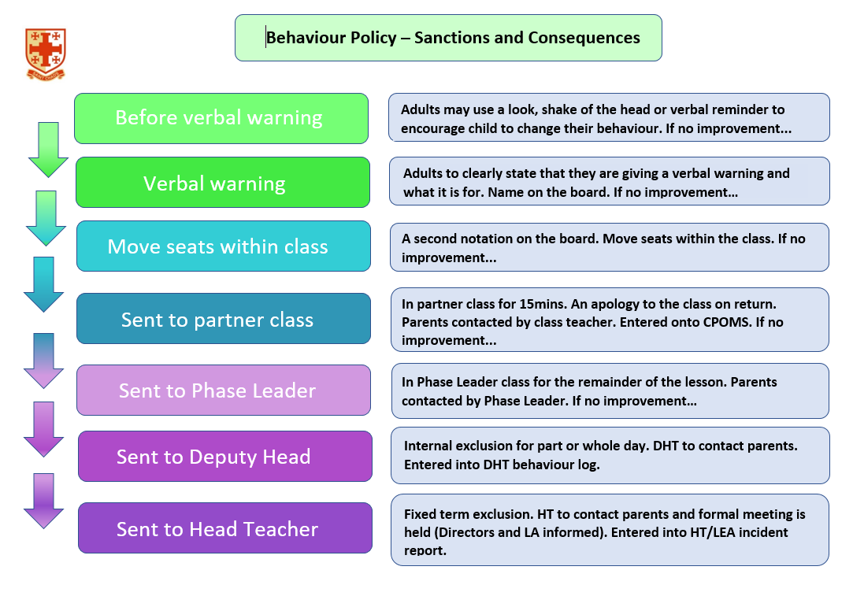

Slide 9
SAT’s preparation
All English and Maths work supports SAT’s preparation. Therefore it is essential your child attends school every day.
Yr6 classes are set for Reading and Maths across the year group. These groups are fluid and subject to change.
There is a focus on Reading fluency and understanding this year, to support the increased demand of the SAT paper. Your child will be expected to read 3200 words and answer 32 questions in 1 hour.
There will be a further meeting in the Spring term, to discuss the arrangements for SAT’s.

Slide 10
How to contact us . . .
If you have any concerns or need to talk to us for any reason we are available for a very brief word after school , or appointments can be made with the office.
If we receive a message that you have called, we will endeavour to contact you by the end the working day, or if unavailable, by the end of the next working day.
All messages left should indicate the nature of your call.

