Slide 1

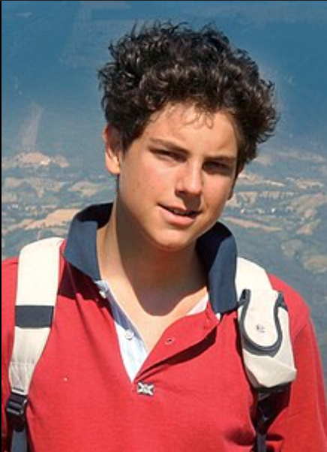

YEAR 3
Welcome to Meet the Teacher evening
18th September 2024

Slide 2

Staffing
St John Bosco - Miss McNicholas
St Carlos- Mr Moonsam
Support staff
Mrs Zions and Mrs Koffi (1:1)

Slide 3


Curriculum

Slide 4
Uniform and appearance
Please refer to the school website for the full uniform list.
Children are expected to arrive and leave school looking respectable at all times.
Correct uniform must be worn on school trips, as children are representing the school.
Shirts must be tucked in, ties worn at waist length, and top buttons done up.
The only jewellery to be worn is a pair of stud earrings.
Hair - Fasteners are in school colours only, grey, white, yellow, or black. Shoulder length hair must be tied back and hair extensions must be of a reasonable length. No hair gel, tramlines, or other shaved designs including Mohicans are allowed.
v

Slide 5

P.E. Kit
P.E. kit – All children to have yellow polo shirt (with school badge), black shorts, long black tracksuit bottoms, (no logos) St Chad’s P.E black jumper (with school badge), P.E. socks, plimsolls and plain white/black trainers.

Slide 6
Assessment
Assessment will be ongoing.
Sept – Baseline for Reading and Maths
Dec – Autumn Assessment
April - Spring Assessment
July - Summer Assessment
White Rose end of block assessments- ongoing
Foundation assessments - ongoing

Slide 7
Marking Policy
In line with Education Endowment Foundation (EEF) research, around the benefits providing immediate verbal feedback, St Chad’s have been working on updating their marking policy to be inline with this.
We will be providing in-lesson feedback for children, furthering their learning and allowing children to act on teacher feedback and targets within the lesson itself.

Slide 8
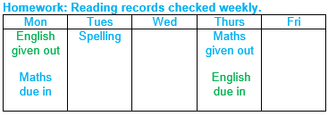
Homework
The responsibility to complete the homework is with you and your child.
Please ensure that they complete all of it and that it is in their neatest handwriting.
We encourage children to borrow books from the classrooms and library to take home and read daily, documenting this in their reading journals.

Slide 9
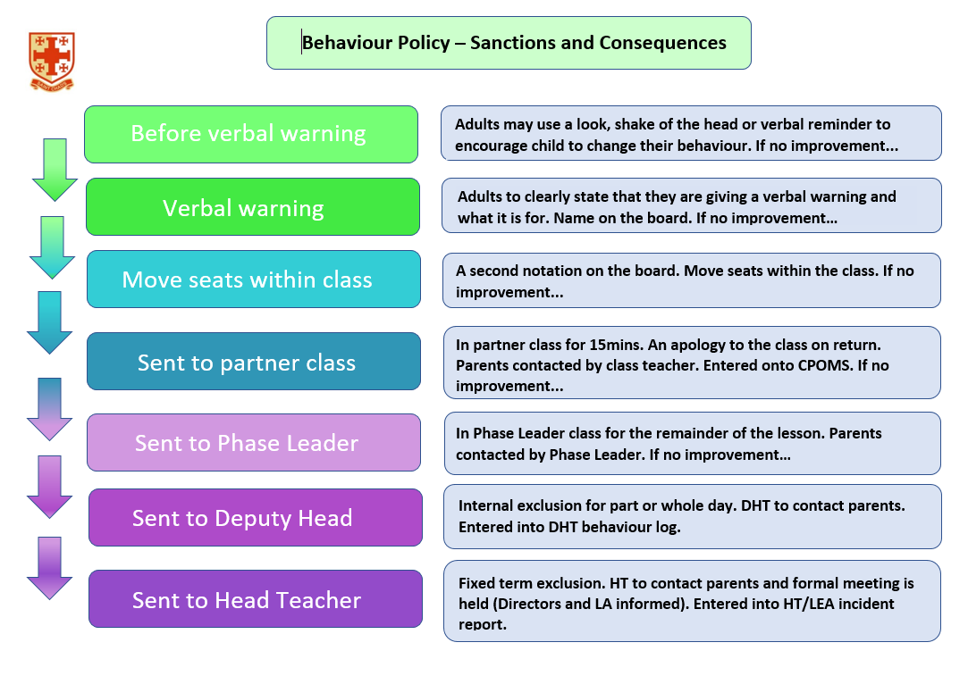

Slide 10
How to contact us . . .
If you have any concerns or need to talk to us for any reason we are available for a very brief word after school, or appointments can be made with the office.
If we receive a message that you have called, we will endeavour to contact you by the end the working day, or if unavailable, by the end of the next working day.
All messages left should indicate the nature of your call.
Follow us on Twitter @StChads_Croydon

