Slide 1

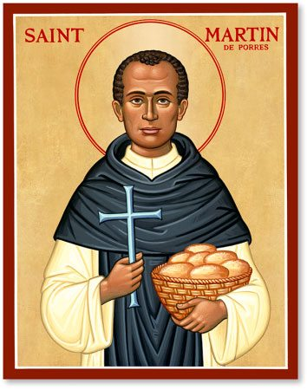
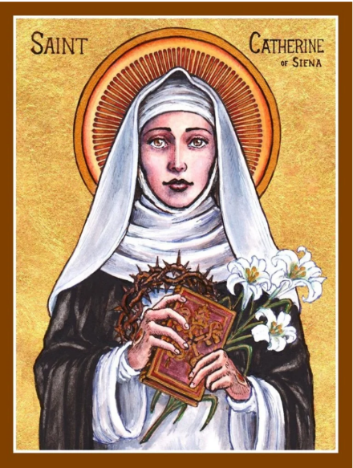
Welcome to Year 4
St. Martin de Porres
Mr Cameron
Mrs Britto (TA) Mrs Mbala (1:1)
St. Catherine
Miss Dench
Mrs Stewart (TA), Miss Addo/Mr Brady (1:1)

Slide 2

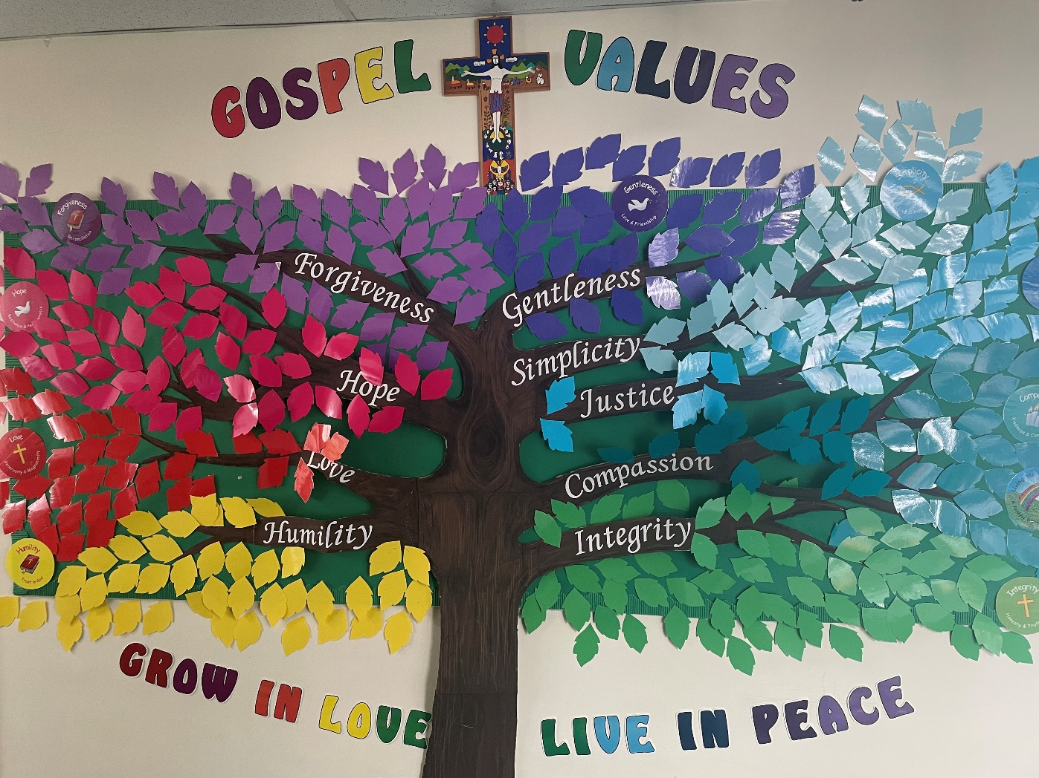

Slide 3
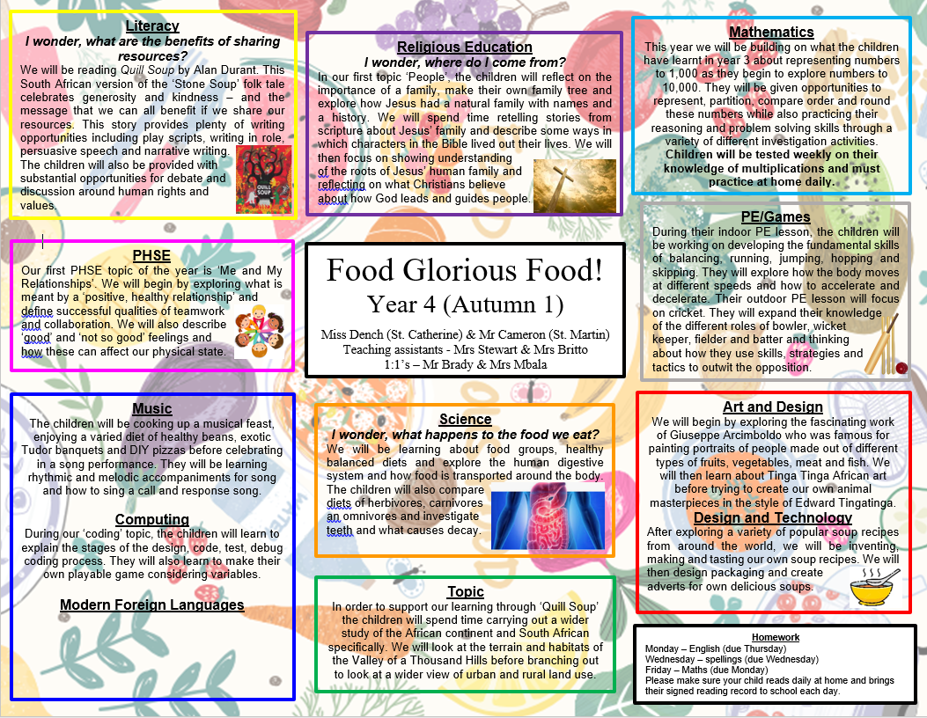

Slide 4


PE
Both classes will have outdoor PE on Wednesday afternoon
Both classes will begin having their second PE lesson on Thursday 26th September
Please make sure your child wears the correct PE kit each week
Yellow t-shirt, black tracksuit, sweatshirt, trainers or plimsolls (outdoor PE)
Yellow t-shirt, black shorts and plimsolls (indoor PE)
Everything must be clearly labelled

Slide 5

Homework
Monday – English (due Thursday)
Wednesday – spellings (due following Wednesday)
Friday – Maths (due Monday)
Spelling test and Rainbow test takes place on a Wednesday.
Regular practice of times tables up to 12 x 12
Please ensure your child reads for at least 20 minutes a day and reading records are kept up to date.

Slide 6

Multiplication Tables Check (MTC)
The MTC determines if Year 4 children can fluently recall their multiplication tables.
Monday 3rd June and Friday 14th June.

