Slide 1

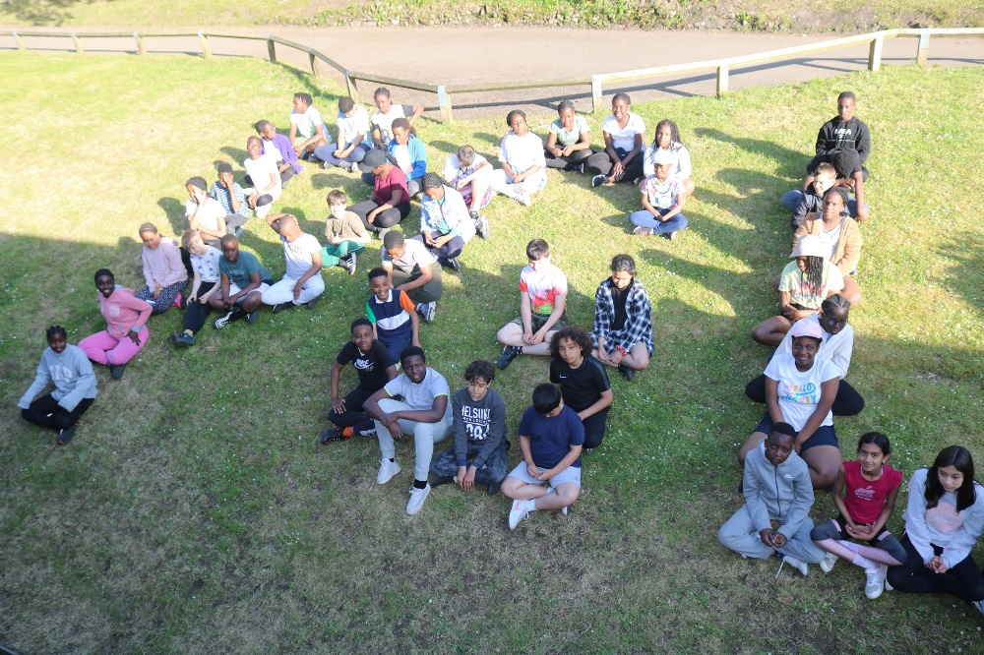
Year 6 PGL
Presentation
23rd May – 26th May
2025

Slide 2

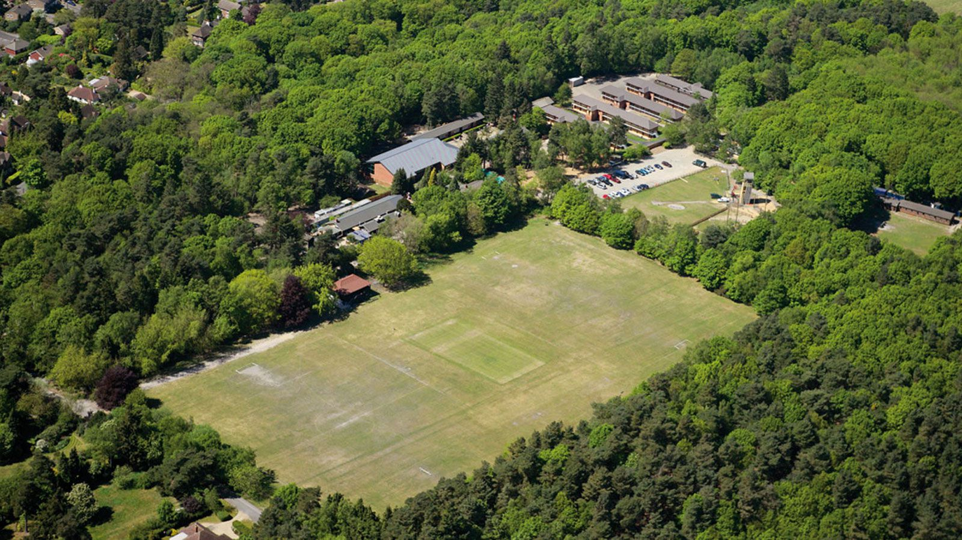
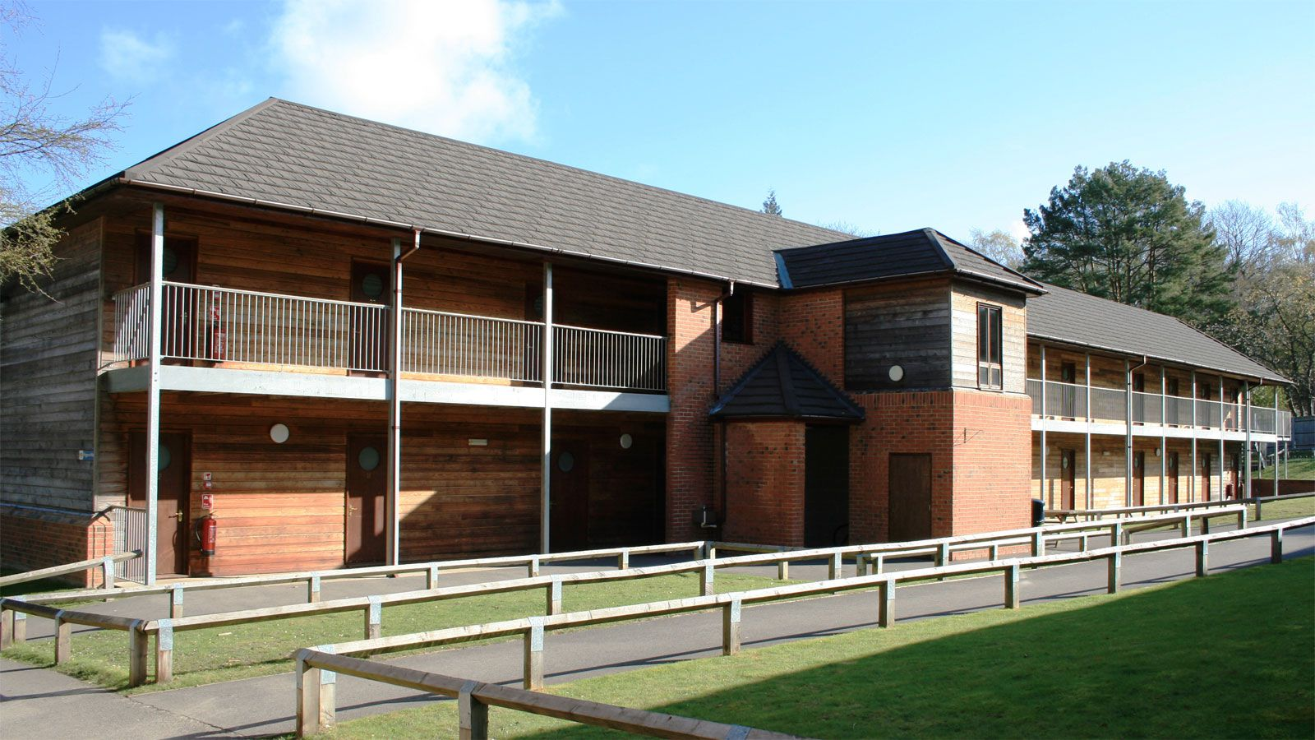
Accommodation
Setting

Slide 3

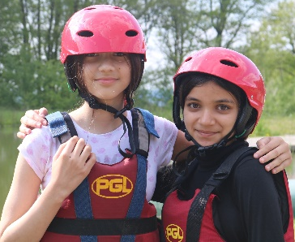
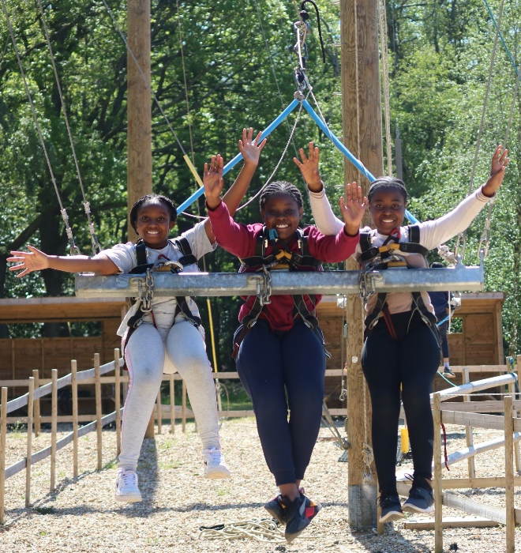
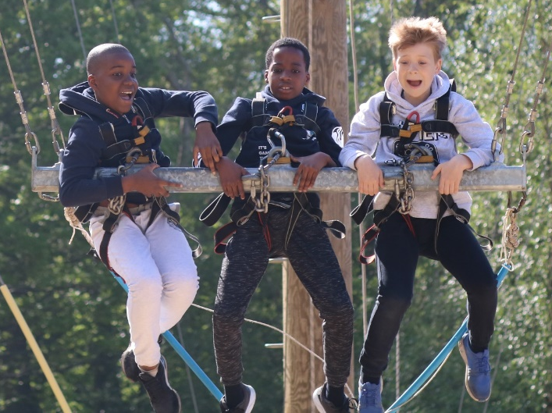

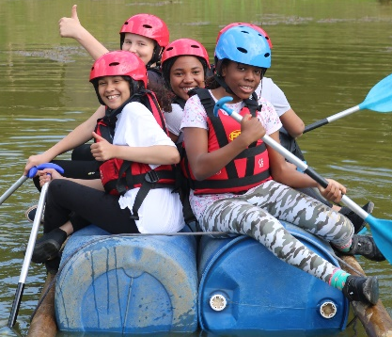
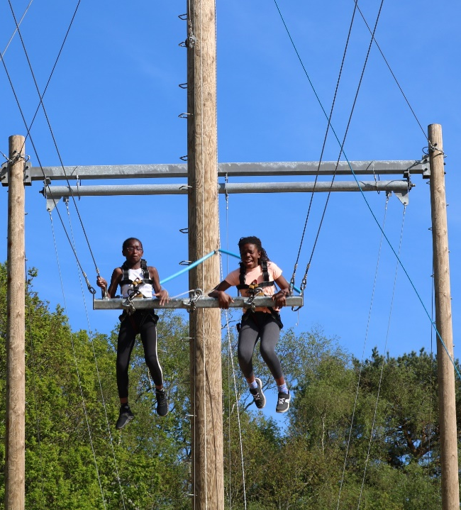
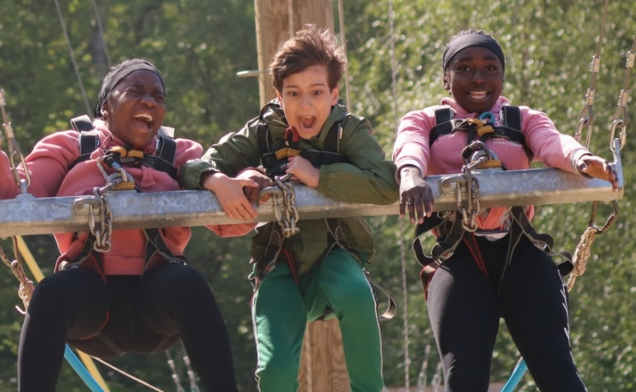
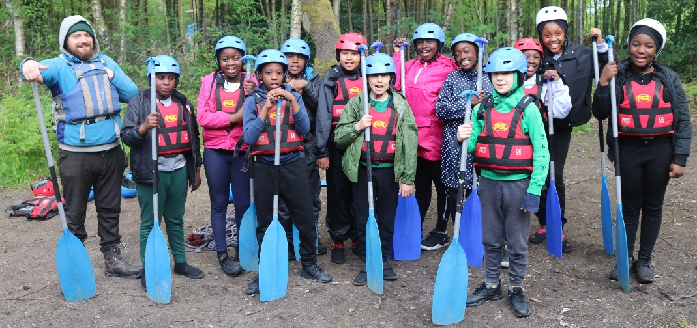
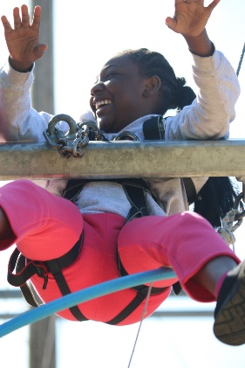
Giant Swing
Raft Building

Slide 4
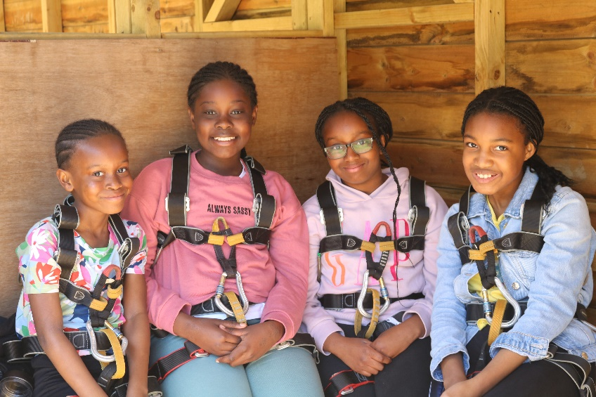
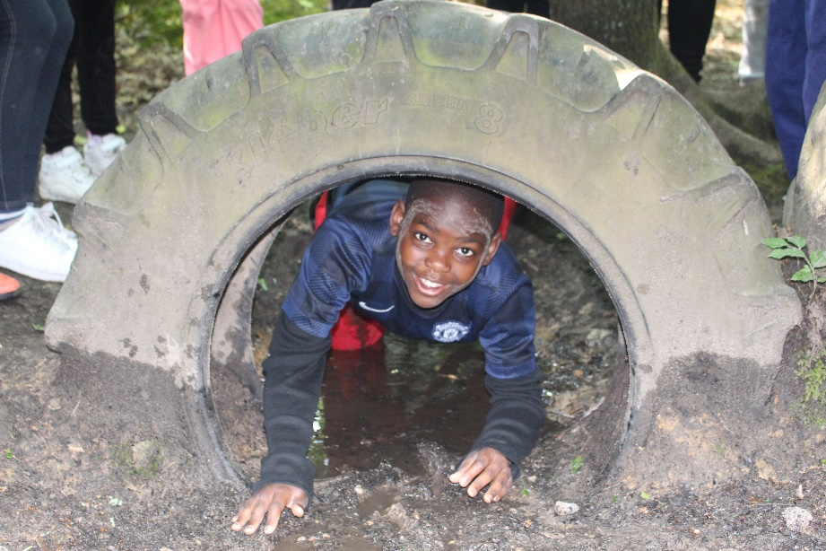
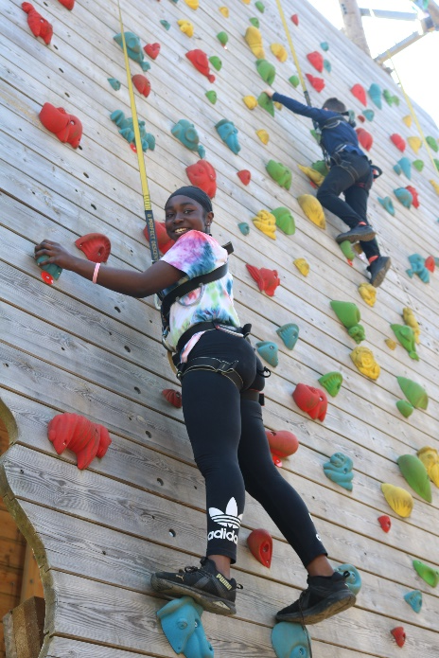
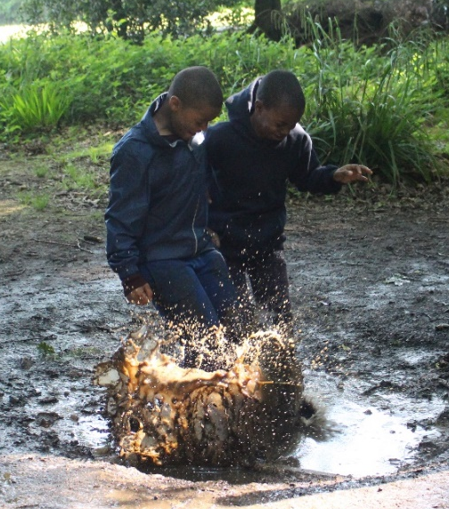
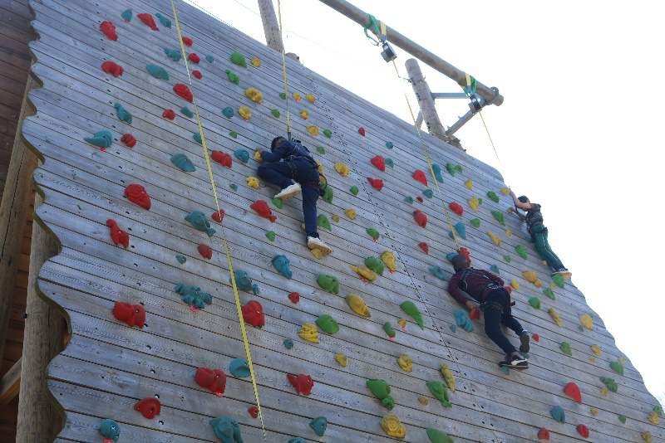
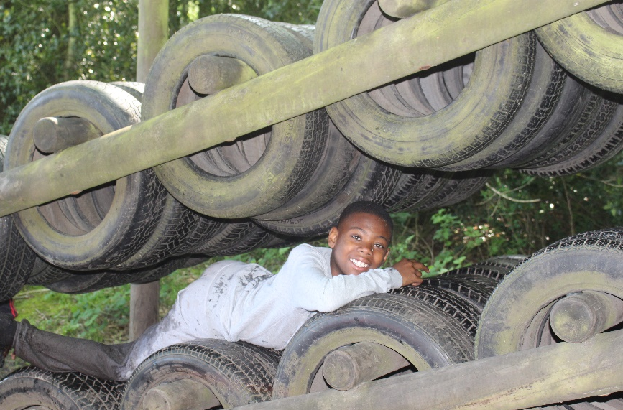
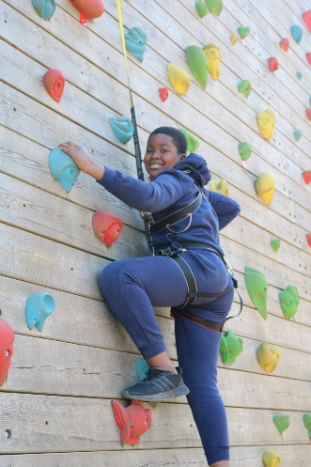
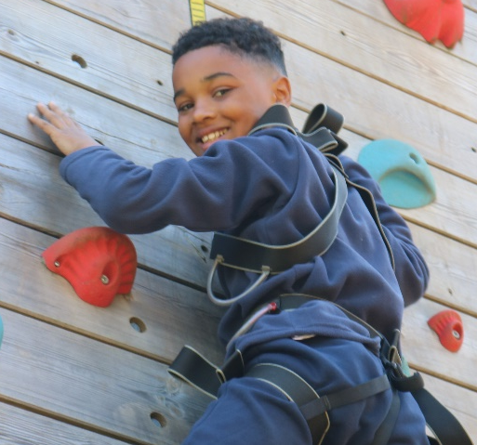
Challenge Course
Climbing Wall

Slide 5
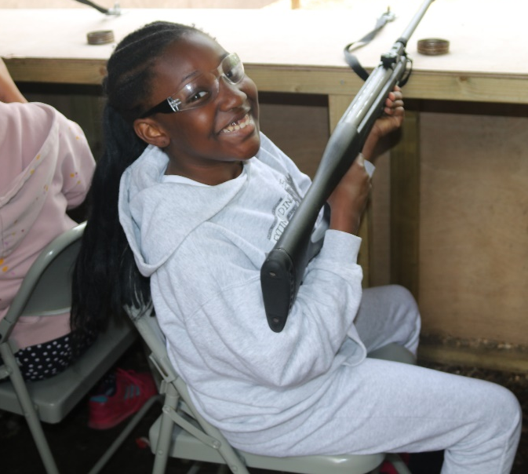
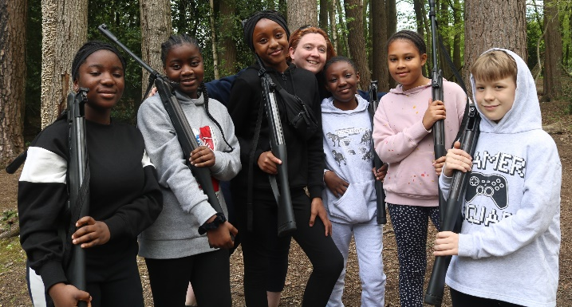
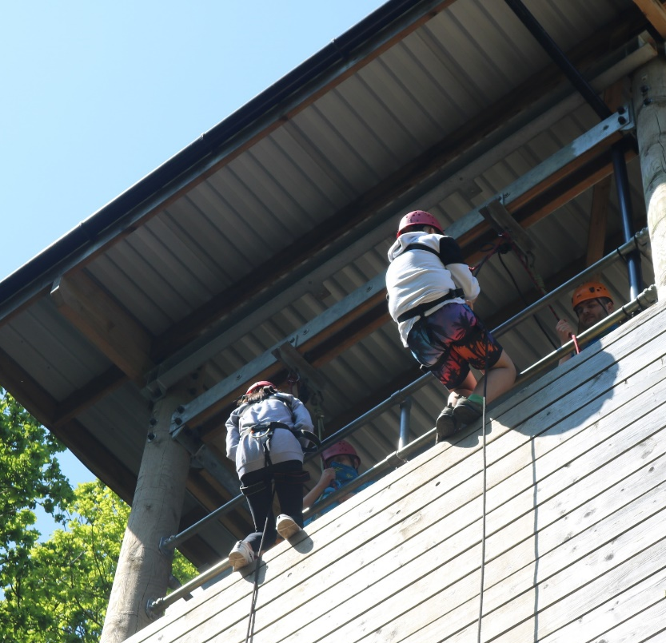
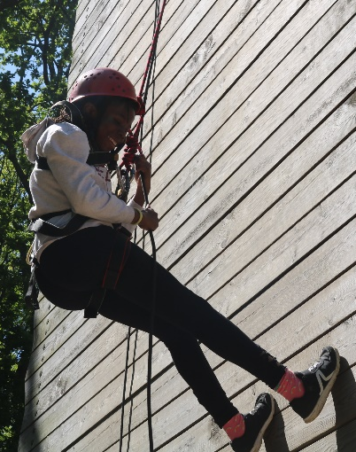
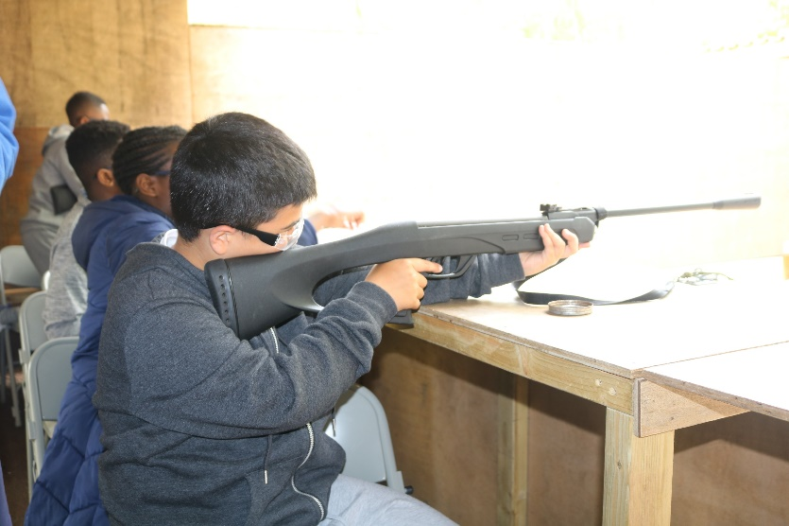
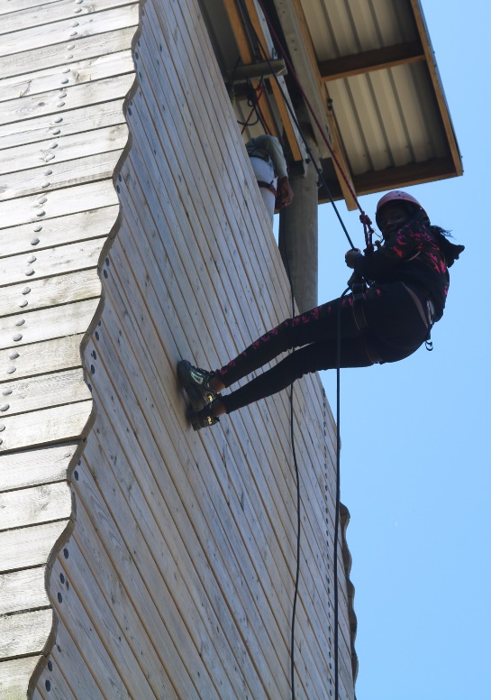
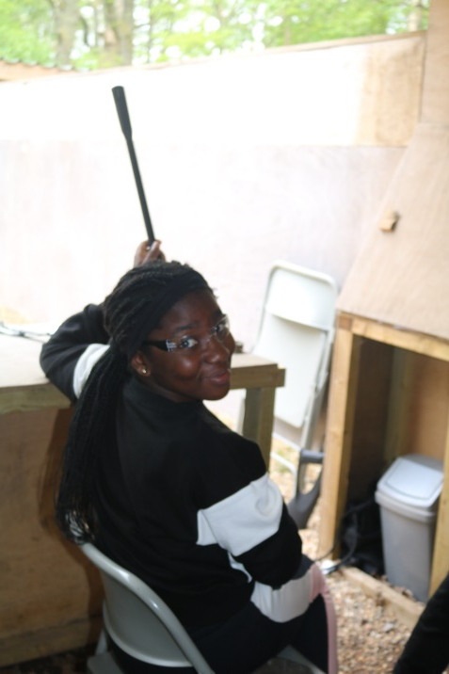
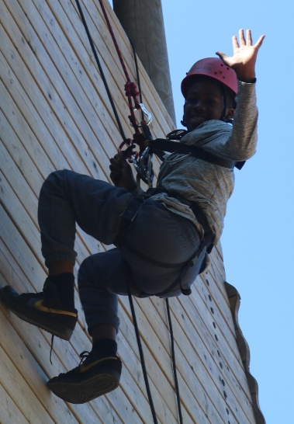
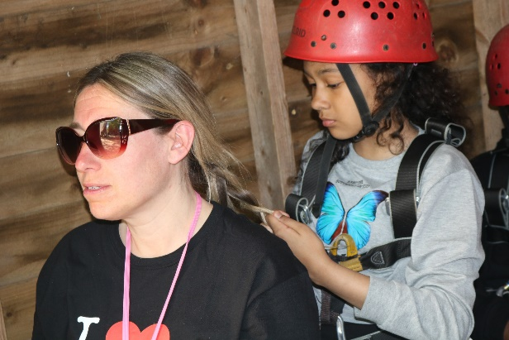
Abseiling
Rifles

Slide 6
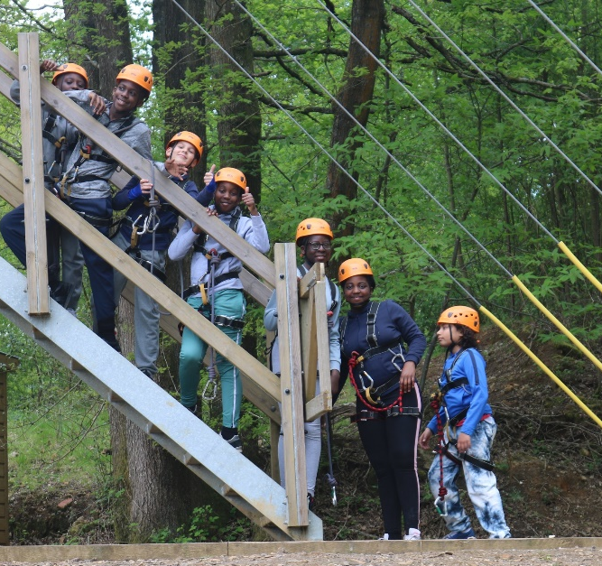
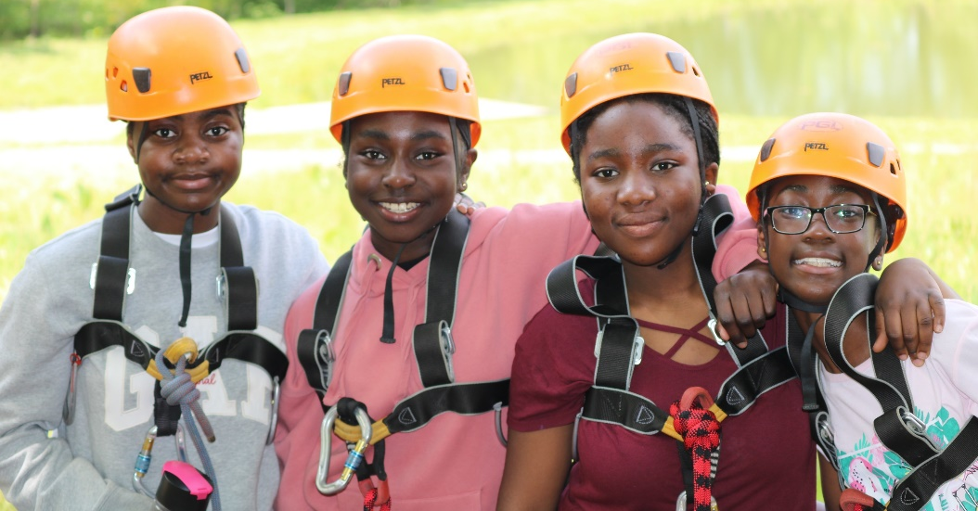
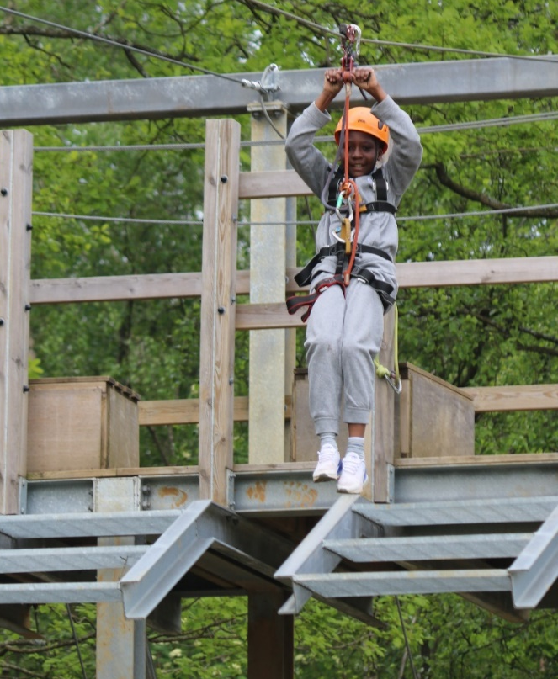
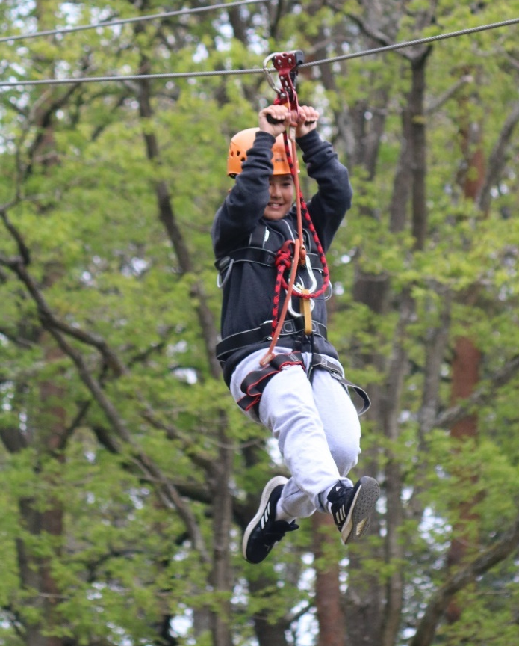
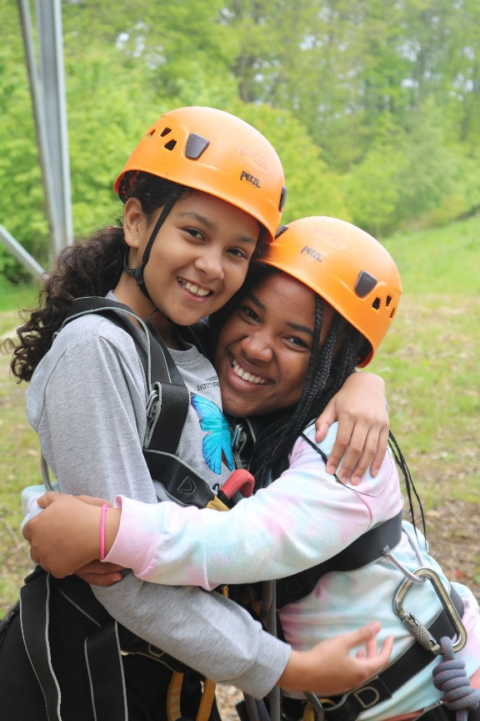
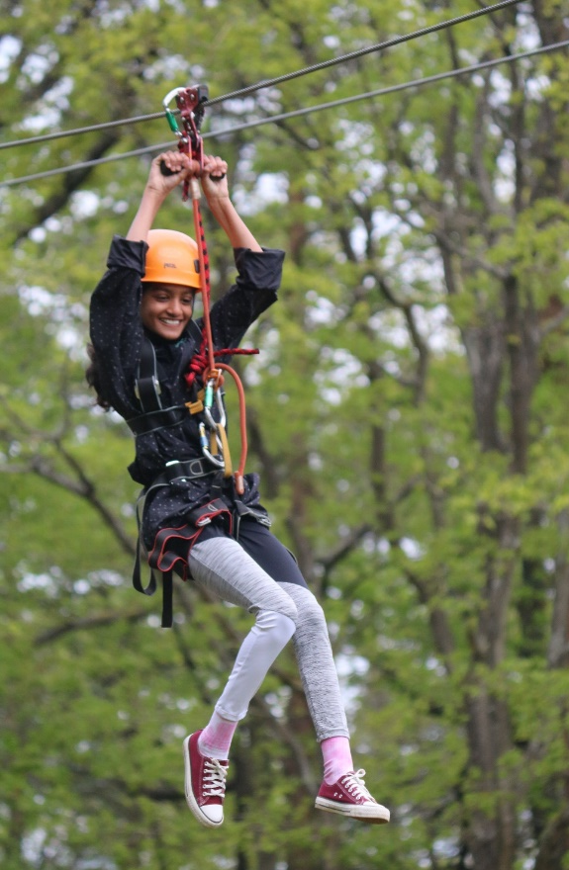
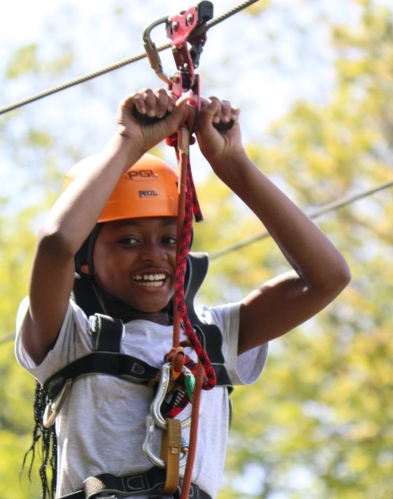
Zip Wire

Slide 7
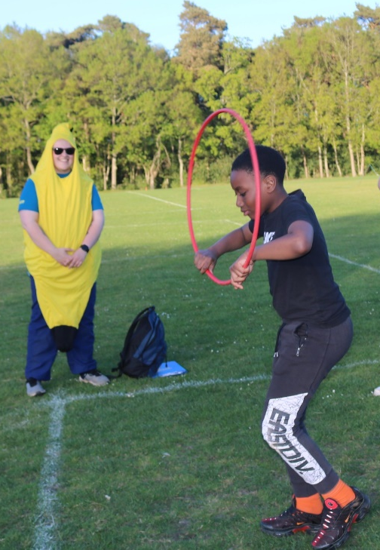
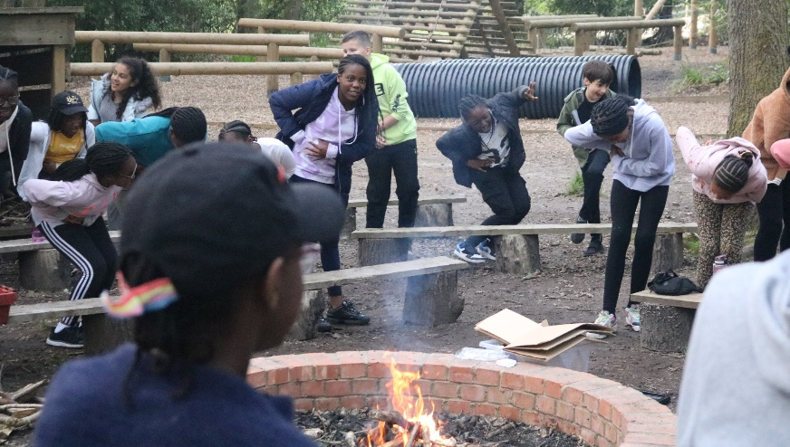
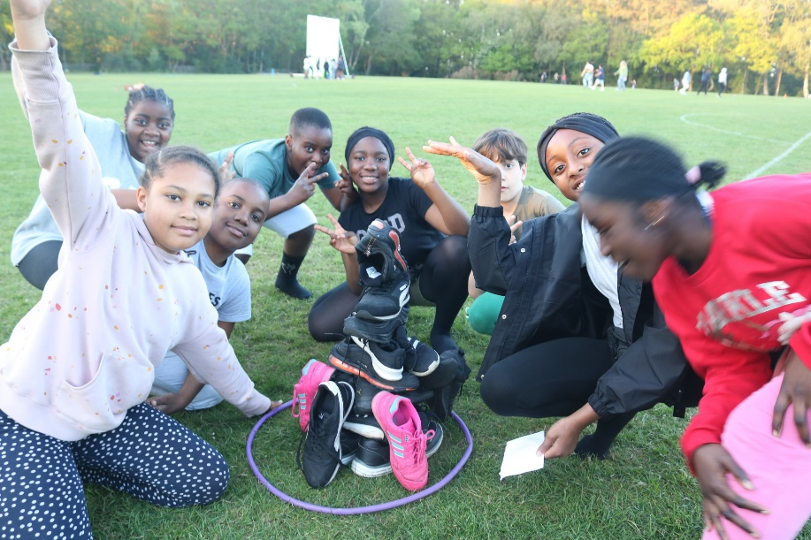
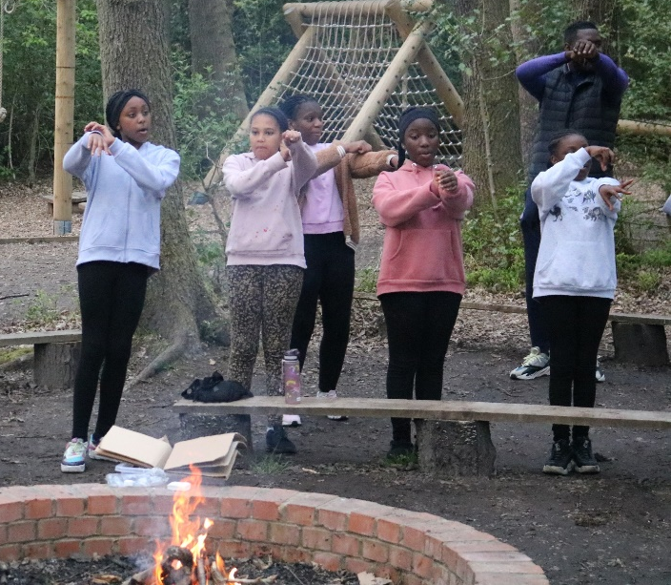
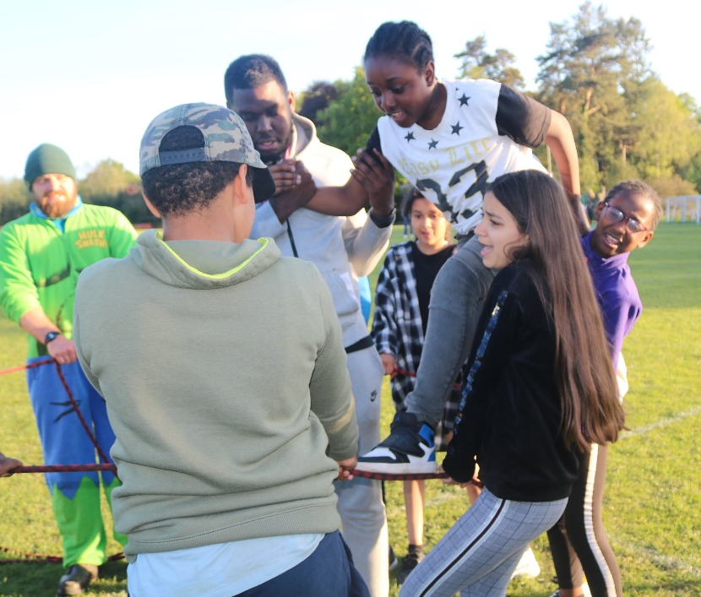
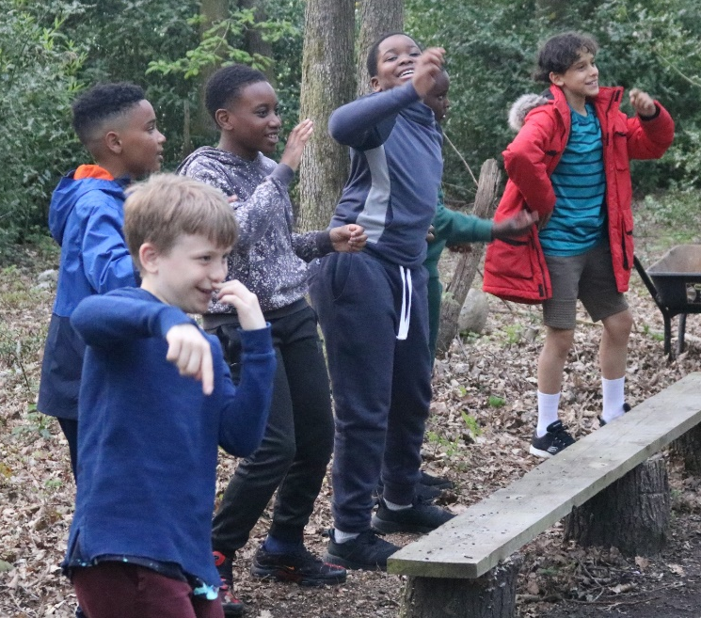
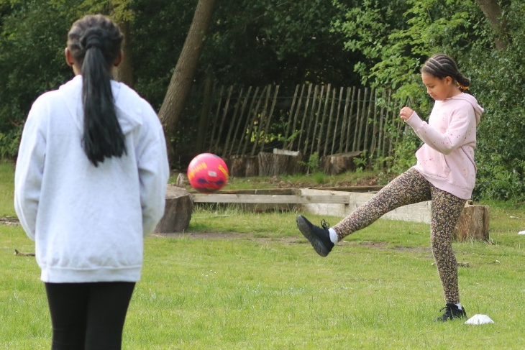
Evening Entertainments

Slide 8

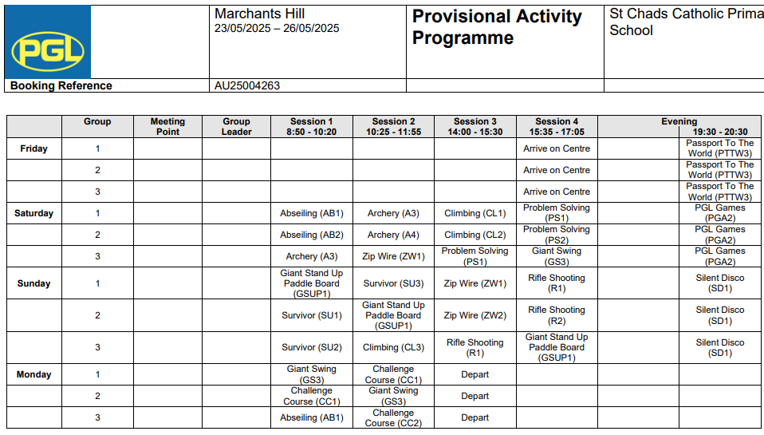
Itinerary

Slide 9

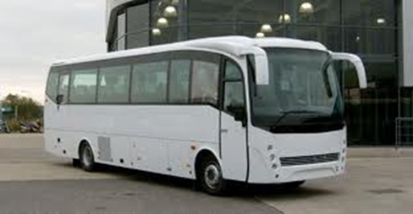
Friday 23rd May 2025
12:45
All Children to arrive at school with their holiday belongings and go to the Learning Hub room- Sorry no parents, please say your goodbyes at the gate. You are welcome to wait until the coach departs, so that you can get a final hug and wave them off.
Register with Mrs Mitchener
Hand all medicines to Mrs Gant
Hand all money to Miss Dench.
1:15 Coach departs
3:30 Settle into the accommodation
5:20 Three-course evening meal
7:30 – 9:00 Evening activity – Passport to the World
10:00 Lights out

Slide 10
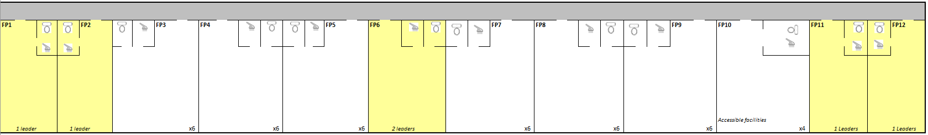
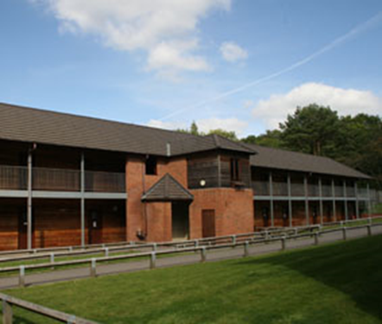
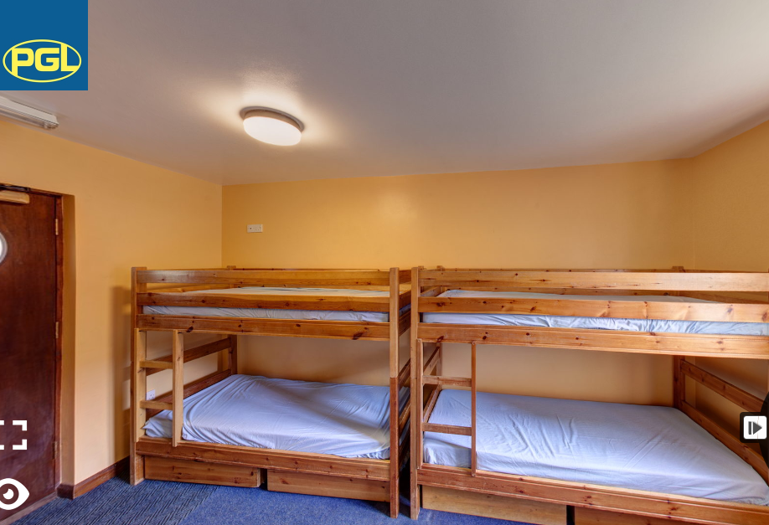
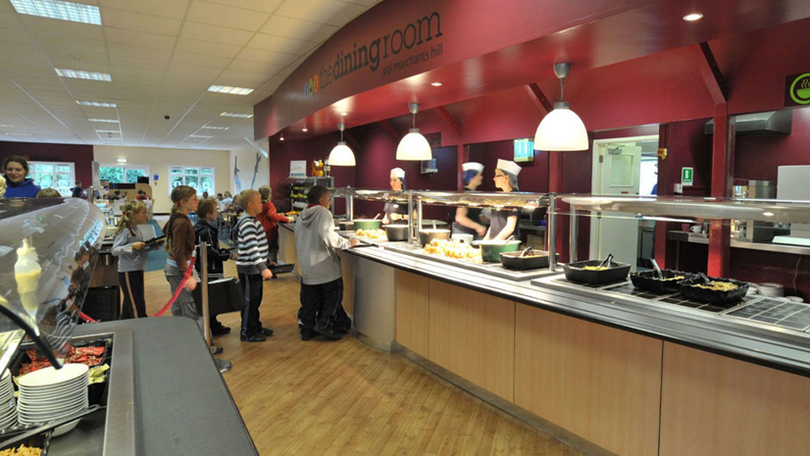
Pupils: En suite rooms sleeping 5/6 per room.
Adults: En suite single room at the edge/middle of children’s accommodation
The Dining Room offer a variety of main courses and side options, like soup, bread and salad. Water and juice is also available at every meal.
A menu board at the entrance advises children about food content and gives allergy information. The children must make sensible selections if they have any allergy concerns. Please complete the allergy part on the medical form.

Slide 11
Behaviour expectations:
The behaviour expectations are the same as expected in school.
Your child must listen and comply with all instructions first time.
They must be respectful to all the St Chad’s and PGL staff.
They should be kind and considerate to the other children on the trip.
They must not engage in any silly or dangerous behaviour.
They should wear suitable clothing for the activity.
They should allow others in their room to sleep uninterrupted.
If your child does not adhere to one or more of these, possible consequences are:
Missing an activity
Missing out on free time
Group or room change
Not being able to chose where to sit during meal times
Standing/sitting outside their room.
Not being allowed in the shop
In extreme circumstances, being sent home, with transport being arranged by you, the parent.
Consequences:

Slide 12
Frequently asked questions
What communication can I expect to receive?
On our safe arrival you will receive a text from the school. When we are 1hr away and 30 mins away from returning to the school you will receive a message from your class reps on the class whatapp group.
Can my child bring their mobile phone?
No – All mobile phones must be left at home. If a child is found in possession of their mobile phone, it will be confiscated and they will miss an activity.
Can my child bring their electronic device / digital camera?
No electronic devices, other than a digital camera are allowed. The camera must be labelled and your son/daughter is responsible for looking after it .
In the event of an emergency, how can I contact my child’s group leader?
In the event of an emergency, please telephone the school mobile, Number: 07808301317
Will they get enough food to eat?
There is plenty of hot and cold choices in the dining hall.
Which members of staff are going with the group?
Mrs Mooney, Mrs Mitchener, Mrs Gant, Miss Dench & Miss McNicholas
Are there first aiders on site?
All PGL instructors are trained in first aid and there are first aiders available at all times.
My child has medication – what do I need to do next?
All medication must be placed in the correct box, which contains the prescription information on it. It must be in date and should be labelled clearly with your child’s name on both the box and bottle/tablets.
Can my child bring money with them?
Yes, your child can bring up to £7.50, (preferably in pound coins). This must be in a purse/wallet that is clearly labelled with your child’s name. No child is allowed to bring more than £7.50.
What if my child becomes homesick?
The staff on the trip are extremely experienced and will deal with all incidents of homesickness with compassion.

Slide 13
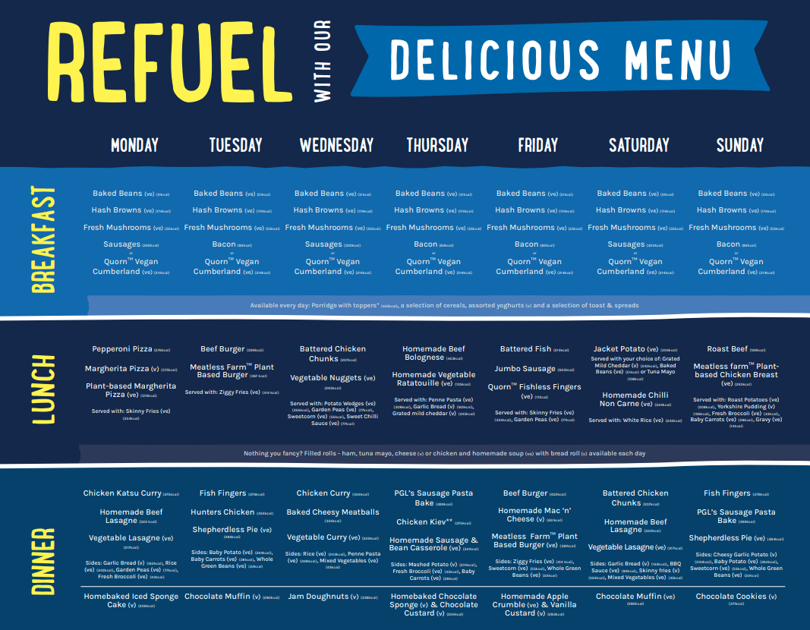
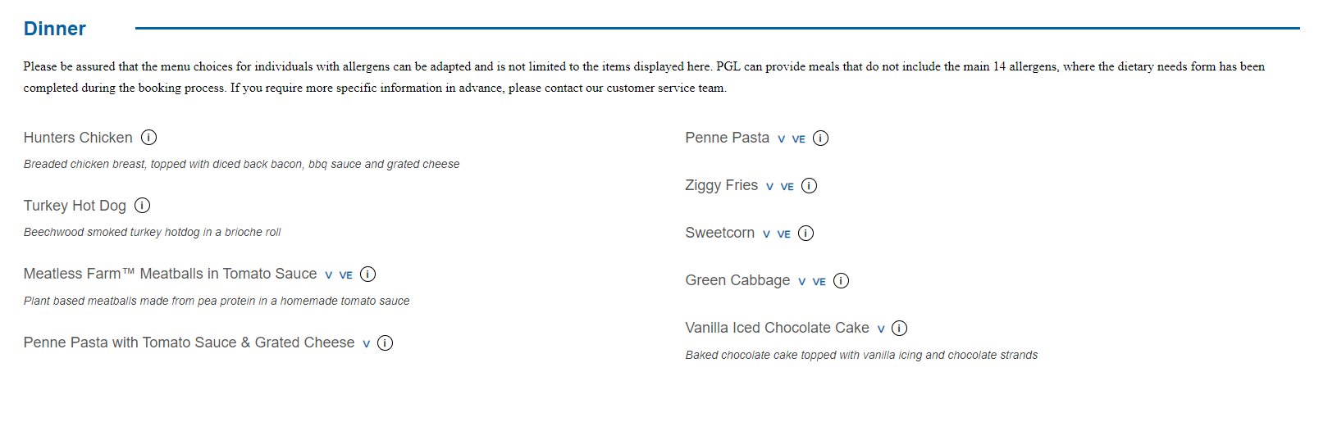

Slide 14

Suitable nightwear x2
Underwear (extra is advisable)
Socks (that cover ankles for many activities)
Trousers/leggings for activities (not jeans)
Shorts
1 pair of trainers for activities
1 pair of waterproof shoes (old trainers are ideal)
Dry shoes for evening activities
Fleeces/sweatshirts
Long sleeved shirt/t-shirt (for activities where arms need to be covered)
T-shirts
Waterproof jacket (and trousers if you have them)
Baseball hat/sun hat
1 or 2 sets of clothes for the evening
1 towel for showering
1 ‘old’ towel for wet activities
Plastic drinks bottle
Sun cream
Small rucksack/bag
Labelled bin bag for wet and dirty clothing
Wash bag with flannel, soap, shampoo, toothbrush, toothpaste
Sleeping bag and pillow

Slide 15


Slide 16



Monday 26th May
Children will have to pack their bags (consider this when you pack for them)
07:45 Breakfast and lunch will be provided
12:10 Children will complete final activities
13:30 Depart
15:00 Scheduled to return to school
Please be on time!

